Slide 1
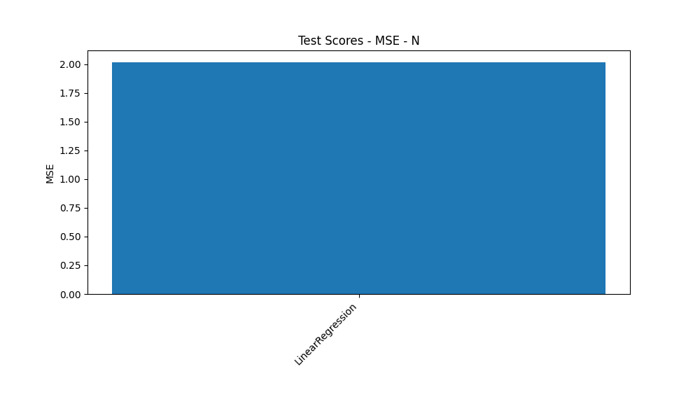
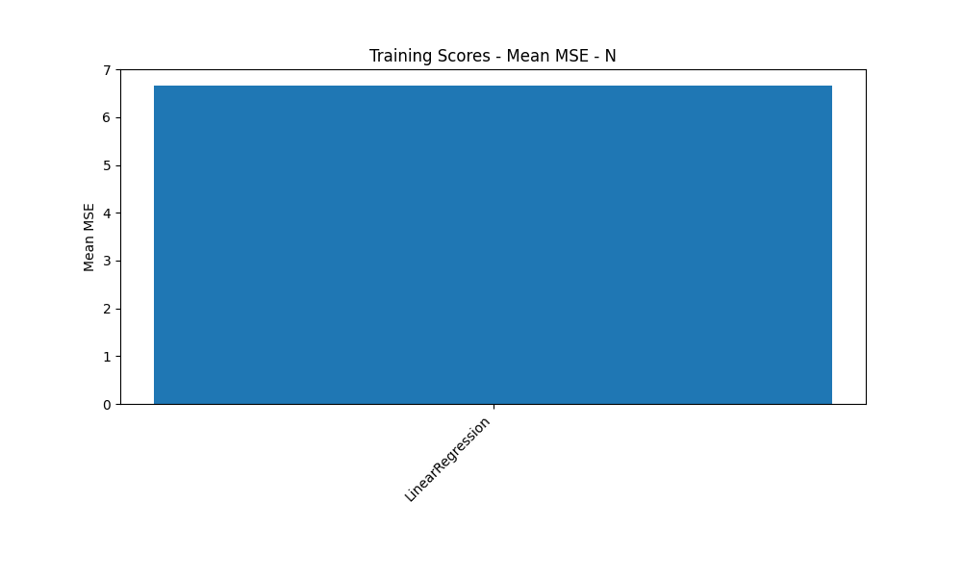

Analysis for column: N Model: All Models

Slide 2

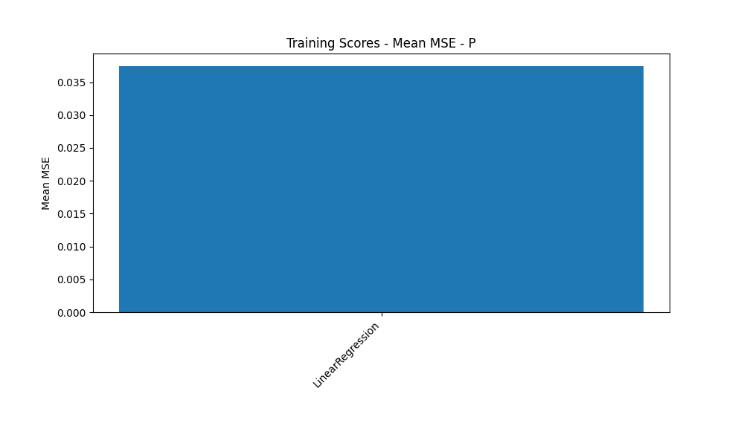

Analysis for column: P Model: All Models

Slide 3



Analysis for column: K Model: All Models

Slide 4
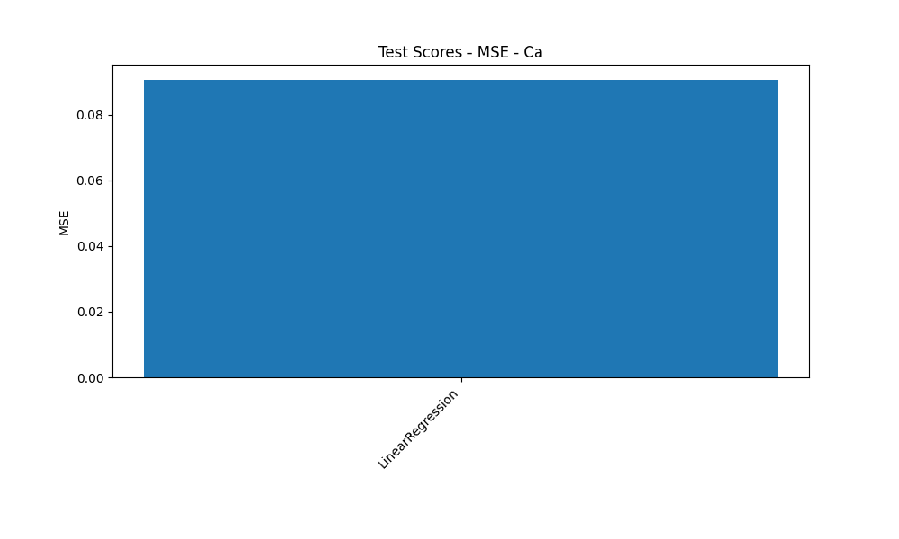

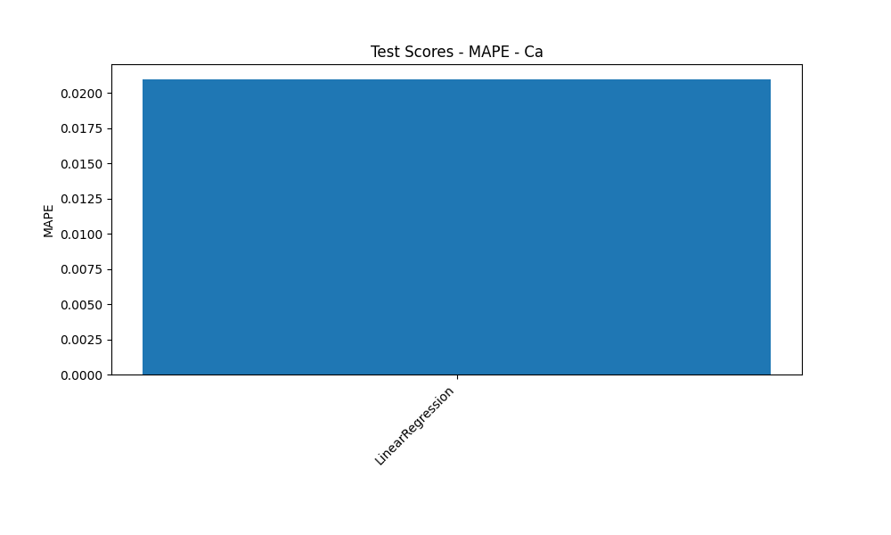
Analysis for column: Ca Model: All Models

Slide 5

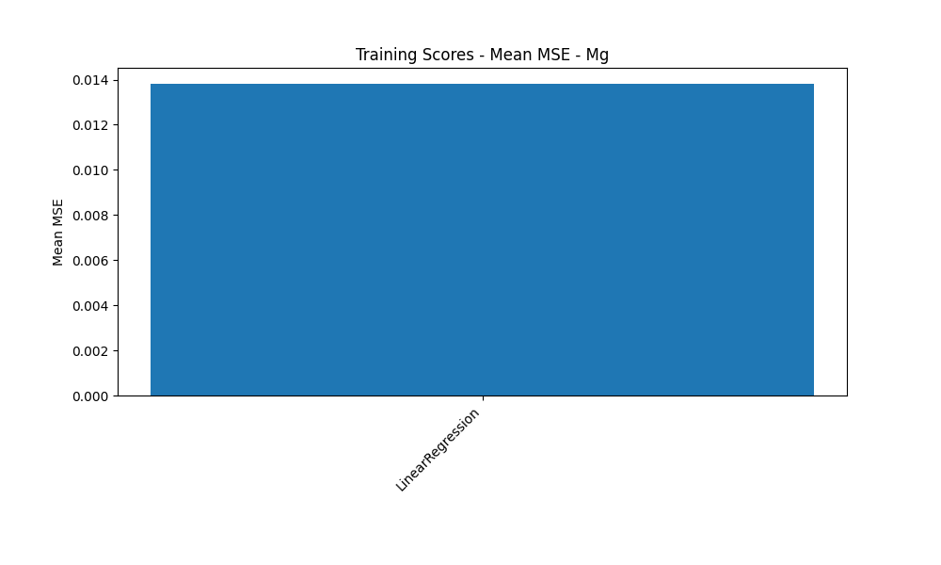

Analysis for column: Mg Model: All Models

Slide 6



Analysis for column: S Model: All Models

Slide 7



Analysis for column: B Model: All Models

Slide 8



Analysis for column: Cu Model: All Models

Slide 9



Analysis for column: Mn Model: All Models

Slide 10



Analysis for column: Zn Model: All Models

Slide 11



Analysis for column: Mo Model: All Models

Slide 12



Analysis for column: Ni Model: All Models

