Slide 1



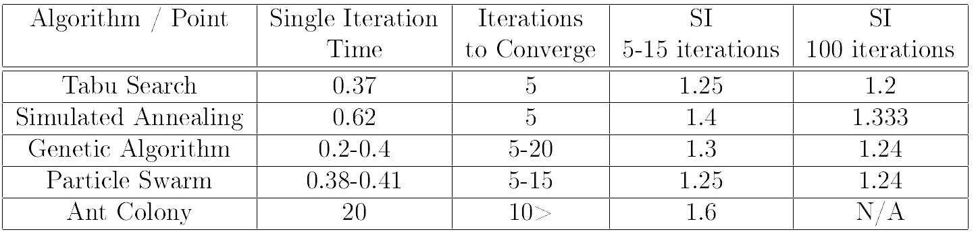
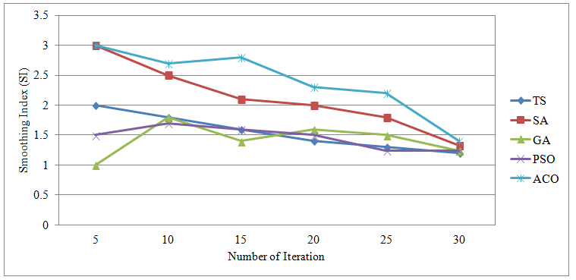
University of Waterloo
Department of Electrical and Computer Engineering
Spring 2014 – ECE457A Cooperative and Adaptive Algorithms
27. Solving Complex Task Allocation
using Metaheuristic Algorithms
Complex Task Allocation
This problem describes a situation where multiple agents are working cooperatively to solve a complex problem with many discrete tasks. Often the problem is used to describe multi-robot systems and their task allocation. The tasks can be completed in any order, but each agent has a “skill” at each task and each task has a priority. These skills and priorities both are used to evaluate our solution using metaheuristic algorithms.
Problem Formulation
Metaheuristics
Experimental Results
Given a set of tasks needing to be completed, and a set of robots capable of accomplishing them to varying degrees of skill, we want to find the best solution by maximizing the total quality of the tasks, and by minimizing the total time required to accomplish all tasks. Tasks have a physical distance from one another, which must be traversed by a robot before progress can be started. Additionally, all robots have a total energy cost, which may not be expended in the course of their duties.
Tabu Search
Experiment Setup
Design an consistent example data set
Simulated Annealing
Evaluation Metrics
Time to convergence
Objective function value
Comparative Study
GA – This is a permutation problem so we use a variation with the order 1 crossover algorithm, the swap mutation and a elitism based survivor selection process
Problem Modeling
We model this problem as an instance of the Multiple Traveling Salesmen problem. A graph is constructed with nodes for each task and a starting location for each robot. All nodes are connected to one another, with a weighting function to unify distance, times, priorities and skill levels. An additional constraint is added to ensure no robot exceeds its energy budget.
PSO
ACO – We use a variation of ACS on the problem graph, treating the ant's visit to a home node as a switch between robots and the graph's associated cost function.
Conclusion
Conclusions go here…
Dane Carr, Austin Dobrik, Alexander Maguire, Ariel Weingarten, Lucas Wojciechowksi

