Slide 1



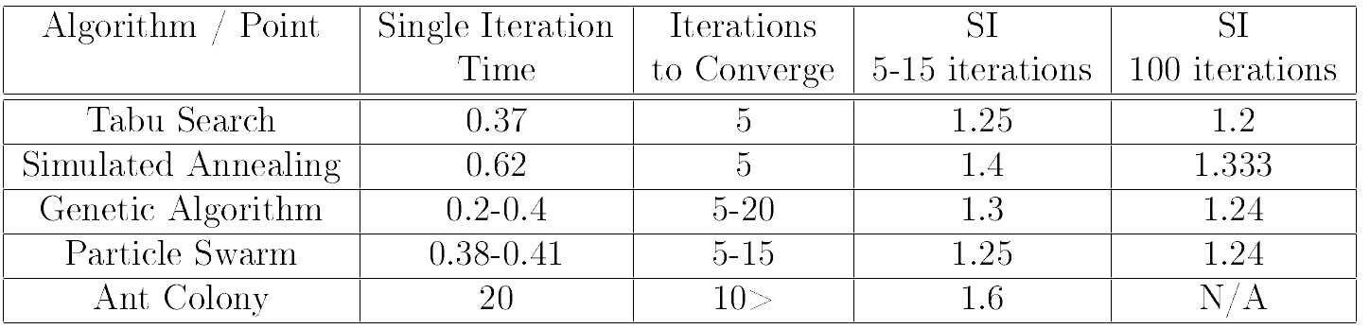
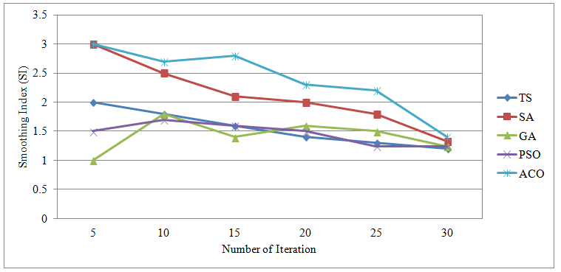
University of Waterloo
Department of Electrical and Computer Engineering
Spring 2014 – ECE457A Cooperative and Adaptive Algorithms
26. Solving Complex Task Allocation Problem
using Metaheuristic Algorithms
Complex Task Allocation
This problem describes a situation where multiple agents are working cooperatively to solve a complex problem with many discrete tasks. Often the problem is used to describe multi-robot systems and their task allocation. The tasks can be completed in any order, but each agent has a “skill” at each task and each task has a priority. These skills and priorities both are used to evaluate our solution using metaheuristic algorithms.
Problem Formulation
Metaheuristics
Experimental Results
Problem formulation goes here…
Tabu Search
Experiment Setup
Design an consistent example data set
Simulated Annealing
Evaluation Metrics
Time to convergence
Objective function value
Comparative Study
Genetic Algorithm
Problem Modeling
Given a population of robots R, a set of tasks T, a priority for each task Pt, the skill of each robot Sr,t and a assignment of tasks to robots Ar, for each r ∈ R we can create a directed, weighted graph as follows:
Gr = (V, E)
V = {start} ∪ Ar
Ex,t = −PaSr,t ∀t ∈ Ar
Ex,start = 0
PSO
ACO
Conclusion
Conclusions go here…
Austin Dobrik, Lucas Wojciechowksi, Ariel Weingarten, Alexander Maguire, Dane Carr

