Slide 1
IM-free wireless mic planner
Describe the venue in plain words. Get mic frequencies with no intermodulation hits, found with QAOA.
[Team name]
[Member 1], [Member 2], [Member 3], [Member 4]
Qiskit Fall Fest 2026, University of Waterloo
Notes:
Hi, we're [Team name]. Our project turns a real sound-engineering headache into a quantum optimization problem. When several wireless mics transmit at once, they create ghost signals that can land on other mics and make them crackle. Our tool lets someone describe their venue in plain words, and it returns a frequency plan with no ghost hits, found with QAOA on Qiskit. We'll be upfront: this is a modelling contribution, not a speed-up.

Slide 2
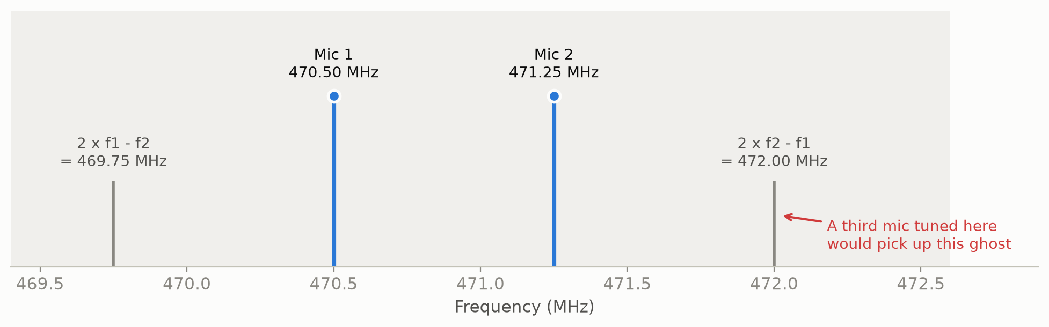
Two mics on stage make two ghost signals
Mics at f1 and f2 mix and create third-order products at 2f1 − f2 and 2f2 − f1
A third mic tuned to a ghost picks it up as noise or crackle
Most manufacturers recommend at least 250 kHz between any product and any mic (Shure)
Notes:
Here's the physics in one picture. Two mics at 470.50 and 471.25 megahertz. Their signals mix inside the electronics, and third-order products appear at two f1 minus f2 and two f2 minus f1: 469.75 and 472.00. If we put a third mic at 472.00, it hears that ghost. Shure's guide says most manufacturers recommend keeping every third-order product at least 250 kilohertz from every carrier. That's the rule our tool enforces.

Slide 3
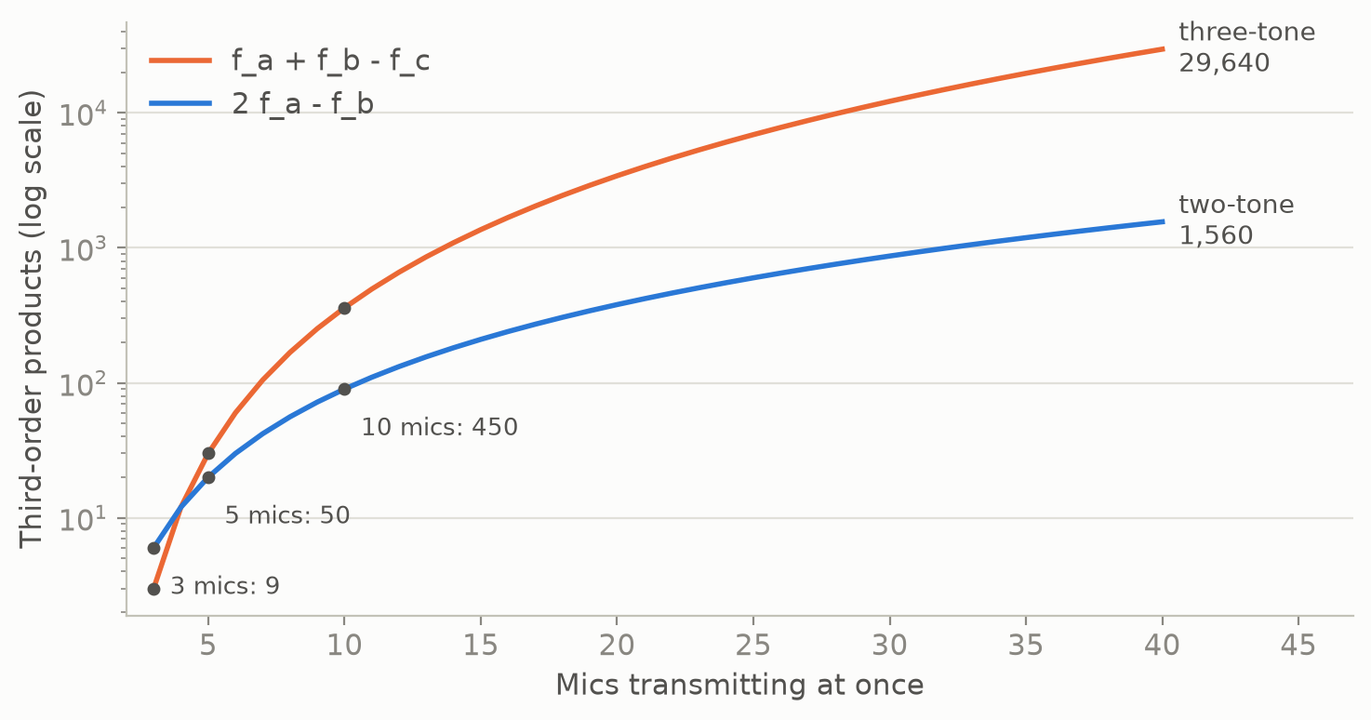
Products grow with the cube of the mic count
50
third-order products from just 5 mics
31,200
from 40 mics, a size pros run routinely (SoundPro)
Pros use vendor software (Shure Wireless Workbench, Sennheiser WSM, PWS IAS) or an RF coordinator
Notes:
Why is planning hard? The number of products explodes. n carriers make n times n minus 1 two-tone products and n choose 2 times n minus 2 three-tone products. Five mics already make 50. Forty mics make 31,200, and SoundPro's 2026 guide says coordinated systems routinely run 40 or more channels. Professionals use vendor tools like Shure Wireless Workbench, which is free, Sennheiser WSM or PWS IAS, or they hire an RF coordinator. Every count on this slide comes from our own code.

Slide 4
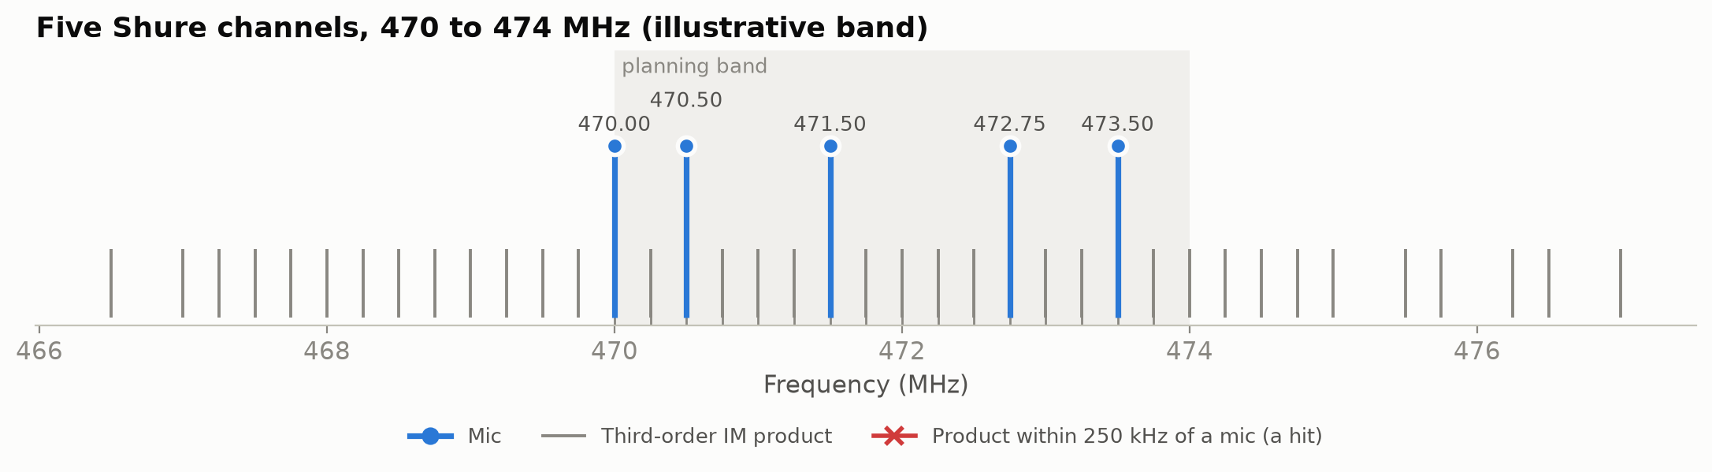
Our tool: describe the venue, get a clean plan
For a school AV tech or theatre sound designer
No QUBO, Hamiltonian, penalty or mixer in sight
Returns the plan, a report, a spectrum and a CSV
plan_mics(band="470-474 MHz", mics=5,
step="250 kHz", spacing="500 kHz",
im_guard="250 kHz")
Story: five of the Humanities Theatre's six Shure channels (seats 721). The band is illustrative.
Notes:
This is the whole interface. You say the band, how many mics, the grid step, the spacing and the guard, in plain units. Our story is the Humanities Theatre in Hagey Hall, which seats up to 721 and lists three Shure ULD handhelds and three body-packs. We plan five of those six channels. The venue pages don't give frequency bands, so 470 to 474 megahertz is illustrative. The tool returned 470.00, 470.50, 471.50, 472.75, 473.50 megahertz. Every grey product line misses every blue mic. It also writes a CSV.

Slide 5
The bridge: planning rules become qubit interactions
1. Rules
2. Conflict sets
3. Cost on 16 qubits
4. QAOA
Mics 500 kHz apart. No product within 250 kHz of a mic.
15 close pairs, 56 triples (2fₖ − fₗ), 252 quadruples (fₖ + fₗ − fₚ)
x = (1 − Z)/2 gives 948 Z-strings, up to 4 Z's each
Dicke start and XY mixer keep exactly 5 mics in every sample
C(x) = Σ close pairs xₖxₗ + Σ triples xₖxₗxₘ + Σ quadruples xₖxₗxₚxₘ, with exactly 5 mics
A plan is IM-free exactly when its cost is 0
Three- and four-way IM rules go in directly as 3- and 4-qubit Z terms
The mic count is fixed by the circuit, so there is no penalty weight to tune
Notes:
Here's the bridge. Each allowed frequency is a qubit: 1 means a mic sits there. The rules become three kinds of conflict: close pairs, triples where a two-tone product lands on a third mic, and quadruples where a three-tone product lands on a fourth. Substituting x equals one minus Z over two gives a diagonal Hamiltonian with 948 Z-strings. QAOA starts in a Dicke state, every five-mic plan with equal weight, and the XY mixer only swaps a one and a zero, so it moves mics but never adds or removes one. No penalty weights. The circuit is built with Qiskit's qaoa_ansatz function.

Slide 6
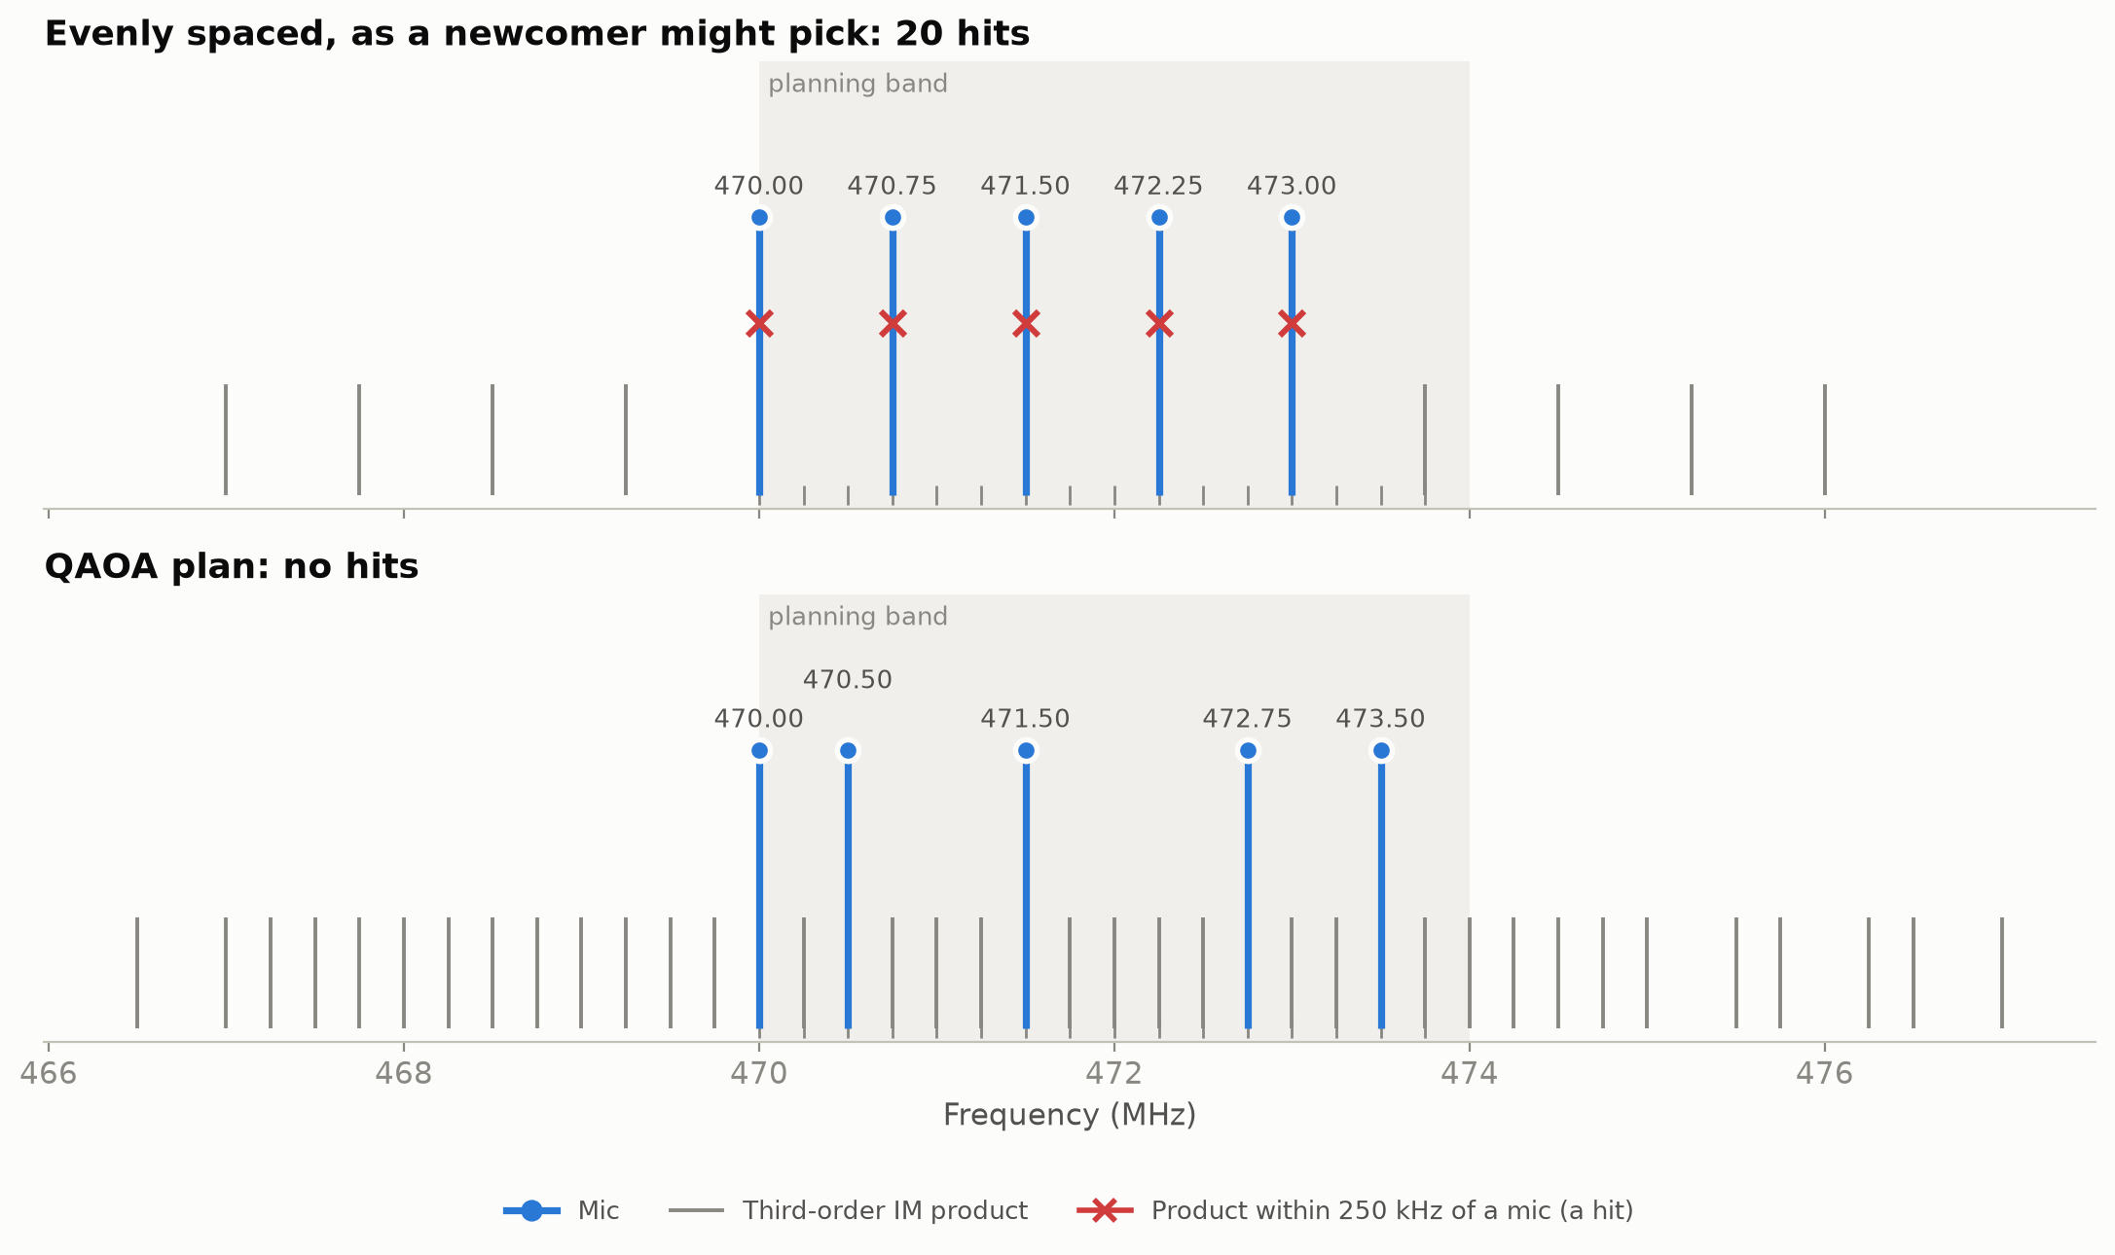
Demo: even spacing is the worst case
20
hits for evenly spaced mics
0
hits for the QAOA plan
Greedy also finds a clean plan here. We say so.
Notes:
What does a newcomer do? Often they space the mics evenly. That's the worst case. Evenly spaced carriers are full of arithmetic progressions, and each one drops a product right on a mic: 8 two-tone hits and 12 three-tone hits, shown as red crosses. The QAOA plan below has none. To be fair, a simple greedy method also finds a clean plan on this instance, so our bad example is the newcomer's plan, not greedy's.

Slide 7
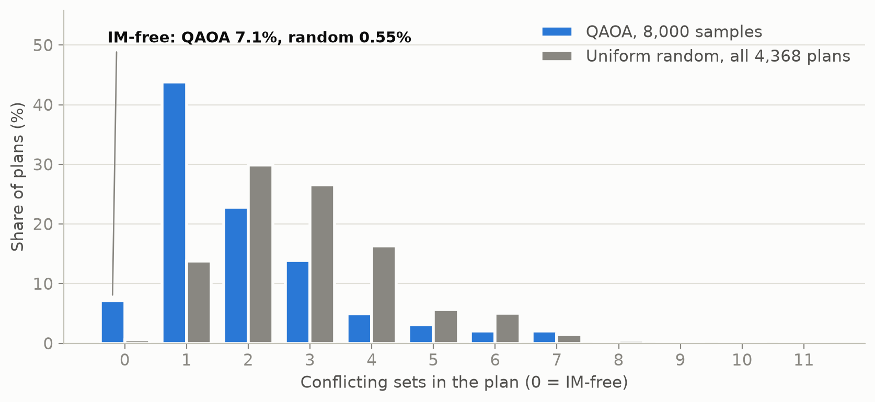
How well it works: QAOA against random plans
7.1%
of 8,000 QAOA samples are IM-free (p = 3)
0.55%
of random plans are IM-free (24 of 4,368)
12%
at p = 5 on our exact simulation, not run on the circuit
Notes:
How well does it work? With three layers, 7.1 percent of 8,000 samples from Qiskit's StatevectorSampler are IM-free. A random five-mic plan is IM-free 0.55 percent of the time, so that's about 13 times better. The exact probability from our simulation is 6.96 percent, so the sampler agrees. CVaR beat the plain average as the training objective. On our exact NumPy simulation, five layers reach 12 percent, but we only ran three on the circuit to keep the notebook fast. This gain is real but modest.

Slide 8
Why quantum, honestly
No speed-up
A modelling fit
The price
4,368
16 vs 121
12,716
plans, all checked by brute force in about 10 ms. Annealing ends clean in 50 of 50 runs.
qubits here vs variables as a QUBO. No auxiliary variables, no count penalty.
CNOTs at p = 3. Four-way terms cost circuit depth.
We found no earlier quantum approach that models IM products.
Notes:
Why quantum? Three honest answers. First, there's no speed-up: brute force solves this in about 10 milliseconds, and simulated annealing ends clean in 50 of 50 runs. Second, a modelling fit: the IM rules are three- and four-way, and QAOA takes them as is on 16 qubits. A QUBO needs 121 variables after greedy Rosenberg substitution, 114 to 125 depending on tie-breaks, plus a penalty for the mic count. Third, the price: the four-way terms make the circuit deep, 12,716 CNOTs at three layers. And we found no earlier quantum approach that models IM products. D-Wave's frequency example and Vandelli et al. 2025 handle pairwise interference only.

Slide 9
Where it falls short
Classically trivial at 16 frequencies, and greedy solves it
Here it is a Golomb-ruler search, a link known since 1953 (Babcock)
Third-order only: no fifth order, TV data, power or distance
Angles tuned by exact simulation, which does not scale
12,716 CNOTs at p = 3, and not run on hardware
Beyond the toy size
21
grid points for 6 mics, with just 2 clean plans
782+
qubits for 40 mics on this grid, with 39.6 million 4-qubit terms
Notes:
Where it falls short. At this size every classical method wins. On this grid with exact landings, an IM-free plan is a Golomb ruler with no gap of one, and Babcock linked IM to these rulers in 1953. We only model third-order products, with no fifth-order, no TV channel data and no transmitter power or distance. We tuned the angles with an exact classical simulation, which can't scale. The circuit is deep. Beyond the toy size: six mics need 21 grid points and only two plans work; forty mics on this kind of grid need at least 782 qubits and about 39.6 million four-qubit terms.

Slide 10
What's next
1
2
3
4
Fifth-order products
Real venues
Scale
Hardware
Shure lists them as in-band too. Add 5-body terms or a guard margin.
Receiver tuning ranges, local TV channels, several bands and rooms.
Sparser models and problem decomposition for 40 or more mics.
A p = 1 run with the leaner 2,570-CNOT cost layer.
Notes:
What's next. First, fifth-order products, which Shure also lists as in-band. Second, real venues: actual receiver tuning ranges, local TV channel data, and several bands or rooms at once. Third, scale: the full model grows too fast, so we'd need sparser models or to split the problem. Fourth, hardware: synthesizing the whole cost layer as one gate cuts it to 2,570 CNOTs, which is a start for a one-layer test.

Slide 11
Team contributions
[Member 1]
[Member 2]
[Member 3]
[Member 4]
Problem and engine
Quantum circuit
Results and baselines
Story and demo
RF rules, IM enumeration, checker, brute force
Cost operator, Dicke state, XY mixer, QAOA
Tuning, sampling, classical baselines, figures
plan_mics interface, venue story, slides, live demo
Each of us can explain every part. AI tools helped write code and drafts; we checked every number.
Notes:
Placeholder slide: fill in names and adjust roles before Friday. Each role matches one of the four explainers in the team folder. Say plainly what AI did: it helped write code and first drafts, and we checked every number against the notebook.

Slide 12
References
Shure: All about wireless intermodulation distortion
SoundPro: RF coordination for live events, 2026 guide
UW Theatres: Our theatres; Humanities Theatre specs
D-Wave: frequency-selection example (GitHub)
Vandelli, Ferrari, Dragoni, arXiv:2511.15566 (2025)
Shure: Wireless Workbench product page
Farhi, Goldstone, Gutmann, arXiv:1411.4028 (2014)
Hadfield et al., Algorithms 12, 34 (2019)
Wang et al., Phys. Rev. A 101, 012320 (2020)
Bärtschi, Eidenbenz, arXiv:1904.07358 (2019)
Barkoutsos et al., Quantum 4, 256 (2020)
Babcock, Bell Syst. Tech. J. 32, 63 (1953)
Full list with links in mic_planner.ipynb, section 9. Every number in this deck comes from that notebook.
Notes:
Full references with links are in the notebook's last section. Every number on these slides comes from code in the notebook or from a page we opened and cite here.

