Slide 1

Compression for Wireless Sensor Networks
Daniel Shteremberg and Jason Waterman
Harvard
School of Engineering
and Applied Sciences

Slide 2
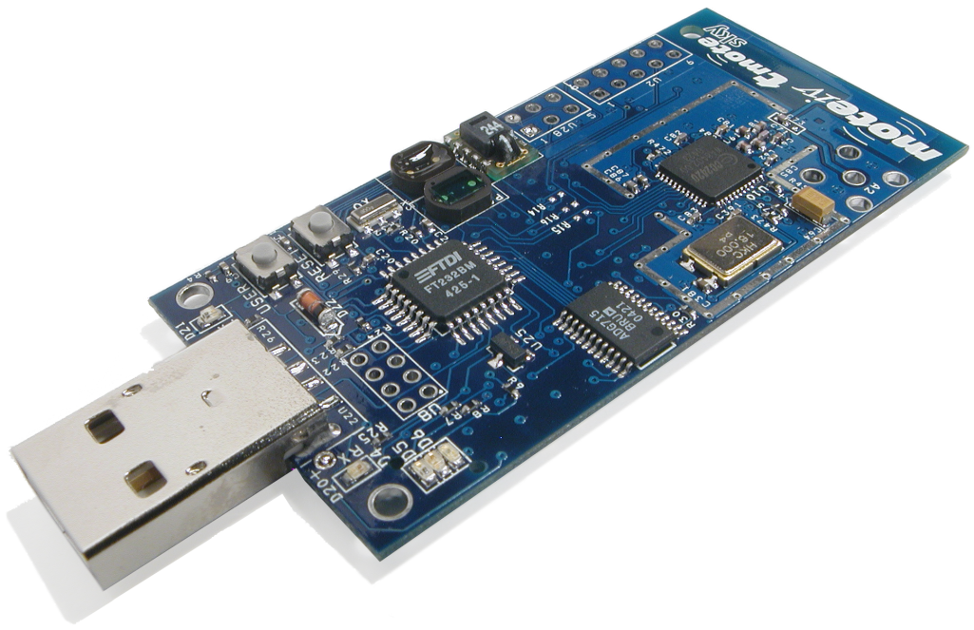

Sensor Networks: Coping with Limited Resources
Sensor nodes are severely resource constrained
  8 MHz CPU
  10 KB of memory
  ~100 Kbps of radio link bandwidth (best case)
  200 mAh to 2000 mAh batteries
Radio is by far the biggest drain on energy
  ~19 ma to send and receive
  Sending a byte is the equivalent of executing hundreds of instructions
Compression could be a big win
  If it can be made to work under the resource constraints
Data

Slide 3
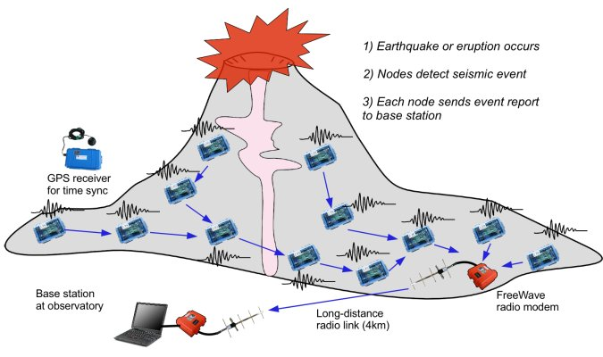
Data Sources

Slide 4
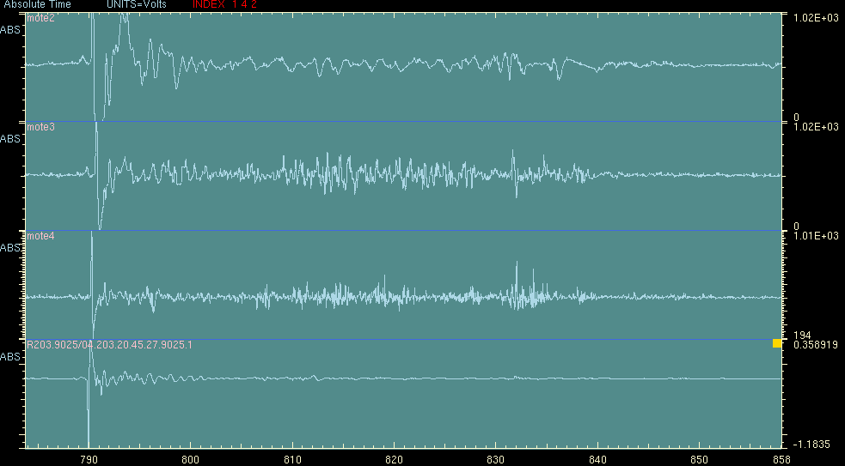
Data Sources
Seismic data collected at 100 Hz, 24 bit resolution

Slide 5

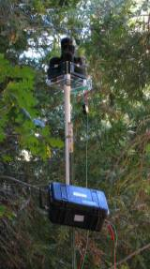
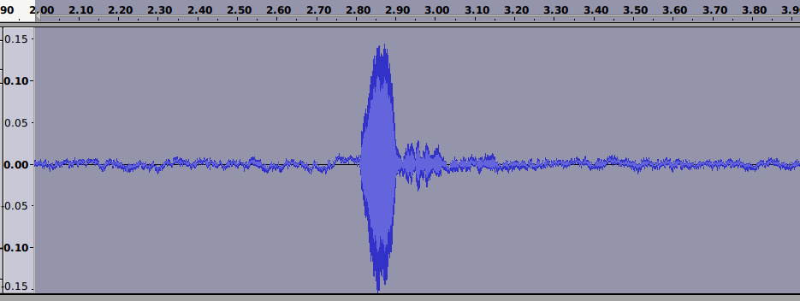
Data Sources
Acoustic marmot data
  Very high data rate 24K Hz, 16 bit

Slide 6
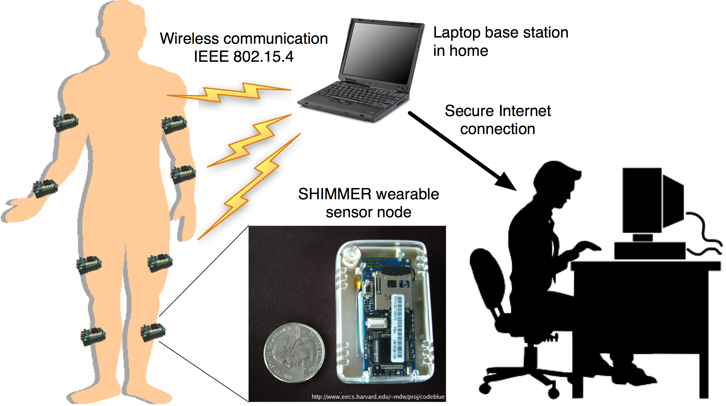
Data Sources

Slide 7
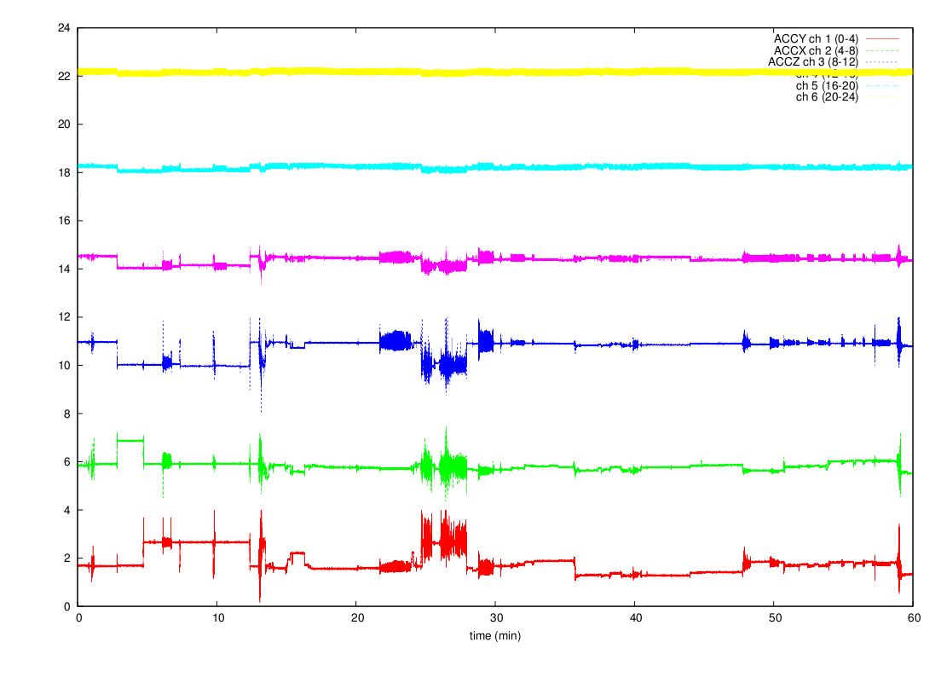
Data Sources
3 axis accelerometer data, 3 axis gyroscope data
  100 Hz, 12 bit

Slide 8
LZ77 Compression
We wanted to do LZ77
  Sliding Window
  Inefficient, requires large memory
  Turns out LZ77 performs poorly for typical sensor network data

Slide 9
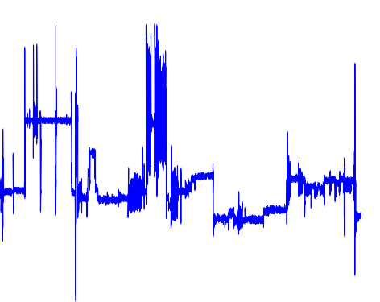
Variable Block Size Delta Encoding
At each time step we calculate the delta
We find the # of bits needed to encode the delta
Each delta is encoded with the bits needed for the largest delta
New elements arrive
See if the new delta fits
Send block and start over

Slide 10
Variable Block Size Delta Encoding
Minimal computation
Yields good compression ratios for sensor data
High variability reduces compression

Slide 11
Conclusions and Future Work

