Slide 1
Digital Marketing Project
Testa Luca 816000

Slide 2

2
The goal of the churn model is to assign each customer their probability of leaving the agency, in order to implement specific corrective marketing actions aimed at retaining the highest value customers.

Slide 3
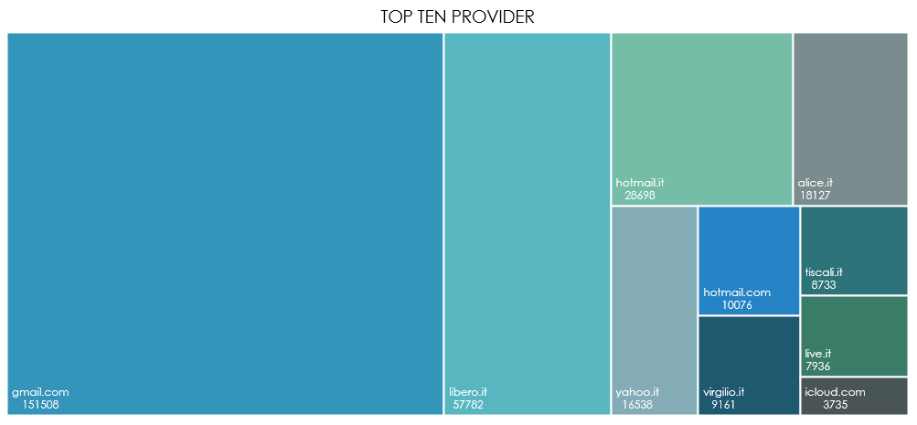
DESCRIPTIVE ANALYSIS

Slide 4
DESCRIPTIVE ANALYSIS

Slide 5
DESCRIPTIVE ANALYSIS

Slide 6
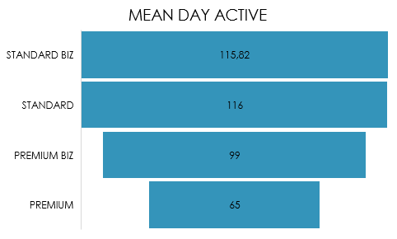
DESCRIPTIVE ANALYSIS

Slide 7
DESCRIPTIVE ANALYSIS

Slide 8
DESCRIPTIVE ANALYSIS
The 90% of customers buys back in 30 days

Slide 9
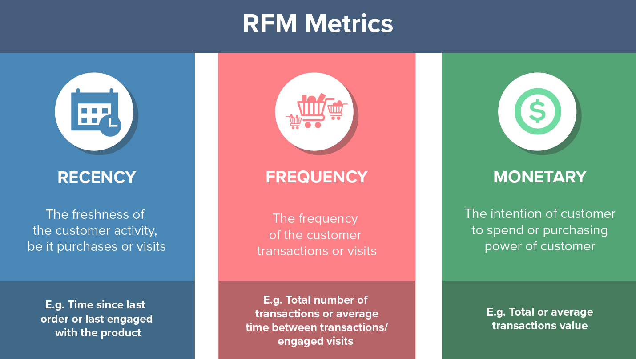
RFM MODEL
Il 90% riacquista entro i 30 giorni

Slide 10
RFM MODEL

Slide 11
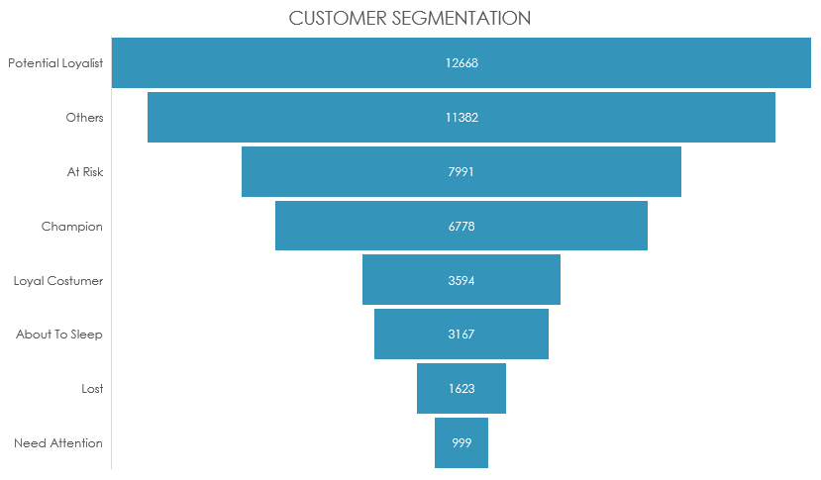
RFM MODEL

Slide 12
CHURN MODEL
According to the RFM model, all those who had not bought back in the previous 30 days could be designated as "Churner".
As variables it was decided to select :
RFM value
CAP
TYP_CLI_ACCOUNT
REGION
N_CAMP

Slide 13
CHURN MODEL
Decision Tree: 75,15% Accuracy
Random Forest: 75,04% Accuracy
 | Actual
Predicted | TRUE | FALSE
TRUE | 5519 | 1417
FALSE | 2665 | 6827
 | Actual
Predicted | TRUE | FALSE
TRUE | 7626 | 3283
FALSE | 2126 | 8868
GLM: 33,19% Accuracy
BOOSTED: 75,56% Accuracy
 | Actual
Predicted | TRUE | FALSE
TRUE | 876 | 3667
FALSE | 7308 | 4577
 | Actual
Predicted | TRUE | FALSE
TRUE | 5665 | 1496
FALSE | 2519 | 6748

Slide 14
CHURN MODEL

Slide 15



FINAL REVIEW
As expected, initial analyzes showed that most users come from Lombardy and use a 'gmail' account. 90% of them buy back within the first 30 days.
Through the RFM model we have been able to divide the customers into 8 categories, in order to suggest the company to focus its efforts above all on those who are the "Champion" customers, they have the maximum frequency, monetary value and recency.
The classifier Boosted Gradient Tree can predict, with an accuracy of 75.5%, whether a customer, who has repurchased in the last month, could turn out a churner or not. Thanks to this, we can maximize the company's efforts on customers who are loyal to our brand.

