Slide 1

Multi-robot collision avoidance using control barrier functions
Presented to Prof. Andrea Cristofaro
Done by
Luca Tirel tirel.1702631@studenti.uniroma1.it
Alessandro Reali reali.1714214@studenti.uniroma1.it Ali Mohamed Ali Hassan Ali ali.1936023@studenti.uniroma1.it
Notes:
‹#›

Slide 2
Project overview
Introduction
Lyapunov & Control Barrier Functions
Quadratic programming
Problem statement
04
Simulation and results
Exp 1: Centralized & Decentralized CBFs for 8 robots swapping positions
Exp 2: Obstacle avoidance and leader follower with CBFs
01
03
Centralized safety barrier certificates
Approach
Optimization
Implementation & Results
Decentralized safety barrier certificates
Approach
Optimization
Implementation & Results
02
Multi-robot collision avoidance using control barrier functions

Slide 3
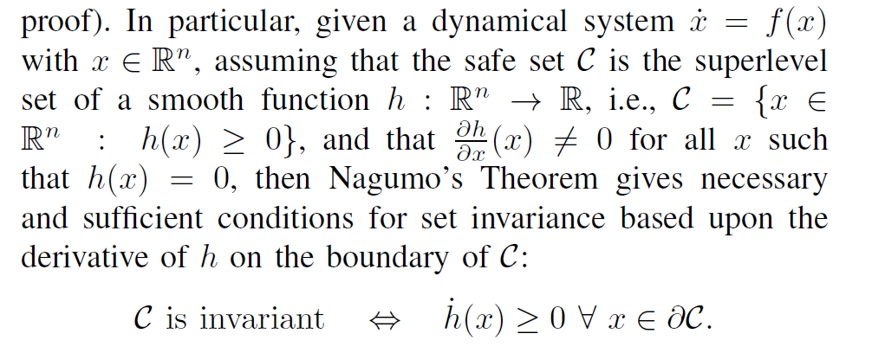
Introduction to Control Barrier Functions
The point of departure is the term safety-critical system which is many times used to distinguish those systems for which safety is a major design consideration.
Safety & Stability (Invariance & asymptotic stability)
Started in 1940’s when Nagumo studied the concept of invariance and safety and provide necessary and sufficient conditions for set to be invariant.
Multi-robot collision avoidance using control barrier functions

Slide 4

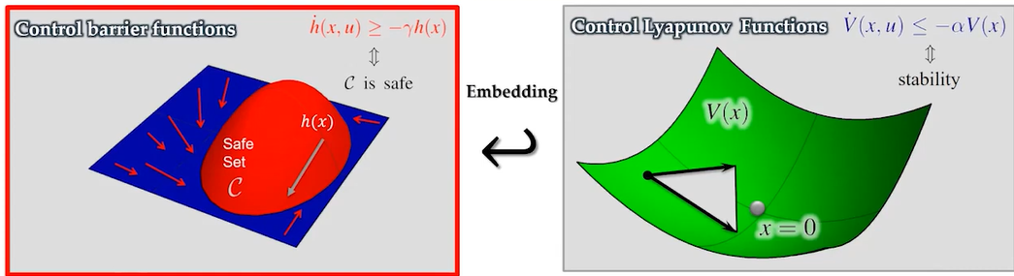
Re-discovery of the control barrier function from 2004
Re-discovery of the control barrier function from 2004
That is, Lyapunov functions yield invariant level sets so, if these level sets are contained in the safe set one can guarantee safety—importantly, these conditions can be applied over the entire set and not just on the boundary.
The major limitation is that, while these conditions ensure safety they also enforce invariance of every level set.
The new formulation is
Class K extended function
Multi-robot collision avoidance using control barrier functions
Pagina ‹#›
Notes:
‹#›

Slide 5

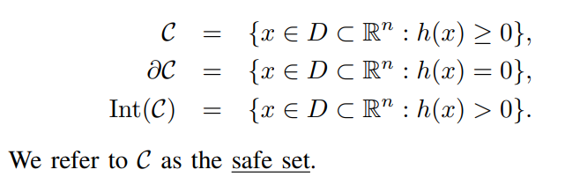
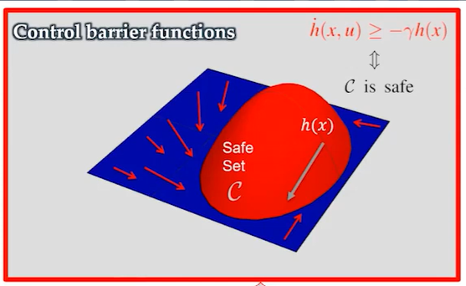
Control Barrier Function
Unlike stability which involves driving a system to a point (or a set), safety can be framed in the context of enforcing invariance of a set, i.e., not leaving a safe set. In particular, we consider a set C defined as the superlevel set of a continuously differentiable function :
Multi-robot collision avoidance using control barrier functions

Slide 6



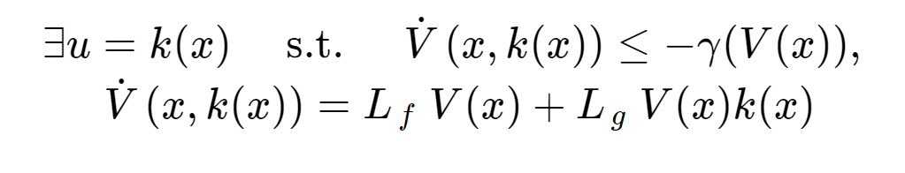

Control Lyapunov VS Control Barrier Functions
CLF | CBF
Multi-robot collision avoidance using control barrier functions
Pagina ‹#›
Notes:
‹#›

Slide 7
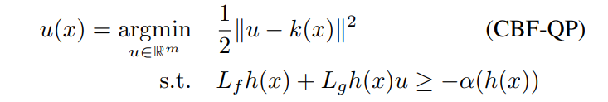
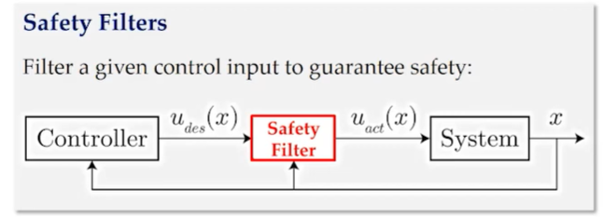
Quadratic Programming
To modify this controller in a minimal way so as to guarantee safety, Thus, we can consider the following Quadratic Program (QP) based controller that finds the minimum perturbation on u.
Desired Control
Multi-robot collision avoidance using control barrier functions
Pagina ‹#›
Notes:
‹#›

Slide 8
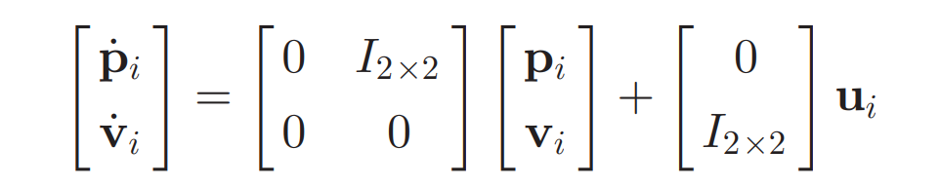
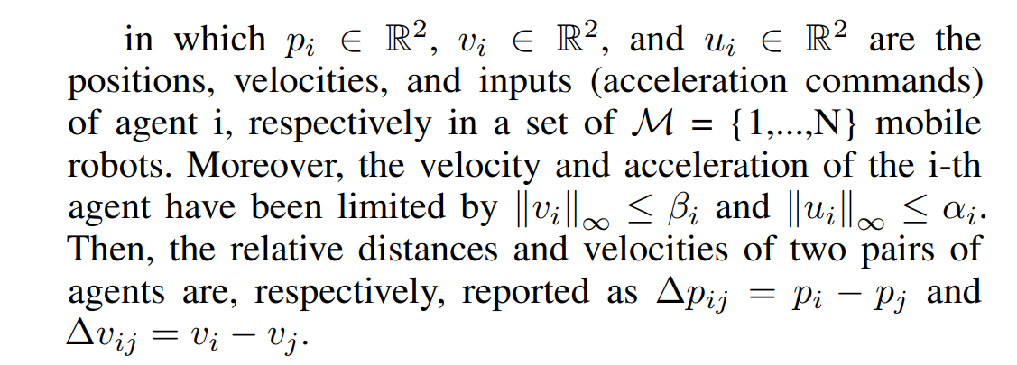
Problem Formulation
Concretely, consider a multirobot system consisting of M planar, mobile robots, we choose to model the robot dynamics as double integrators.
Multi-robot collision avoidance using control barrier functions
Pagina ‹#›
Notes:
‹#›

Slide 9






Problem Formulation
In the first experiment the multi-robot system is organized in the space in a star-shaped starting configuration and it’s controlled by a PID controller, to let each robot reach its desired position, almost-symmetrical with respect to the origin. In the second experiment the robot swarm moves in an environment with obstacles, using a leader-follower control strategy.
Once we have defined a safety critical distance named , each robot need to satisfy the following constraint to be safe: Where is the normal component to the relative velocity :
is the time at what the collision happen when robots apply a maximum braking acceleration, and has to be enforced only when agent are moving closer to others ( ) ). This will enable us to define the pairwise safety barrier certificate as: where are the maximum braking acceleration for robot i-th and j-th (assumed equal).
Multi-robot collision avoidance using control barrier functions
Pagina ‹#›
Notes:
‹#›

Slide 10







Problem Formulation
Now that we have defined the barrier functions we can define the pairwise safety sets as : Now, by combining the definition of with the constraint used to render forward invariant, and by fixing the class-k extended function as:
We can rewrite the QP safety (linear) constraints as:
Furthermore, in the presence of obstacles (fixed or moving), we can assume it to be bounded by circles and treat them as agents with no control inputs. The barrier functions are: where is the radius of the circle and is the position of k-th obstacle.
The QP problem defined will aim at finding the control input that deviates the least from the PID (reference) control input, by satisfying the safety constraints (Zeroing Control Barrier Functions problem). The cost function will change according to approach and is defined as:
Multi-robot collision avoidance using control barrier functions
Pagina ‹#›
Notes:
‹#›

Slide 11

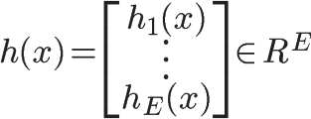

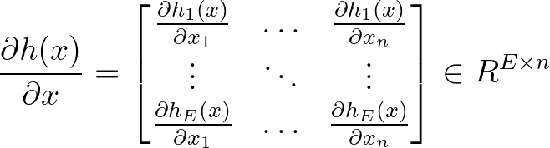
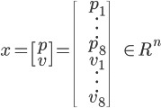




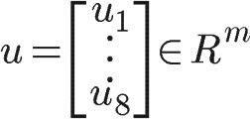

Experiment 1 - Centralized Approach
In the centralized approach we can model the robot swarm as a complete graph with N robots, considering the pairwise barriers within all of the couples.
Parameters and Dimensions
Dynamics
CBFs and other quantities
Name | Symbolic Value | Numeric Value
Robots swarm size | N | 8
State dimension | n = 4*N | 32
Control input dimension | m = 2*N | 16
Number of edges in the graph | E = N*(N-1)/2 | 28
Position of
robot i-th
Barrier functions
(Centralized)
Velocity of
i-th robot
Barrier gradient
(Centralized)
State vector
State dynamics
(Centralized)
Input matrix
(Centralized)
Control input of
i-th robot
Lie product (dynamic)
(Centralized)
Control vector
Lie product (control)
(Centralized)
Multi-robot collision avoidance using control barrier functions

Slide 12
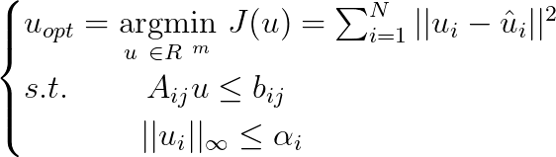


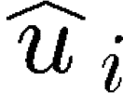
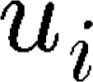
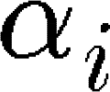


Experiment 1 - Centralized Approach - Optimization Problem
The safe control action is computed by solving a single centralized QP problem.
Where is the output of the PID control system, is the optimization variables vector relative to the i-th robot, are the bounds on the accelerations of the i-th robot, and:
With respect to the dimensions using the Lie’s notation, the following holds: This will imply that at each timestep, we have to satisfy E constraints. Thus a more scalable approach is needed.
Multi-robot collision avoidance using control barrier functions

Slide 13
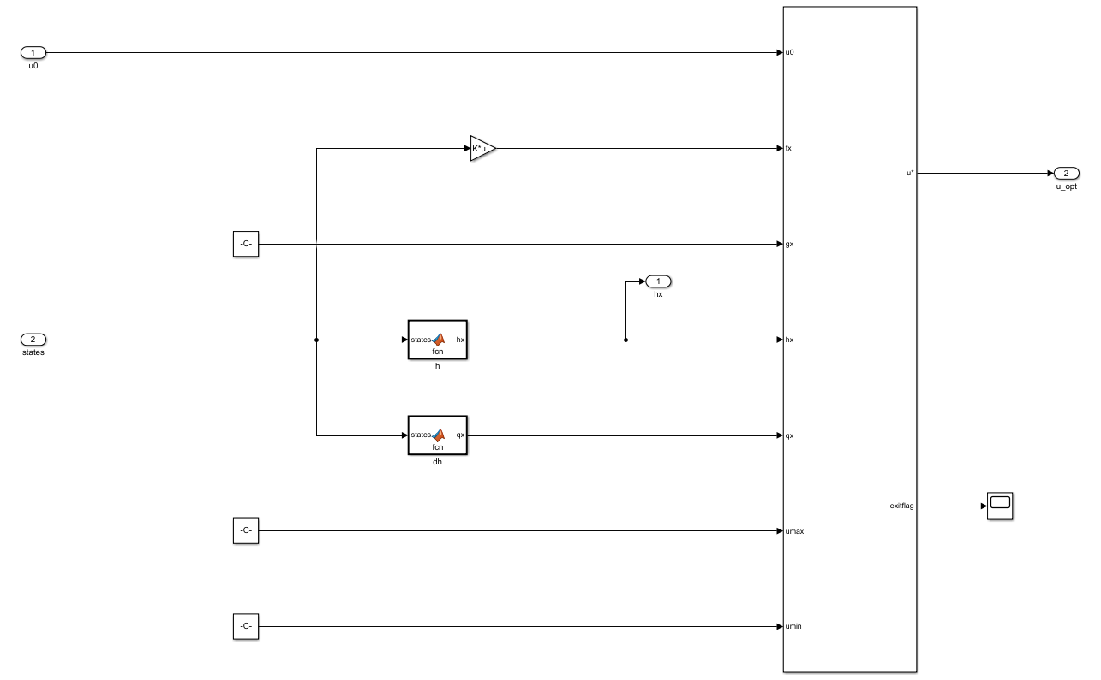
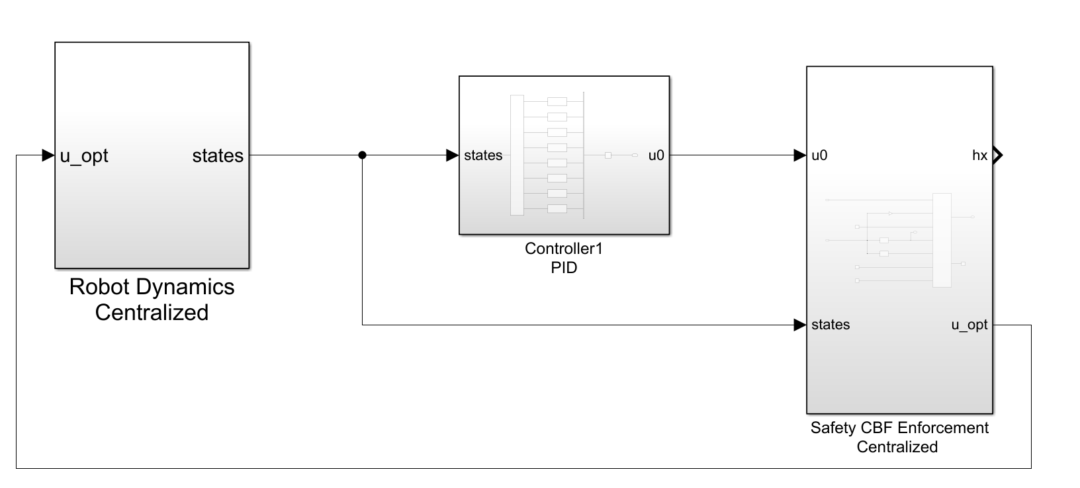
Experiment 1 - Centralized Approach - Implementation
The first experiment was implemented using MATLAB R2022a making use of Symbolic Toolbox, Simulink, and Optimization Toolbox, in particular the Barriers Certificates Enforcement block. This is the scheme for the centralized algorithm.
Computation of h and dh using the state vector
Barrier
Certificate
Enforcement block
Multi-robot collision avoidance using control barrier functions

Slide 14
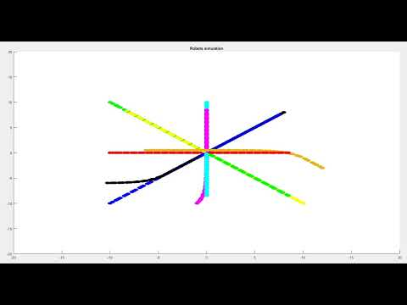
Experiment 1 - Centralized Approach - Results
Below is shown the behaviour of the system if we use a PID controller. The robots collides in the center. Plot is not continuous because the use of a fixed step solver.
PID
Multi-robot collision avoidance using control barrier functions

Slide 15
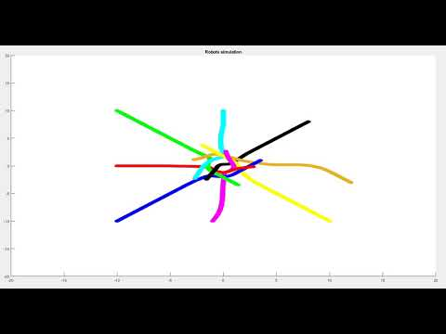
Experiment 1 - Centralized Approach - Results
This are the results of the centralized control system.
CENTRALIZED
Multi-robot collision avoidance using control barrier functions

Slide 16
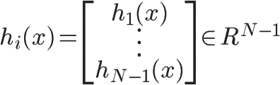
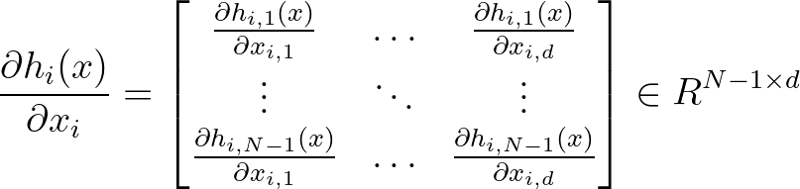
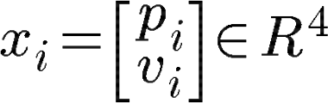




Experiment 1 - Decentralized Approach
In the decentralized approach we can model the robot swarm as a complete graph with N robots and consider the pairwise barriers within all of the couples, for each i-th robot.
Parameters and Dimensions
Dynamics
CBFs and other quantities
Name | Symbolic Value | Numeric Value
Robots swarm size | N | 8
State dimension | n = 4*N | 32
State dimension (i-th robot) | d = n/N | 4
Control input size | m = 2*N | 16
Edges in the graph | E = N*(N-1)/2 | 28
Edges per robot | Ei = N-1 | 7
Position of
robot i-th
Barrier functions
(Decentralized)
Velocity of
i-th robot
Barrier
gradient
(Decentralized)
State vector
of i-th robot
State dynamics
(Decentralized)
Control input
of
i-th robot
Input matrix
(Decentralized)
Control vector
Lie product (dynamic)
(Decentralized)
State vector
Lie product (control)
(Decentralized)
Multi-robot collision avoidance using control barrier functions

Slide 17
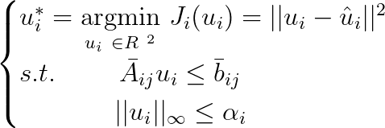




Experiment 1 - Decentralized Approach - Optimization Problem
The safe control action is computed by solving a single centralized QP problem.
In the decentralized approach the author of the paper further reduced the admissible control space by partitioning it according to agents’ acceleration limits, as shown:
With respect to the dimensions using the Lie’s notation, the following holds: This will imply that at each timestep, we have to satisfy N-1 constraints. We can further simplify the admissible control space by using the notion of neighborhood.
Multi-robot collision avoidance using control barrier functions

Slide 18
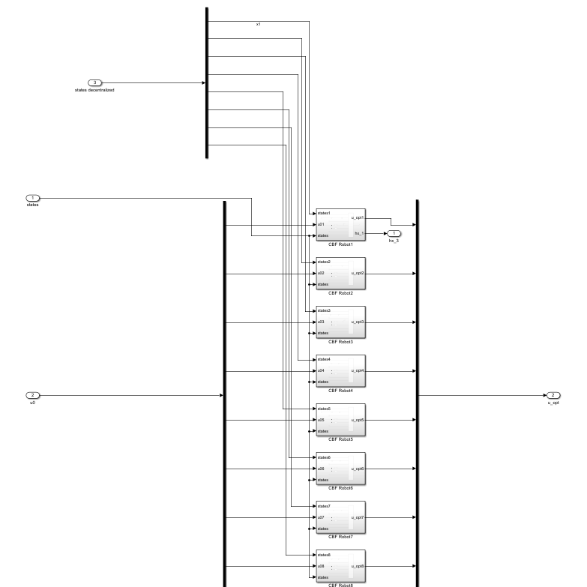
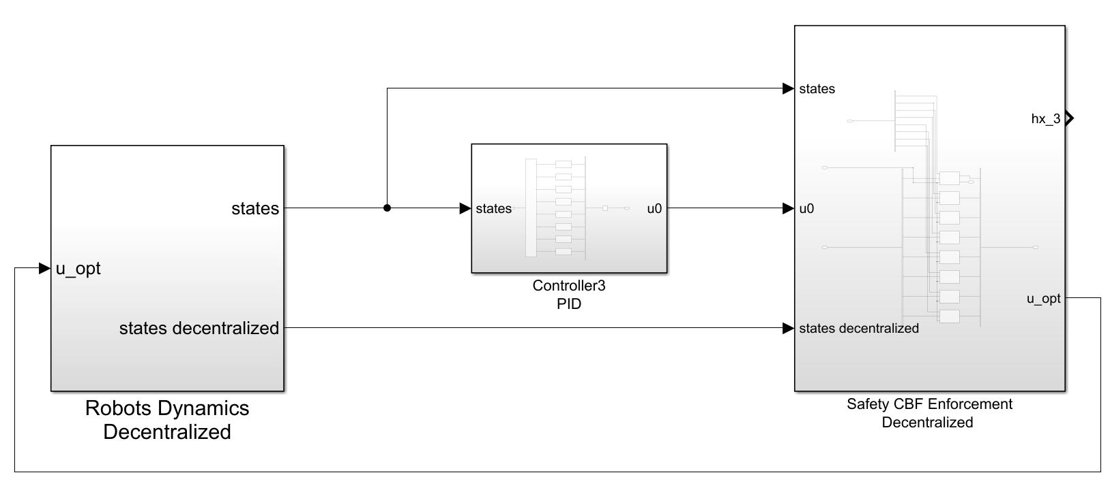
Experiment 1 - Decentralized Approach - Implementation
The first experiment was implemented using MATLAB R2022a making use of Symbolic Toolbox, Simulink, and Optimization Toolbox, in particular the Barriers Certificates Enforcement block. This is the scheme for the decentralized problem.
Reshaped
states input
Decentralized barrier certificates (one for each robot)
PID control system output
Multi-robot collision avoidance using control barrier functions

Slide 19
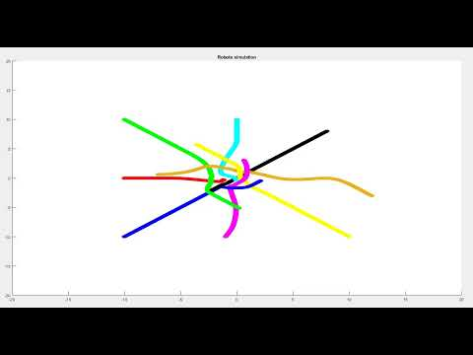
Experiment 1 - Decentralized Approach - Results
This is the video of the simulation using the decentralized approach.
DECENTRALIZED
Multi-robot collision avoidance using control barrier functions

Slide 20





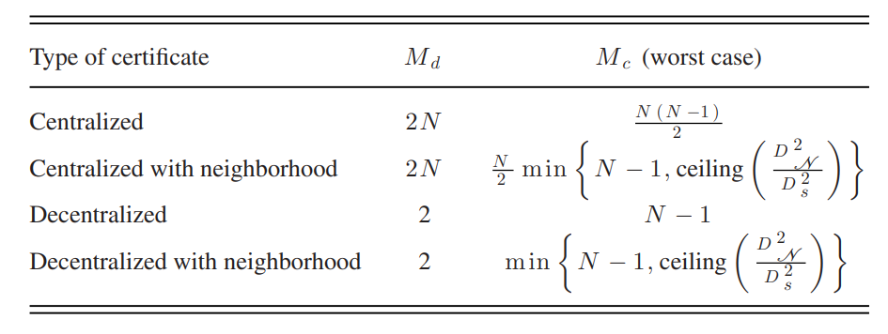


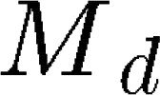
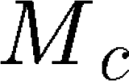


Experiment 1 - The notion of neighborhood
In the control strategies presented above all pairs of robots are considered (this requires a complete information graph for the centralized case), which is potentially a very large number. We can further reduce the number of constraints to enforce by considering only the robots that lies within a specified disk information graph, for each robot. The neighbourhood set is defined in the following way:
Where is the radius of the neighbourhood and is an adjustable parameter for the radius of the sensing area, are the lower bounds for accelerations and velocities.
From
To
Centralized
The parameters and represents
the maximum number of decision variables
and constraints, respectively.
Decentralized
Multi-robot collision avoidance using control barrier functions
Pagina ‹#›
Notes:
‹#›

Slide 21
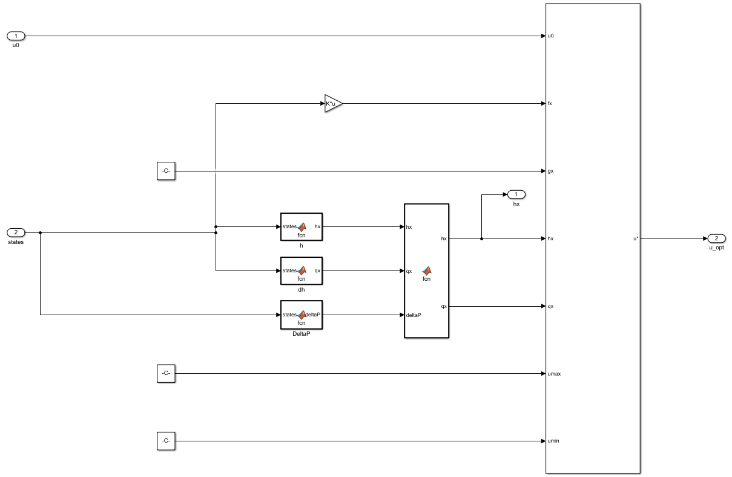
Experiment 1 - Neighborhood approach - Implementation
The neighborhood version of the problem requires the definition of an additional block to activate or deactivate the barrier functions, depending on the relative positions. This is the scheme for the Centralized problem, the decentralized one is similar.
Activation or deactivation of the barriers
Computations of h, dh, and the relative positions
Multi-robot collision avoidance using control barrier functions

Slide 22
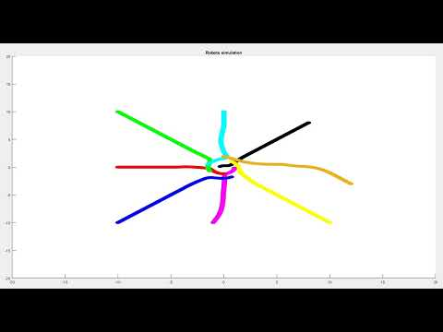
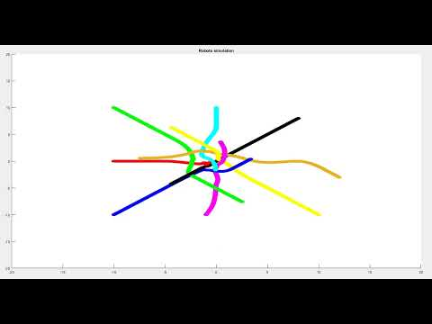
Experiment 1 - Neighborhood approach - Results
In this page the videos of the neighbourhood approaches are shown.
Centralized
Decentralized
Multi-robot collision avoidance using control barrier functions

Slide 23
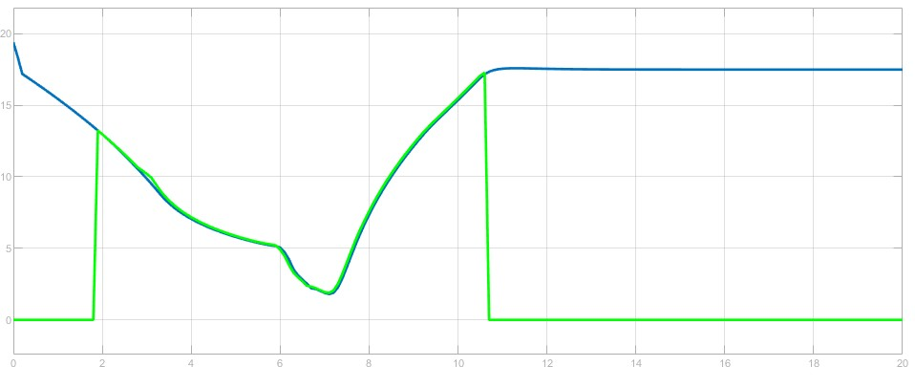
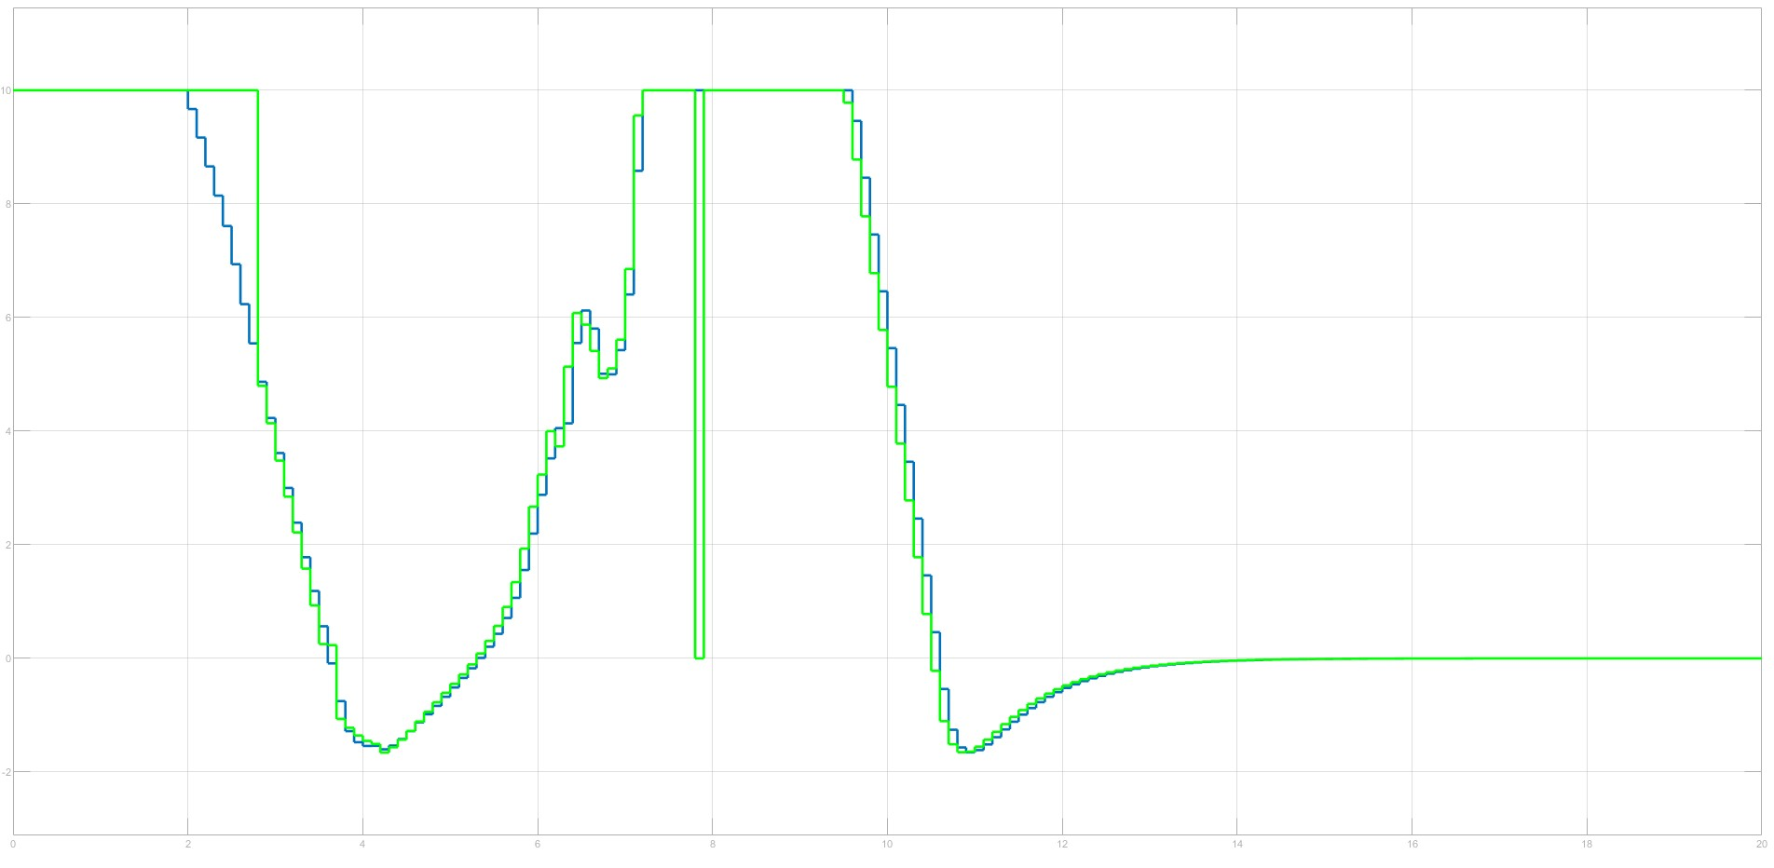
Experiment 1 - Neighborhood approach - Results
In this slide we show the behaviour of the barrier function and control input between robot 1 and robot 2, comparing what happens in the centralized case using the neighbourhood strategy (in green) with respect to the nominal one (in blue).
We can see from the plot that before entering in the neighborhood area, the barrier is not activated, and it deactivates when robots are sufficiently far away between them.
This will result in less constraints to be enforced.
Barrier function h12
Nominal vs Neighborhood
Control input u1x
Nominal vs Neighborhood
Multi-robot collision avoidance using control barrier functions

Slide 24
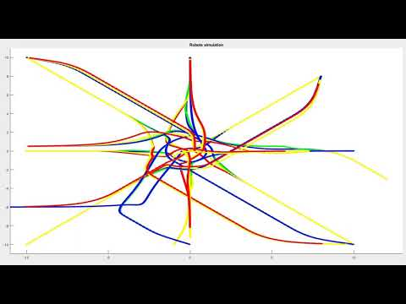
Experiment 1 - Comparison - Results
Finally, we want to show the resulting trajectories using the 4 control schemes. We see in blue and red the centralized and decentralized trajectories, and in green and yellow the neighborhood centralized and neighborhood decentralized approaches.
Multi-robot collision avoidance using control barrier functions

Slide 25
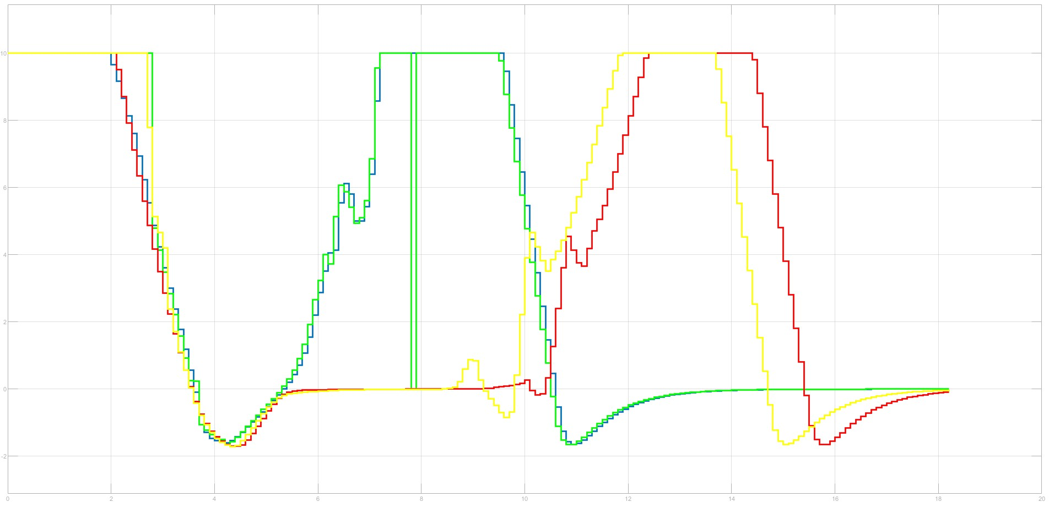
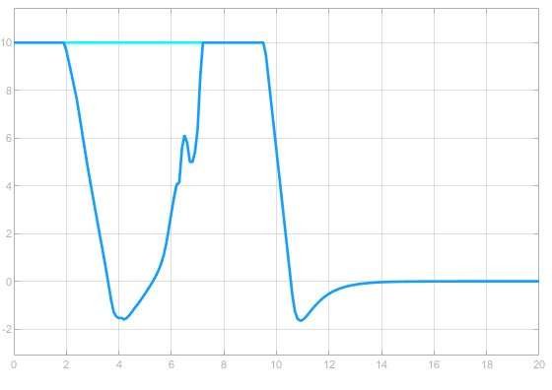
Experiment 1 - Comparison - Results
In this slide we would like to show the resulting control actions for the 4 cases we presented in the first experiment, and the difference between the nominal control (from PID) and the safe one (from CBF), in the centralized case without neighbours.
All the plots regards the first component of the control vector, representing the acceleration of the first robot along x-axis.
Control input u1x
CBF’s outputs comparison
Control input u1x (Centralized nominal)
PID (cyan) vs CBF outputs (blue)
Multi-robot collision avoidance using control barrier functions

Slide 26
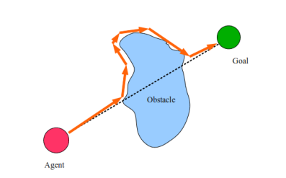
Experiment 2 - Obstacle avoidance with CBFs
Safety barrier certificates can also be used to deal with obstacles. Obstacle avoidance implies that, given a trajectory between a starting and a final point (the goal that must be reached), a possible obstacle may be present to interfere the robot navigation to the target position.
Thus, after identifying the
position and shape of the
obstruction, this must
be avoided by changing
the trajectory a bit.
Assuming the obstacles
have circular shapes, they can be treated as agents with no control inputs.
For example, assuming a given obstacle k having radius Rk and centered at pk, we can design a Zeroing Control Barrier Function that ensures that agent i does not collide with obstacle k, using the formulation for the barrier that was stated in the previous slides:
There is no need to assume that the obstacle stands still. Therefore by defining its position as a variable quantity we can replicate the same logic for a moving obstacle.
Multi-robot collision avoidance using control barrier functions

Slide 27
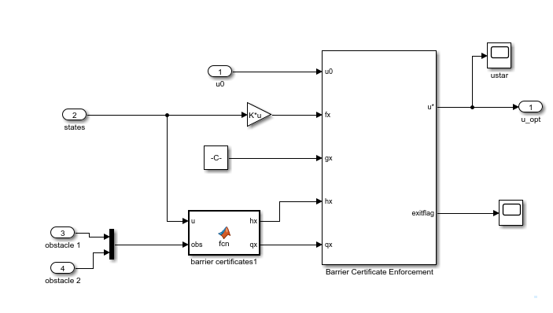
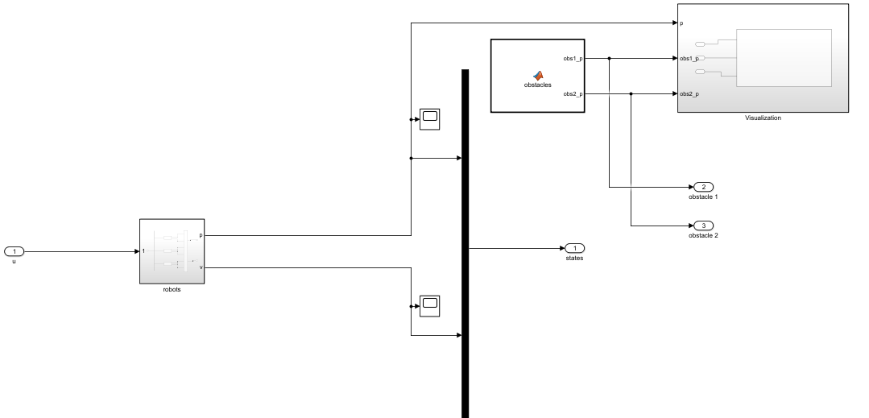
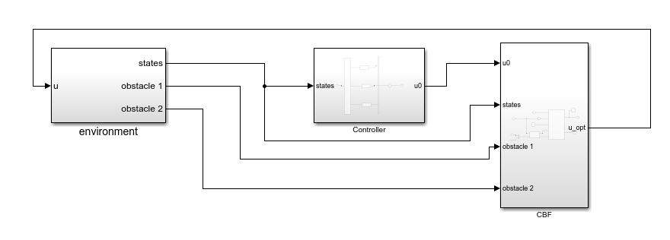
Experiment 2 - Obstacle avoidance - implementation
The second experiment was implemented using MATLAB R2022a making use of Symbolic Toolbox, Simulink, and Optimization Toolbox, in particular the Barriers Certificates Enforcement block. We manage the problem of obstacle avoidance by applying a centralized algorithm
Obstacles definition
Robots inputs
Computations of h and dh by considering both robots & obstacles
Multi-robot collision avoidance using control barrier functions

Slide 28
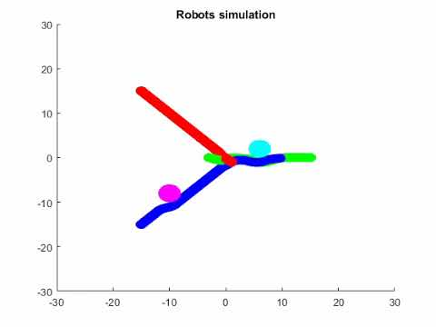
Experiment 2 - Obstacle avoidance - results
Robots’ trajectories in a collision avoidance environment with static obstacles (in light-blue and purple).
Multi-robot collision avoidance using control barrier functions

Slide 29
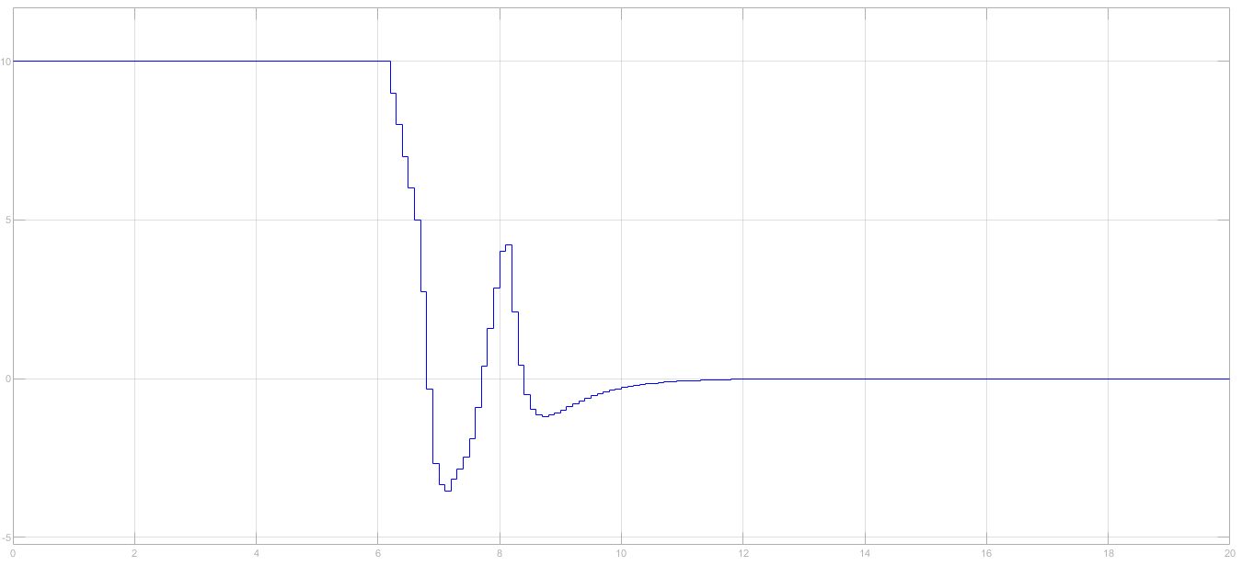
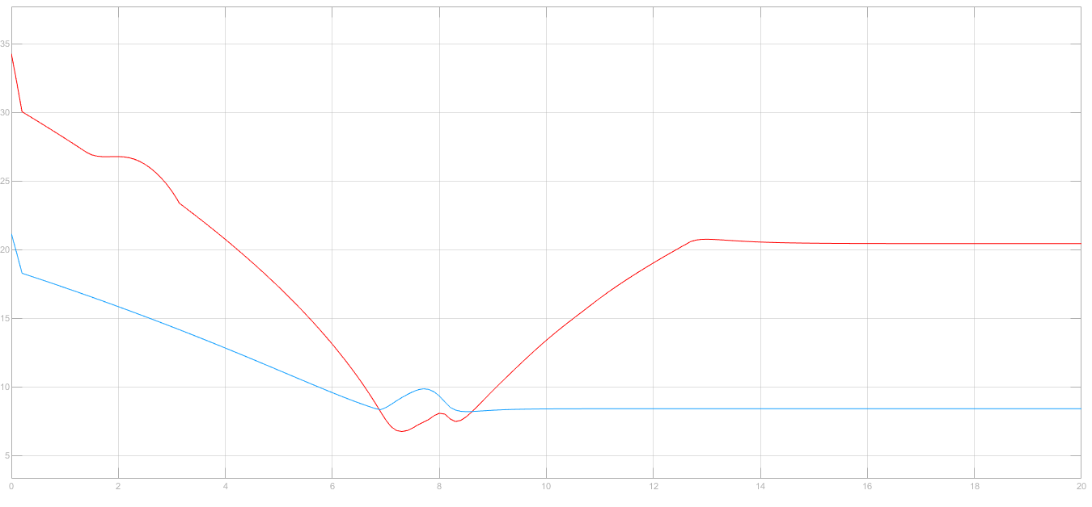
Experiment 2 - Obstacle avoidance - results
Top: Control input u1x for the robot 1 only navigating in the environment. We can see its value is constant until the collision-avoidance triggers
Bottom: in RED the control barrier functions h12 between robots 1 and 2, in BLUE the control barrier function between robot 1 and obstacle 1
Multi-robot collision avoidance using control barrier functions

Slide 30
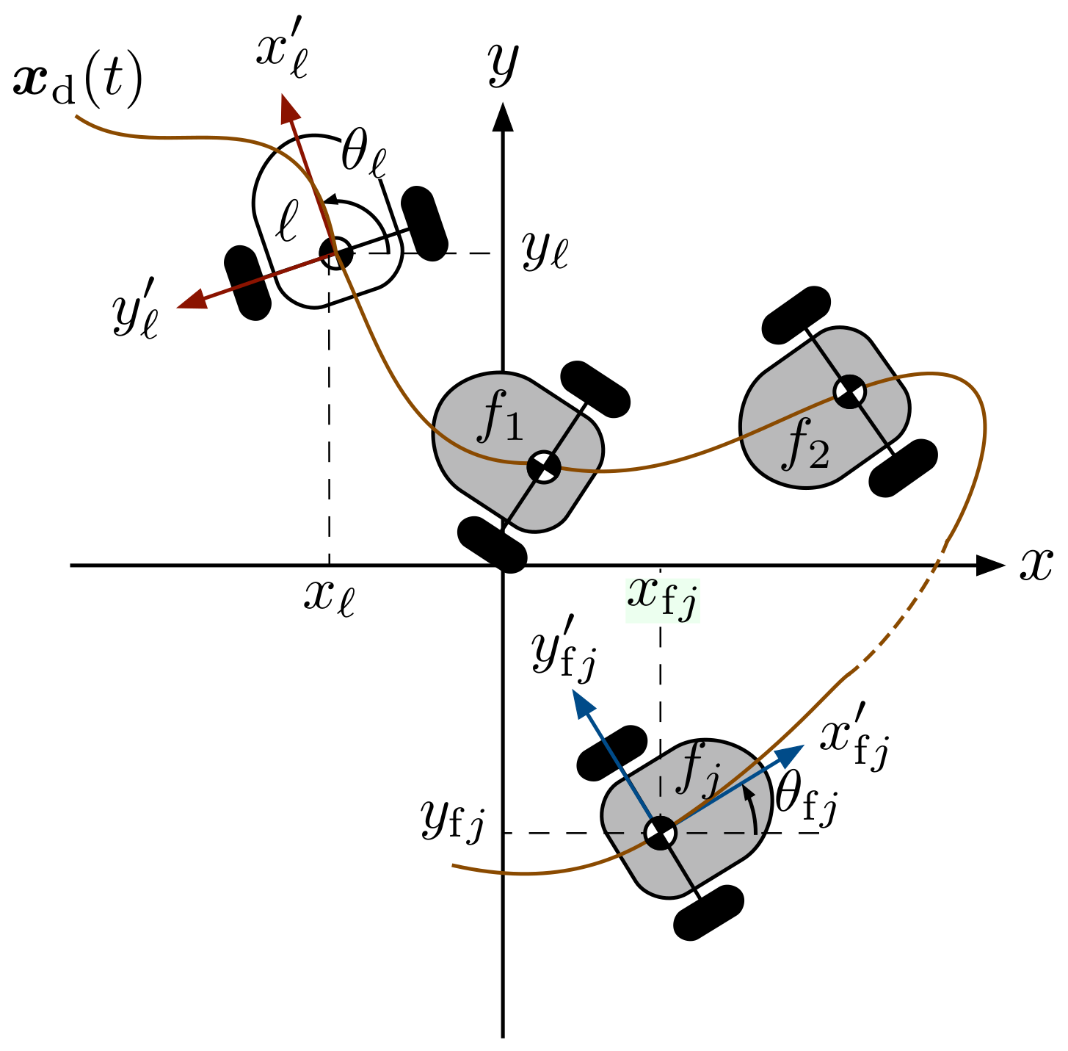

Experiment 2 - Leader Followers
Given n robots (called followers), each one having position and velocity (pi,vi), the goal of the tracking control problem consists in following a fictitious vehicle (called leader)
with position and velocity (pL,vL).
From a control viewpoint, calling
(xf,yf) the x-y positions of a generic
follower robot and (xL,yL) the
x-y of the leader robot, acting as
reference positions for the
follower one, the goal is to steer
the following quantities to zero:
Multi-robot collision avoidance using control barrier functions

Slide 31
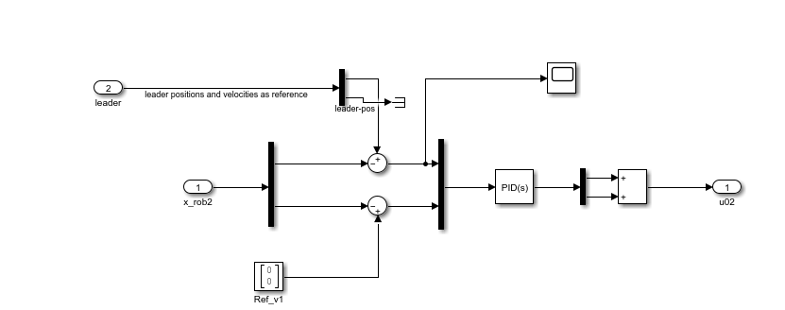
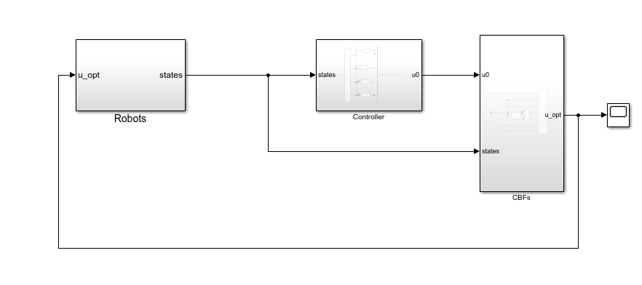
Experiment 2 - Leader Followers - implementation
The second experiment was implemented using MATLAB R2022a making use of Symbolic Toolbox, Simulink, and Optimization Toolbox, in particular the Barriers Certificates Enforcement block. We manage the problem of leader-following by applying a centralized algorithm
Example for robot2 (follower) chasing robot1 (leader). At time t, robot2 has the position of robot1 as reference
Multi-robot collision avoidance using control barrier functions

Slide 32
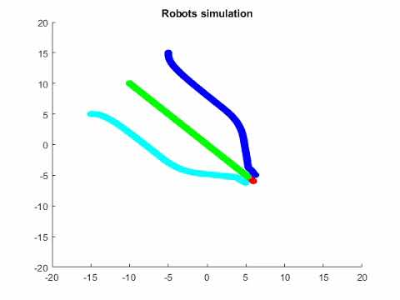
Experiment 2 - Leader Followers - Results
follower robots chasing a leader one (in red)
Multi-robot collision avoidance using control barrier functions

Slide 33


Experiment 2 - Leader Followers - Results
Top: Control input u1x for the robot 1 only navigating in the environment. We can see its value is constant until the collision-avoidance triggers
Bottom: control barrier functions h12 between robots 1 (leader) and 2 (follower)
Multi-robot collision avoidance using control barrier functions

Slide 34
Experiment 2 - All together: Leader Followers & obstacle avoidance - implementation
The second experiment was implemented using MATLAB R2022a making use of Symbolic Toolbox, Simulink, and Optimization Toolbox, in particular the Barriers Certificates Enforcement block. We manage the problem of obstacle avoidance + leader-following by applying a centralized algorithm
Multi-robot collision avoidance using control barrier functions

Slide 35

Experiment 2 - All together: Leader Followers & obstacle avoidance - results
follower robots chasing a leader one while avoiding static obstacles
Multi-robot collision avoidance using control barrier functions

Slide 36


Experiment 2 - All together: Leader Followers & obstacle avoidance - results
TOP: Control input u1x for the robot 1 only navigating in the environment. We can see its value is constant until the collision-avoidance triggers
Bottom: control barrier functions h12 between robots 1 (leader) and 2 (follower)
Multi-robot collision avoidance using control barrier functions

Slide 37

Limitations - Deadlocks and Feasibility
As the robot swarm size grows, the enforcement of the constraints can reduce the safe controller space to an empty set.
In order to overcome this issue, the authors of the paper proposed first a relaxed version of the QP problem, and then embed the control systems in a fuzzy logic controller that applies different control actions depending on the feasibility of the QP problem, by always guaranteeing that a strong brake can be applied.
Other problems should be considered: the deadlocks.
They happens sometimes when objectives of multiple agents conflict with the safety certificates, because the certificates are designed to use local informations only. In these scenarios, the agents are safe but can’t complete their tasks.This behaviour is common when the starting formation is perfectly symmetrical.
The authors classified possible deadlocks in three types and proposed a perturbation of the control input that is coherent with the type of the deadlock. Type 3 deadlocks are not resolved in the algorithm proposed but can be treated by embedding navigation functions.
Deadlock detection
Deadlock happens when the norm of the nominal control is not null, but the robot remains blocked in its position.
Deadlock classification
Deadlock resolution (Type 1 and 2)
Multi-robot collision avoidance using control barrier functions

Slide 38
Thank you
Multi-robot collision avoidance using control barrier functions

