Slide 1
Homework 2
Image Classification on Small Datasets
Machine Learning course 2021-2022

Slide 2
Recap
(Some) open questions
Ensembles of small-scale convolutional networks provide good accuracy in small-data settings (Seminar 1)
Tuning the hyper-parameters like learning rate and weight decay is a critical factor to ensure the highest performance (Seminar 2)
Do custom/newer architectures work better than popular ResNets?
Can we do even better choosing hyper-parameters?
Do heterogeneous ensembles perform better than homogeneous ones?

Slide 3
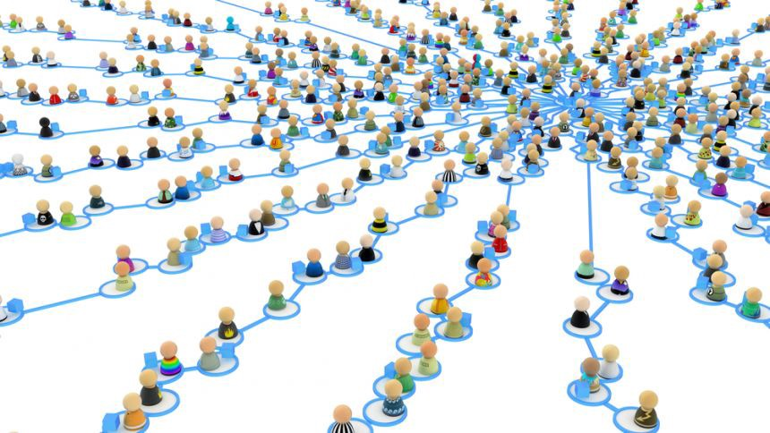
Answering these questions with crowd-sourcing
What if each student will train a “small” network to provide an ensemble member?
In this way:
Obtaining a (very!) large and heterogeneous ensemble
Exploring its own search space is easier for each single member (i.e. hyper-parameters)

Slide 4
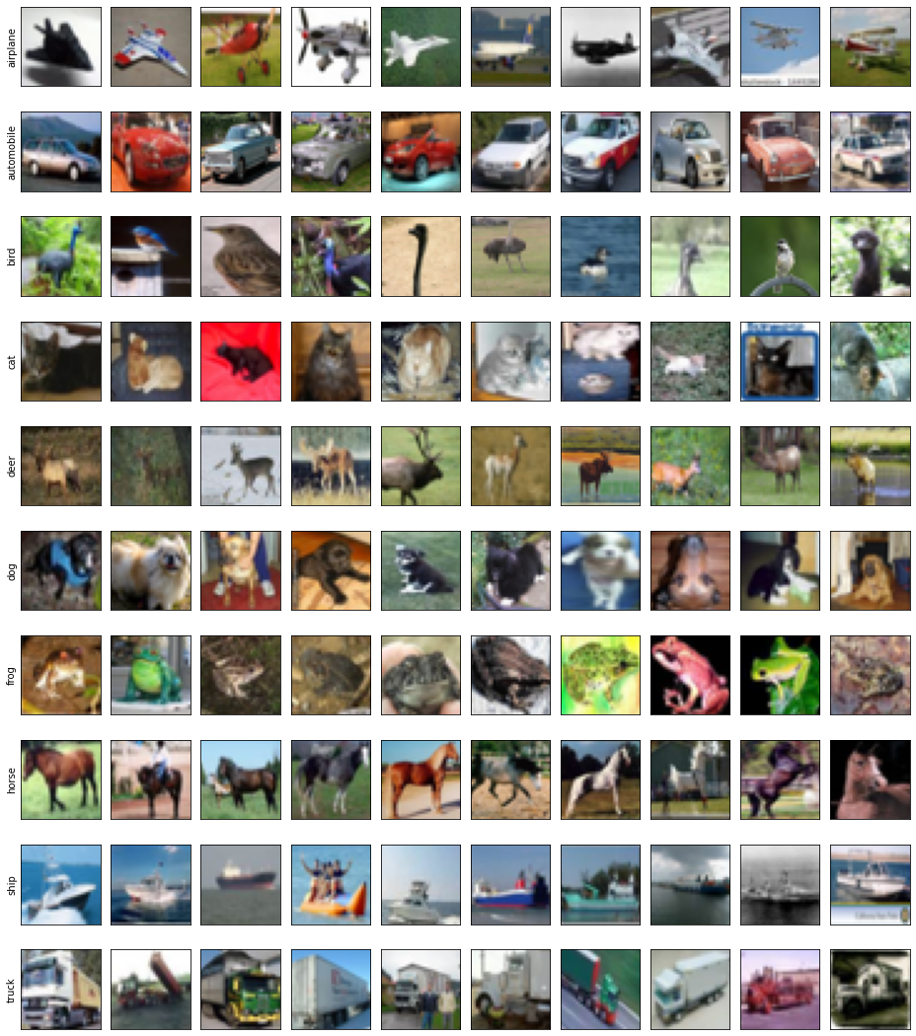
Dataset [link]
The dataset is ciFAIR-10 of the DEIC Benchmark (Seminar 2)
10-class problem
50 training images per class
1000 testing images per class
image dimension 32x32x3
Categories:
airplane
automobile
bird
cat
deer
dog
frog
horse
boat
truck

Slide 5
Objectives
Train your favorite network architecture:
published one (e.g. ResNet, Wide ResNet, EfficientNet…)
custom one (note that published ones are a good starting point)
Analyze results concerning few modifications of chosen architecture:
size (e.g., network depth/width)
layer configurations (e.g., kernel size, convolution stride)
Analyze results concerning few modifications of optimization process:
optimizer (e.g. SGD, Adam, ...)
optimizer parameters (e.g. learning rate, weight decay, momentum)
training (e.g. epochs, batch size)

Slide 6


Code Repository [link]
We provide a code repository as starting point for your experiments
ciFAIR Exploration.ipynb
example_images.png
README.md
datasets
cifair
train.py
plot_training_history.py
evaluate_baccuracy.py
sapienza_ml21_deic
scripts
__init__.py
cifar_resnet.py
wrn.py
small_data
architectures
__init__.py
cifair.py
common.py
loader.py
requirements.txt
README.md
datasets
__init__.py
classifiers.py
...
__init__.py
common.py
xent.py
methods

Slide 7
Code Repository
sapienza_ml21_deic is the main directory containing: file with package requirements, readme of the repository and subdirectories.
ciFAIR Exploration.ipynb
example_images.png
README.md
datasets
cifair
train.py
plot_training_history.py
evaluate_baccuracy.py
sapienza_ml21_deic
scripts
__init__.py
cifar_resnet.py
wrn.py
small_data
architectures
__init__.py
cifair.py
common.py
loader.py
requirements.txt
README.md
datasets
__init__.py
classifiers.py
...
__init__.py
common.py
xent.py
methods

Slide 8
Code Repository
Put the provided dataset repository (ciFAIR-10 shared on Drive) inside this directory.
ciFAIR Exploration.ipynb
example_images.png
README.md
datasets
cifair
train.py
plot_training_history.py
evaluate_baccuracy.py
sapienza_ml21_deic
scripts
__init__.py
cifar_resnet.py
wrn.py
small_data
architectures
__init__.py
cifair.py
common.py
loader.py
requirements.txt
README.md
datasets
__init__.py
classifiers.py
...
__init__.py
common.py
xent.py
methods

Slide 9
Code Repository
Notebook for dataset visualization and readme file with baseline performance along with terminal command to reproduce the baseline result.
ciFAIR Exploration.ipynb
example_images.png
README.md
datasets
cifair
train.py
plot_training_history.py
evaluate_baccuracy.py
sapienza_ml21_deic
scripts
__init__.py
cifar_resnet.py
wrn.py
small_data
architectures
__init__.py
cifair.py
common.py
loader.py
requirements.txt
README.md
datasets
__init__.py
classifiers.py
...
__init__.py
common.py
xent.py
methods

Slide 10
Code Repository
small_data is the directory that you will submit, with all its content.
ciFAIR Exploration.ipynb
example_images.png
README.md
datasets
cifair
train.py
plot_training_history.py
evaluate_baccuracy.py
sapienza_ml21_deic
scripts
__init__.py
cifar_resnet.py
wrn.py
small_data
architectures
__init__.py
cifair.py
common.py
loader.py
requirements.txt
README.md
datasets
__init__.py
classifiers.py
...
__init__.py
common.py
xent.py
methods

Slide 11
Code Repository
The folder architectures is the place to add other architecture files (e.g., densenet.py).
ciFAIR Exploration.ipynb
example_images.png
README.md
datasets
cifair
train.py
plot_training_history.py
evaluate_baccuracy.py
sapienza_ml21_deic
scripts
__init__.py
cifar_resnet.py
wrn.py
small_data
architectures
__init__.py
cifair.py
common.py
loader.py
requirements.txt
README.md
datasets
__init__.py
classifiers.py
...
__init__.py
common.py
xent.py
methods

Slide 12
Code Repository
The folder datasets contains functions for loading data.
ciFAIR Exploration.ipynb
example_images.png
README.md
datasets
cifair
train.py
plot_training_history.py
evaluate_baccuracy.py
sapienza_ml21_deic
scripts
__init__.py
cifar_resnet.py
wrn.py
small_data
architectures
__init__.py
cifair.py
common.py
loader.py
requirements.txt
README.md
datasets
__init__.py
classifiers.py
...
__init__.py
common.py
xent.py
methods

Slide 13
Code Repository
The folder methods contains functions for running the training algorithms.
ciFAIR Exploration.ipynb
example_images.png
README.md
datasets
cifair
train.py
plot_training_history.py
evaluate_baccuracy.py
sapienza_ml21_deic
scripts
__init__.py
cifar_resnet.py
wrn.py
small_data
architectures
__init__.py
cifair.py
common.py
loader.py
requirements.txt
README.md
datasets
__init__.py
classifiers.py
...
__init__.py
common.py
xent.py
methods

Slide 14
Code Repository
The folder scripts contains higher-level scripts to actually run the training or visualize results.
ciFAIR Exploration.ipynb
example_images.png
README.md
datasets
cifair
train.py
plot_training_history.py
evaluate_baccuracy.py
sapienza_ml21_deic
scripts
__init__.py
cifar_resnet.py
wrn.py
small_data
architectures
__init__.py
cifair.py
common.py
loader.py
requirements.txt
README.md
datasets
__init__.py
classifiers.py
...
__init__.py
common.py
xent.py
methods

Slide 15

Google Colab Demo
Setup the code repository on Google Drive with SetupGitRepoOnDrive.ipynb
Run baseline experiment with ExampleTrain.ipynb

Slide 16
Your Task
Add something in the code, save the trained model and evaluate it on the test set.
Examples:
New architecture
A different optimizer for training
A choosable hyper-parameter (e.g., momentum parameter of SGD)
At least perform two of these tasks.
Only running the demo would translate in 0 points for your homework.

Slide 17
Adding a new architecture
ciFAIR Exploration.ipynb
example_images.png
README.md
datasets
cifair
train.py
plot_training_history.py
evaluate_baccuracy.py
sapienza_ml21_deic
scripts
__init__.py
cifar_resnet.py
wrn.py
small_data
architectures
__init__.py
cifair.py
common.py
loader.py
requirements.txt
README.md
datasets
__init__.py
classifiers.py
...
__init__.py
common.py
xent.py
methods

Slide 18
Adding a new architecture
You should add a file that define the architecture inside architectures.
ciFAIR Exploration.ipynb
example_images.png
README.md
datasets
cifair
train.py
plot_training_history.py
evaluate_baccuracy.py
sapienza_ml21_deic
scripts
__init__.py
cifar_resnet.py
wrn.py
small_data
architectures
__init__.py
cifair.py
common.py
loader.py
requirements.txt
README.md
datasets
__init__.py
classifiers.py
...
__init__.py
common.py
xent.py
methods

Slide 19
Adding a new architecture
Steps:
Create a new file inside folder architectures (e.g., wrn.py) to contain all the python classes/functions needed by the given architecture.
The main class must have an __init__, forward, get_classifiers, and build_classifier method.
class WideResNet(nn.Module):
def __init__(self, depth, num_classes, input_channels=3, widen_factor=1, ...):
…
def forward(self, x):
…
@staticmethod
def get_classifiers():
return ['wrn-16-8', 'wrn-16-10', ..., 'wrn-28-12']
@classmethod
def build_classifier(cls, arch: str, num_classes: int, input_channels: int):
_, depth, widen_factor = arch.split('-')
cls_instance = cls(int(depth), num_classes, input_channels=input_channels, widen_factor=int(widen_factor))
return cls_instance

Slide 20
Using a different optimizer for training
ciFAIR Exploration.ipynb
example_images.png
README.md
datasets
cifair
train.py
plot_training_history.py
evaluate_baccuracy.py
sapienza_ml21_deic
scripts
__init__.py
cifar_resnet.py
wrn.py
small_data
architectures
__init__.py
cifair.py
common.py
loader.py
requirements.txt
README.md
datasets
__init__.py
classifiers.py
...
__init__.py
common.py
xent.py
methods

Slide 21
Using a different optimizer for training
You should sub-class the method get_optimizer of LearningMethod defined in common.py with a different instance inside xent.py.
ciFAIR Exploration.ipynb
example_images.png
README.md
datasets
cifair
train.py
plot_training_history.py
evaluate_baccuracy.py
sapienza_ml21_deic
scripts
__init__.py
cifar_resnet.py
wrn.py
small_data
architectures
__init__.py
cifair.py
common.py
loader.py
requirements.txt
README.md
datasets
__init__.py
classifiers.py
...
__init__.py
common.py
xent.py
methods

Slide 22
Using a different optimizer for training
The main training class contains multiple methods that can be sub-classed:
LearningMethod is the general class for a training pipeline of a method defined in common.py.
An instance of this class is CrossEntropyClassifier which is defined in xent.py.
CrossEntropyClassifier, when called will override all methods of LearningMethod defined inside its file.
Any change can be applied by modifying the desired class method (e.g., get_optimizer).

Slide 23
Using a different optimizer for training
Original get_optimizer function defined inside common.py.
def get_optimizer(self, model: nn.Module, max_epochs: int, max_iter: int):
optimizer = torch.optim.SGD(model.parameters(), lr=self.hparams['lr'], momentum=0.9, weight_decay=self.hparams['weight_decay'])
scheduler = torch.optim.lr_scheduler.CosineAnnealingLR(optimizer, T_max=max_iter)
return optimizer, scheduler

Slide 24
Using a different optimizer for training
New get_optimizer method (with Adam instead of SGD) of CrossEntropyClassifier defined inside xent.py.
def get_optimizer(self, model: nn.Module, max_epochs: int, max_iter: int):
optimizer = torch.optim.Adam(model.parameters(), lr=self.hparams['lr'], weight_decay=self.hparams['weight_decay'])
scheduler = torch.optim.lr_scheduler.CosineAnnealingLR(optimizer, T_max=max_iter)
return optimizer, scheduler

Slide 25
Add choosable hyper-parameter
Making the momentum parameter of SGD as choosable hyper-parameter by the user.
ciFAIR Exploration.ipynb
example_images.png
README.md
datasets
cifair
train.py
plot_training_history.py
evaluate_baccuracy.py
sapienza_ml21_deic
scripts
__init__.py
cifar_resnet.py
wrn.py
small_data
architectures
__init__.py
cifair.py
common.py
loader.py
requirements.txt
README.md
datasets
__init__.py
classifiers.py
...
__init__.py
common.py
xent.py
methods

Slide 26
Add choosable hyper-parameter
You should sub-class the static methods default_hparams and get_optimizer of class CrossEntropyClassifier in xent.py.
ciFAIR Exploration.ipynb
example_images.png
README.md
datasets
cifair
train.py
plot_training_history.py
evaluate_baccuracy.py
sapienza_ml21_deic
scripts
__init__.py
cifar_resnet.py
wrn.py
small_data
architectures
__init__.py
cifair.py
common.py
loader.py
requirements.txt
README.md
datasets
__init__.py
classifiers.py
...
__init__.py
common.py
xent.py
methods

Slide 27
Add choosable hyper-parameter
Sub-class the static default_hparams method of CrossEntropyClassifier to add momentum:
@staticmethod
def default_hparams() -> dict:
return {
**super(CrossEntropyClassifier, CrossEntropyClassifier).default_hparams(),
'momentum' : 0.9
}
Update the get_optimizer method too:
def get_optimizer(self, model: nn.Module, max_epochs: int, max_iter: int):
optimizer = torch.optim.SGD(model.parameters(), lr=self.hparams['lr'], momentum=self.hparams['momentum'], weight_decay=self.hparams['weight_decay'])
scheduler = torch.optim.lr_scheduler.CosineAnnealingLR(optimizer, T_max=max_iter)
return optimizer, scheduler

Slide 28
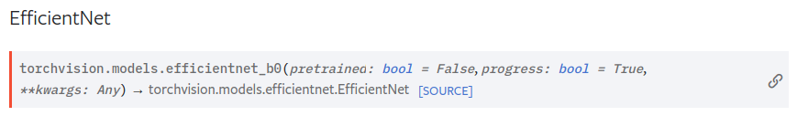
Deep Learning Library
The code is written in PyTorch which is very similar to Tensorflow:
PyTorch (1.7) documentation [link].
The modules of torch.nn are equivalent to layers in tf.keras.layers. Docs [link].
To use different network architectures I advise looking at the available models at torchvision.models [link] and copying, using/modifying their source code (e.g., EfficientNet).

Slide 29
Save the trained model
Models in PyTorch are saved similarly to Tensorflow:
A torch.nn.Module has a state dictionary containing all the information concerning the layer weights.
It is enough to simply call:
torch.save(model.state_dict(), “model.pth”)
Note that to load back the model, you should first instantiate an instance of the model class and then override the state dictionary.
Therefore, you should call: model.load_state_dict(torch.load(“model.pth”))
Additional documentation is available [link]

Slide 30
Suggestions
To start from a good baseline take into account these tricks:
Small batch sizes (e.g., 10 or less) are preferable to improve generalization.
An high number of epochs (e.g., > 500) allow the network to find better local minima with better generalization.
Not all lr-wd couples work the same. Choosing a good couple strongly increases the results (Seminar 2) and may change with network width/depth.
Network width ease the optimization process. With the right hyper-parameters, a wider network (i.e., more conv. filters) may find better solutions than thinner ones.
Baseline to beat:
Wide ResNet-16-8 (wrn-16-8) , epochs = 500, bs = 10, lr = 4.55e-3, wd = 5.29e-3
Accuracy on test set: 58.22%
Note: the homework evaluation won’t be related to the test set performance obtained (unless for extremely bad results).

Slide 31
Submission
Through Google Classroom:
PDF report with description of the models and results on the test set.
ZIP file of small_data folder, named with your matricola code (e.g, 1771597.zip).
Your trained model saved with your matricola code (e.g, 1771597.pth).

Slide 32
Expected Outcome
Publish a paper with 100 names!! Or less optimistically:
Get interesting insights and results about this crowd-sourcing experiment with ensembles on small datasets.
Not getting the same model from all of you since this would basically ruin the experiment:
predictions of average of 100 identical models = predictions of 1 model
And would give 0 points to your homework!!
You’ll learn important tools and practices to train neural networks.

Slide 33
Summary
To run the code you need a GPU either locally or on the Cloud:
Use Colab or make sure to have PyTorch locally installed with GPU support
[For Colab] Use the notebook SetupGitRepoOnDrive.ipynb to clone the repository on your Google Drive.
[For Colab] Use/take inspiration from ExampleTrain.ipynb to run experiments.
[For Colab] Note that to change the running code, you should modify the files of the repo that are located in your Google Drive.

