Slide 1


Master Degree in Control Systems (MCER) Professor: A. Uncini, Supervisor: D. Comminiello DIAG Department, Sapienza University of Rome Academic Year 2021-2022 Neural Networks
Studente: Luca Tirel
E-mail: tirel.1702631@studenti.uniroma1.it

Slide 2
Topic of interest: Light-Sernet: a lightweight fully convolutional neural network for speech emotion recognition

Slide 3
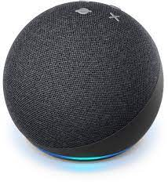


Speech Emotion Recognition
Detecting speaker’s emotions from speech audio signals (SER) plays an important role in human-computer interactions.
Thanks to big data, this field has lots of applications, especially in intelligent dialogue systems.
Amazon Alexa
Apple Siri
Google Assistant

Slide 4
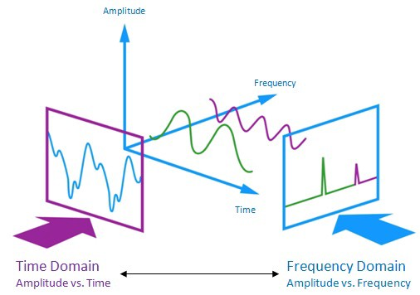
Speech Emotion Recognition
An audio signal is a representation of a sound wave, a longitudinal wave that propagates thought its medium by compression and expansions.
Audios are considered as complex unstructured signals that contains informations in both the time and frequency domains, to be extracted.
(SER) Before: Feature extractor + Classifier
(SER) Now: Deep Neural Networks (CNN)

Slide 5
Introduction and state of the art in SER
In [1] the authors proposed several large parallel paths, with large convolutional filters, and a phoneme embedding.
In [2] Chen et al. used Mel-spectrogram, deltas, and delta-deltas as inputs and proposed a 3-D attention-based RCNN to preserve effective emotional information.
In [3] Zhong et al. proposed a combination of the attention mechanism with focal loss, improving learning on hard samples.

Slide 6
The Dataset
In

Slide 7
Proposed methodology
The authors proposed a hierarchical DL model with three parallel paths extracting the first features maps, which are fed to a deep CNN to extract high level features for the classifier.
The network takes as inputs the MFCC (Mel frequencies cepstral coefficients) of the input signal.
The main advantages of this model rely in its lightness, making it suitable for IoT devices with limited resources, while reaching the same or higher SOTA accuracy.

Slide 8

Input Pipeline
The audio signals are normalized between -1 and 1, and MFCC are computed using a Hamming window to reduce ripple, splitting the signal in 64-ms frames.
Then a 1024-point Fast Fourier transform is applied to each frame. After, the signal undergoes a Mel Filter Bank (MFB) analysis and for each frame MFCC are computed.
This pre-processing procedure helps extracting high quality features than directly considering raw audio signal as input. In fact, Mel scale helps mimicking our perception of sound by transforming the frequencies use of the following empirical mapping:

Slide 9
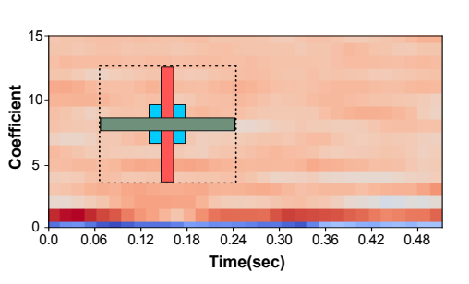
Body Part I
The three parallel CNNs with different kernel sizes are used to extract spectral, temporal and spectral-temporal dependencies.
The authors of [4] noticed a direct relationship between the classification accuracy and receptive field size, that is moreover proportional to the depth. However, increasing the layers leads to an increase of the parameters which lead to overfitting. They also noticed that for multidimensional signals, each dimension can be considered separately for calculating the receptive field.
The authors wanted to keep the model light-weight while increasing receptive fields, so they used different kernels sizes.

Slide 10
Body Part II
The output of the first body is concatenated and fed to the second body, that consist in several Local Features Learning Blocks (LFLBs) to capture high level features.
The authors used a slightly modified version of the LFLBs, that are composed by a convolutional layer, followed by a batch normalization, a RELU and an avg. pooling layer.
The last LFLB use a global average pooling, making the model capable of training on dataset of different lengths, without changes in architecture.

Slide 11
Head
The output of the body is fed to the head, that includes only a dropout layer to reduce overfitting and a fully connected layer with SoftMax activation function.
This structure for the head block significatively reduce the computational complexity of the model with respect to Attention and LSTM layers.

Slide 12
Experimental Setup
An

Slide 13
Main Results
An

Slide 14
Code in Depth
An

Slide 15
References
[1] P. Yenigalla, A. Kumar, S. Tripathi, C. Singh, S. Kar, and J. Vepa, “Speech emotion recognition using spectrogram & phoneme embedding,”, INTERSPEECH, Sept. 2018.
[2] M. Chen, X. He, J. Yang, and H. Zhang, “3-d convolutional recurrent neural networks with attention model for speech emotion recognition,” IEEE Signal Process., Oct. 2018.
[3] Y. Zhong, Y. Hu, H. Huang, and W. Silamu, “A lightweight model based on separable convolution for speech emotion recognition,”, INTERSPEECH, Nov. 2020.

Slide 16
Dipartimento di Ingegneria Informatica, Automatica e Gestionale Master in Control Systems Professor Aurelio Uncini Facoltà di Ingegneria, Università di Roma Sapienza Anno Accademico 2021-2022 Luca Tirel
Grazie per la Vostra Attenzione!
Studente: Luca Tirel
E-mail: tirel.1702631@studenti.uniroma1.it

