Slide 1


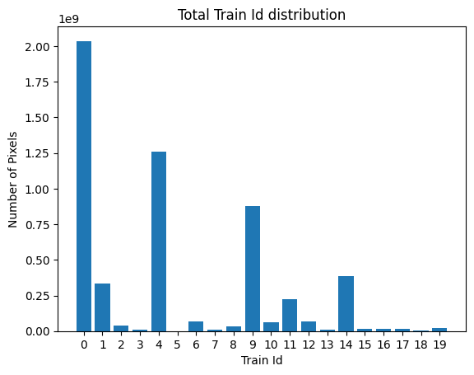
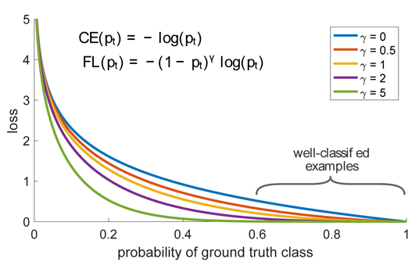
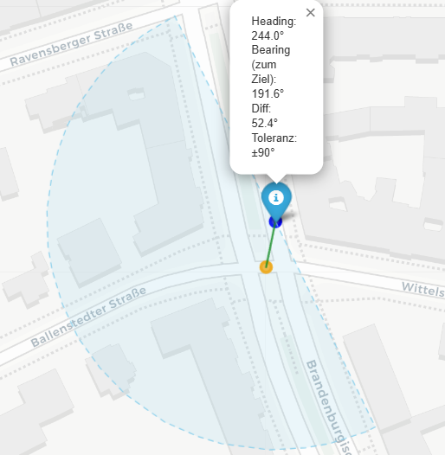
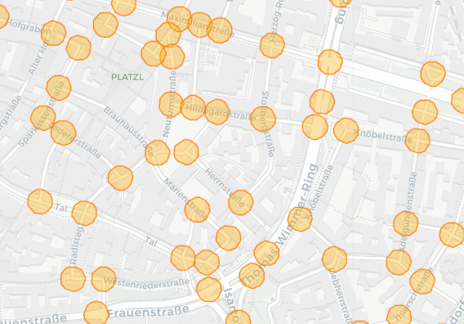
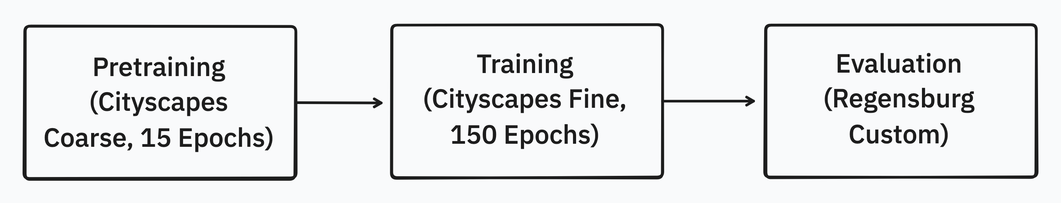
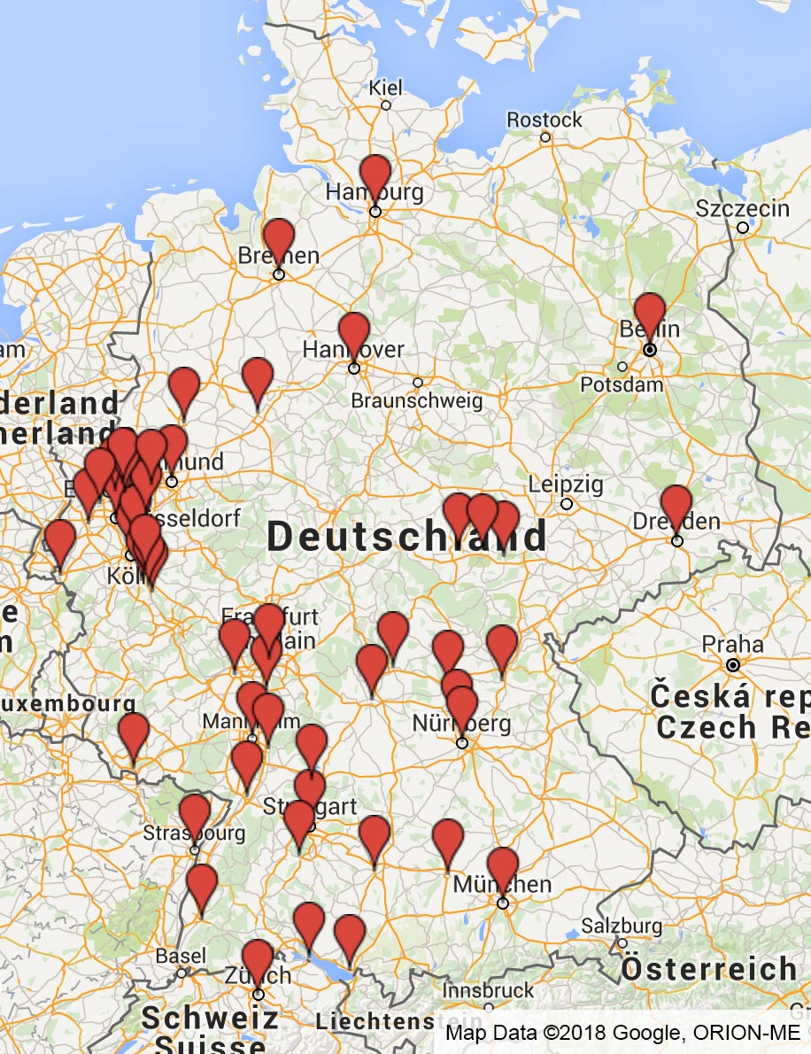
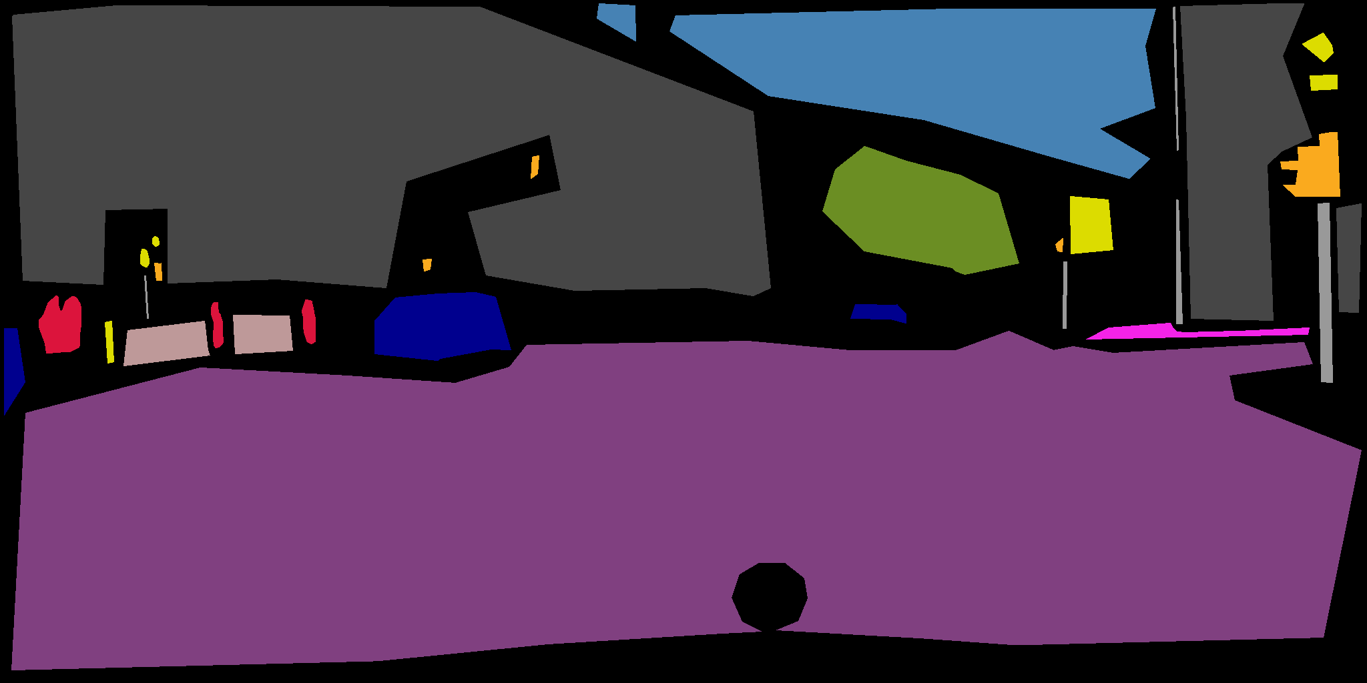
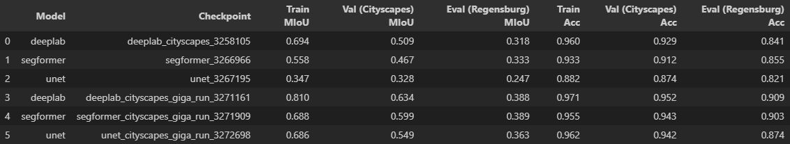
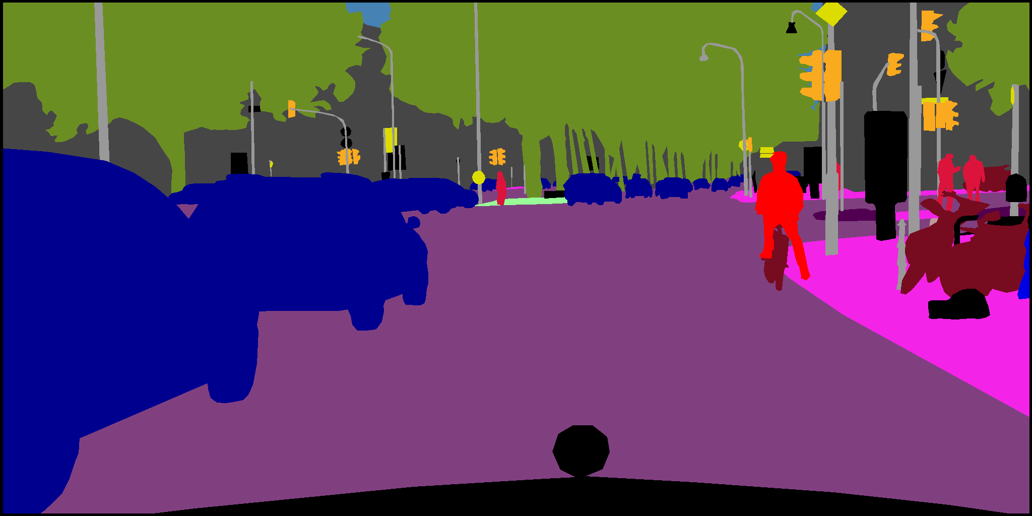
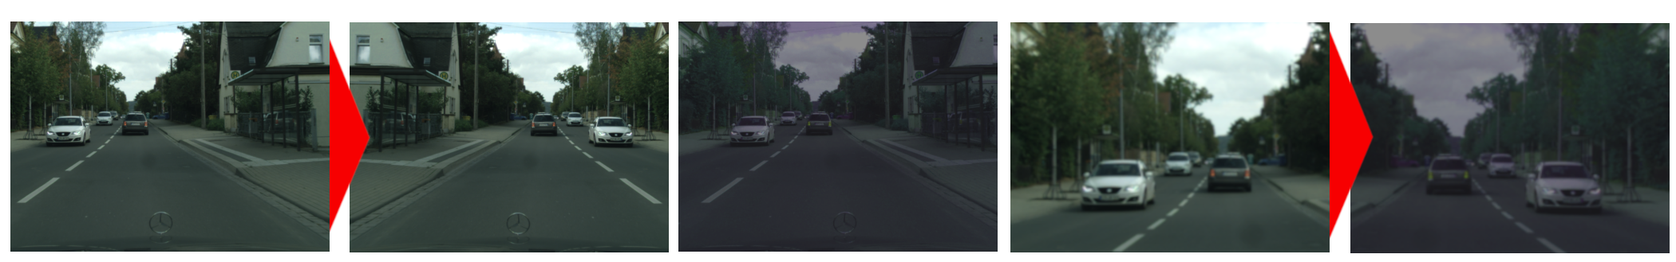
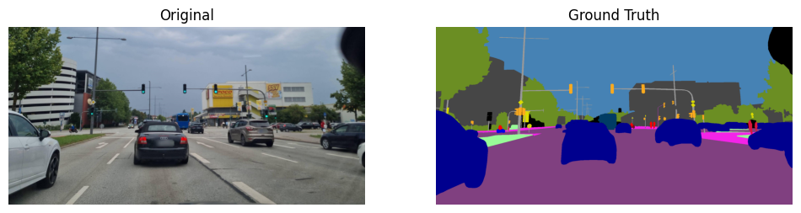
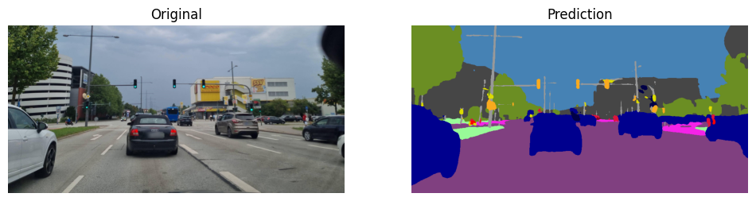
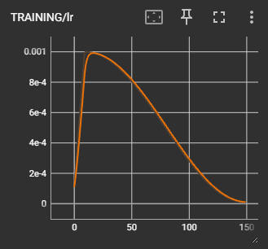
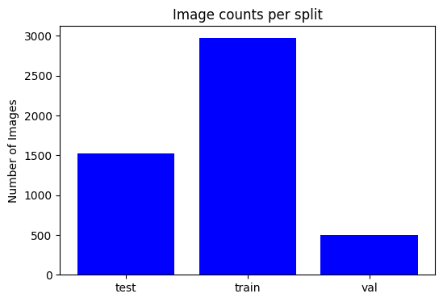
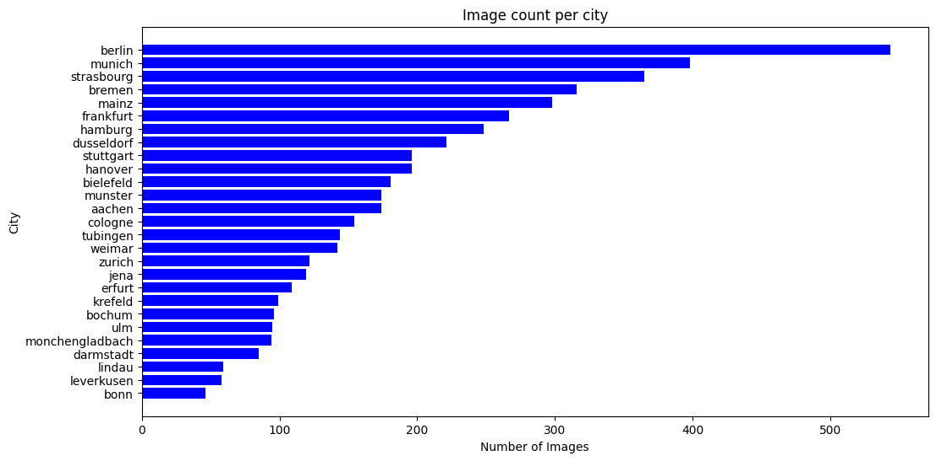
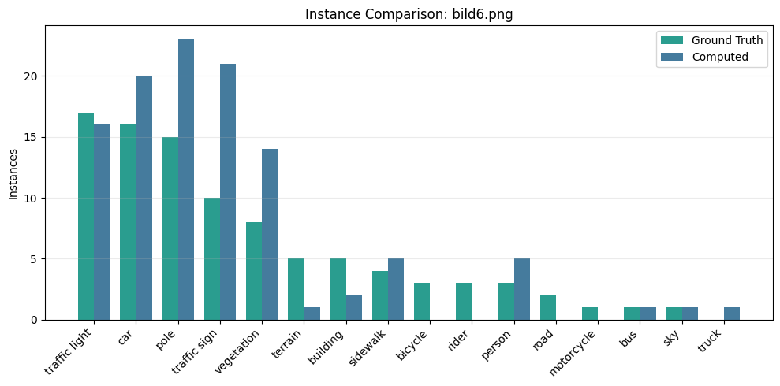
OSTBAYERISCHE TECHNISCHE HOCHSCHULE REGENSBURG
Faculty of Computer Science and Mathematics
Artificial Intelligence for Infrastructure and Urban Development
Extraction of infrastructure features at intersections from street-level imagery
Florian Kammerer, Florian Zierer, Luca Uhl, Matthias Maucher
Business Understanding: Motivation
Data Preparation: Intersection Filtering
Use Cases
Urban planning and safety analysis: Identifying bottlenecks, missing pedestrian facilities, or unsafe intersections.
Autonomous driving: Providing machine-readable infrastructure representations for perception and navigation systems.
Digital infrastructure mapping: Deriving up-to-date maps of lanes, sidewalks, bike paths, and crossings.
Goals
data-driven pipeline for semantic segmentation of street-level imagery
extraction of traffic-related infrastructure features
To isolate relevant images, multiple filters were applied:
Data Collection:
  Collecting intersection coordinates.
Filtering:
  Matching image GPS metadata (longitude, latitude) with the intersection data.
  Filtering images only heading towards the intersection
Image count
  25000 before -> after 3877 (coarse + fine)
Custom training classes
  From 19 to 20 classes (2 removed, 3 added)
Figure 9: class imbalance
Figure 10: focal loss
Evaluation
Data Understanding: Cityscapes Dataset
Each model was trained on both the filtered and the complete Cityscapes dataset seperately.
The models were then evaluated on 4 self annotated mapilliary images of intersections in Regensburg.
Training on the intersections only dataset led to early
overfitting and therefore decreased the models performance.
The mIoU score is a more meaningful evaluation metric than pixel accuracy for image segmentation. Small pixel-level errors can lead to large differences in class overlap, especially for smaller classes.
DeepLabv3 trained on the complete Cityscapes dataset was the best model with the following scores:
train mIoU: 0.810, val mIoU: 0.634, eval mIoU: 0.388
Figure 11: training and evaluation pipeline
Figure 2: sample coarse annoteted image
Figure 6: heading filtering
Figure 7: intersection filtering
Augmentation
To combat the small amount of available annotated images and to increase model generalization, augmentations were implemented.
Original
Horizontal Flip
Color Jitter
Scale & Crop
Combined
Figure 12: display of all relevant trained models
Figure 1: Cityscapes image location
Figure 3: sample fine annotated image
Cityscapes Dataset
Street level imagery
5,000 fine annotated images
20,000 coarse annotated images
GPS-metadata
30 classes in total:
  flat: road, sidewalk, parking, ...
  human: person, rider (a person on a bycicle, motorcycle, scooter, ...)
  vehicle: car, truck, bus, motorcycle, bycicle, ...
  object: pole, traffic sign and traffic light, ...
Modeling
Models: U-Net, DeepLabv3, SegFormer
Custom loss function: Focal loss to combat class imbalance
2-Step-Training
Pretraining with coarse
  15 epochs
  5 warmup epochs
  Learning rate (0.001 to 0.00001)
Training with fine
  150 epochs
  10 warmup epochs
  Learning rate (0.001 to 0.00001)
Hyperparameters:
batch_size 32
AdamW optimizer with wheight_decay 0.0001
Evaluation Criterias:
mIoU, pixel accuracy, loss
Figure 13: sample of deeplab_cityscapes_giga_run_3271161
Metrics
Compute per‑class instances from masks using CC, Watershed, or Peaks (fixed per class).
Compare against manual ground truth to get absolute and % error per class.
Determine a GT‑weighted average % error across classes. (~50% for self annotated pictures)
Figure 4: dataset image count split distribution
Figure 5: dataset image count city distribution
Figure 8: cosine annealing
Figure 14: computed metrics to ground truth comparison
Notes:
why important to be able to predict and understand mode choice?
- for planning demand & supply (infrastructure, service)
not been done for this kind of data, and lack of in depth interpretability analyses of ML methods in this field
idea ...
w.r.t. data --> semi-passive tracking based RP data -->
1. darft travel diaries generated from data collected by smartphone,
2. users can then validate/correct these.
Wide range of inputs considered
(Collinearity removed)
XGBoost and RF because consistently best for stated preference data
For the overall results XGBoost best
For interpretability analysis i used an apporach called SHAP (by Lundberg and Lee)
- relative contribution of a feature to the model output
- The contribution of individual features can be explored at various levels:
1. all features for all modes (left)
2. all features for one mode (right)
3. one feature for one mode (far right)
4. all features for one single prediction
- e.g. length contributes most when considering all modes, but only second most for car, where car ownership is more important
- for specific mode, e.g., bike --> here the features are sorted by decreasing contribution
- can also look at the specific SHAP value for a specific feature for a mode --> RHS pic
Lastly, sensitivity analysis, as all these features are not always readily available in practice
'How much performance impacted, compared to the previously best result?'
- weather data not too important
- in comparison, the lack of user validation has a larger impact
To conclude,
- we have seen that these ML models by far outperformed the conventional MNL,
- and that such models are indeed interpretable, to an extent

