Slide 2
Session resources
Azure ML checklist – https://aka.ms/mlchecklist
Azure ML customer presentation – https://aka.ms/aml-customer-deck
Azure ML labs - https://aka.ms/aml-labs
Azure ML Demo - https://aka.ms/aml-walgreens-demo
Azure ML Project POC Guide - https://aka.ms/aml-poc-guide
Azure ML Project Delivery Guide - https://aka.ms/aml-delivery-guide
Microsoft Ready content can be found at https://myready.microsoft.com.
Notes:
This slide is required. Do NOT delete. This slide is required at the end of your session to recap additional resources.
Use this slide to share additional available content that attendees can leverage after the event. In this section you can call out whitepapers, websites, communities, etc. that might be useful for the learner.

Slide 3
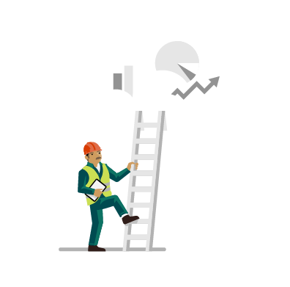
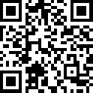

FastTrack for Azure
Maximize ACR with more deployed Azure projects
Increase the number of Azure projects your customers can build and achieve your ACR goals by offering your customers, or their partners, the expertise and personalized guidance available with FastTrack for Azure
FastTrack for Azure Engaged Accounts
2x Increase in ACR
3x ACA Acceleration
Visit GearUp to learn more
Come talk to us in
“The Hub”
https://aka.ms/fasttrackforazure
Notes:
Talk Track:
FastTrack for Azure is a customer success program for organizations with cloud projects that enables the rapid, effective design & deployment of solutions. It includes tailored guidance from Azure engineers that leverages proven practices and architectural guides. Delivered with personalized guidance from Microsoft engineers, we help your customers and partners understand the deployment details, requirements, and roles and responsibilities for your unique cloud solution. Each engagement works to remove technical roadblocks and helps your customers accelerate your cloud adoption journey.
Check out FastTrack for Azure page on GearUp or have a conversation within the Microsoft Showcase at The Hub

Slide 4
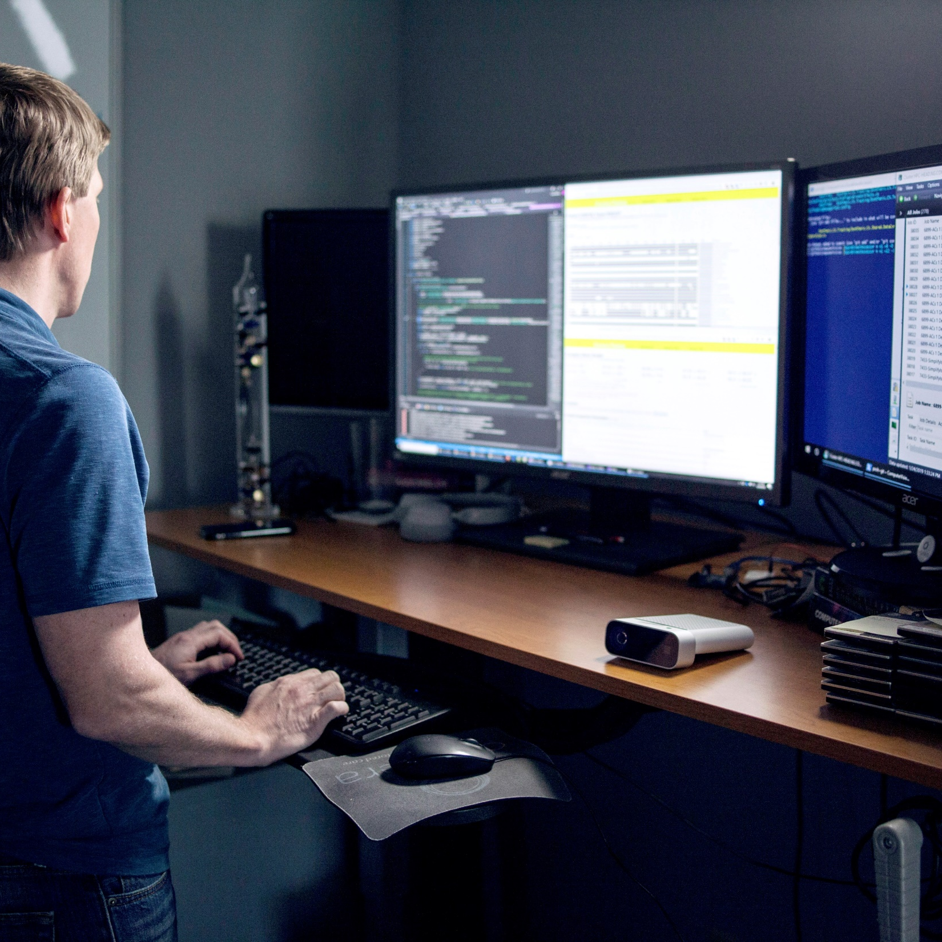
Learn more about FastTrack for Azure today!
https://aka.ms/fasttrackforazure
Notes:
Talk Track:
To get started, visit GearUp (aka.ma/fasttrackforazure) and review the eligibility criteria. If your customer has an eligible project, submit a nomination. If you have additional questions, the FastTrack for Azure team has a booth within the Microsoft Showcase at The Hub.
End

