Slide 1
“Predicting Stock Prices Is VERY HARD” -Jonathan Hersh
Jon Flees, Austin Heimos, Trent Commins, Lucca Kolberg

Slide 2


Slide 3

Motivation
Understand investors valued metrics
Predict stock price changes at the event of:
Improve margins during releases
Earnings Calls
Asset Management ratios?
Debt Management ratios?
10-K & 10-Q releases
Mere Profitability?
Useful for day traders
Important for investors margins

Slide 4
Dataset
NYSE
Fundamentals
Stock Price
Volume
Annual Percentage Change
Balance Sheet
Income Statement
Statement of Cash Flows
New York Stock Exchange (kaggle)
437 tickers
2 merged datasets
2012 → 2017

Slide 5

Data Cleaning
Year-end metrics
10-K
Stock Price
% Change
Attempted raw values but received better results from % changes
Logs
IPO’s
Normalized data through logs
High variance in stock prices
Removed IPO’s starting in January 2012
Did not allow to calculate % change

Slide 6
Multicollinearity
Total Liabilities
Total Assets
Gross Margin / Operating Income / Pre-Tax Margin
Net Cash Flows from Investing
Cause of Correlation
Metrics in Balance Sheet, Income Statement and Statement of Cash Flows
14/73 variables deleted
Criteria: VIF > 5.0

Slide 7
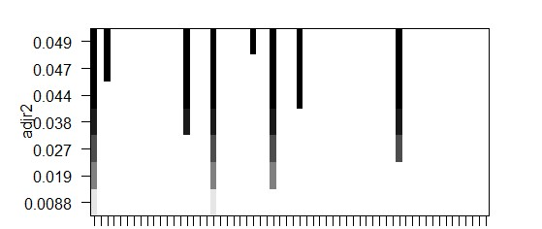
Forward Stepwise
Choice of variable to add may be lowest p-value
Highest increase in adjusted R^2
Hopefully would give us best predicting variables
Equity Earnings Loss Unconsolidated Subsidiary
Other Liabilities
Inventory
Long-Term Debt
Net Cash Flow
Accounts Payable
Depreciation

Slide 8
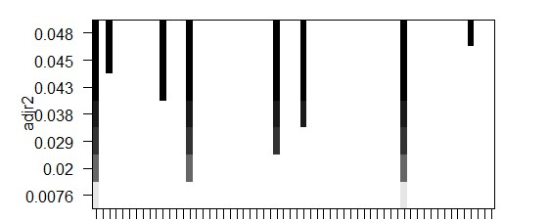
Backward Stepwise
Depreciation
Other Liabilities
Long-Term Debt
Choice of variable to remove may be one that has lowest p-value
Highest increase in adjusted R^2
Similar results to Forward
Looking for local vs global max
Net Cash Flow
Accounts Payable
Common Stock
Equity Earnings Loss Unconsolidated Subsidiary

Slide 9
Similarity: Forward and Backward Stepwise
Forward
Backward
Accounts Payable
Accounts Payable
Depreciation
Long-Term Debt
Net Cash Flow
Other Liabilities
Equity Earnings Loss Unconsolidated Subsidiary
Inventory
Common Stock
Depreciation
Long-Term Debt
Net Cash Flow
Other Liabilities
Equity Earnings Loss Unconsolidated Subsidiary

Slide 10
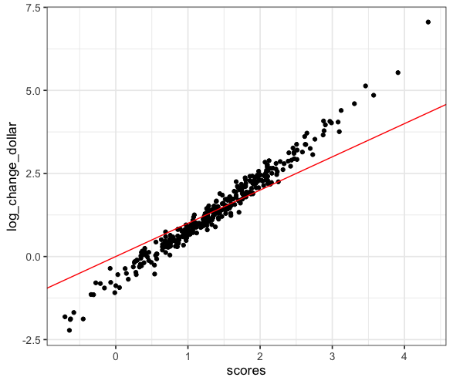
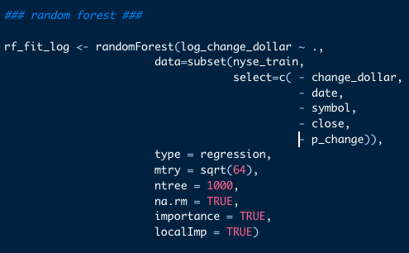
Random Forest
Seemed very good on training data…

Slide 11
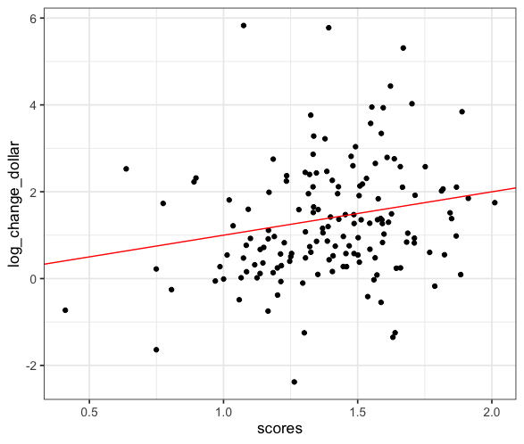
Random Forest
Seemed very good on training data…
A little too good
Lasso?
Ridge?
Elastic Net?

Slide 12
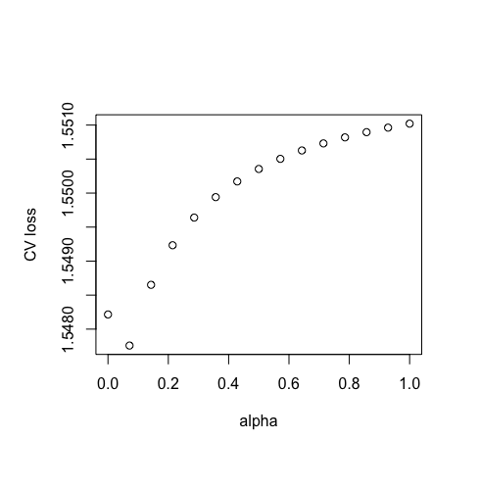
Elastic Net
Conclusion from graph: use Elastic Net
Alpha = 0.1

Slide 13
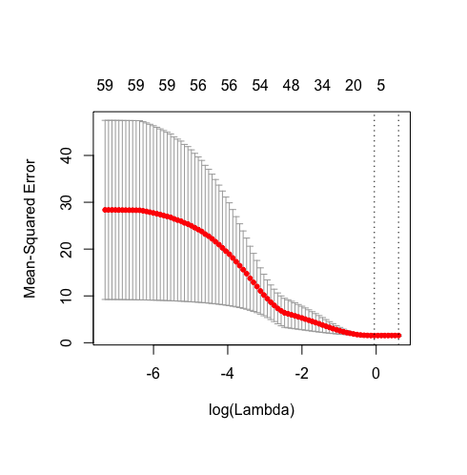
Elastic Net
Shows that one variable is better than all other variables
Same prediction for every observation
All values yielded a value at e^-38 or smaller
Better to use the intercept rather than any value

Slide 14
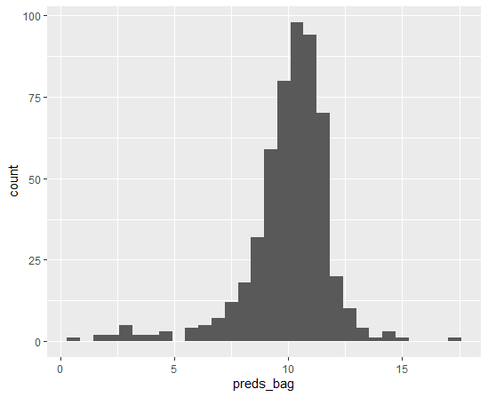
Bagging
Repeatedly sampling from training set
Reduce variance
Prediction: The amount of times the prediction variables are chosen to be included

Slide 15
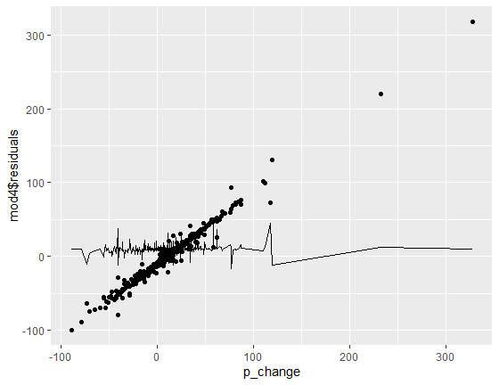
Least Square’s
Simple model beats more sophisticated model?
Depreciation
LT Investments
Total Current Assets
Short Term Debt Portion of Current Debt
Net Cash Flow
Interest Expense
VERY simple model beats simple model?

Slide 16

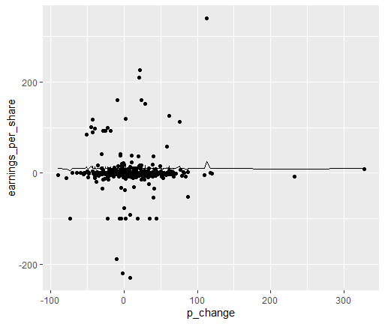

Least Square’s - EPS

Slide 17
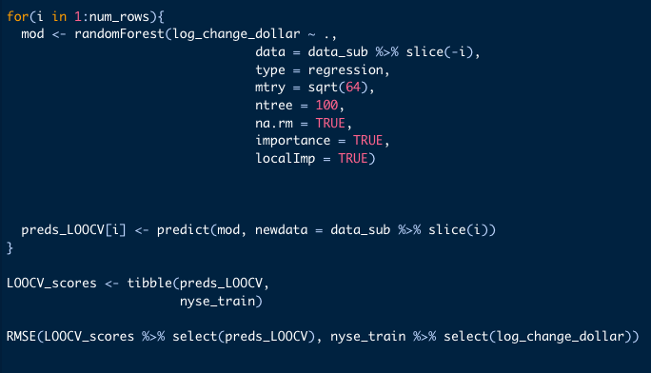
Random Forest (with LOOCV)
Why not try a LOOCV?
Reduce bias
Reduce randomness of training and test split

Slide 18
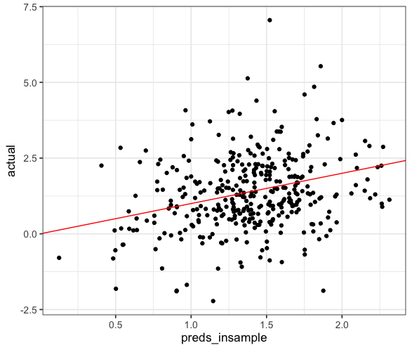
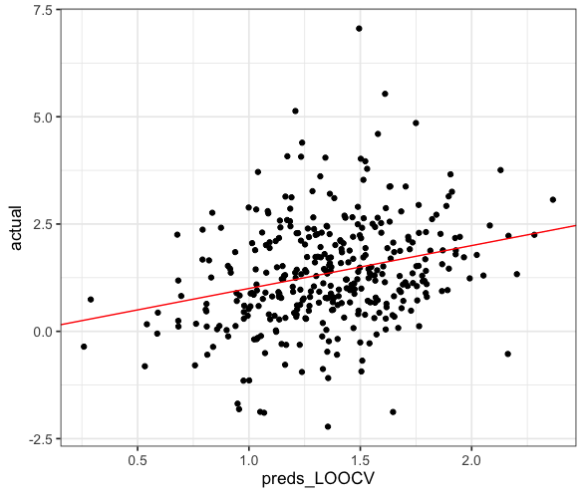

Random Forest (with LOOCV)

Slide 19

Conclusions
Idea for how to fix in the future
More Comprehensive Data
Stock Prices cannot be predicted by our metrics alone
More accurate data
Larger (or cleaner) dataset
Dummy Variables accounting for qualitative signs
Speculation
Product Releases

Slide 20

Get rich predicting stock prices
Stay humble

