Slide 1

08/03/2025
INSY 8413 – Introduction to Big Data Analytics
Analyzing IMDb Movie Ratings Using Logistic Regression
“Predicting High-Rated vs Low-Rated Movies Based on Runtime, Year, and Popularity”
Presented By:
Munezero Irakoze Luccin
Student ID:
25815

Slide 2
PROBLEM DEFINITION
Problem Statement:
Can we identify patterns in highly-rated movies by analyzing their genres, release years, and runtimes using IMDb open data?
Goal:
To understand what features correlate with high movie ratings and attempt to predict whether a movie is likely to be highly rated.

Slide 3
DATASET DETAILS
Field | Value
Dataset Title: | IMDb Open Data (title.basics & title.ratings)
Source | IMDb Dataset (https://www.imdb.com/interfaces/)
Rows (after filtering) | ~58,000 movies
Format | Structured (.tsv files)
Preprocessing | Merging, filtering, cleaning, scaling

Slide 4
DATA PREPOCESSING (Python)
Filtered to only include titleType = ‘movie’
Removed nulls, short films, and edge cases
Converted startYear and runtimeMinutes to numeric
Merged ratings file using tconst
Created a binary target: highRated (1 if rating ≥ 7)
Used pandas, matplotlib, seaborn, sklearn
Train/test split: 80/20
Handled class imbalance using class_weight=’balanced’

Slide 5
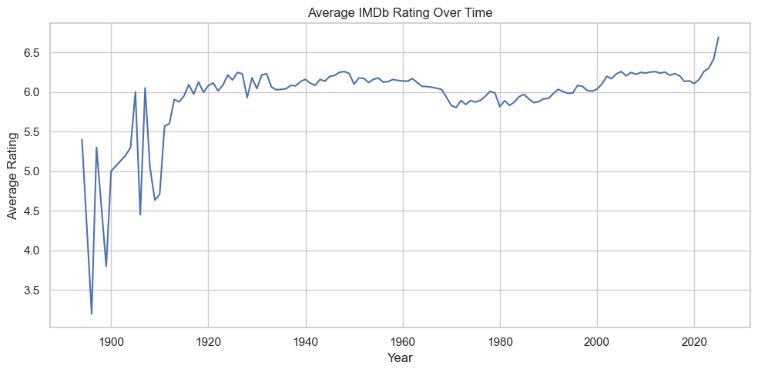
EXPLORATORY DATA ANALYSIS (EDA)
INSIGHTS
Ratings peaked around the early 2000s

Slide 6
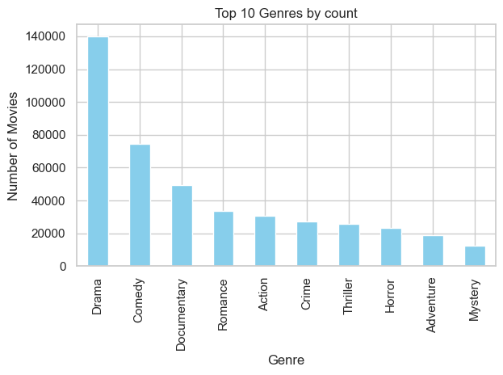
EXPLORATORY DATA ANALYSIS (EDA)
INSIGHTS
Top genres: Drama, Comedy, Documentary

Slide 7
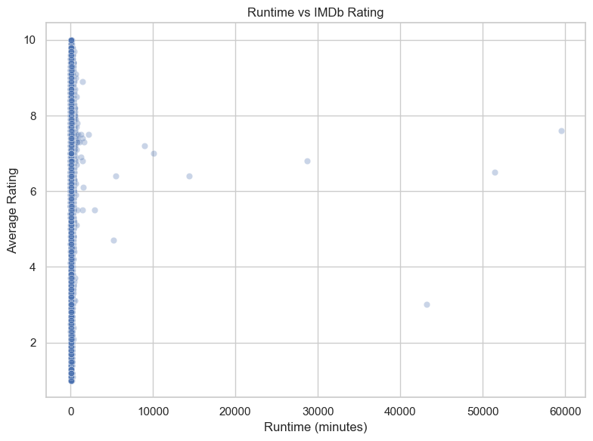
EXPLORATORY DATA ANALYSIS (EDA)
INSIGHTS
Runtime has weak correlation with rating

Slide 8
MACHINE LEARNING MODEL
Model used: Logistic Regression
Target: Predict if a movie is “high-rated” (IMDb rating ≥ 7)
Features: runtimeMinutes, startYear, numVotes (log-transformed)
Data Handling:
Used class_weight='balanced' for class imbalance
Applied StandardScaler for normalization
Why Logistic Regression? Simple, interpretable binary classification to serve as a baseline.

Slide 9
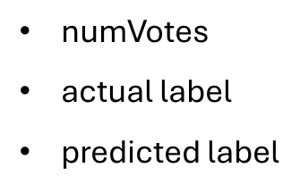
MODEL EVALUATION
Focus:
Prioritized recall on high-rated movies.
Interpretation:
Many false positives (low-rated predicted as high)
Decent recall for high-rated class
Metric | High-Rated (1) | Low-Rated (0)
Precision | 33% | 80%
Recall | 72% | 44%
Accuracy | 52% Overall
Exported Predictions
Added actual and predicted labels to the test set
Reversed scaling on numerical features
Exported results as imdb_predictions.csv
Used in Power BI for interactive insights
Features in CSV:
runtimeMinutes
startYear

Slide 10
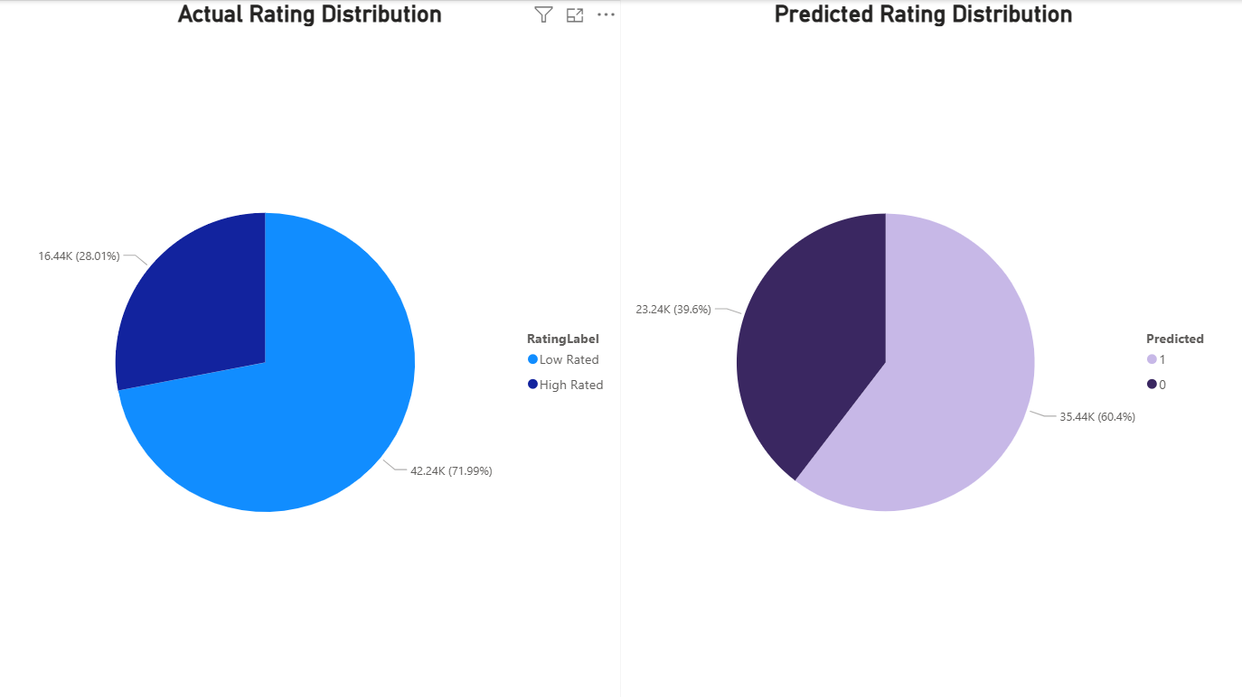
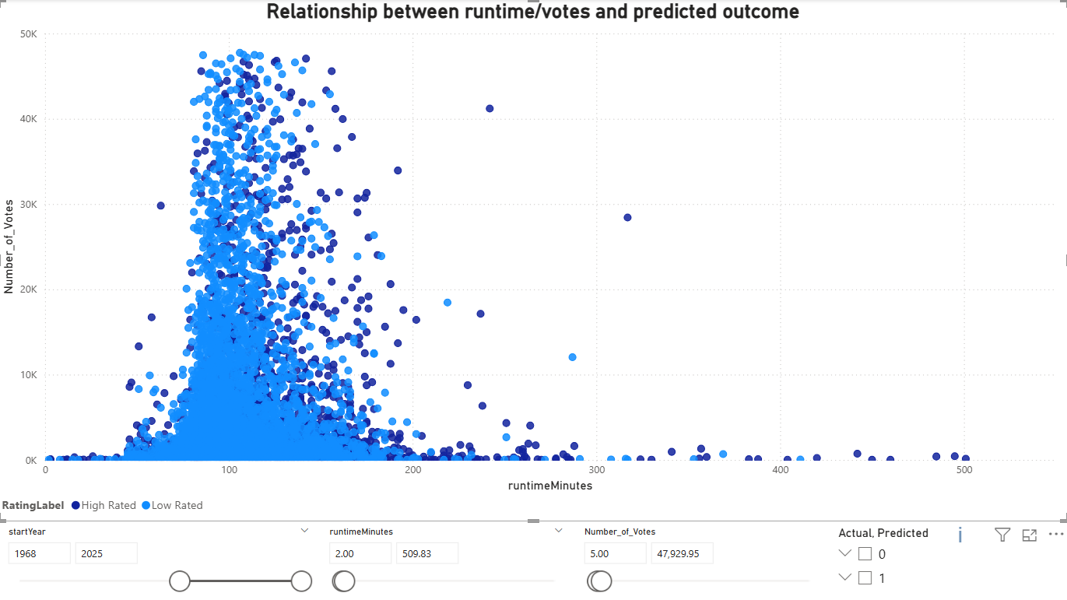
POWER BI DASHBOARD
Data Exported from Python:
Cleaned dataset with movie titles, genres, ratings, years, runtime
ML predictions for high/low-rated class (optional)
Visual Elements in Power BI:
Pie charts: Actual vs Predicted class distributions
KPI cards: Accuracy & Recall
Scatter plot: Runtime vs Votes colored by prediction
Table: Misclassified examples
Slicers: Year, Actual class, Predicted class
Interactive Filters:
Year range slicer
Genre slicer

Slide 11
Innovation Component (What Makes This Unique)
Used real-world open data from IMDb
Built a predictive model using Logistic Regression with class weighting
Included numVotes feature, recognizing viewer engagement as a predictive factor
Exported ML results to Power BI for extended insights
Explored genre-based trends and modeling without complex tools — showing real Big Data thinking in a lightweight form

Slide 12
KEY INSIGHTS | LIMITATIONS | FUTURE WORK
KEY INSIGHTS
Votes (popularity) had stronger correlation with rating than runtime or year
Logistic Regression captured 72% of high-rated movies, but with 33% precision
Imbalanced classes and limited features constrained performance
Misclassifications were common in borderline-rated or low-vote movies
LIMITATIONS
Only metadata used (no genres, cast, or text)
Linear model lacks complexity to capture nonlinear relationships
Class imbalance affected accuracy
Movie ratings are subjective and influenced by external trends (e.g. hype, politics)
FUTURE WORK
Try advanced models (Random Forest, XGBoost)
Add genre, director, cast, or text analysis (NLP)
Tune thresholds to improve precision-recall balance
Visualize time trends: Ratings by decade or genre

Slide 13



CONCLUSION
Built a baseline model that performs reasonably with minimal inputs
Demonstrated the feasibility of predicting movie success using only numeric metadata
Created an interactive dashboard for classification insights

Slide 14
THANK YOU!!
Feel free to ask any questions!

