Slide 1
VTC · CRM
Vision Technologies CRM
Final Exam Project — Full Documentation (Phases 1–4)
Author: MUNEZERO IRAKOZE Luccin · Student ID 25815
Course: SENG 8240 — Best Programming Practices and Design Patterns
Instructor: Rutarindwa Jean Pierre
Period: Academic Year 2025 / 2026, Semester II

Slide 2
OVERVIEW
Project Overview
A web-based CRM for Vision Technologies Company Ltd
Built with Vue.js 3 + Spring Boot 3 + MySQL 8 + Docker
Applies the MVC architectural pattern end-to-end
Delivered in four phases: Analysis → Prototype → Containerisation → Testing
Vision Technologies CRM · Full Documentation Deck
Slide 2 / 40

Slide 3
AGENDA
What this deck covers
Phase 1 — Case study & system analysis
Phase 2 — Software prototype, design pattern, coding standards
Phase 3 — Dockerisation & version control
Phase 4 — Software test plan
Live demo: login → dashboard → leads → tickets → reports
Vision Technologies CRM · Full Documentation Deck
Slide 3 / 40

Slide 4
PHASE 1 · §1 CASE STUDY
Vision Technologies Company Ltd (VTC)
East-African integrator: Security Systems, IT & Telecom, ICT, Low-Voltage
Data-centre design, build and support
Customers: banks, telecoms, hospitals, manufacturing, government
Operates across Rwanda, Kenya, Uganda, Burundi
Vision Technologies CRM · Full Documentation Deck
Slide 4 / 40

Slide 5
PHASE 1 · §3 PAIN POINTS
Why VTC needs a CRM
Fragmented customer data across Excel, WhatsApp, e-mail
Lost leads; no pipeline visibility
Unstructured support workflow, SLA breaches
No interaction history per customer
Manual, late, inconsistent reporting
Vision Technologies CRM · Full Documentation Deck
Slide 5 / 40

Slide 6
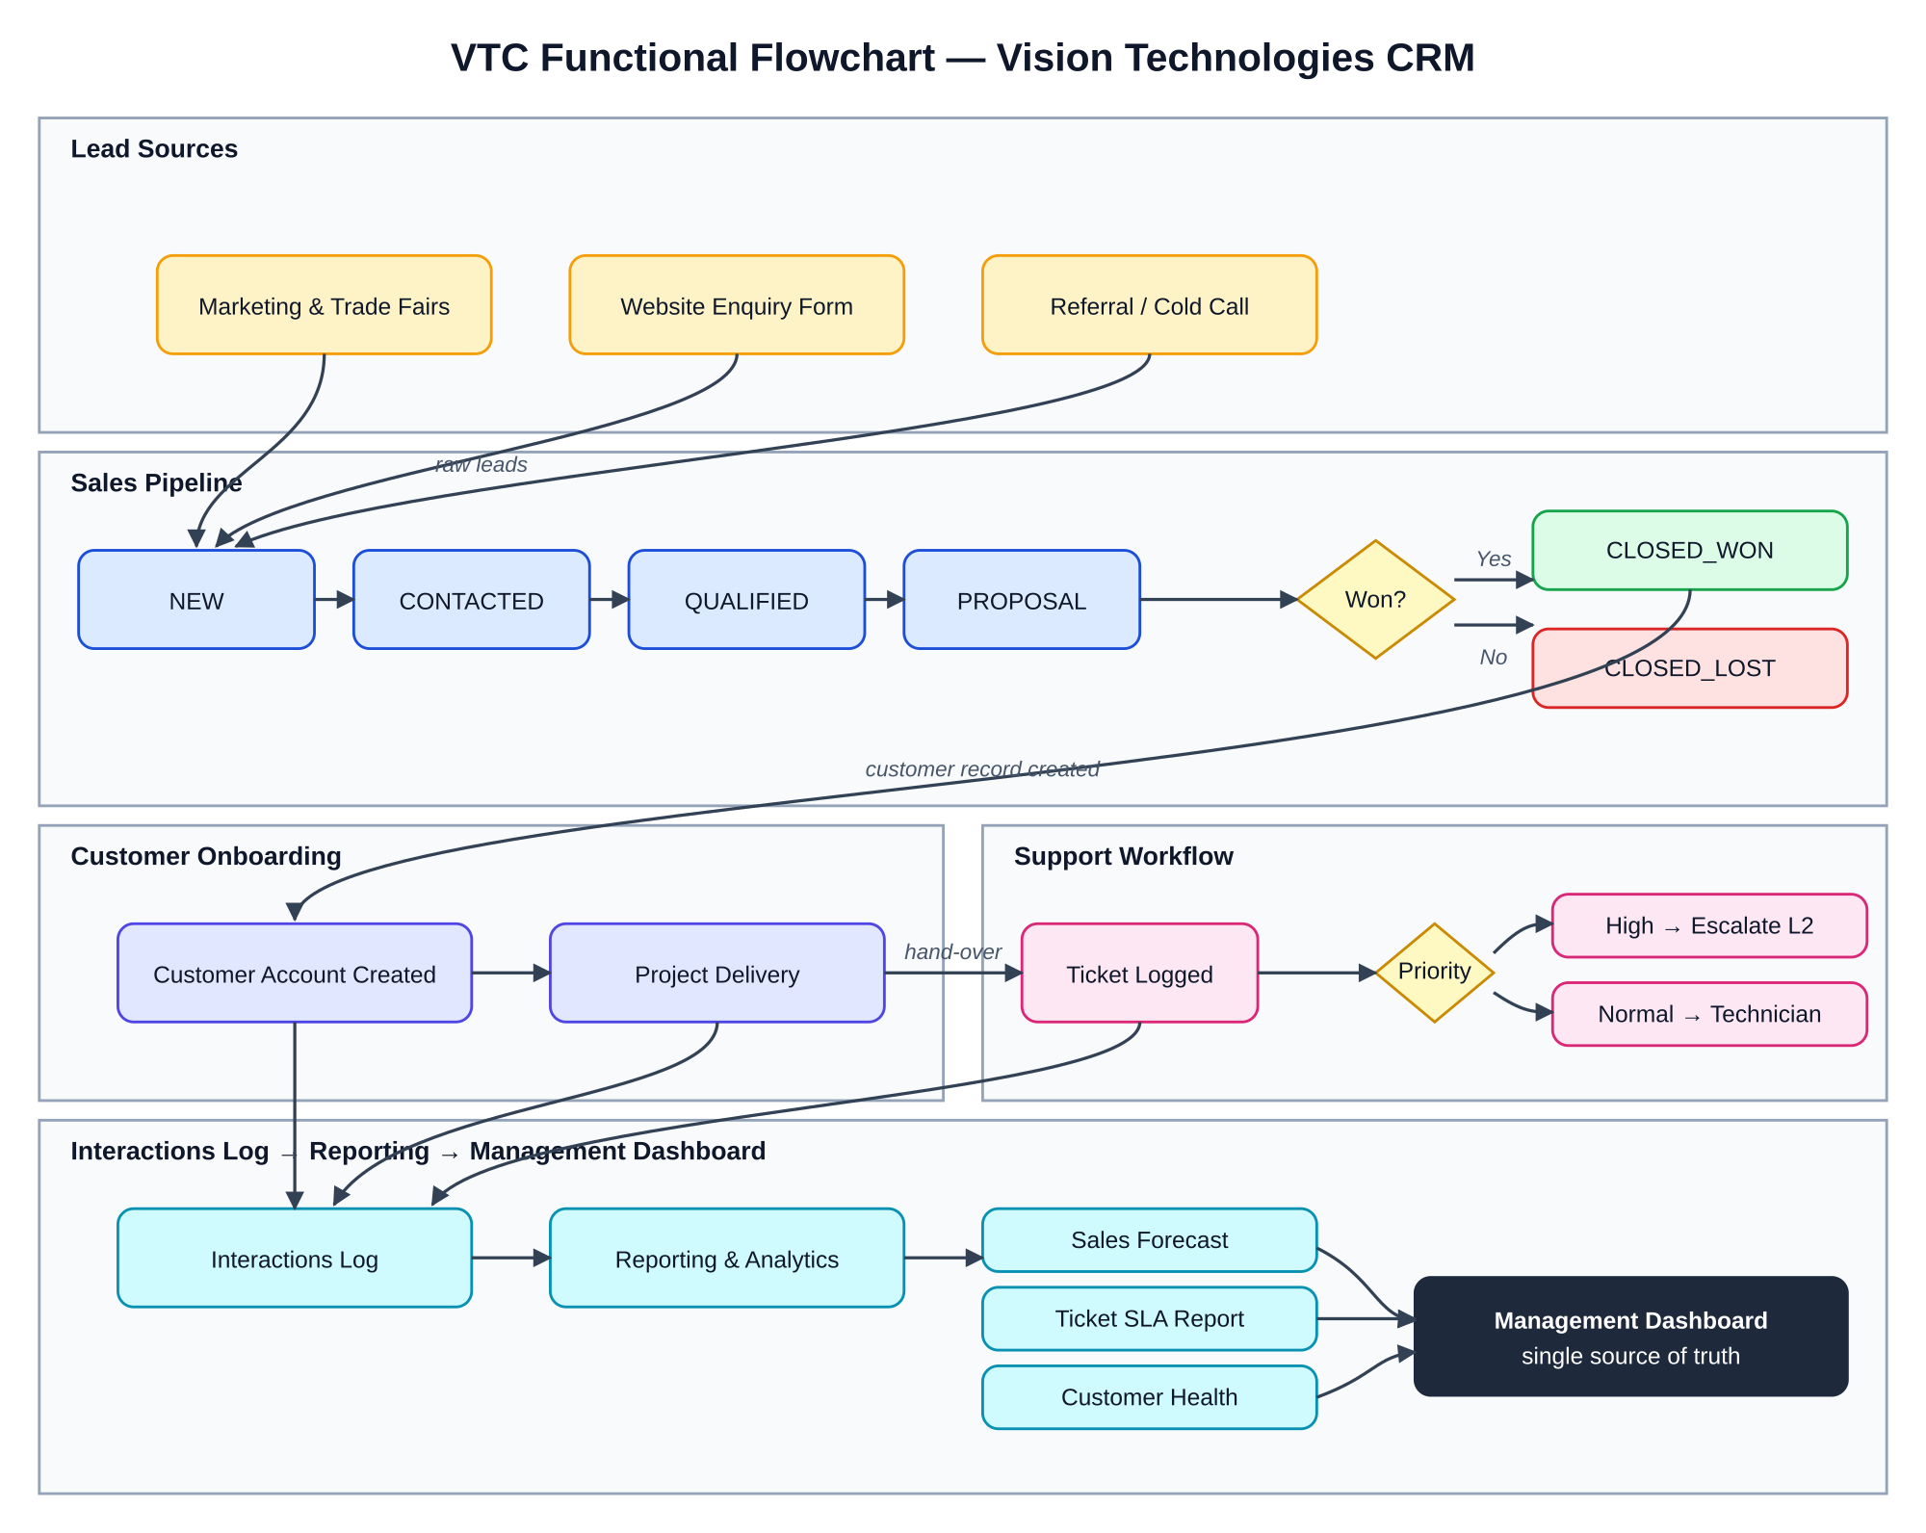
PHASE 1 · §2 FUNCTIONAL FLOW
Functional Diagram of VTC
Lead capture → sales pipeline → customer onboarding → support → reporting
Vision Technologies CRM · Full Documentation Deck
Slide 6 / 40

Slide 7
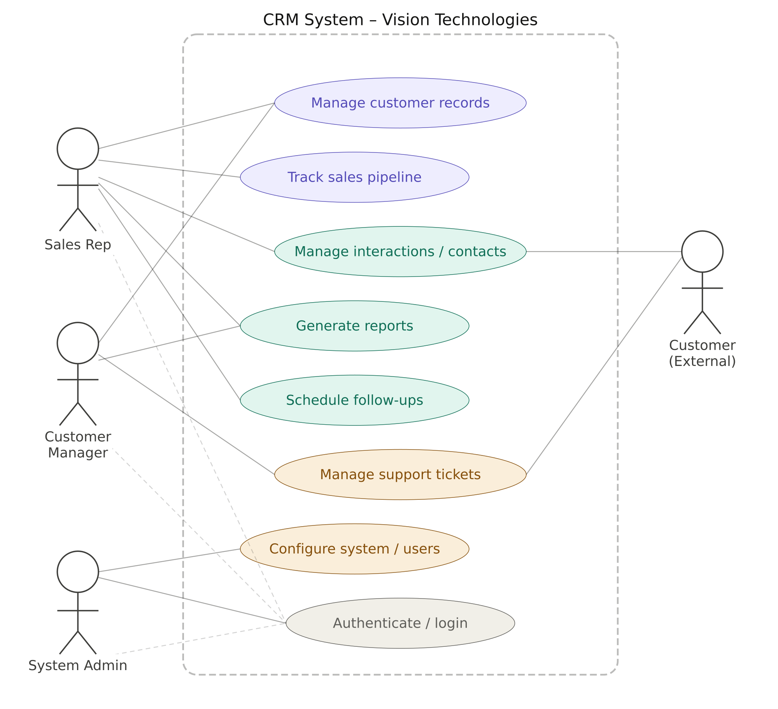
PHASE 1 · §4.1 USE CASE
Use Case Diagram
Actors: Admin, Sales Rep, Support Engineer, Manager, Customer
Vision Technologies CRM · Full Documentation Deck
Slide 7 / 40

Slide 8
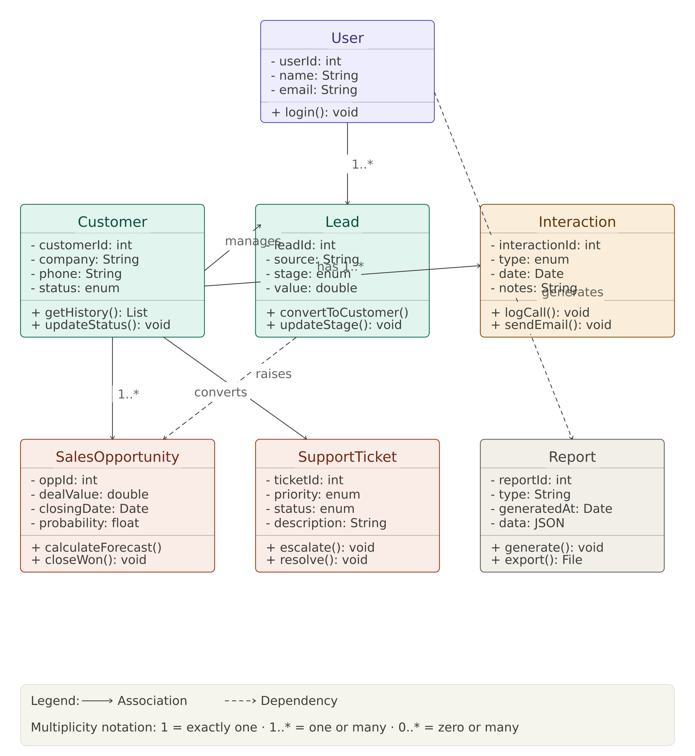
PHASE 1 · §4.2 CLASS MODEL
Class Diagram
Six entities, five enumerations, Customer as aggregate root
Vision Technologies CRM · Full Documentation Deck
Slide 8 / 40

Slide 9
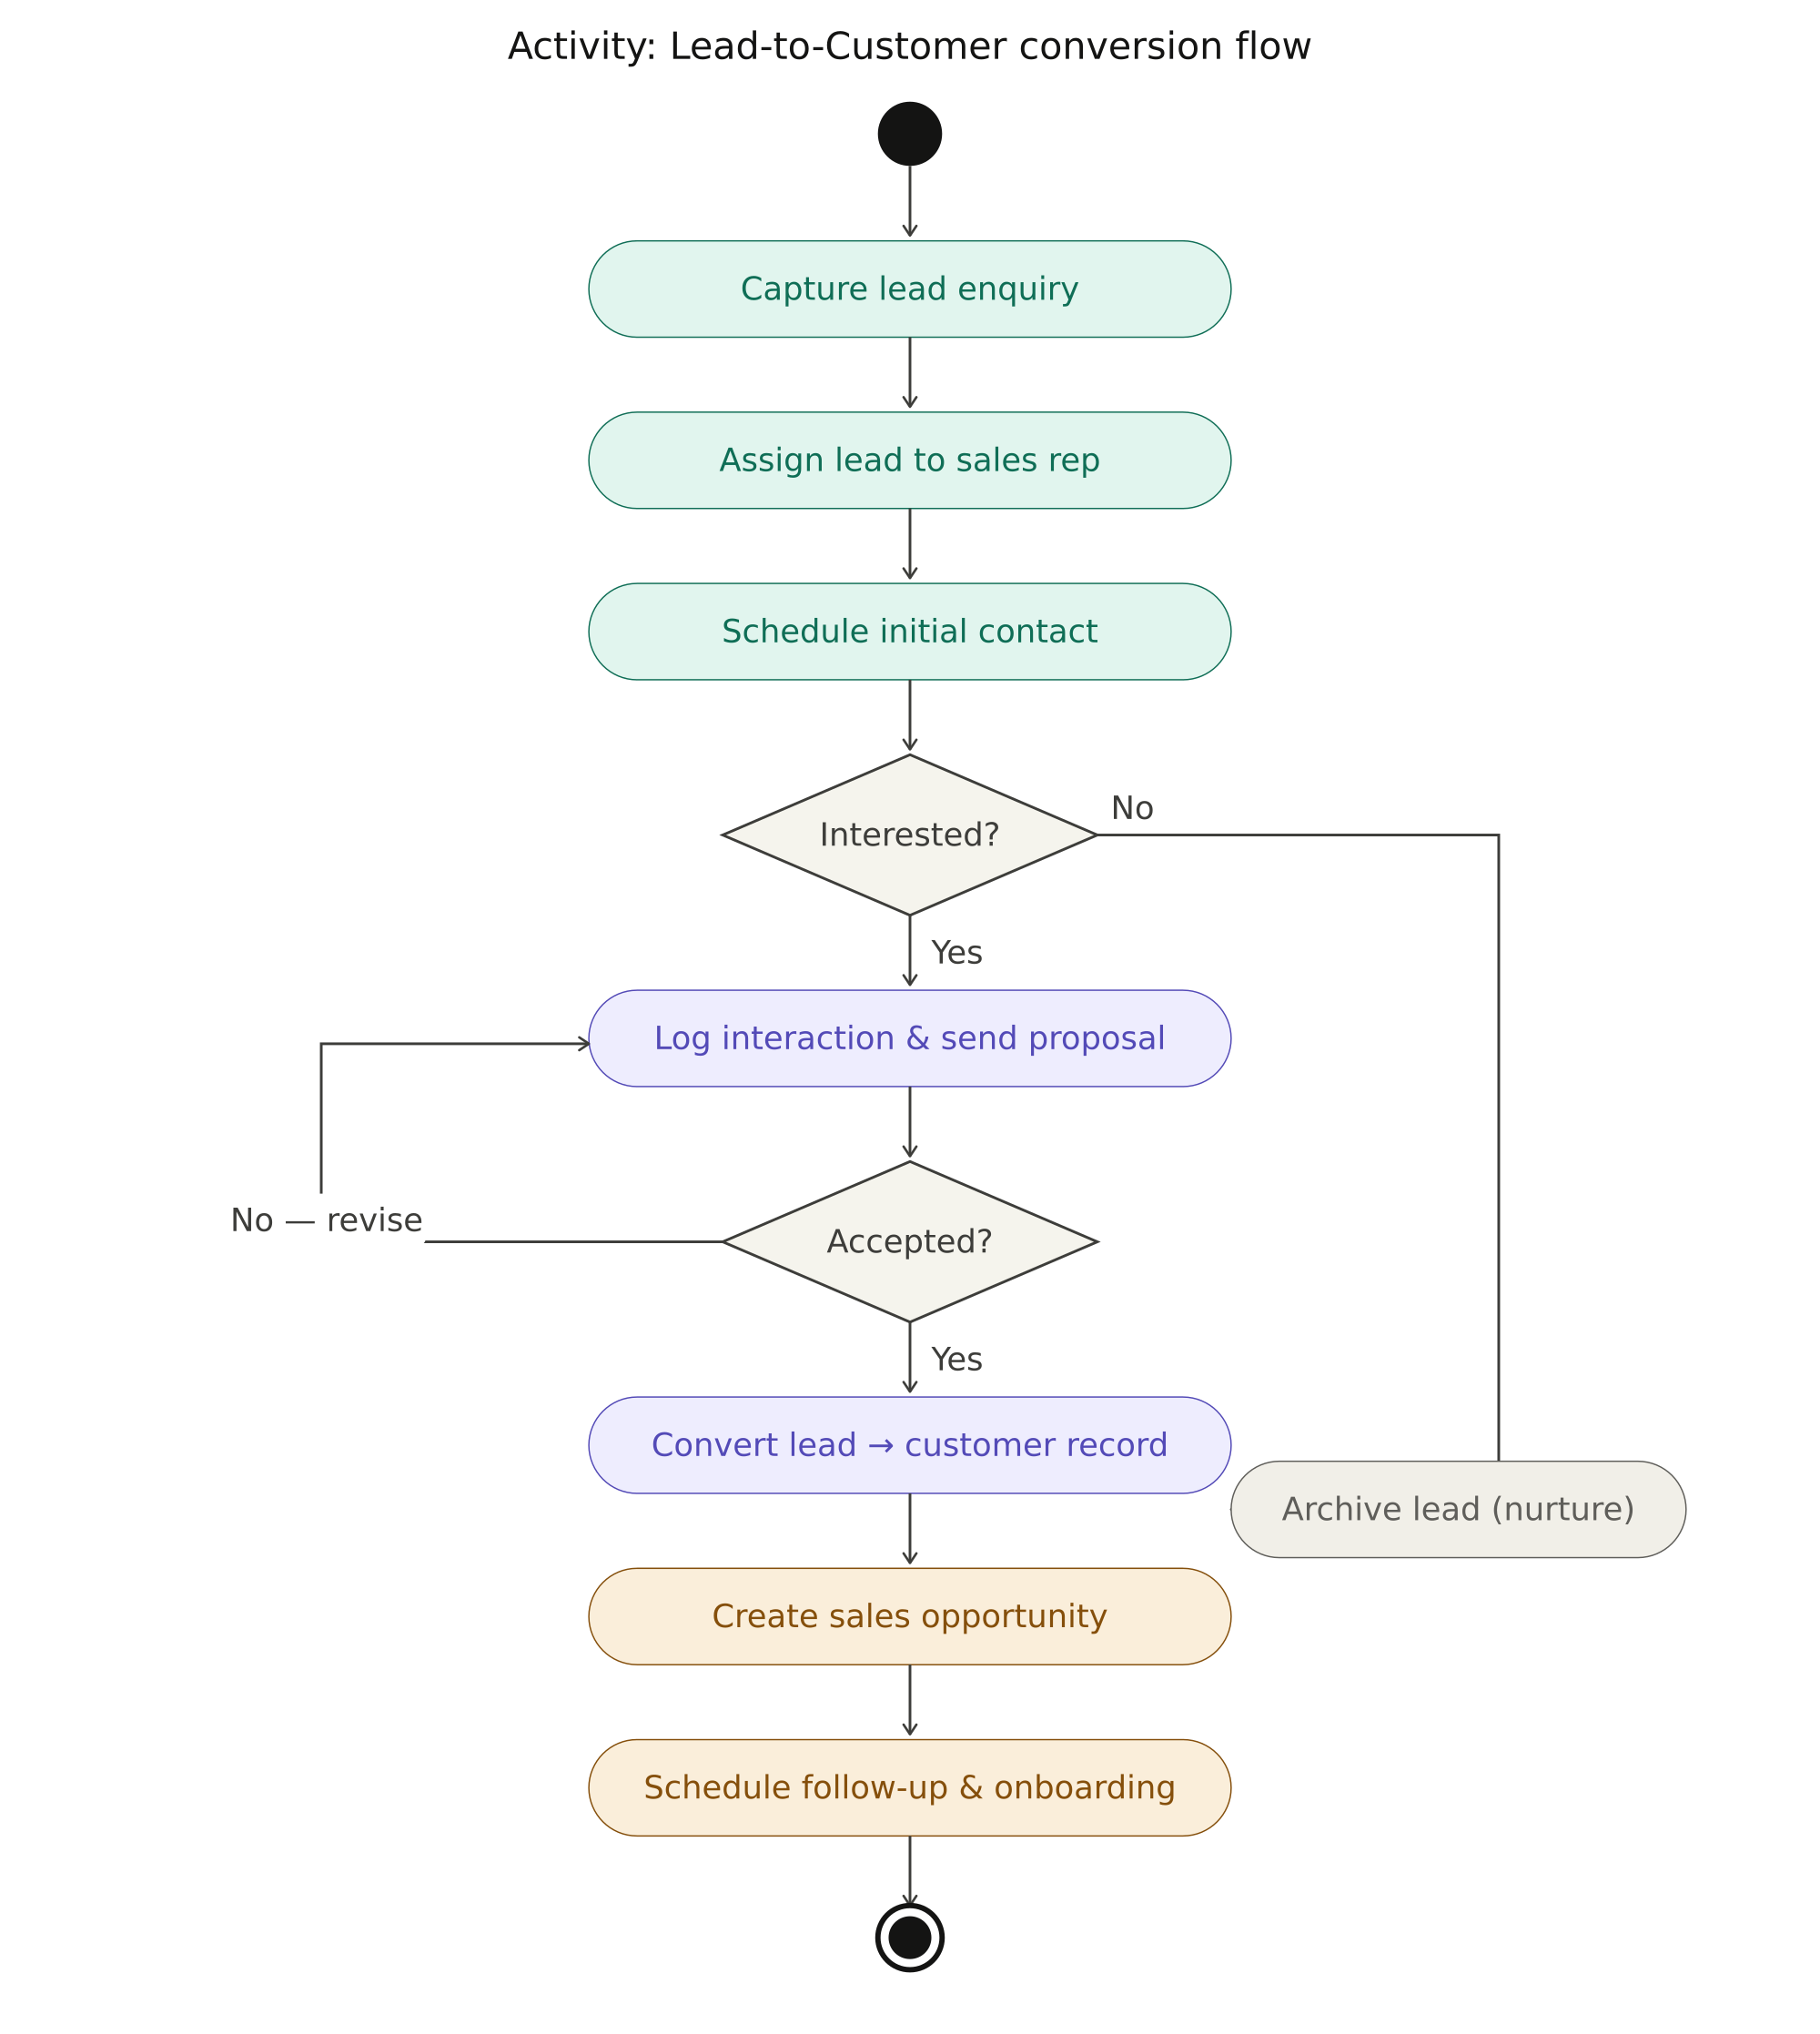
PHASE 1 · §4.3 ACTIVITY
Activity Diagram — Lead → Customer
Branches for Closed-Lost and not-qualified loops
Vision Technologies CRM · Full Documentation Deck
Slide 9 / 40

Slide 10
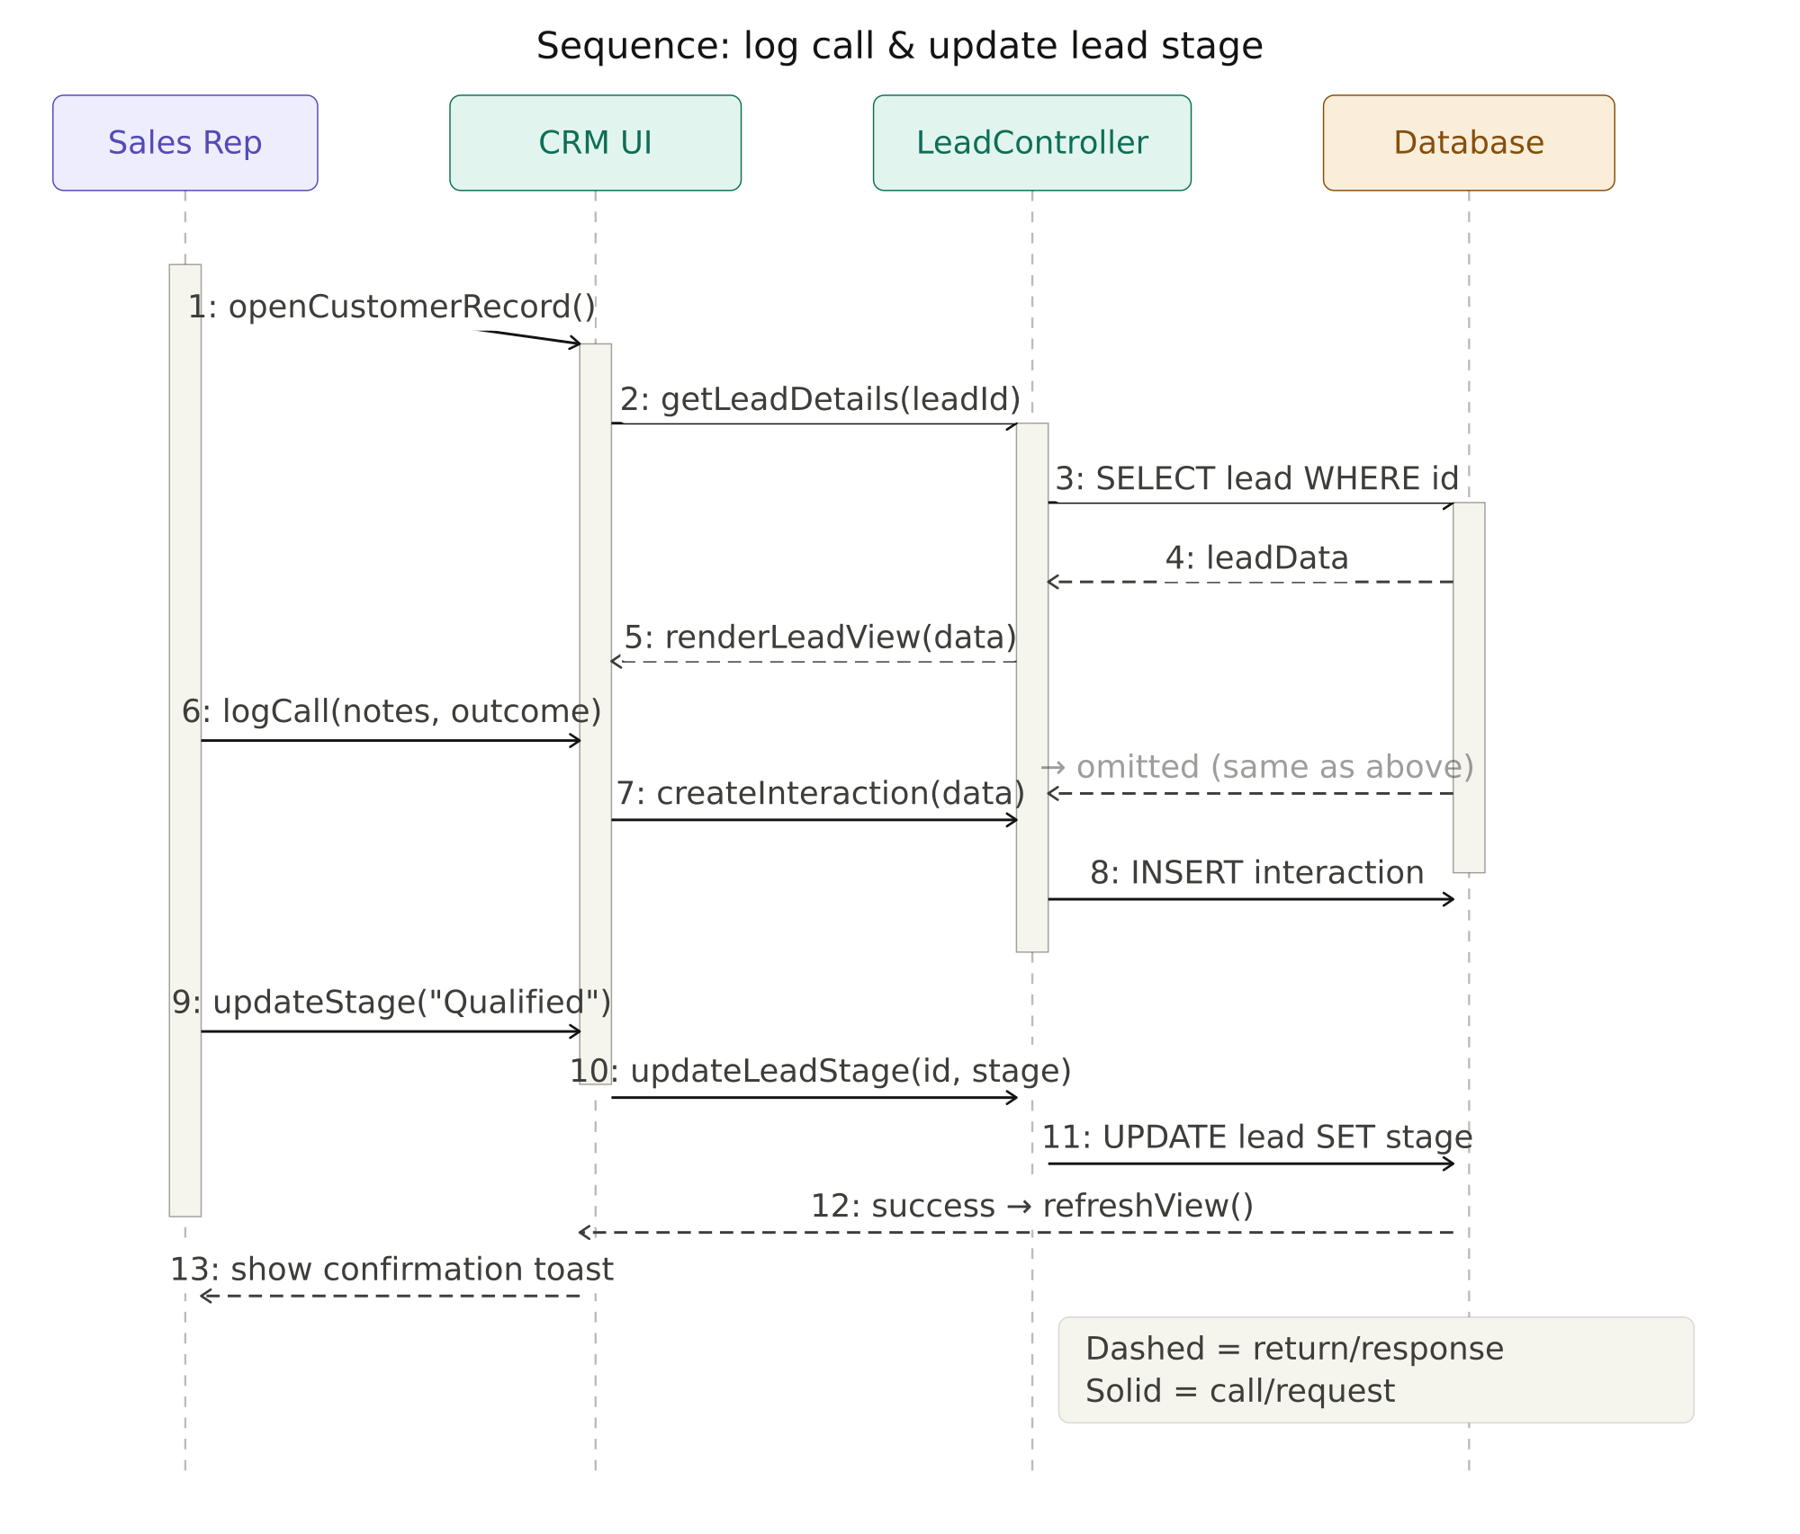
PHASE 1 · §4.4 SEQUENCE
Sequence Diagram — Log call & update stage
Sales Rep → Vue UI → REST API → Service → MySQL
Vision Technologies CRM · Full Documentation Deck
Slide 10 / 40

Slide 11
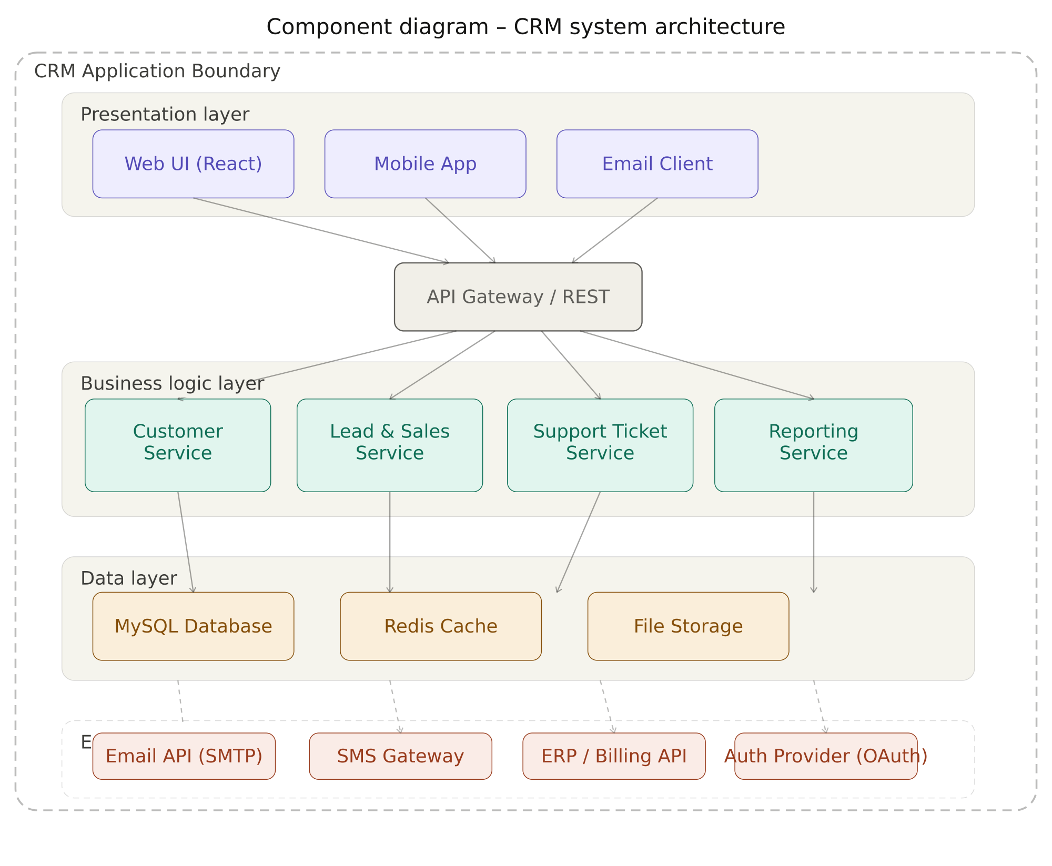
PHASE 1 · §4.5 DEPLOYMENT
Component Diagram — Containers & Network
Three Docker containers · private bridge network · named volume mysql_data
Vision Technologies CRM · Full Documentation Deck
Slide 11 / 40

Slide 12
PHASE 2 · STACK
Tech Stack
Frontend
Backend
Data + Build
Vue 3 (Composition API)
Vite + Vue Router 4 + Pinia
Tailwind CSS + Chart.js
Spring Boot 3 + Spring Security
Spring Data JPA + Lombok
JWT-based stateless auth
MySQL 8 with InnoDB
Maven + npm
Docker Compose orchestration
Vision Technologies CRM · Full Documentation Deck
Slide 12 / 40

Slide 13
PHASE 2 · FOLDER TREE
Project Folder Structure
Top-level: backend/, frontend/, docs/, docker-compose.yml
Backend packages: controller · service · repository · model · dto · mapper · security · config · exception
Frontend folders: views · components · stores · router · services
Full tree in docs/FOLDER_TREE.md
Vision Technologies CRM · Full Documentation Deck
Slide 13 / 40

Slide 14
PHASE 2 · PROTOTYPE 1/4
Login Screen
(missing image: MISSING-SCREENSHOT-login.png)
[Replace with screenshot of LoginPage.vue — email + password form with inline validation]
Vision Technologies CRM · Full Documentation Deck
Slide 14 / 40

Slide 15
PHASE 2 · PROTOTYPE 2/4
Dashboard — KPI Cards & Recent Activity
(missing image: MISSING-SCREENSHOT-dashboard.png)
[Replace with screenshot of DashboardPage.vue — 4 KPI cards, leads-by-stage, recent activity feed]
Vision Technologies CRM · Full Documentation Deck
Slide 15 / 40

Slide 16
PHASE 2 · PROTOTYPE 3/4
Leads Kanban + Customers Table
(missing image: MISSING-SCREENSHOT-leads-customers.png)
[Replace with two side-by-side screenshots: LeadsPage.vue Kanban + CustomersPage.vue table]
Vision Technologies CRM · Full Documentation Deck
Slide 16 / 40

Slide 17
PHASE 2 · PROTOTYPE 4/4
Tickets + Reports
(missing image: MISSING-SCREENSHOT-tickets-reports.png)
[Replace with screenshots of TicketsPage.vue + ReportsPage.vue (bar + pie chart, CSV export)]
Vision Technologies CRM · Full Documentation Deck
Slide 17 / 40

Slide 18
PHASE 2 · USER JOURNEYS
Three Representative User Journeys
Sales rep: Login → Dashboard → Customers → Add → Edit → Delete → Logout
Sales rep: Login → Leads → Create lead → Drag to Qualified → Reports
Support engineer: Login → Tickets → Create → Escalate → Resolve
Vision Technologies CRM · Full Documentation Deck
Slide 18 / 40

Slide 19
PHASE 2 · DESIGN PATTERN
Design Pattern — MVC End-to-End
Model
View
Controller
JPA entities (User, Customer, Lead…)
Pinia stores on the frontend
DTOs guard the boundary
Vue Single-File Components
JSON returned by REST API
Reusable shared components
Spring @RestController + Service
Vue Router + store actions
JWT filter & exception handler
Vision Technologies CRM · Full Documentation Deck
Slide 19 / 40

Slide 20
PHASE 2 · MVC — MODEL
Model layer in code
JPA entities: User, Customer, Lead, Interaction, SupportTicket, SalesOpportunity
Enumerations: Role, LeadStage, InteractionType, Priority, TicketStatus
Pinia stores: auth.js, customer.js, lead.js
Reference: docs/DESIGN_PATTERN.md §1
Vision Technologies CRM · Full Documentation Deck
Slide 20 / 40

Slide 21
PHASE 2 · MVC — VIEW
View layer in code
Pages: Login, Dashboard, Customers, CustomerDetail, Leads, Interactions, Tickets, Reports
Reusable components: AppShell, AppNavbar, AppSidebar, CustomerCard, LeadCard, TicketBadge…
Single-File Components with <script setup>
Reference: docs/DESIGN_PATTERN.md §2
Vision Technologies CRM · Full Documentation Deck
Slide 21 / 40

Slide 22
PHASE 2 · MVC — CONTROLLER
Controller layer in code
REST controllers map URL → service → response
Service classes hold business logic
Repository interfaces handle persistence
Reference: docs/DESIGN_PATTERN.md §5 — How a request flows
Vision Technologies CRM · Full Documentation Deck
Slide 22 / 40

Slide 23
PHASE 2 · CODING STANDARDS
Coding Standards — Backend
Google Java Style Guide: 4-space indent, ≤ 100 cols, UpperCamelCase classes
lowerCamelCase methods, no wildcard imports
Lombok for boilerplate: @Getter, @Builder, @Data
Javadoc on every public class; comments for non-obvious logic only
Vision Technologies CRM · Full Documentation Deck
Slide 23 / 40

Slide 24
PHASE 2 · CODING STANDARDS
Coding Standards — Frontend
Vue.js Style Guide: multi-word component names, <script setup>, typed props
:key on every v-for
Tailwind utility classes + project-wide @layer components
Reference: docs/CODING_STANDARDS.md §2
Vision Technologies CRM · Full Documentation Deck
Slide 24 / 40

Slide 25
PHASE 3 · CONTAINERS 101
What is a Container?
A lightweight, isolated process bundling app + dependencies
Shares the host kernel — starts in milliseconds, small footprint
Same image runs identically on every machine
VMs ship a full OS — containers ship just the app
Vision Technologies CRM · Full Documentation Deck
Slide 25 / 40

Slide 26
PHASE 3 · WHY DOCKER
Why Docker for this project?
Eliminates 'works on my laptop' issues
Examiner needs only Docker + Git to run the system
Volumes guarantee data persists across container restarts
Compose orchestrates the three services with one command
Vision Technologies CRM · Full Documentation Deck
Slide 26 / 40

Slide 27
PHASE 3 · DOCKERISATION
Dockerisation steps (general)
Choose base images: eclipse-temurin:17-jdk-alpine, node:18-alpine, nginx:alpine, mysql:8
Write a Dockerfile per service (multi-stage for compiled languages)
Build with docker build
Compose multiple containers with docker-compose.yml
Run with docker compose up --build
Vision Technologies CRM · Full Documentation Deck
Slide 27 / 40

Slide 28
PHASE 3 · COMPOSE
docker-compose architecture
Three services on vtc-net · named volume mysql_data · health checks gate the frontend
Vision Technologies CRM · Full Documentation Deck
Slide 28 / 40

Slide 29
PHASE 3 · BACKEND DOCKERFILE
Backend Dockerfile — multi-stage build
Stage 1: Maven + JDK 17 → mvn -B -DskipTests package
Stage 2: eclipse-temurin:17-jdk-alpine runs the fat jar
HEALTHCHECK calls /actuator/health every 20s
Final image < 250 MB
Vision Technologies CRM · Full Documentation Deck
Slide 29 / 40

Slide 30
PHASE 3 · FRONTEND DOCKERFILE
Frontend Dockerfile — NGINX serves the SPA
Stage 1: node:18-alpine → npm run build
Stage 2: nginx:alpine serves /dist and proxies /api/* to backend
SPA fallback try_files $uri $uri/ /index.html
Vite hashed assets cached for one year
Vision Technologies CRM · Full Documentation Deck
Slide 30 / 40

Slide 31
PHASE 3 · VERSION CONTROL
Git Setup & Branching
git init · .gitignore for Java + Vue + Docker · first commit
Branches: main (stable) · develop (integration) · feature/* per feature
Push to GitHub via git remote add origin && git push -u origin main develop
Full guide in docs/GIT_GUIDE.md
Vision Technologies CRM · Full Documentation Deck
Slide 31 / 40

Slide 32
PHASE 3 · COMMITS
Conventional Commits — feat / fix / docs / test / chore
(missing image: MISSING-SCREENSHOT-git-log.png)
[Replace with screenshot of `git log --oneline --graph --all` after initial push]
Vision Technologies CRM · Full Documentation Deck
Slide 32 / 40

Slide 33
PHASE 4 · §1 + §2
Test Plan Summary
Objectives O1–O8 align 1-to-1 with system requirements
Scope: backend API, frontend SPA, JWT/CORS, MySQL persistence, Docker stack
Out of scope: SMS/e-mail, multi-tenancy, full pen-testing
Reference: docs/TEST_PLAN.md §1 + §2
Vision Technologies CRM · Full Documentation Deck
Slide 33 / 40

Slide 34
PHASE 4 · §3 + §4
Test Types & Tools
Type | Tooling | What it covers
Unit | JUnit 5 + Mockito | Pure logic in services
Integration | Spring Boot Test + MockMvc + H2 | REST endpoints with in-memory DB
E2E (manual) | Browser + checklist | 20 cases against the live stack
E2E (auto) | Cypress (optional) | Smoke flows: login → CRUD → drag → ticket
Performance | JMeter | 50 concurrent users, p95 latency
Security | Postman + manual | JWT, CORS, 401/403
Vision Technologies CRM · Full Documentation Deck
Slide 34 / 40

Slide 35
PHASE 4 · §5 + §7
Entry / Exit Criteria & Schedule
Entry: code compiles, docker stack healthy, seed data loaded
Exit: 100% of 20 test cases executed; ≥ 95% unit pass rate
Exit: All Critical / High defects fixed
5-day execution schedule — unit → integration → manual → fix → perf
Vision Technologies CRM · Full Documentation Deck
Slide 35 / 40

Slide 36
PHASE 4 · §8 (EXCERPT)
Test Cases — TC-01 to TC-08
ID | Feature | Description | Expected Result
TC-01 | Login valid | Admin login with correct password | JWT issued, redirect /dashboard
TC-02 | Login invalid | Wrong password | Inline error, stays on /login
TC-03 | Create customer | Add Acme Ltd via UI | Row visible, DB row persisted
TC-04 | Edit customer | Change industry to Banking | Row updated, 200 OK
TC-05 | Delete customer | Confirm modal | Row removed, 204 No Content
TC-06 | Search customer | Type 'bank' in search box | Filtered to matching customers
TC-07 | Create lead | Capture lead in NEW stage | Card in New column, 201 Created
TC-08 | Move lead stage | Drag New → Qualified | PUT 200, DB stage updated
Vision Technologies CRM · Full Documentation Deck
Slide 36 / 40

Slide 37
PHASE 4 · TEST CODE
JUnit + Integration Test Code in the Repo
CustomerServiceTest.java — 9 Mockito unit tests for CRUD + search + error paths
AuthServiceTest.java — 3 Mockito unit tests for login OK / bad / missing user
CustomerControllerIT.java — @SpringBootTest + MockMvc + H2, full JWT-authenticated CRUD
AuthControllerIT.java — @SpringBootTest covering TC-01 and TC-02 end-to-end
Vision Technologies CRM · Full Documentation Deck
Slide 37 / 40

Slide 38
CLOSING · DEMO
Live Demo Checklist
Login as Alice (sales)
Create and delete a customer
Drag a lead from New → Qualified
Log a call interaction
Escalate a ticket
View reports & export CSV
Vision Technologies CRM · Full Documentation Deck
Slide 38 / 40

Slide 39
CLOSING · LESSONS
Lessons Learned
MVC keeps each layer small and replaceable
Docker eliminated environment friction
DTOs + mappers protect the model from API consumers
Conventional Commits turn `git log` into a project timeline
Vision Technologies CRM · Full Documentation Deck
Slide 39 / 40

Slide 40
THANK YOU
Questions?
MUNEZERO IRAKOZE Luccin · Student ID 25815
Instructor: Rutarindwa Jean Pierre
Repo: github.com/<your-username>/vision-tech-crm
Demo login: admin@visiontech.rw / Admin@123
Vision Technologies CRM · Full Documentation Deck
Slide 40 / 40

