Slide 1
VTC · CRM
Vision Technologies CRM
Final Exam Project — Live Defense (Phase 1 + Phase 4)
Author: MUNEZERO IRAKOZE Luccin · Student ID 25815
Course: SENG 8240 — Best Programming Practices and Design Patterns
Instructor: Rutarindwa Jean Pierre
Period: Academic Year 2025 / 2026, Semester II

Slide 2
PHASE 1 · CASE STUDY
Vision Technologies Company Ltd
East-African integrator — Security Systems, IT & Telecom, ICT, Low-Voltage
Data-centre design, build and support across Rwanda, Kenya, Uganda, Burundi
Customers: banks, telecoms, hospitals, manufacturing and government
SPEAKER NOTES
Vision Technologies (VTC) is a real Rwandan integrator that installs and supports CCTV, access control, fire detection, networking and data-centre infrastructure for mission-critical clients. They have grown from a single office to four countries. Their challenge today is not technical delivery — it is keeping track of who their customers are, what is being sold to them, and how well they are being supported.
Vision Technologies CRM · Live Defense Deck
Slide 2 / 14
Notes:
Vision Technologies (VTC) is a real Rwandan integrator that installs and supports CCTV, access control, fire detection, networking and data-centre infrastructure for mission-critical clients. They have grown from a single office to four countries. Their challenge today is not technical delivery — it is keeping track of who their customers are, what is being sold to them, and how well they are being supported.

Slide 3
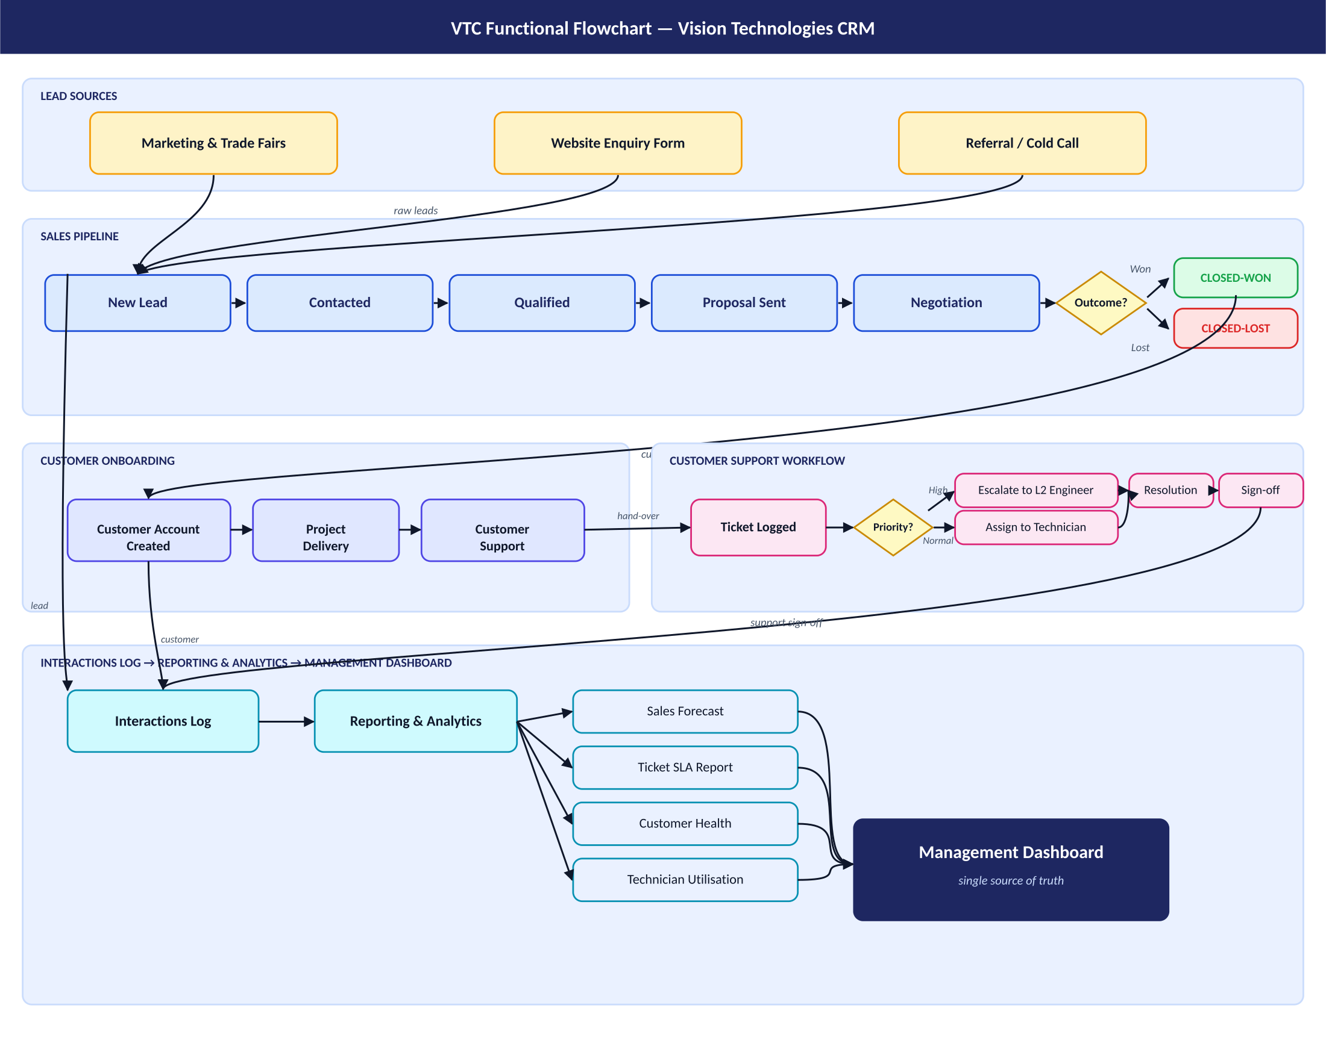
PHASE 1 · §2 FUNCTIONAL FLOW
Functional Diagram of VTC
Marketing & sales → pipeline → customer onboarding → support → interactions log → dashboard.
Vision Technologies CRM · Live Defense Deck
Slide 3 / 14

Slide 4
PHASE 1 · §3 PROBLEM STATEMENT
The Five Pain Points VTC Faces Today
Fragmented customer data — e-mail, Excel, WhatsApp — no single source of truth
Lost leads & no pipeline visibility — managers cannot forecast revenue
Unstructured support workflow & SLA breaches on mission-critical accounts
No interaction history per customer — new staff have no context
Manual, late, inconsistent reporting — Excel-stitched, hard to audit
SPEAKER NOTES
VTC currently runs all of this through e-mail, Excel and WhatsApp. When a sales rep leaves, his pipeline goes with him. Support tickets raised by phone are sometimes never logged, so SLAs are missed and the company's reputation suffers. Reports take days to compile. A CRM solves all five problems by being the single source of truth.
Vision Technologies CRM · Live Defense Deck
Slide 4 / 14
Notes:
VTC currently runs all of this through e-mail, Excel and WhatsApp. When a sales rep leaves, his pipeline goes with him. Support tickets raised by phone are sometimes never logged, so SLAs are missed and the company's reputation suffers. Reports take days to compile. A CRM solves all five problems by being the single source of truth.

Slide 5
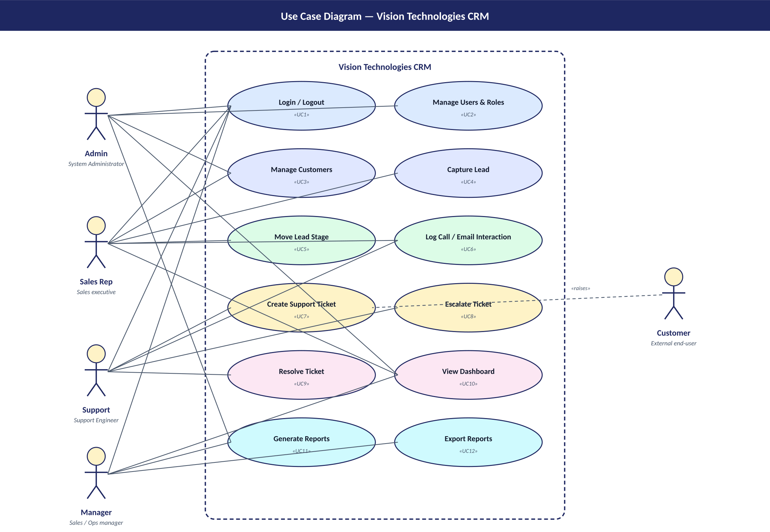
PHASE 1 · §4.1 USE CASE
Use Case Diagram — Actors & System Boundary
Admin · Sales Rep · Support Engineer · Manager · Customer — each role sees only what it needs.
Vision Technologies CRM · Live Defense Deck
Slide 5 / 14

Slide 6
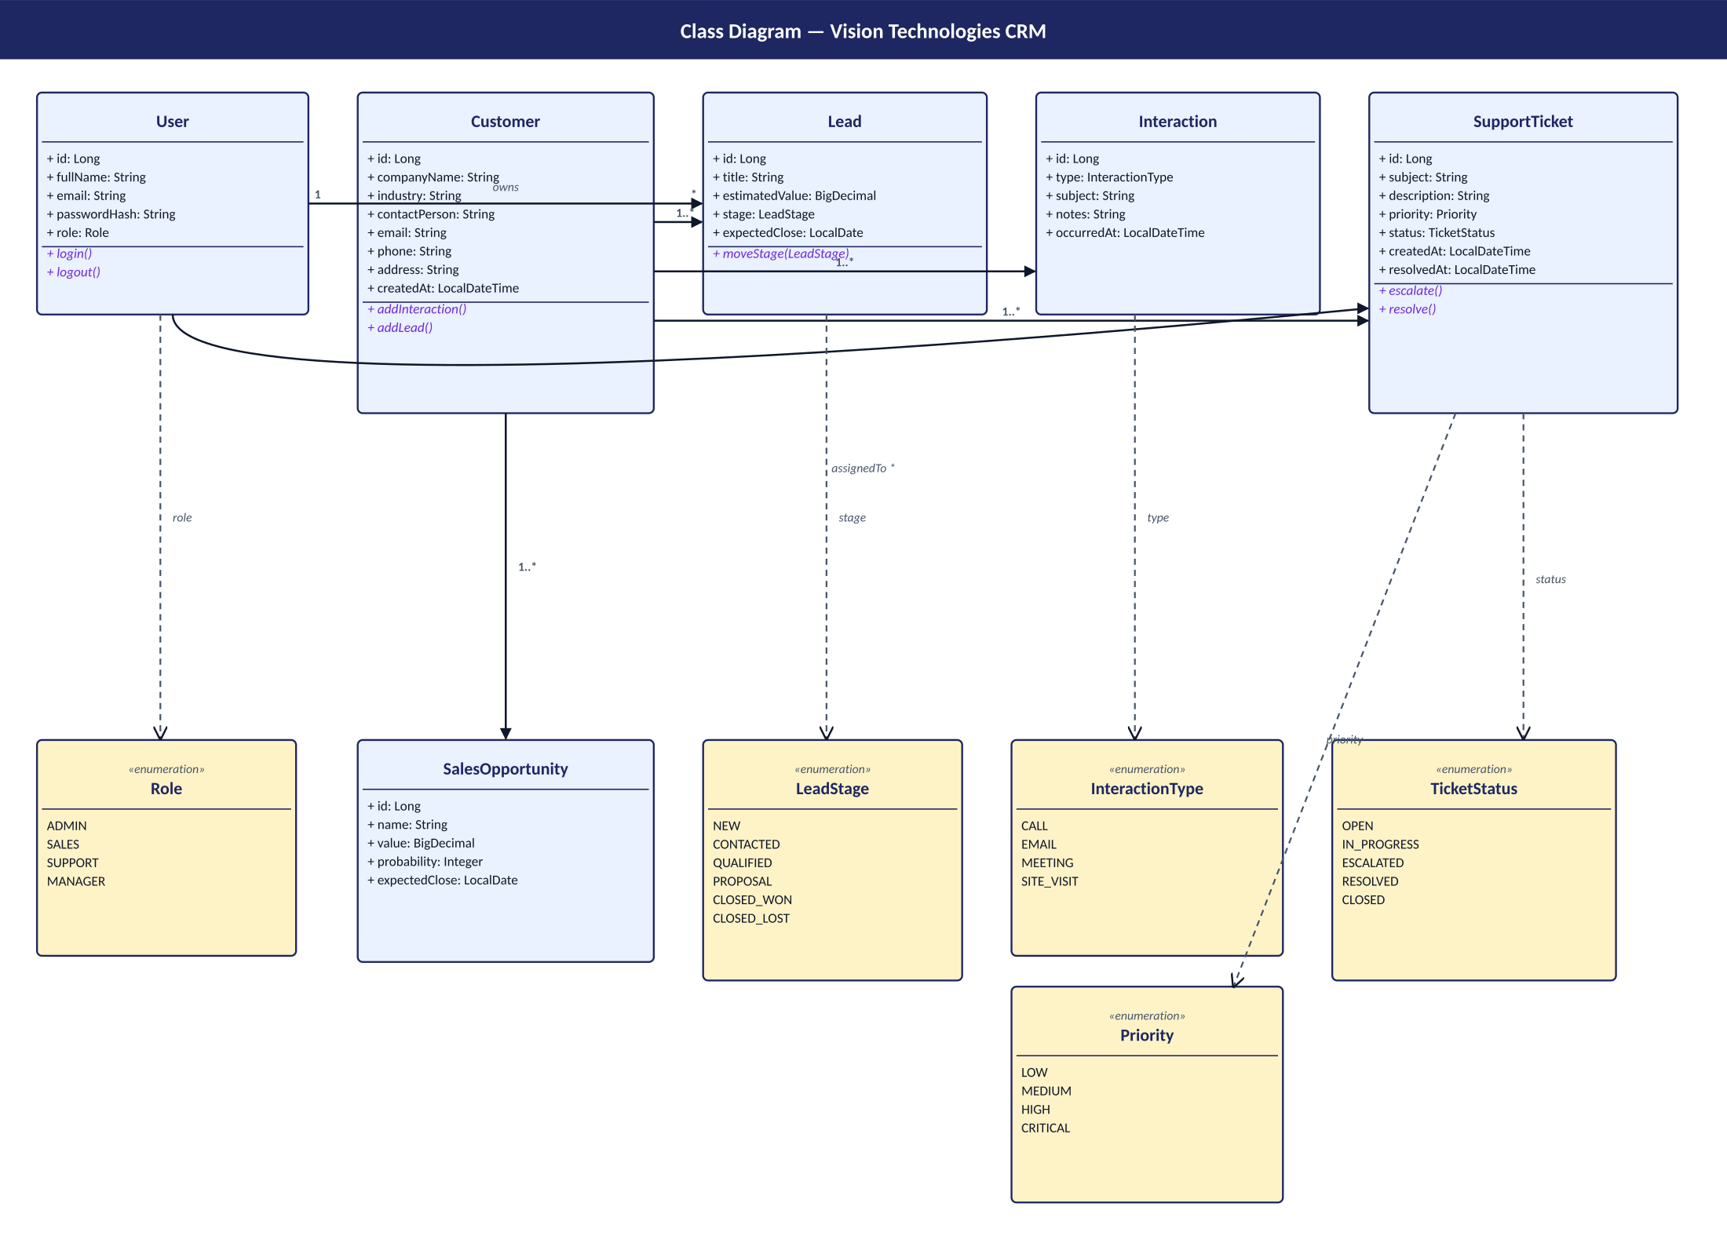
PHASE 1 · §4.2 CLASS MODEL
Class Diagram — Entities & Enumerations
Six entities, five enumerations — Customer is the aggregate root for Leads, Interactions and Tickets.
Vision Technologies CRM · Live Defense Deck
Slide 6 / 14

Slide 7
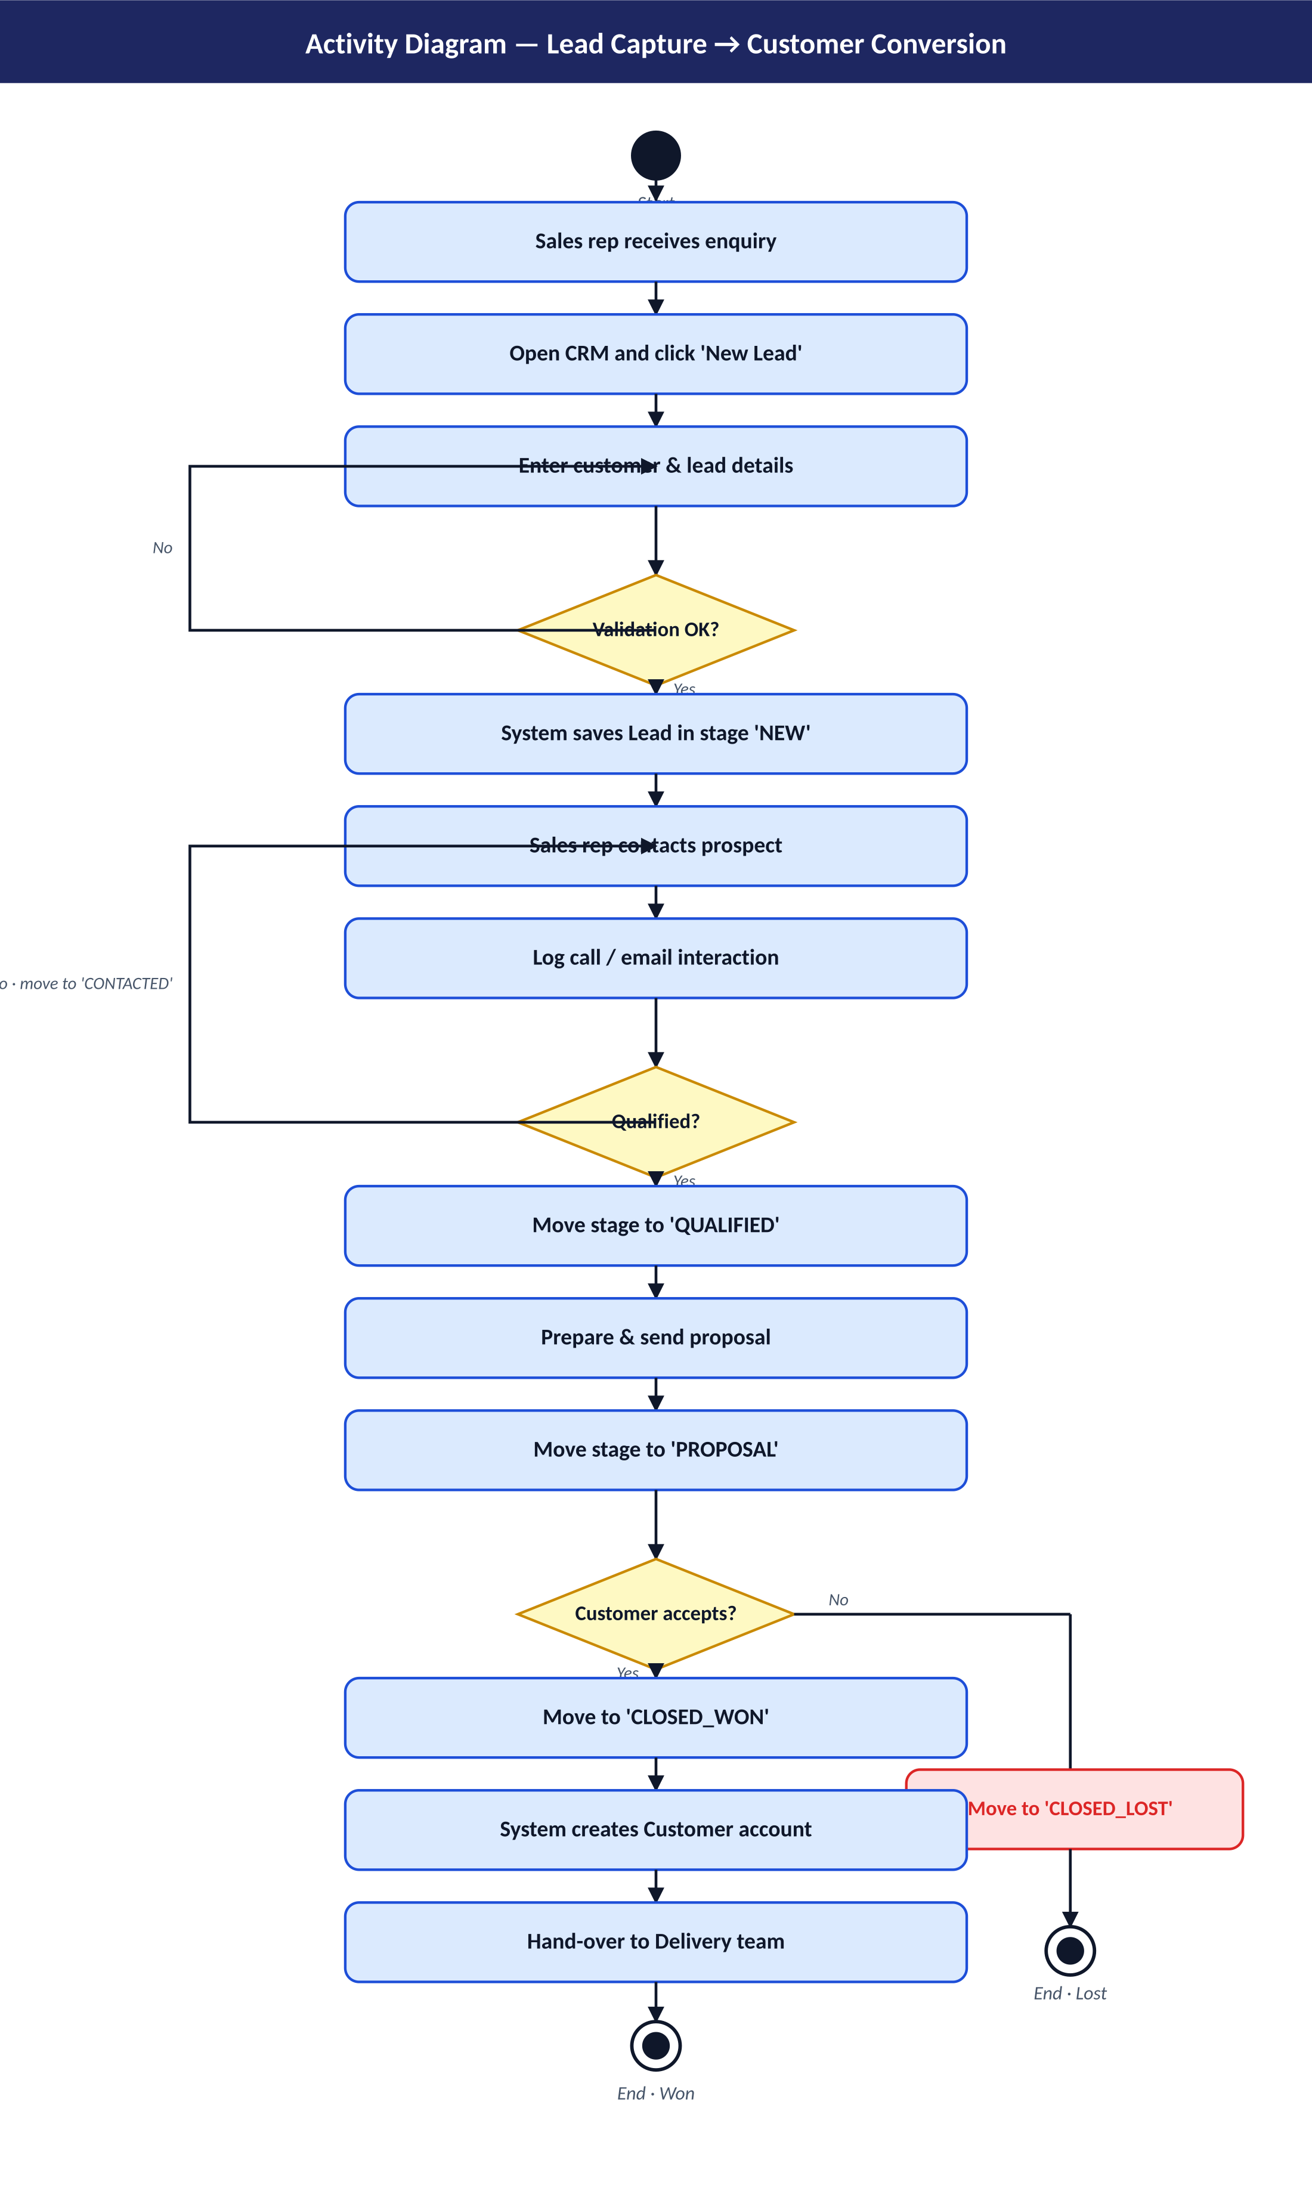
PHASE 1 · §4.3 ACTIVITY
Activity Diagram — Lead Capture → Customer Conversion
The diamond decision points map directly to Kanban drag-and-drop actions in the live app.
Vision Technologies CRM · Live Defense Deck
Slide 7 / 14

Slide 8
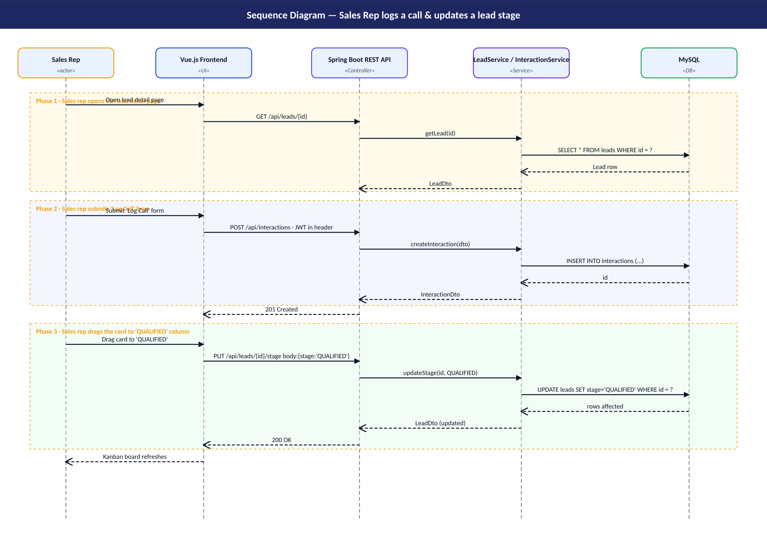
PHASE 1 · §4.4 SEQUENCE
Sequence Diagram — Log Call & Update Lead Stage
Sales rep → Vue UI → REST API → Service → MySQL — POST /api/interactions then PUT /api/leads/{id}/stage.
Vision Technologies CRM · Live Defense Deck
Slide 8 / 14

Slide 9
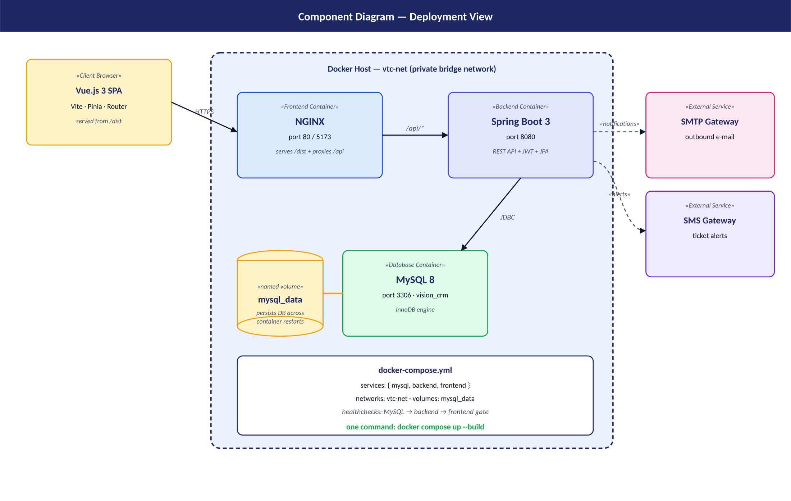
PHASE 1 · §4.5 DEPLOYMENT
Component Diagram — Three Docker Containers
Vue/NGINX :80 → Spring Boot :8080 → MySQL :3306 · one private network, one named volume.
Vision Technologies CRM · Live Defense Deck
Slide 9 / 14

Slide 10
PHASE 4 · §1 + §2
Test Plan — Objectives & Scope
Eight objectives (O1–O8) tied 1-to-1 to system requirements
In scope: every REST endpoint, every page, JWT, CORS, Docker health
Out of scope: SMS/e-mail gateway, multi-tenancy, full pen-testing
SPEAKER NOTES
Phase 4 is the proof that the project works. Objectives O1 to O8 each map to a concrete requirement from Phase 1 — for example O3 verifies that the sales pipeline only allows legal stage transitions. The scope is honest: we are testing the things we built and explicitly excluding integrations we did not implement.
Vision Technologies CRM · Live Defense Deck
Slide 10 / 14
Notes:
Phase 4 is the proof that the project works. Objectives O1 to O8 each map to a concrete requirement from Phase 1 — for example O3 verifies that the sales pipeline only allows legal stage transitions. The scope is honest: we are testing the things we built and explicitly excluding integrations we did not implement.

Slide 11
PHASE 4 · §3 + §4
Test Types — A Testing Pyramid
Unit + Integration
End-to-End
Performance + Security
JUnit 5 + Mockito (services)
Spring Boot Test + MockMvc + H2
Fast feedback inside the build
Manual checklist of 20 cases
Cypress smoke flows (optional)
Runs against dockerised stack
JMeter, 50 concurrent users
JWT expiry, CORS, 401/403
GitHub Issues for defects
Vision Technologies CRM · Live Defense Deck
Slide 11 / 14

Slide 12
PHASE 4 · §8 (EXCERPT)
Sample Test Cases (3 of 20)
ID | Feature | Description | Expected Result
TC-01 | Login (valid) | Login with seeded admin | JWT issued; redirect to /dashboard
TC-08 | Move lead stage | Drag card New → Qualified | Stage updated in DB; PUT 200
TC-12 | Escalate ticket | Click Escalate on a ticket | Status ESCALATED; priority bumped
Total of 20 cases covering authentication, CRUD, lead lifecycle, ticket lifecycle, reporting, robustness and Docker health.
Vision Technologies CRM · Live Defense Deck
Slide 12 / 14

Slide 13
PHASE 4 · §3 (EXECUTED)
JUnit + Spring Boot Tests in the Repo
CustomerServiceTest — 9 unit tests for CRUD + search + error paths (Mockito)
AuthServiceTest — 3 unit tests for login OK / bad password / missing user
CustomerControllerIT — full @SpringBootTest + MockMvc, JWT-authenticated CRUD
AuthControllerIT — login OK, wrong password, unknown user
SPEAKER NOTES
To show the test plan is not just paper, I implemented JUnit 5 unit tests and two Spring Boot integration test classes that boot the full ApplicationContext against an in-memory H2 database. The integration tests log in as the seeded admin to obtain a JWT and then drive every controller through MockMvc.
Vision Technologies CRM · Live Defense Deck
Slide 13 / 14
Notes:
To show the test plan is not just paper, I implemented JUnit 5 unit tests and two Spring Boot integration test classes that boot the full ApplicationContext against an in-memory H2 database. The integration tests log in as the seeded admin to obtain a JWT and then drive every controller through MockMvc.

Slide 14
THANK YOU
Demo & Questions
Live demo: login → dashboard → customers → leads → tickets → reports
Repo: github.com/<your-username>/vision-tech-crm
Run: docker compose up --build
Vision Technologies CRM · Live Defense Deck
Slide 14 / 14

