Slide 1
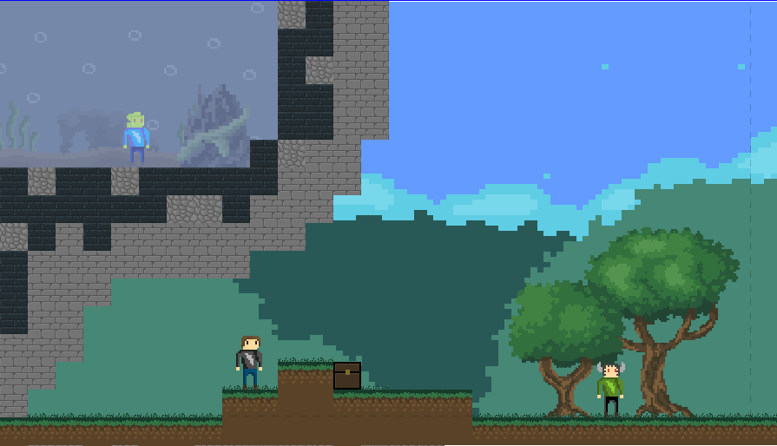
Mithras

Slide 2

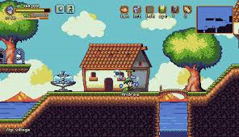
The Humble Adventures Of Mithras is an exciting role playing game built by Luc Hutton and Mostyn Michael-White.
The plan
dungeons | What you learn | What you do
asma1 | Learn to kill enemies | Kill enemies
asma2 | Learn to climb ladder | Kill enemies
asma3 | Learn about cannons | Kill enemies dodge cannon
asma4 | Learn to shoot | Dodge cannon shoot guard
asma boss | Learn to kill boss | Kill boss
atlantis1 | Learn to swim | Dodge enemies
atlantis2 | Learn to drown | Dodge enemies find
Story line: the knight Mithras is looking for work and comes across a mourning wizard, he lost his son and wants to avenge him. But he is old and needs you to do it, you must explore 5 dungeons killing everyone as you go. FUN.
Example of other game

Slide 3



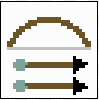
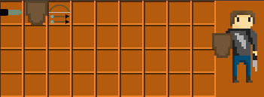
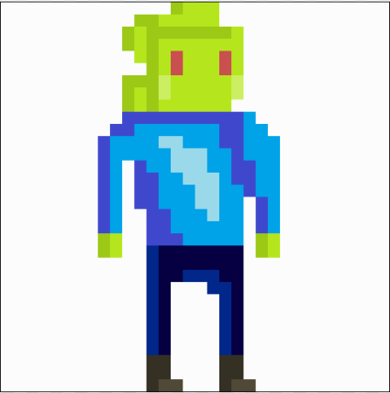
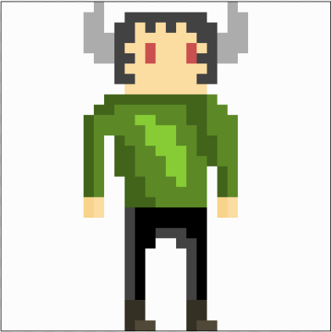

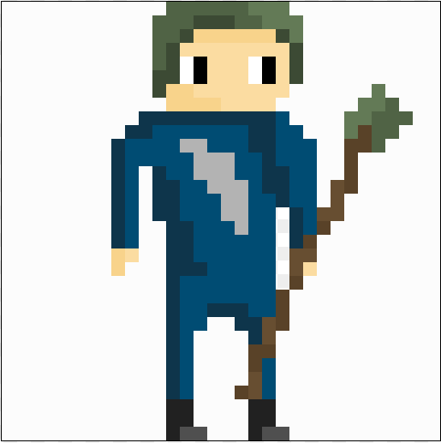
To win you must defeat the last boss, the kraken. However, you must endure 2 dungeons first.
During your travels you can collect weapons, you can access these in the inventory:
Possible weapons.
Enemies:
Optoguy, floatio,
Characters:
Mithras, wooodoe,

