Slide 1
PowerCLI goes Core!
Going Core with VMware PowerCLI

Slide 2
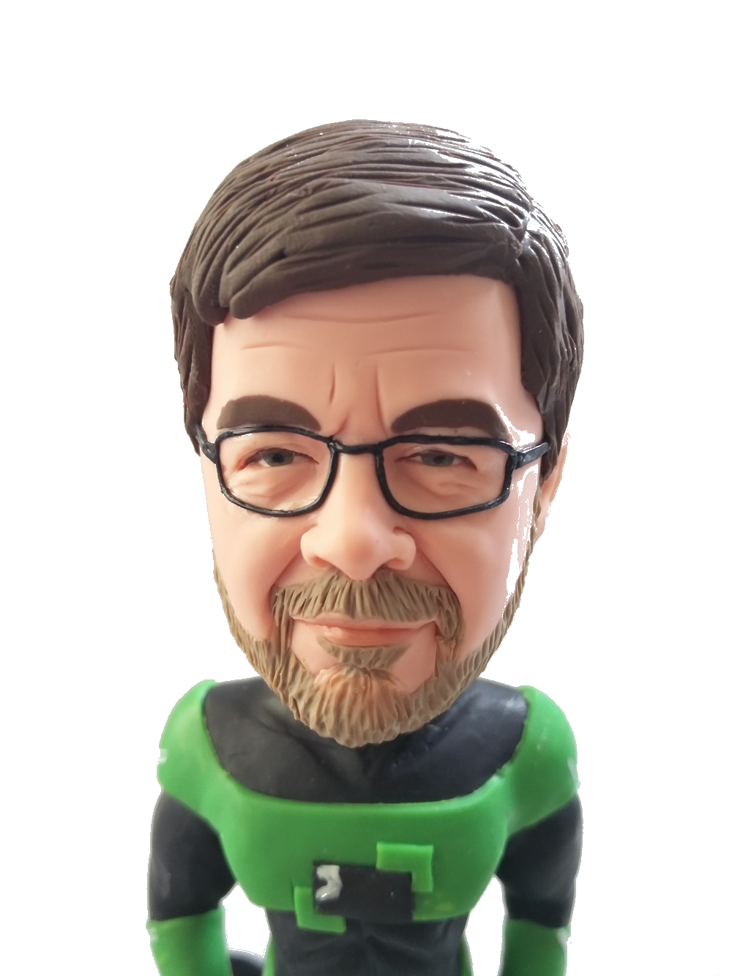

Bio
Luc Dekens
Virtualisation
Automation
PowerCLI
PowerShell
Author & Speaker
vExpert & MVP
www.lucd.info
@LucD22
VMTN - LucD

Slide 3
Agenda
Exploring the Field
Problems? Not really!
New opportunities - Building on a Fix
Takeaways
Q&A

Slide 4
Some History
VMware PowerCLI
+11 years old
From vSphere to multiple VMware products
August 18th 2016
PowerShell Core + PowerCLI Core
Linux distros + Mac OS X
Since 6.5R1 each release side-by-side
Release cycle is incremental
Multiple releases last year

Slide 5
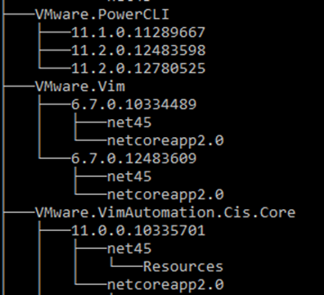
A Clean Environment
Admin?
Get-Module -Name 'VMware.*' -ListAvailable |
Group-Object -Property Name |
ForEach-Object -Process {
$_.Group | Sort-Object -Property { [version]$_.Version } |
Select-Object -SkipLast 1 | ForEach-Object -Process {
$sSplat = @{
Name = $_.Name
RequiredVersion = $_.Version
Force = $true
}
Uninstall-Module @sSplat -WhatIf
}
}

Slide 6
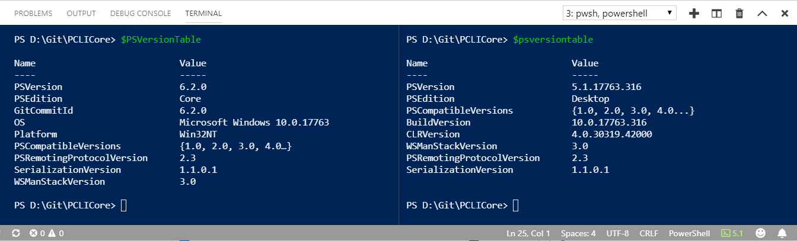
Your Editor
Visual Studio Code
On Windows: side-by-side
Ideal for cross-version scripting! (Windows only)
Shell Launcher extension

Slide 7
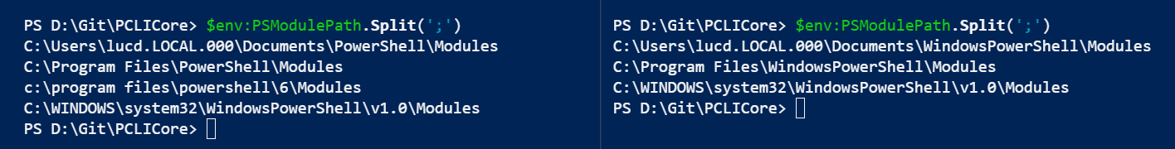

Lay of the Land – Part I
This & following: all for Vmware PowerCLI 11.2
Be aware that the module paths are not the same!
Might have an impact on testing and running

Slide 8
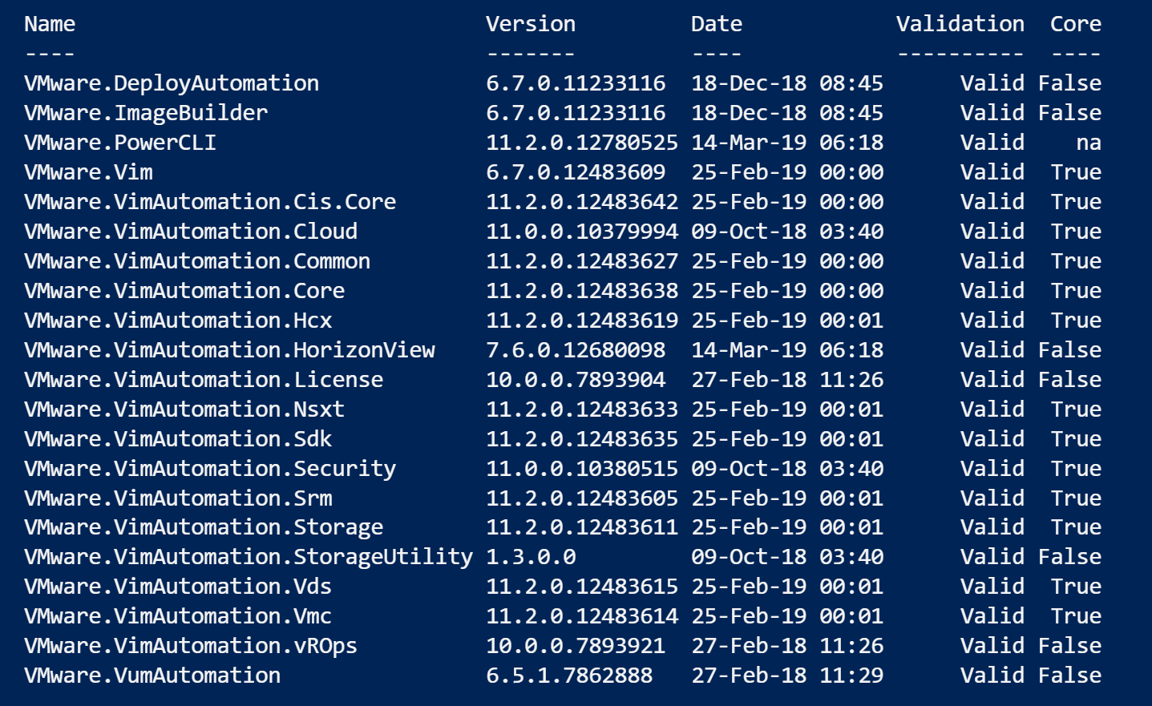

Lay of the Land – Part II

Slide 9
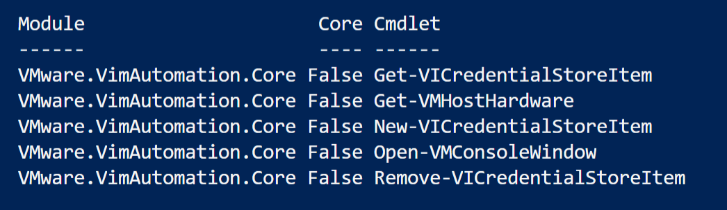
Lay of the Land – Part III

Slide 10
Tackling the Issue
Your Legacy scripts on PSv6
Target = No changes!
Modules that are not ported yet
Write your own (module)
Worth the effort?
WindowsCompatibility module
Unsupported functions
Write your own
Adapt existing
Read About_Command_Precendence
☹

Slide 11
Cmdlets, functions…
Just to recap (what you probably already know)
Create a function with the same name
Example: Get-VMHostHardware
WMI
Vendor dependent
Place in profile or .dot source before script (wrapper)
Alias
Function
Cmdlet
Command

Slide 12
Get-VMHostHardware I
Info is mostly there (except the WMI part)
vSphere object
Get-EsxCli
Use the V2 option!
Create PowerCLI object (.Net)
Unfortunately = nogo!
PowerCLI Ideas
Only properties accessed, no problem

Slide 13
Get-VMHostHardware II
$esx = Get-VMHost -Name MyEsx
$esxcli = Get-EsxCli -VMHost $esx -V2
New-Object PSObject -Property @{
AssetTag = $esxcli.hardware.platform.get.Invoke().BIOSAssetTag
BiosVersion = $esx.ExtensionData.Hardware.BiosInfo.BiosVersion
CpuCoreCountTotal = $esx.ExtensionData.Hardware.CpuInfo.NumCpuCores
CpuCount = $esx.ExtensionData.Hardware.CpuInfo.NumCpuPackages
CpuModel = $esx.ExtensionData.Summary.Hardware.CpuModel
# Other properties
}

Slide 14
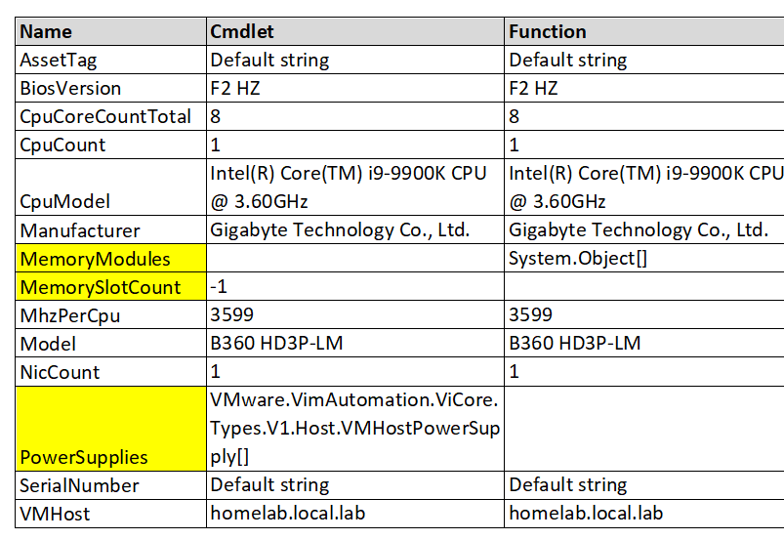
Get-VMHostHardware III

Slide 15
What about the parameters?
Say hello (again) to Proxies
2009, Extending and/or Modifying Commands with Proxies
2009, VMworld, TA2650 Proxy Cmdlets – Customise The PowerCLI Cmdlets
Use New-ProxyCommand to get parameter definitions
Why not to use names of automatic variables as parameter names
Replace the call to the cmdlet with your code

Slide 16
Generate the proxies
Meta
$cmd = Get-Command -Name 'New-VICredentialStoreItem'
$metaData = New-Object System.Management.Automation.CommandMetaData ($cmd)
[System.Management.Automation.ProxyCommand]::create($MetaData)
Module
New-ProxyCommand -Name Get-VICredentialStoreItem -CommandType Cmdlet

Slide 17
Proxy command layout
Function
Param()
Begin
Change, add, remove parameters
$PSBoundParameters
Call command
Begin pipeline
Process
Call (or not) original cmdlet
Process pipeline
End
End pipeline

Slide 18
(Somewhat) Reserved Names
Proxy contains Host param definition
param(
[Parameter(Mandatory = $true, Position = 0)]
[ValidateNotNullOrEmpty()]
[string]
${Host},
Avoid runtime issue with $Host variable
param(
[Alias('Host')]
[Parameter(Mandatory = $true, Position = 0)]
[ValidateNotNullOrEmpty()]
[string]
${HostEntry},

Slide 19
New-VICredentialStoreItem I
DPAPI
Stores items in an XML file
Replacement function
Solution 1: hard-coded values
Solution 2: external medium
Solution 3: a vault
The Get- and Remove-VICredentialStoreItem same concepts

Slide 20
Get-VICredentialStoreItem - Hardcoded
New- and Remove-VICredentialStoreItem = na
Get-VICredentialStoreItem
$creds = @(
@{
HostEntry = 'Server1’
User = 'user1’
Password = 'Welcome2019!’
})
$creds |
Where-Object {$_.HostEntry -eq $HostEntry -and $_.User -eq $User}

Slide 21
New-VICredentialStoreItem - External
Sample use base64 (alternatives pgp, openssl…)
$creds = @()
if(Test-Path -Path .\vicredentials.xml){
[array]$creds = Import-Clixml -Path .\vicredentials.xml
}
[array]$creds = $creds |
Where-Object{$_.HostEntry -ne $HostEntry -or $_.User -ne $User}
$creds += New-Object PSObject -Property @{
HostEntry = $HostEntry
User = $User
Password = ($password | base64)
}
$creds | Export-Clixml -Path .\vicredentials.xml

Slide 22
Get-VICredentialStoreItem - External
$creds = @()
if(Test-Path -Path .\vicredentials.xml){
[array]$creds = Import-Clixml -Path .\vicredentials.xml
}
$creds |
Where-Object{$_.HostEntry -ne $HostEntry -and $_.User -ne $User} |
ForEach-Object -Process {
New-Object PSObject -Property @{
Host = $_.HostEntry
User = $_.User
Password = ($_.Password | base64 -d)
}
}

Slide 23


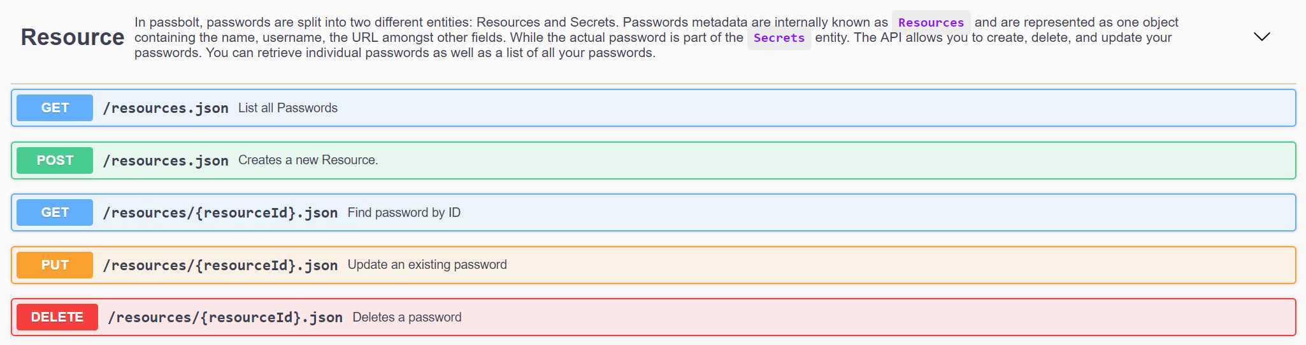
VICredentialStoreItem - Vault
Tested with Passbolt & Mailu
Docker Compose YAML file on Photon VMs
Any Vault with an API will do
Installation fully automated (Invoke-VMScriptPlus + JSON)
See Deploy Photon 2.0 Part 1 & Part 2

Slide 24
Get-VICredentialStoreItem – Vault I
Retrieving the Resource
$sRest = @{
Method = 'Get’
Uri = "$baseUrl/resources.json?api-version=v2"
SkipCertificateCheck = $true
}
$entry = Invoke-RestMethod @sRest |
where { $_.Name -eq $HostEntry -and $_.UserName -eq $User }

Slide 25
Get-VICredentialStoreItem – Vault II
Retrieving the Secret (password)
if ($entry) {
$sRest = @{
Method = 'Get’
Uri = "$baseUrl/secrets/resource/$($entry.id).json?api-version=v2"
SkipCertificateCheck = $true
}
$pswd = Invoke-RestMethod @sRest
}
New-Object PSObject -Property @{
Host = $entry.Name
User = $entry.UserName
Password = gpg2 --pinentry-mode=loopback -d -o- < “$($pswd.body.data)”
}

Slide 26
Connect-VIServer I
It does not support only passing a Server parameter
With our new VICredentialStoreItem, we can fix that
Real proxy command this time!
The magic happens in the Begin block

Slide 27

Connect-VIServer II
if ($PSBoundParameters.ContainsKey('Server') -and
-not $PSBoundParameters.ContainsKey('Password'))
{
$sCred = @{
HostEntry = $PSBoundParameters.Item('Server’)
User = $PSBoundParameters.TryGetValue('User’)
}
$cred = Get-VICredentialStoreItem @sCred
if ( $cred.Count -ne 1)
{
throw 'Could not determine user/password’
}
$PSBoundParameters.Add('User', $cred.User)
$PSBoundParameters.Add('Password', $cred.Password)
}

Slide 28
Connect-VIServer III
$cmdName = 'VMware.VimAutomation.Core\Connect-VIServer'
$cmdType = [System.Management.Automation.CommandTypes]::Cmdlet
$wrappedCmd = $ExecutionContext.InvokeCommand.GetCommand($cmdName, $cmdType)
$scriptCmd = { & $wrappedCmd @PSBoundParameters }
$steppablePipeline = ` $scriptCmd.GetSteppablePipeline($myInvocation.CommandOrigin)
$steppablePipeline.Begin($PSCmdlet)

Slide 29
VCSA and scripts I
Alarm action “run script” when on VCSA
VCSA is a “Black Box”
Support?
William Lam
Automatically Securing Virtual Machines Using vCenter Orchestrator
How to run a script from a vCenter Alarm action in the VCSA?
Alarm action – SNMP trap
Configure SNMP target
Target = VM where trap capture script runs

Slide 30
VCSA and scripts II
VCSA
SNMP Target
VM Container
SNMP Trap
Interpreter
Scripts
Scripts

Slide 31
SNMP Configuration
Set up the ESXi nodes
$sSnmp = @{
enable = $true
targets = 'ws1.local.lab@162 public'
}
Get-Cluster -Name $clusterName | Get-VMHost |
ForEach-Object -Process {
$esxcli = Get-EsxCli -VMHost $_ -v2
$esxcli.system.snmp.set.Invoke($sSnmp)
$esxcli.system.snmp.test.Invoke()
}

Slide 32
Capturing the Traps I
Script uses System.Net.Sockets.UdpClient
Supported in .NET Core
The Receive method uses an AsyncCallback Delegate!
Oisin Grehan, PowerShell 2.0 – Asynchronous Callbacks from .NET
.NET threadpool doesn’t have a runspace for a PS scriptblock
Convert into Event and use Register-ObjectEvent
The buffer contains the SNMP data block
Re-arm with BeginReceive

Slide 33
Capturing the Traps II
$global:receiveBuffer = @()
$callBack = New-ScriptBlockCallback -CallBack $receive
$endPoint = [IPEndPoint]::new([ipaddress]::Any, 162)
$udpClient = @{
UdpClient = $snmpSocket
IPEndPoint = $endPoint
}
$snmpSocket.BeginReceive($callBack, $udpClient)

Slide 34
Capturing the Traps III
$receive = {
param(
[IASyncResult]$asyncResult
)
$global:receiveBuffer = $asyncResult.AsyncState.UdpClient.EndReceive(
$asyncResult, [ref]$asyncResult.IPEndPoint)
}

Slide 35
Capturing the Traps IV
if ($global:receiveBuffer.Count -gt 0)
{
$global:receiveBuffer | Format-Hex -Raw
$global:receiveBuffer = @()
$snmpSocket.BeginReceive($callBack, $udpClient) | Out-Null
}

Slide 36
Handling the SNMP data I
The script receives “raw” SNMP data
No (simple) SNMP library found
DIY
ASN1 (Abstract Syntax Notation 1)
MIB required to interpret the SNMP PDU
Scripts started locally/remotely

Slide 37
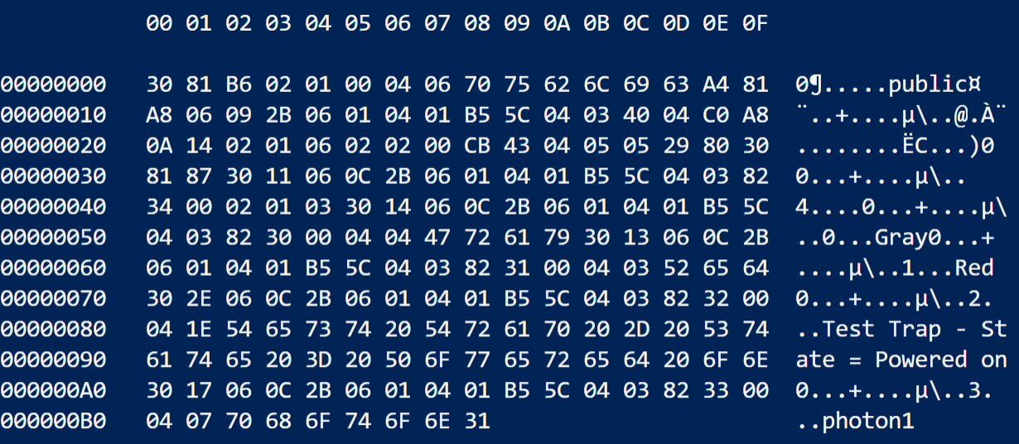
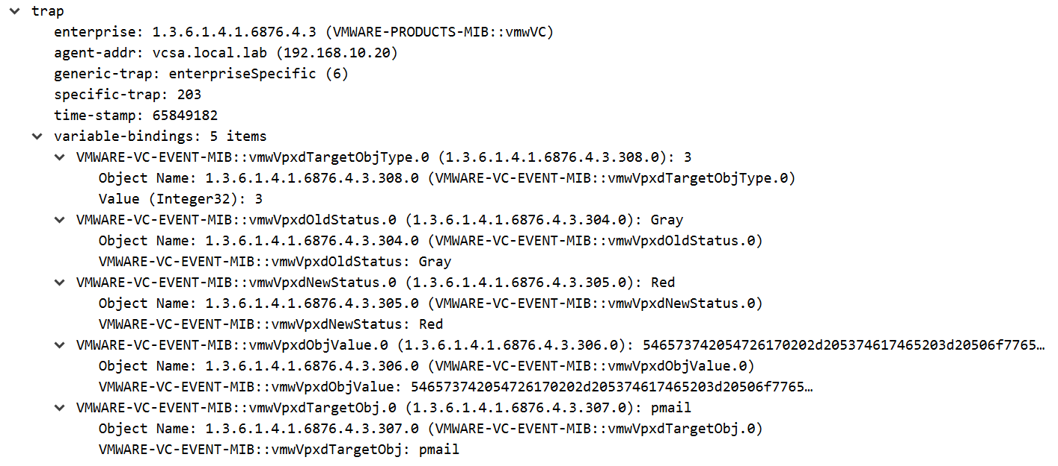
Script Triggers
$scriptTab = @{
VM = 'any’
Trap = 203
NewState = 'red’
Script = '/scripts/audit-entry.ps1'
},
@{
VM = 'VM1’
Trap = 203
NewState = 'red’
Script = '/scripts/start-patch-mgmt.ps1'
}

Slide 38
Some Takeaways
VMware PowerCLI on PS core opens new opportunities
Problem-solving = combining knowledge + techniques
Community is important (even old-ish contributions)

Slide 39
Q&A

