Slide 1
Speed and scale tips for PowerCLI
October
VMUGBE+
23.2020
Luc Dekens

Slide 2
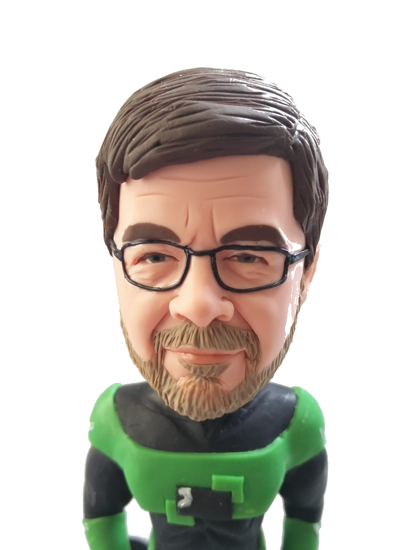
Bio
Former Systems Engineer
‘Dolce far niente’ since 01/01/2020
PowerCLI user since 2007
Contact
Twitter: LucD22
Blog: lucd.info
VMTN : lucd

Slide 3
Agenda
Measure
Repetition
Cmdlets & Modules
Get-View
An Example (watch me make typos)
Some takeaways

Slide 4
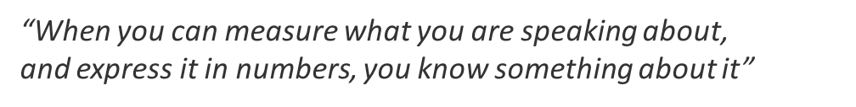
Measure
1
Lord Kelvin

Slide 5
Techniques
Built-in
Measure-Command
DateTime
StopWatch
Which one?

Slide 6
Techniques
Profiling
Not builtin ☹
Visual Studio (?)
Chronometer module by Kevin Marquette

Slide 7
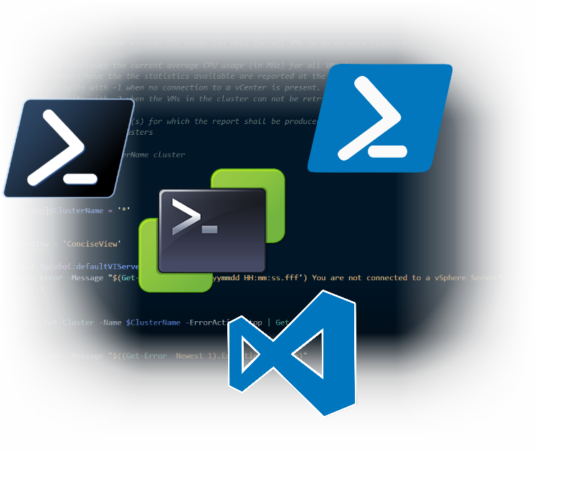
DEMO

Slide 8
Repetition
2

Slide 9
DEMO

Slide 10
Cmdlets & Modules
3

Slide 11
Cmdlets & Modules
Don’t reinvent the wheel
Cmdlets
Measure-Object
Group-Object
Sort-Object
… and a cast of 1000s
Modules
ImportExcel
… and many more

Slide 12
DEMO

Slide 13
Digging Deep
4

Slide 14
Methods & Properties
A word on objects
.NET objects
vSphere objects
PowerCLI is a (very decent) selection
Use the API (for the full experience … and speed)

Slide 15
DEMO

Slide 16
An Example
5

Slide 17
DEMO

Slide 18
Take Aways
6

Slide 19
Takeaways
Your code is perfect!
But his/hers might be a bit more perfect ☺
Learning = reading, watching, trying
Dare to revisit

Slide 20

Q&A

