Slide 1

Reaching beyond the Stars
in recommending Thai Restaurants in Las Vegas

Slide 2
Presentation Outline
1
Problem Definition
2
Techniques Used in the Literature
3
Dataset Description
4
Methodology
5
Results and Discussion
6
Conclusion

Slide 3
Presentation Outline
1
Problem Definition
2
Techniques Used in the Literature
3
Dataset Description
4
Methodology
5
Results and Discussion
6
Conclusion

Slide 4
Problem Definition
Task: Classify a Thai restaurant in Las Vegas that is new to a user as a restaurant to be experienced (or not).
Experience: Two datasets, including the Yelp academic business and review (user ratings and reviews).
Performance: Classification accuracy (1) the restaurant RATING predicted
(2) the SENTIMENT SCORE predicted.

Slide 5
Presentation Outline
1
Problem Definition
2
Techniques Used in the Literature
3
Dataset Description
4
Methodology
5
Results and Discussion
6
Conclusion

Slide 6
Content-based Rec. Knowledge-based Rec. Hybrid Approach
CRAB 2011
Techniques Used in the Literature
recommenderlab for R
Sampling
Top 5 list (highest Predictions)
Prediction Matrix
RMSE & Confusion Matrix
RATINGS
Recommender
Algorithm
Used in collaborative recommendation
UBCF
Lexicon-based Approach
Common words and emoticons with sentiment attached
Each element from lexicon detected in text delivers a score which is added to the total.
SENTIMENT Detection &
SCORES
Reviews
Supervised Learning (i.e.: domain specific)
Unsupervised learning (clustering)
Hybrid Approach

Slide 7
Presentation Outline
1
Problem Definition
2
Techniques Used in the Literature
3
Dataset Description
4
Methodology
5
Results and Discussion
6
Conclusion

Slide 8
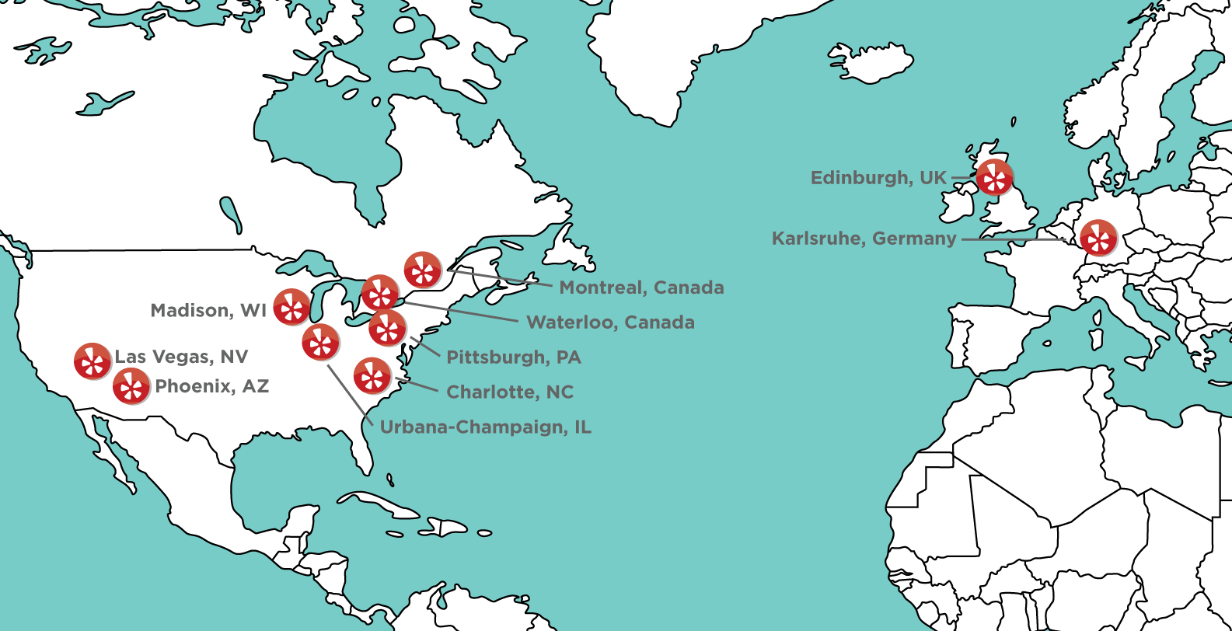
Dataset Description

Slide 9
Presentation Outline
1
Problem Definition
2
Techniques Used in the Literature
3
Dataset Description
4
Methodology
5
Results and Discussion
6
Conclusion

Slide 10
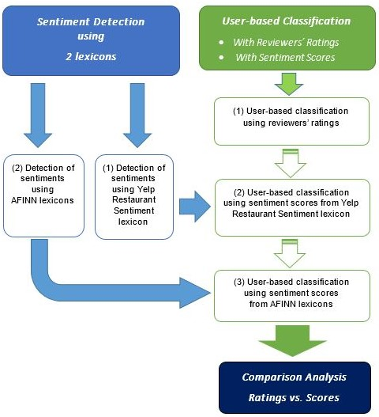
Methodology

Slide 11
Presentation Outline
1
Problem Definition
2
Techniques Used in the Literature
3
Dataset Description
4
Methodology
5
Results and Discussion
6
Conclusion

Slide 12
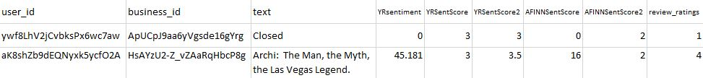
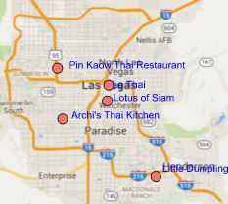
Sentiment Scoring of Restaurant Reviews
Discussion:
Score = 0 (control variable)
Scaling: good idea, but sampling issues with package
Method to measure the accuracy of the lexicon-based results? (Clueless)
Top 5 for aYzA3OgsAN3f3WJPucYCAQ

Slide 13
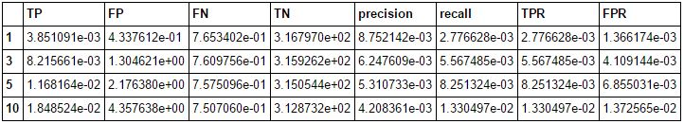
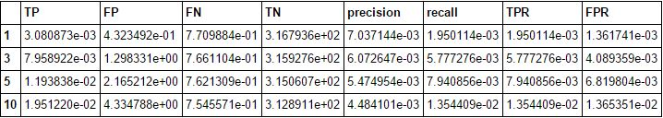
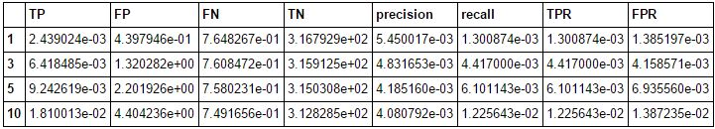
Confusion Matrix – Top Recommendations (gR = min)
Ratings (evaluationScheme = e6) goodRating = min
AFINN Scores (evaluationScheme = e7) Unscaled, goodRating = min
YelpRRL Scores (evaluationScheme = e5) Unscaled, goodRating =min
Discussion: assumptions too restrictive (analyst + algorithm)

Slide 14
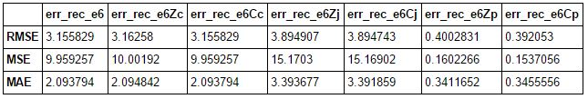
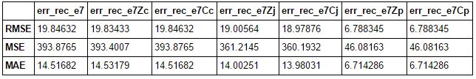
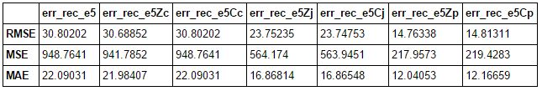
Accuracy – Normalization and Similarity Methods
Ratings (evaluationScheme = e6) 1 to 5 med: 4 avg: 3.9
AFINN Scores (evaluationScheme = e7) -36 to 221 med: 11 avg: 13.2
YelpRRL Scores (evaluationScheme = e5) -234 to 250 med:12 avg: 13.9
Discussion: Pearson is best, but slow & scanty (minutes). Jaccard is effective and efficient across the board (seconds).

Slide 15
Presentation Outline
1
Problem Definition
2
Techniques Used in the Literature
3
Dataset Description
4
Methodology
5
Results and Discussion
6
Conclusion

Slide 16

Conclusion
Hopes too high for the project
CRAB for Python left adrift since 2011: out of date
recommenderlab for R cannot allow cross-evaluation of models using the same random sample (user-restaurant combinations and different data)
recommenderlab still performs well
Scaling was not necessary for the delivery of top 5 recommendations and for accuracy evaluations.
Ratings and sentiment scores produce different recommendations, but we cannot determine which approach produces more accurate and reliable results.
The rating-based collaborative approach remains the fastest and the most economical based on the project’s results.

Slide 17
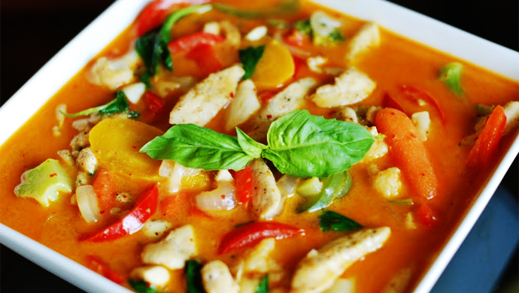
?
?
?
Any questions?

