Slide 1
Final Project: Spike Train Decoding for Brain-Machine Interface (Topic 3)
Suwon Seo, Kihwan Kim

Slide 2
Outline
Background
Motor Cortex Dataset from Monkey
What we try to decode the neural spike dataset.
Could we predict direction from neural spike data?
Could we predict hand position of the monkey from neural spike data?
Conclusion

Slide 3
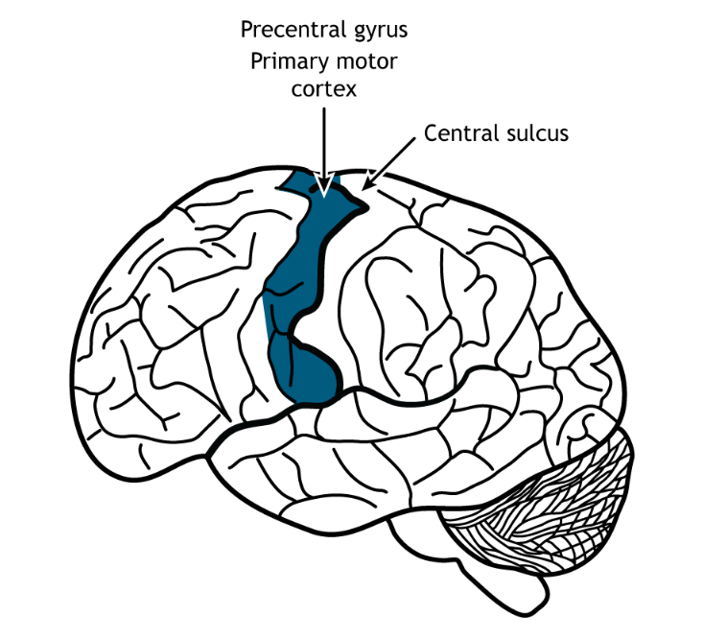
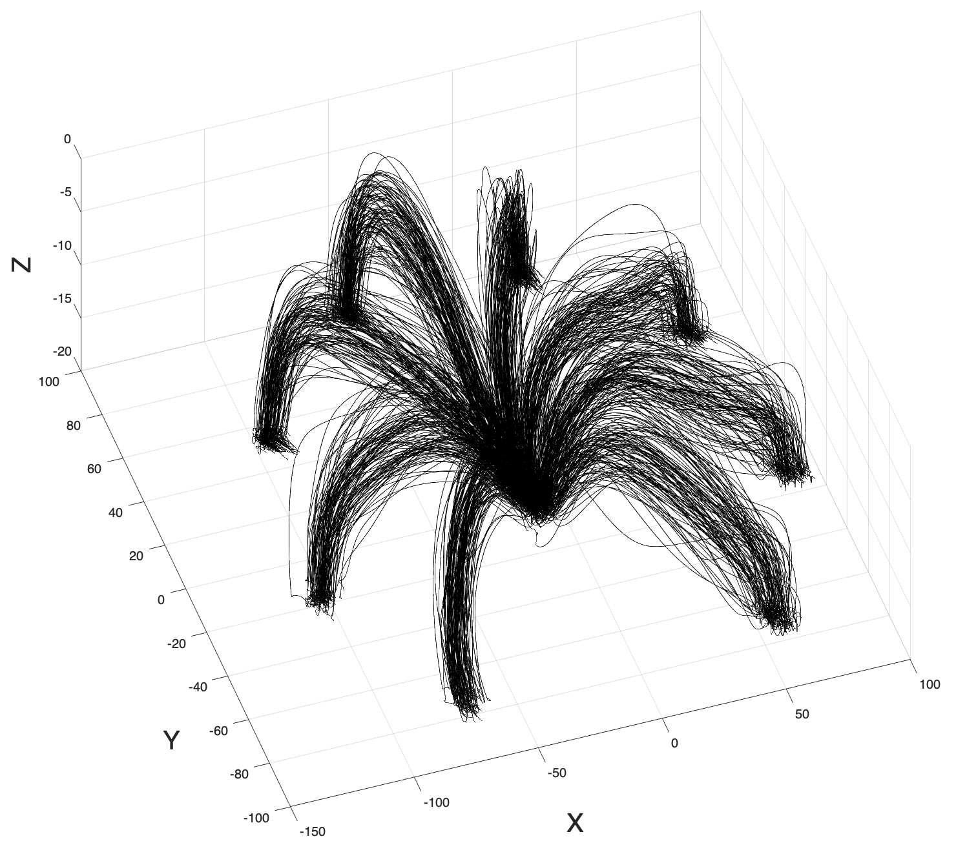
Primary Motor Cortex Data
The primary function of the motor cortex is to generate signals to direct the movement of the body.
We can use recorded neural spike trains in primary motor cortex of monkey.
primary mortor cortex region
hand position
neural spikes

Slide 4
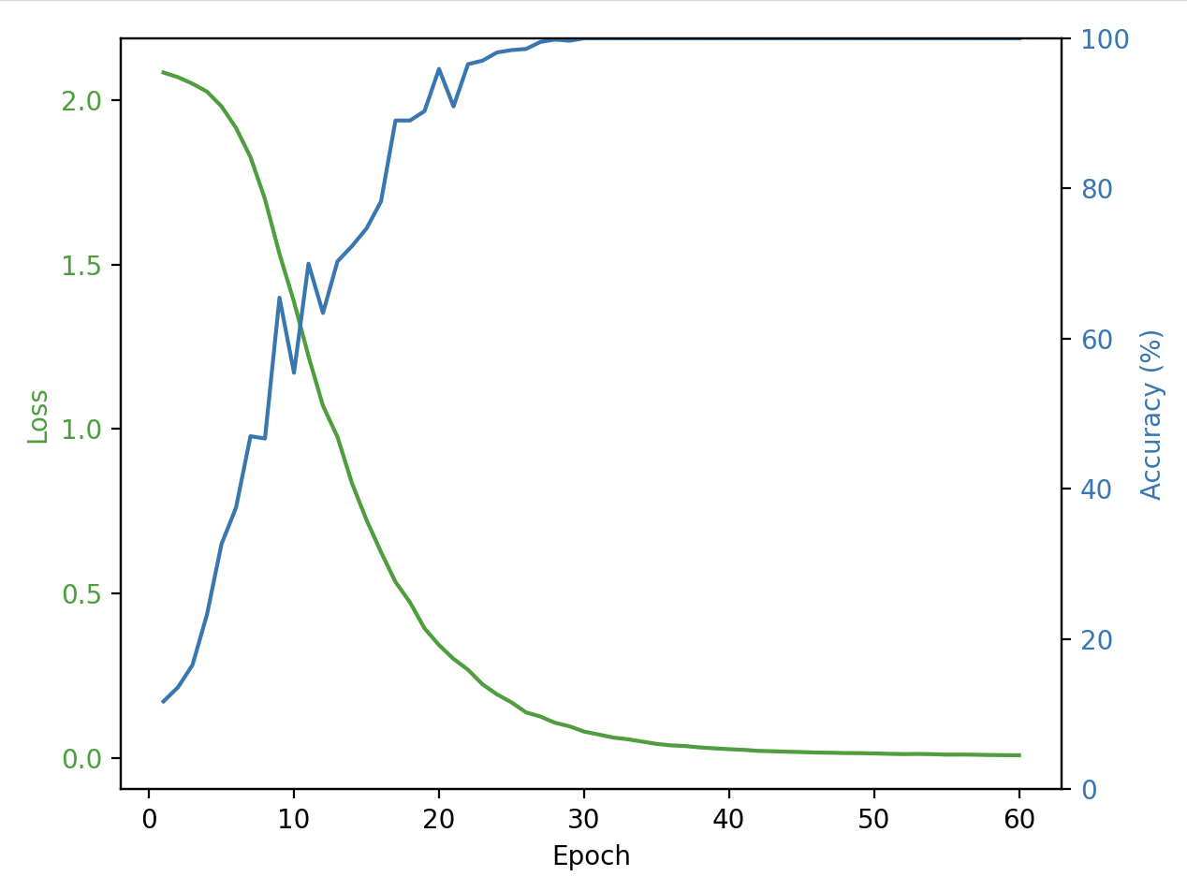
Hand Direction Prediction
Could we predict direction from neural spike data?
We used a simple CNN model following the figure below.
Learning curve
1Dim. CNN model
Max
Pool
Max
Pool
flatten
Predicted
8-Direction
neural spikes
conv1
conv2
fully
connected
layer

Slide 5
Hand Direction Prediction
Experiment results
Train: 640 trials / Test: 160 trials
Model with 2 CNN blocks
Train acc. : 100%
Test acc. : 90%
Model with 1 CNN blocks
Train acc. : 100%
Test acc. : 80%
Learning curve

Slide 6
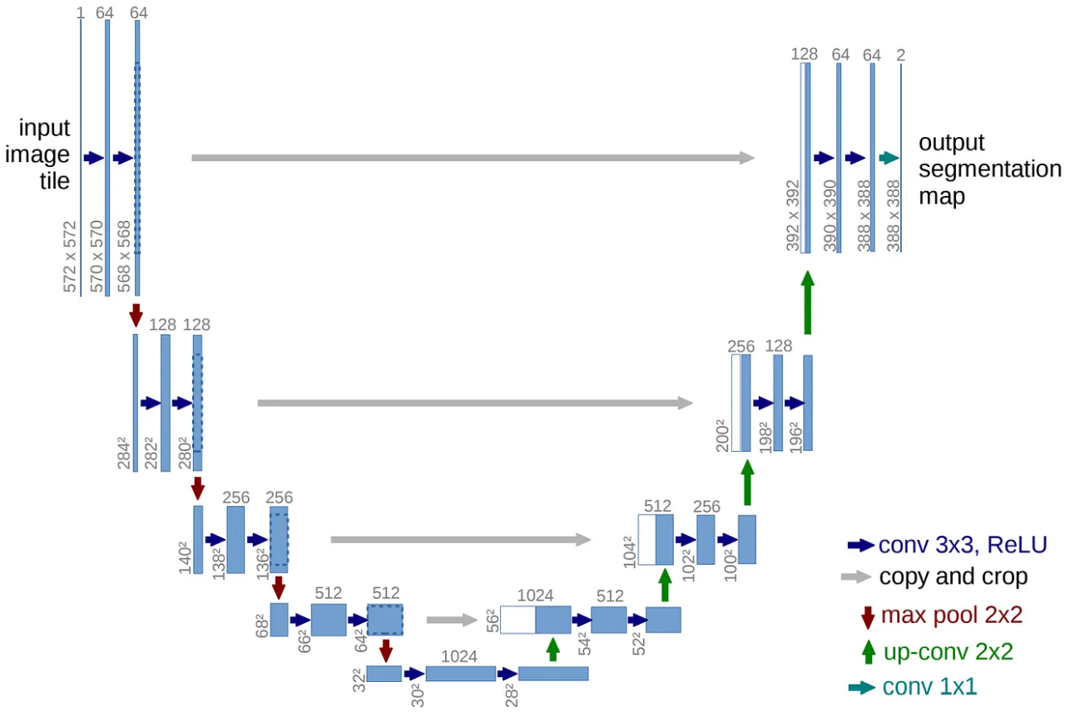
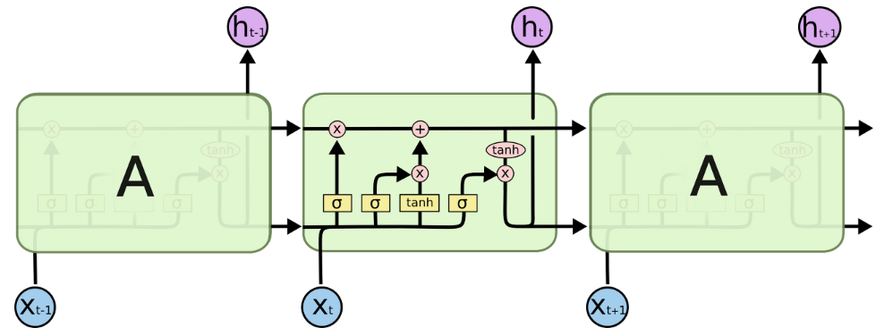
Hand Movement Prediction
Could we predict hand movement of the monkey from neural spike data?
Candidate model: LSTM, U-Net
LSTM
U-Net

Slide 7
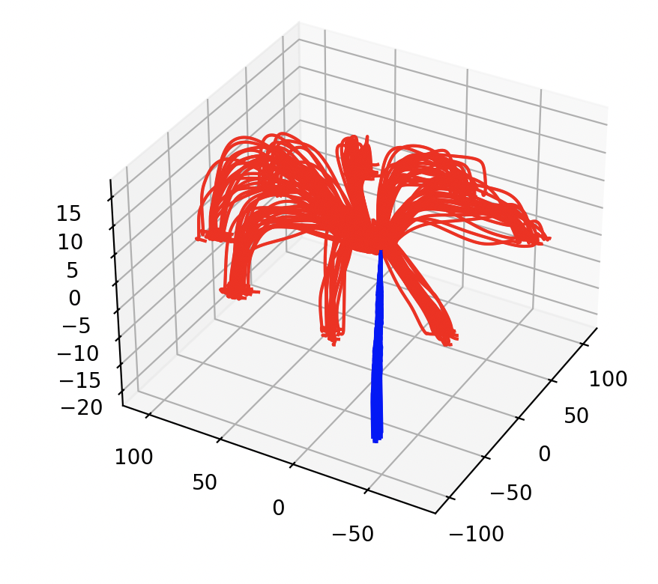
Hand Movement Prediction
What we tried…
Hyper parameter tuning
Learning rate, hidden dimension, layer number…
Data pre-processing
Restrict the prediction space and modify input to be more friendly to the activation signal
Normalize 3-d coordinates
Changing training objective
Displacement has more consistency compared to coordinate values, making the task potentially easier
Change the objective from coordinates regression to displacement

Slide 8
Conclusion
We can extract direction information from the neural spike data of monkey.
We cannot extract hand movement information from the neural spike data of monkey.
Expected causes of failure
Lack of information in data
The spikes signals are 1 channel simple binary data
Small data set size
Compared to difficulty of the task, The data sets are too small

Slide 9
Thank You

