Slide 1
Decision Tree –ID3

Slide 2
Decision Tree
A decision tree is a supervised machine learning algorithm used for classification and regression tasks.
It works by recursively splitting data based on feature conditions to create a tree-like structure

Slide 3
Decision Tree
Decision tree builds regression or classification models in the form of a tree structure.
It breaks down a dataset into smaller and smaller subsets while at the same time an associated decision tree is incrementally developed.
The final result is a tree with decision nodes and leaf nodes. A decision node (e.g., Outlook) has two or more branches (e.g., Sunny, Overcast and Rainy), each representing values for the attribute tested. Leaf node (e.g., Hours Played) represents a decision on the numerical target.
The topmost decision node in a tree which corresponds to the best predictor called root node. Decision trees can handle both categorical and numerical data

Slide 4
Decision Tree Representation
Decision tree builds classification or regression models in the form of a tree structure
It breaks down a dataset into smaller and smaller subsets while at the same time an associated decision tree is incrementally developed.
The final result is a tree with decision nodes and leaf nodes

Slide 5
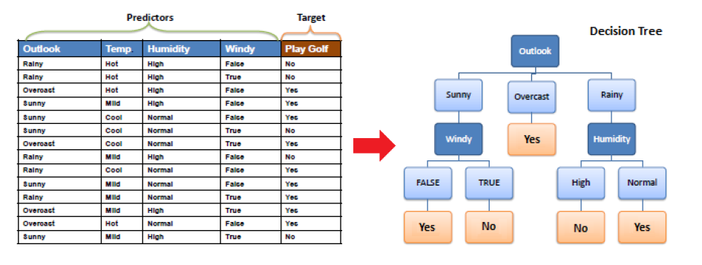

Slide 6
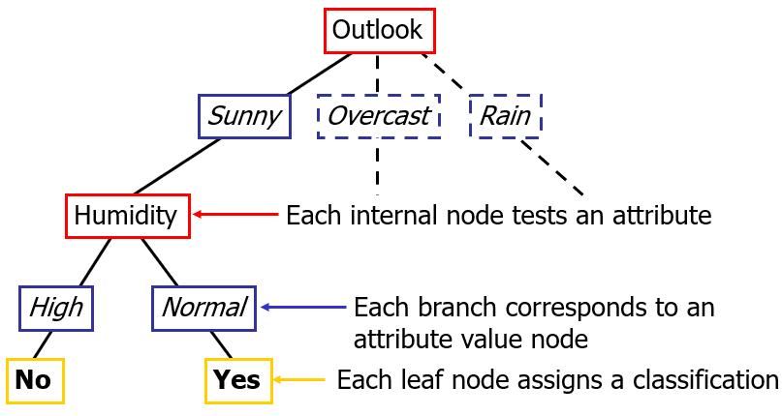
Decision trees classify instances by sorting them down the tree from the root to some leaf node, which provides the classification of the instance.

Slide 7
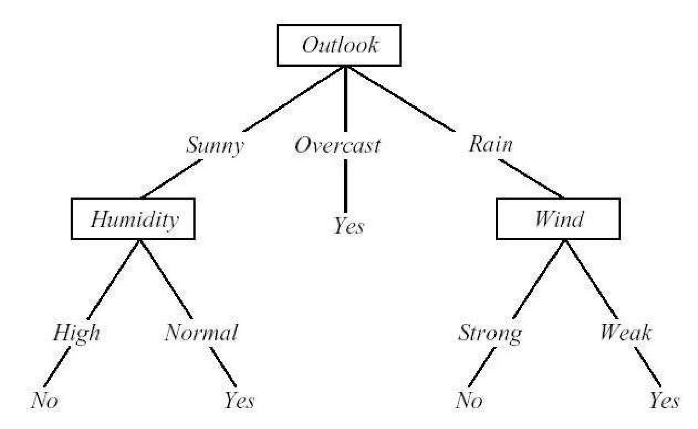
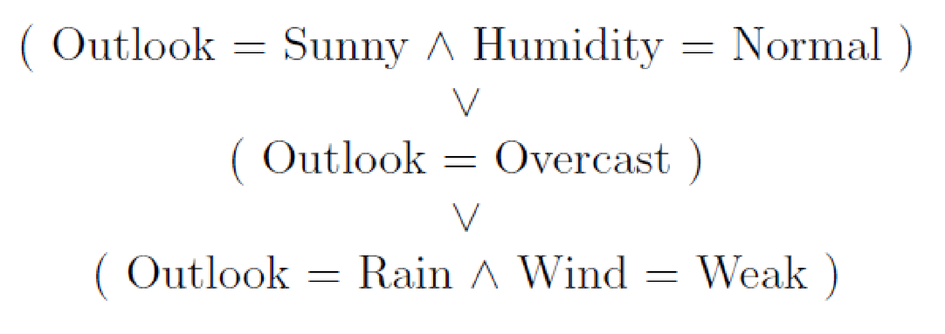
Decision trees represent a disjunction of conjunctions.

Slide 8
Popular Decision tree Algorithms
ID3 (Iterative Dichotomiser 3) – Uses Information Gain for splits.
C4.5 – An improvement over ID3 with handling of missing values.
CART (Classification and Regression Trees) – Used in Scikit-learn, supports both classification and regression.
Random Forest – Uses multiple decision trees to improve accuracy.
XGBoost / Gradient Boosting Trees – An ensemble of decision trees optimized for performance.

Slide 9
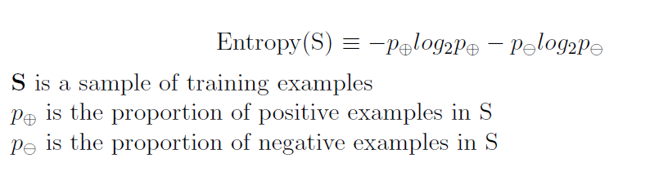
Entropy
Entropy is a measure of uncertainty or impurity in a dataset. It tells us how mixed up the data is.

Slide 10
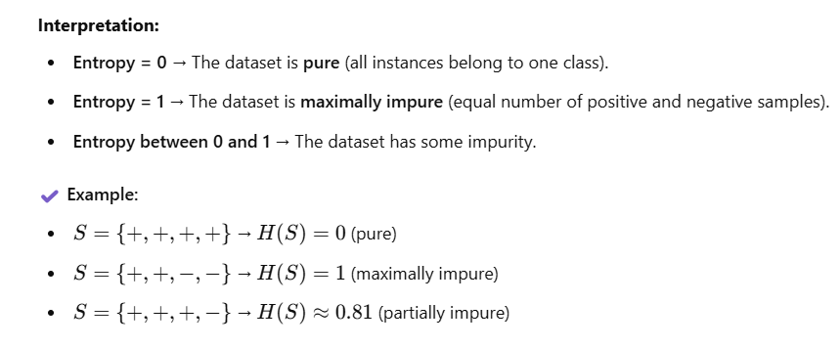
Entropy
Entropy measures the impurity or disorder in a dataset. It tells us how uncertain the dataset is regarding class labels.

Slide 11
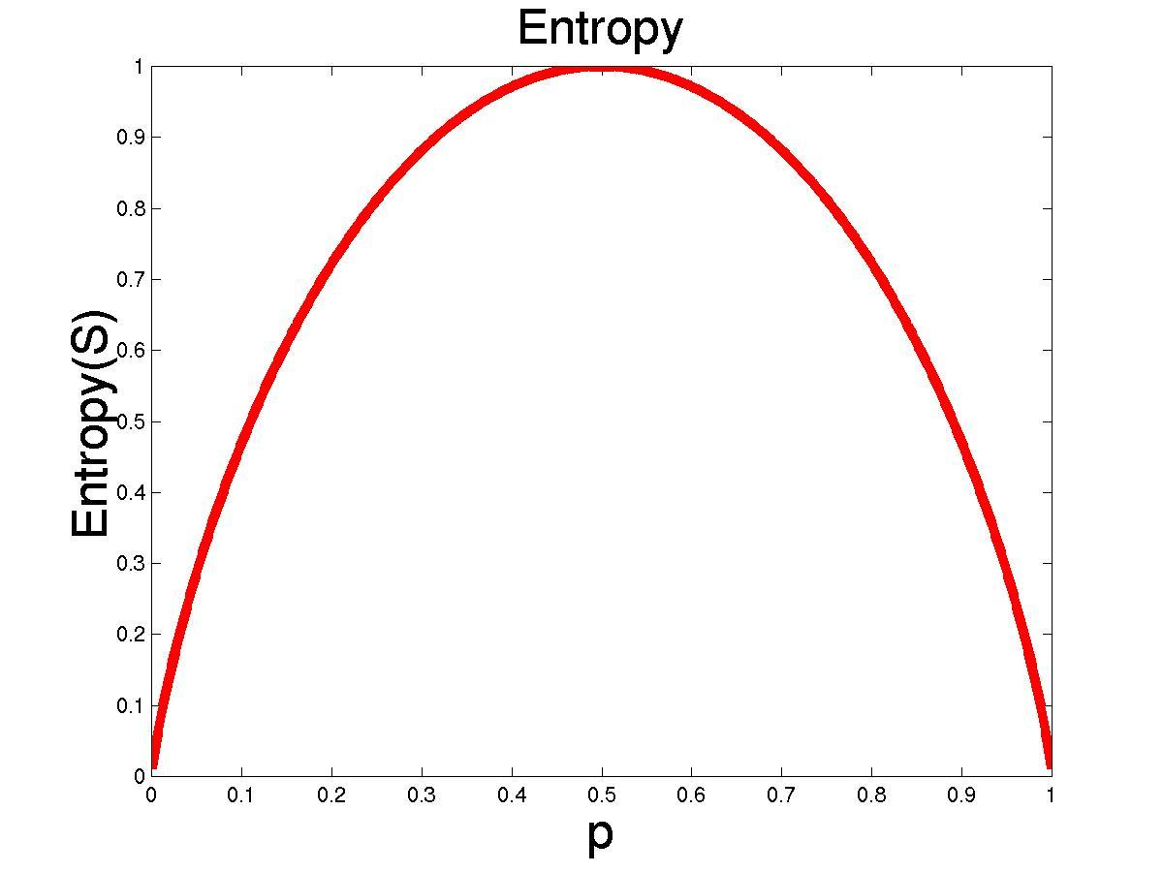
The entropy is 0 if all members of S belong to the same class
The entropy is 1 when the collection contains an equal number of positive and negative examples
If the collection contains unequal numbers of positive and negative examples, the entropy is between 0 and 1

Slide 12
Information Gain
Information Gain (IG) is a key concept in decision tree algorithms like ID3, C4.5, and CART.
It measures the reduction in uncertainty (entropy) after splitting the dataset based on a particular feature.
Information gain is a measure of the effectiveness of an attribute in classifying the training data
Information Gain (IG) as a way to measure how well a feature helps us split the data in a decision tree

Slide 13
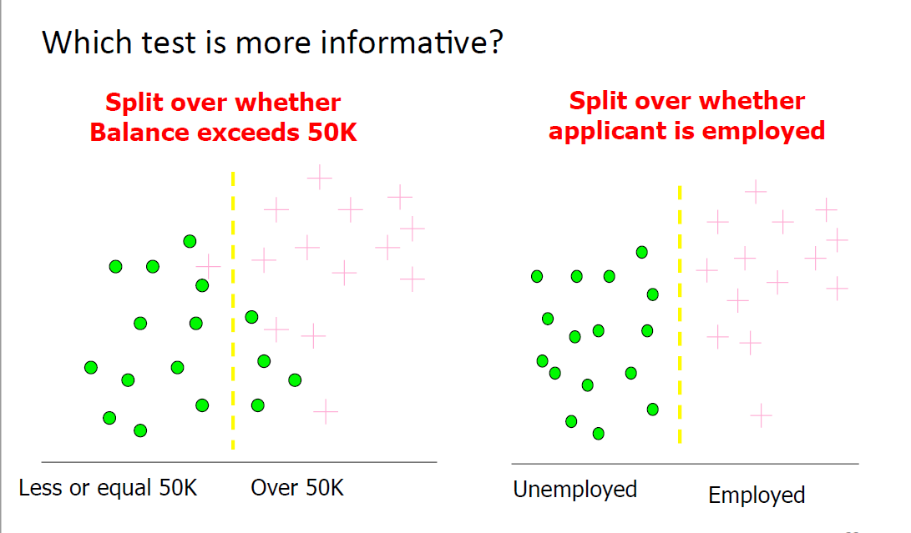
Information gain

Slide 14
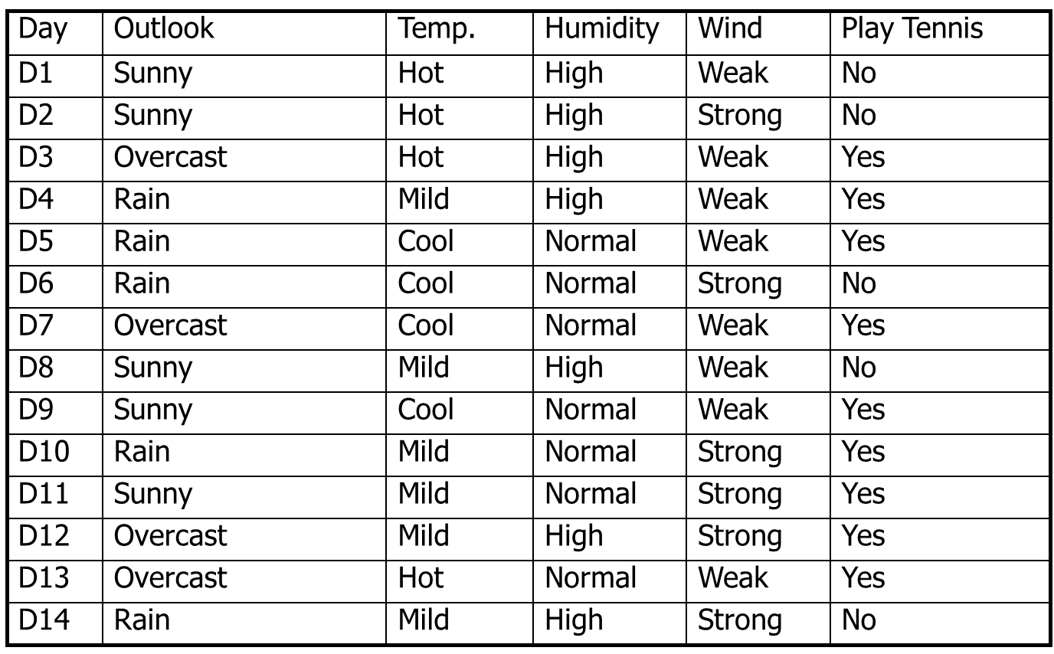

Slide 15
Apply ID3 Algorithm and Construct the decision tree
Attributes and their values:
Outlook: Sunny, Overcast, Rain
Humidity: High, Normal
Wind: Strong, Weak
Temperature: Hot, Mild, Cool
Target concept
Play Tennis: Yes, No

Slide 16
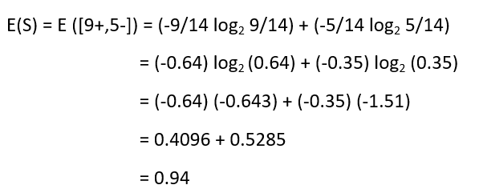
Calculating the Entropy of the Training Set.

Slide 17
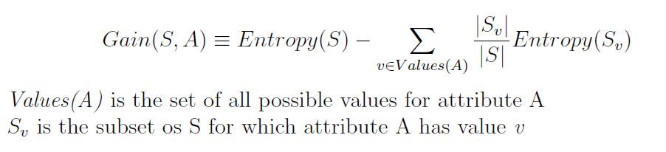
Information gain
Information gain is a measure of the effectiveness of an attribute in classifying the training data
Information gain is simply the expected reduction in entropy caused by partitioning the examples according to this attribute.

Slide 18
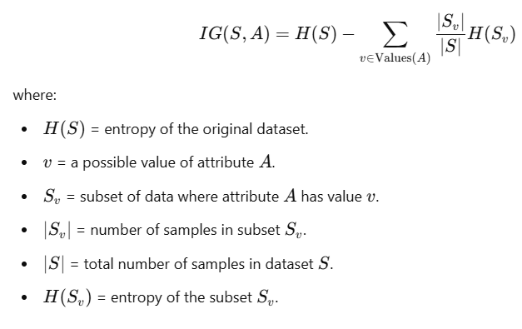
Information gain

Slide 19
Information gain for outlook
G(S,Outlook) = E(S) – [5/14 * E(Outlook=sunny) +
4/14 * E(Outlook = overcast) +
5/14 * E(Outlook=rain)]
G(S,Outlook) = E([9+,5-]) – [5/14*E(2+,3-) + 4/14*E([4+,0-]) +
5/14*E([3+,2-])]
G(S,Outlook) = 0.94 – [5/14*0.971 + 4/14*0.0 + 5/14*0.971]
G(S,Outlook) = 0.246

Slide 20
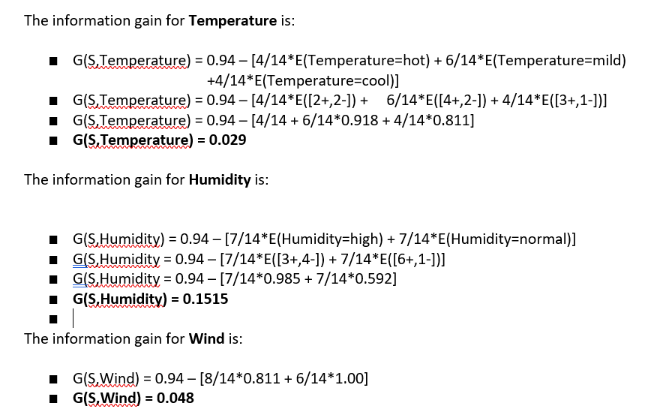

Slide 21
The information gain for all four attributes are:
Gain(S,Outlook) = 0.246
Gain(S,Humidity) = 0.151
Gain(S,Wind) = 0.048
Gain(S,Temperature) = 0.029
Since Outlook attribute provides the best prediction, it is selected as the decision attribute for the root node.

Slide 22
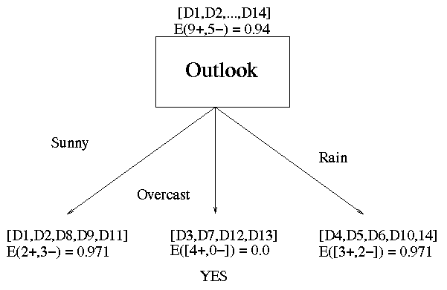
The below figure is the partially learned decision tree resulting from the first step of ID3.

Slide 23
Now that we have discovered the root of our decision tree, we must now recursively find the nodes that should go below Sunny, Overcast, and Rain.
G(Outlook=Rain, Humidity) = 0.971 – [2/5*E(Outlook=Rain ^ Humidity=high) +
3/5*E(Outlook=Rain ^Humidity=normal]
G(Outlook=Rain, Humidity) = 0.02
G(Outlook=Rain,Wind) = 0.971- [3/5*0 + 2/5*0]
G(Outlook=Rain,Wind) = 0.971
G(Outlook=Rain,temperature) = 0.971- [3/5*E[Outlook=Rain ^Temperature=Mild)
+2/5 * E(Outlook=Rain ^ Temperature=Cool)]
=0.31

Slide 24
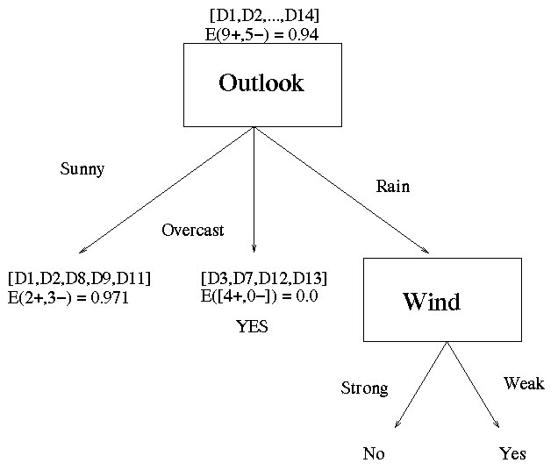

Slide 25
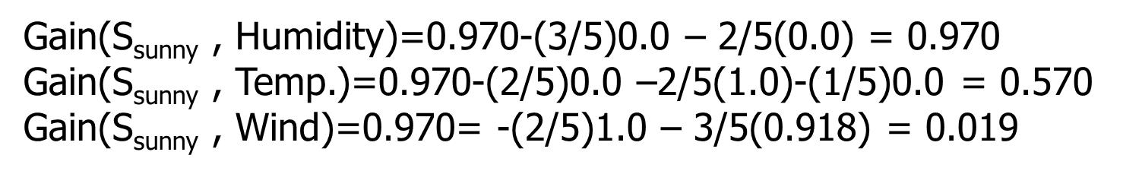
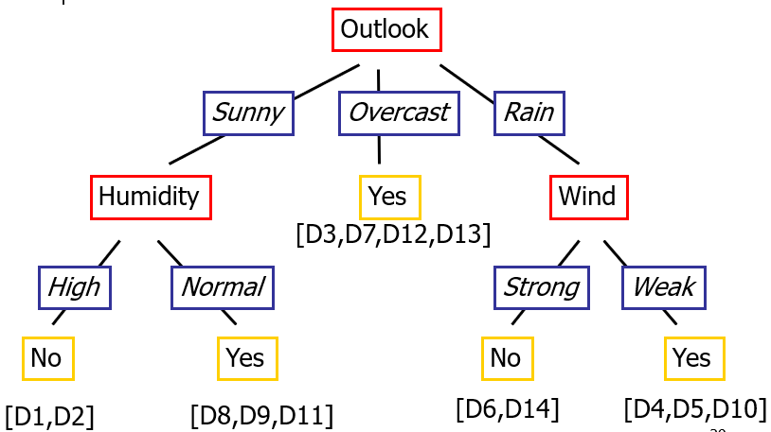

Slide 26
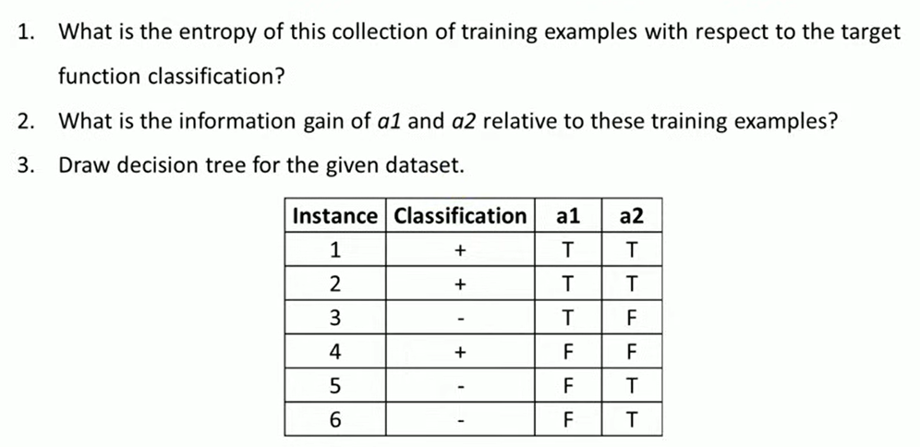
Apply ID3 algorithm to solve the following

Slide 27
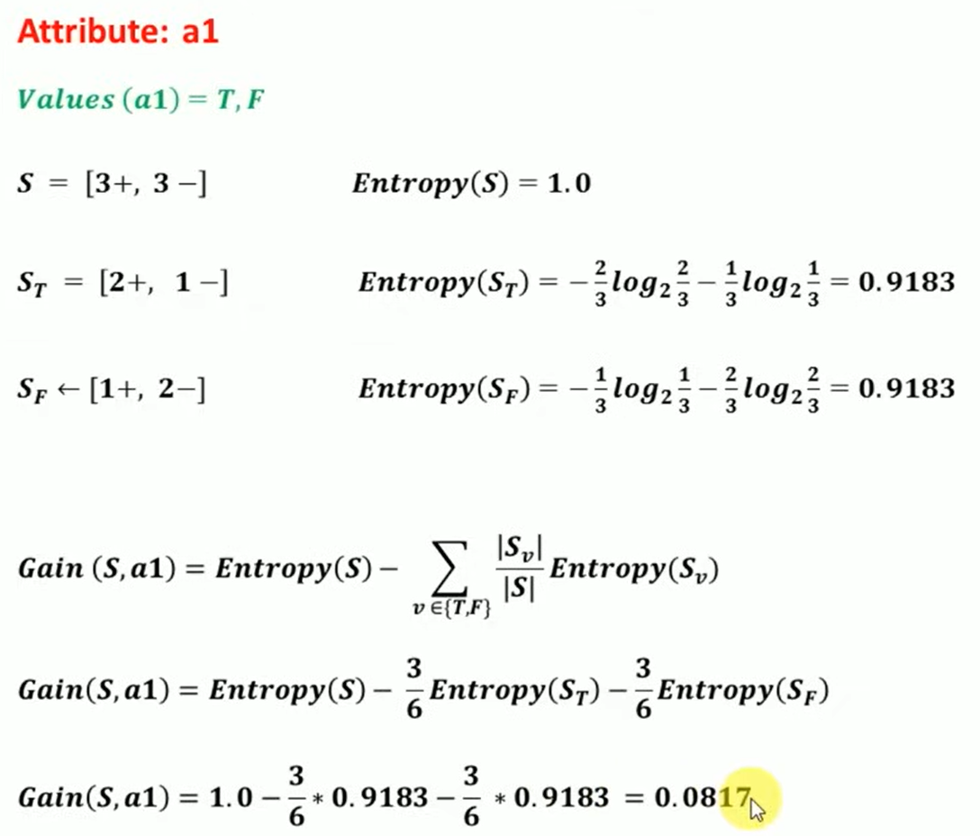
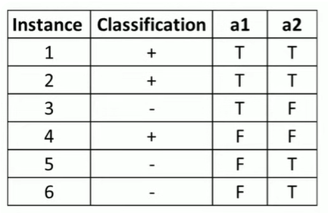

Slide 28
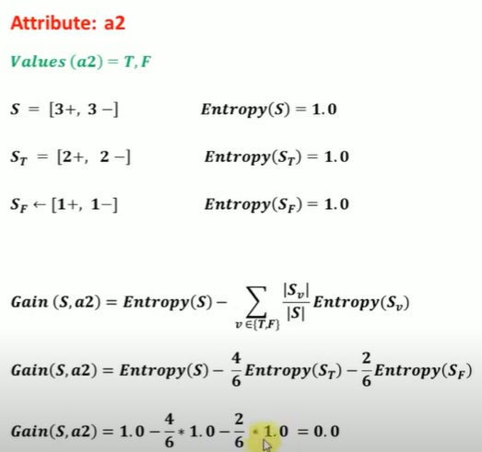

Slide 29

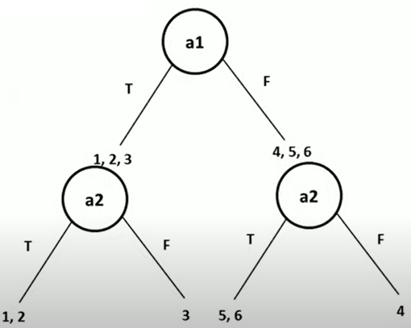

Slide 30
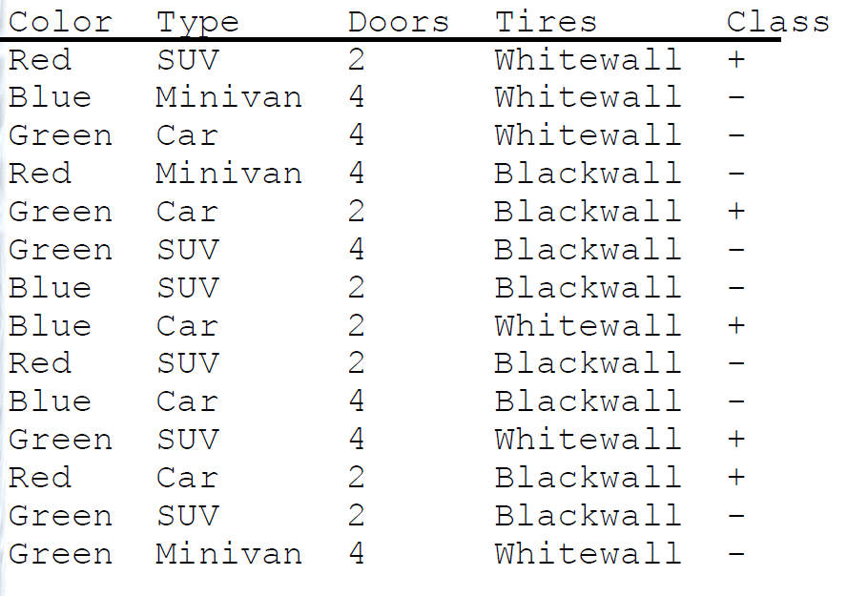

Slide 31
Entropy (S) = 0.94
Gain(S,Color)
= .940 - (4/14)1.0 - (4/14).811 -(6/14).918
= 0.029
Gain(S,Type)
= .940 - (5/14).971 - (3/14)0 -(6/14)0.918
= 0.200
Gain(S,Doors)
= .940 - (7/14)0.985 - (7/14)0.592
= 0.152
Gain(S,Tires)
= .940 - (6/14)1.0 - (8/14).811
= 0.048
Root node is Type attribute

Slide 32
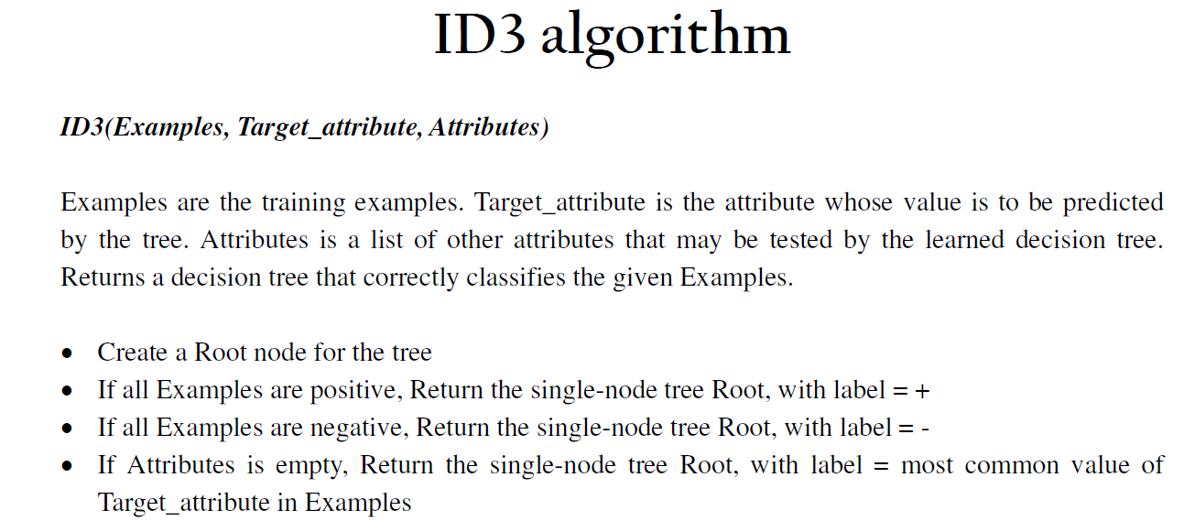

Slide 33
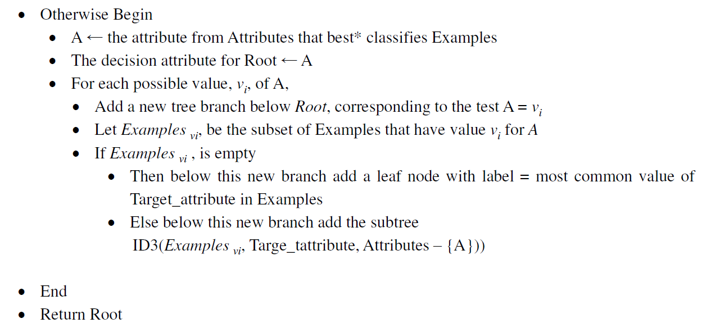
https://www.youtube.com/watch?v=K-oGwFoCGU0

Slide 34
Regression Tree
Regression trees are variant of decision trees where the target feature is continuous valued variable.
These tree are constructed using an algorithm called reduction in variance which uses standard deviation to chose the best splitting attribute

Slide 35
Classification and Regression Trees (CART)
CART is a decision tree algorithm that is used for both classification and regression tasks. It is a supervised learning algorithm that learns from labelled data to predict unseen data.
CART uses a greedy approach to split the data at each node. It evaluates all possible splits and selects the one that best reduces the impurity of the resulting subsets.
For classification tasks, CART uses Gini impurity as the splitting criterion. The lower the Gini impurity, the purer the subset is.
For regression tasks, CART uses residual reduction as the splitting criterion. The lower the residual reduction, the better the fit of the model to the data.

Slide 36
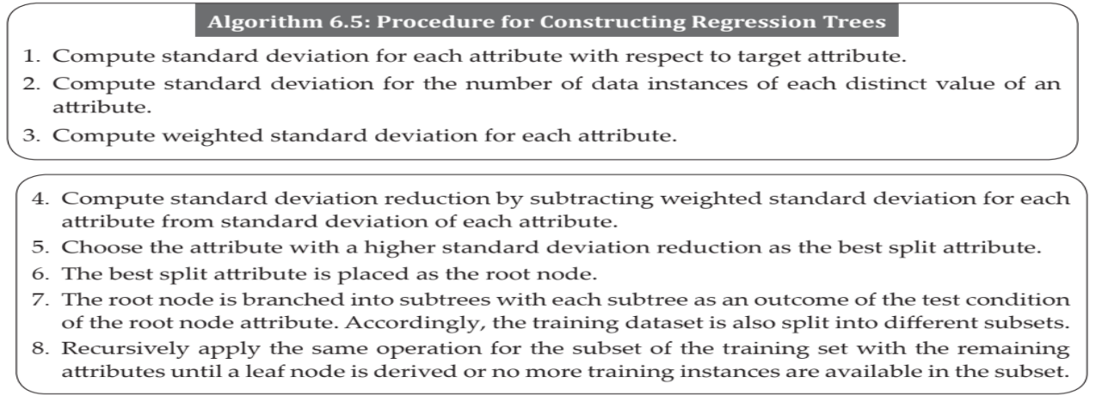
Algorithm: Regression Tree

Slide 37
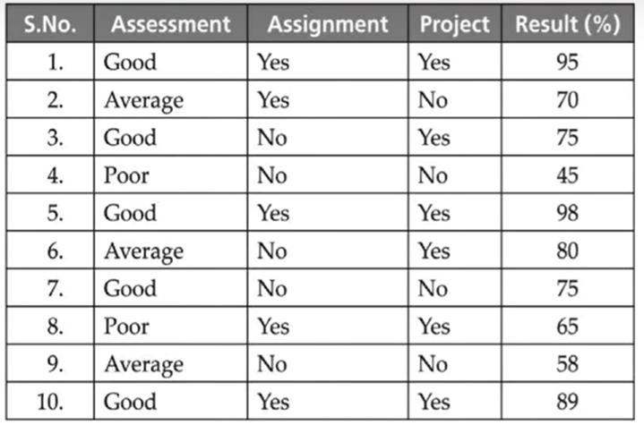
Given a data set with three attributes, assessment, assignment and project of the attributes, Result is a target variable. In this case, the target is continuous in nature. Hence, we need to build the regression trees.

Slide 38
To build regression trees, first we need to compute the standard deviation for the target attribute. So, in this case, the target attribute is result, we need to calculate the standard deviation. To calculate the standard deviation, first we need to calculate the average.
Standard deviation for the whole data set
Standard deviation is equivalent to 16 .55.

Slide 39
Calculate the standard deviation for each of these particular attributes
Standard deviation for Assessment : Good
Standard deviation =10.9
Standard deviation for Assessment: Average
Standard deviation =11.01

Slide 40

Calculate the standard deviation for each of these particular attributes
Standard deviation for Assessment :Poor
Standard deviation =14.14

Slide 41
Assessment | Standard Deviation | Instances
Good | 10.9 | 5
Average | 11.01 | 3
Poor | 14.14 | 2
Calculate the weighted standard deviation. Weighted standard deviation for this assessment attribute is equal to 5 is the data instances for assessment is equal to good divided by total number of examples with respect to assessment.
Calculate the standard deviation reduction for assessment.

Slide 42
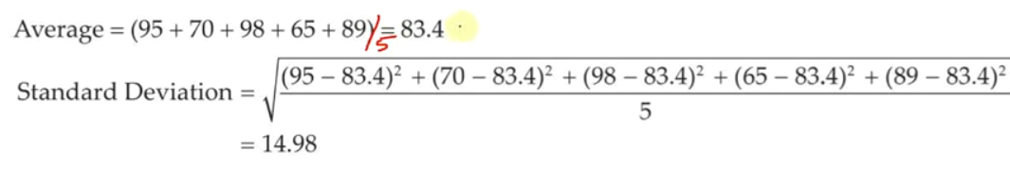
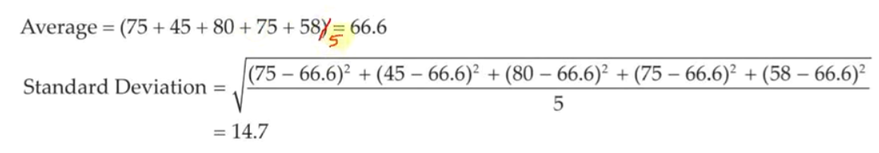
Standard Deviation for Assignment = Yes
Standard Deviation for Assignment = No

Slide 43
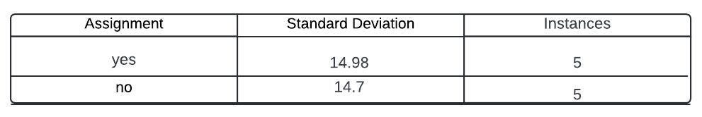

Slide 44
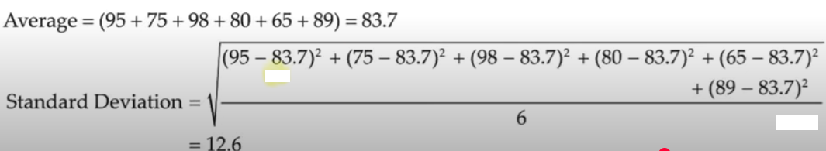
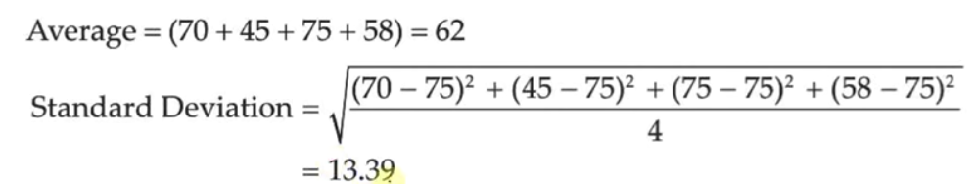
Standard Deviation for Project = Yes
/6
Standard Deviation for Assignment = No
/4

Slide 45
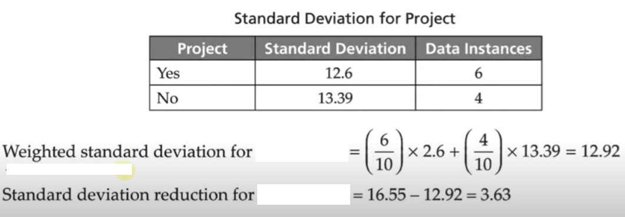
Project
1
Project

Slide 46
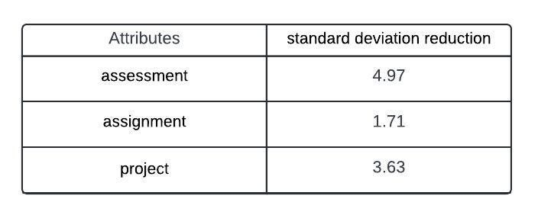
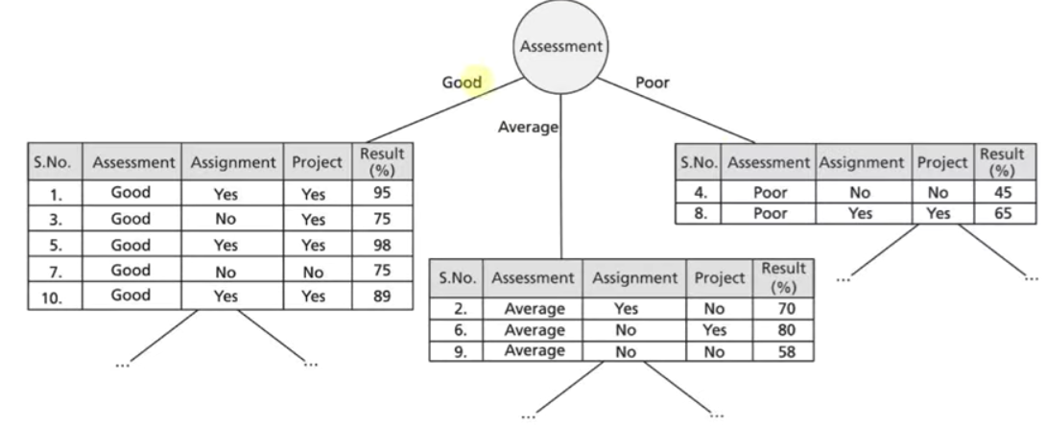
Training dataset is split into subsets based on the attribute "Assessment" and this this process continued until the entire tree is constructed.

Slide 47
Youtube link
https://www.youtube.com/watch?v=g9c66TUylZ4&t=441s

Slide 48
Reference
https://www.studocu.com/in/document/cambridge-group-of-institutions/big-data-analytics/ai-ml-module-2-problems-solution-with-answers/24915005
https://medium.com/@parshad1912/a-decision-tree-is-a-hierarchical-structure-that-makes-decisions-based-on-a-series-of-rules-or-251da4109480

