Slide 1
Support Vector Machine (SVM)

Slide 2
Introduction
Support Vector Machine (SVM) is a supervised learning algorithm used for classification and regression tasks. It is also called as Maximum Margin Classifier
SVM finds a hyperplane that segregates the labeled dataset into two classes.
In machine learning and higher-dimensional geometry, a hyperplane is a flat, n-1 dimensional subspace that divides an n-dimensional space into two regions, often used as a decision boundary in classification or regression tasks.
It is particularly effective for high-dimensional spaces and is widely used in machine learning applications such as text classification, image recognition, and bioinformatics.

Slide 3
Types of SVM
Support Vector Machines (SVMs) come in two main types
Linear SVM
Used for linearly separable data
Non-linear SVM
Which handles complex data using kernel functions like RBF and polynomial.

Slide 4
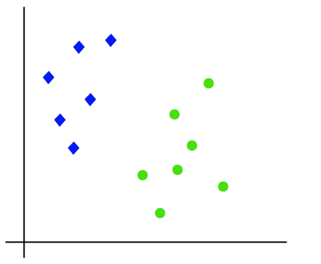
Linear SVM
When the data is linearly separable only then we can use Linear SVM.
Linearly separable means that the data points can be classified into 2 classes by using a single straight line(if 2D).

Slide 5
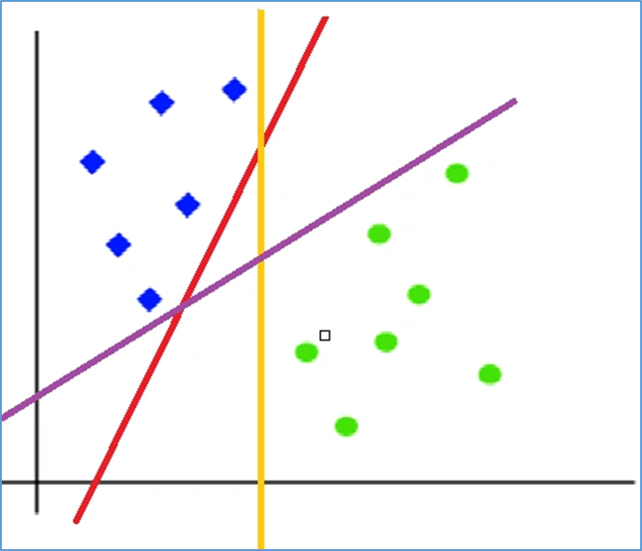
Hyperplane
A hyperplane is a decision boundary that separates data points into different classes in a high-dimensional space.
In two-dimensional space, a hyperplane is simply a line that separates the data points into two classes
When we add the new testing data, whatever side of the hyperplane it goes will eventually decide the class that we assign to it

Slide 6
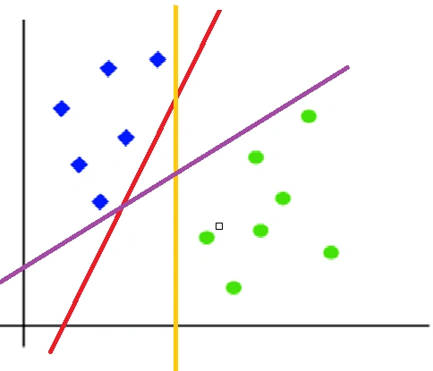
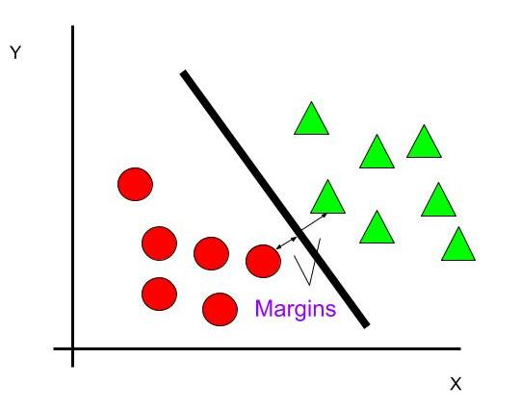
Hyperplane
Margin
The margin is the distance between the hyperplane and the closest data points from either class. SVM aims to maximize this margin to ensure better generalization.
To segregate the dataset into classes we need the hyperplane. To choose the right hyperplane we need margin. Margin is the distance between the hyperplane and the closest point from either set.

Slide 7
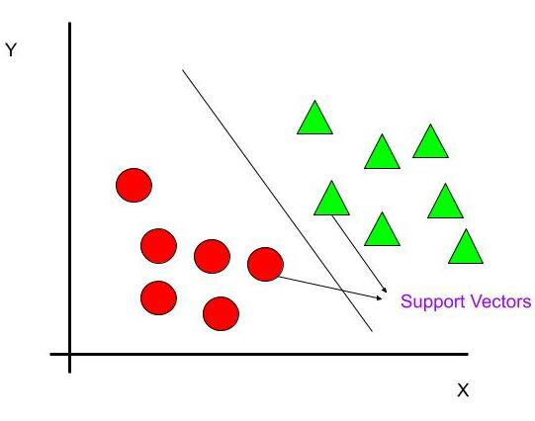
Support Vectors
Support vectors are the data points closest to the hyperplane. These points play a crucial role in defining the position and orientation of the decision boundary.

Slide 8
SVMs are commonly used within classification problems.
They distinguish between two classes by finding the optimal hyperplane that maximizes the margin between the closest data points of opposite classes.
The number of features in the input data determine if the hyperplane is a line in a 2-D space or a plane in a n-dimensional space.
Since multiple hyperplanes can be found to differentiate classes, maximizing the margin between points enables the algorithm to find the best decision boundary between classes.
This, in turn, enables it to generalize well to new data and make accurate classification predictions.
The lines that are adjacent to the optimal hyperplane are known as support vectors as these vectors run through the data points that determine the maximal margin

Slide 9
Support Vector Machine (SVM) is a supervised learning algorithm used for classification and regression tasks. It works by finding the best decision boundary (hyperplane) that separates data points of different classes with the maximum margin.

Slide 10
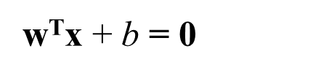
Finding the Optimal Hyperplane
We are given a training dataset of n points of the form
(x₁,y₁),…..,(x_{n},y_{n})
where,
y_{i} are either 1 or -1, each indicating the class to which the point x_{i} belongs
Each x_{i} is a p-dimensional vector
We want to find the “maximum-margin hyperplane” that divides the group of points x_{i} for which y_{i} =1 from the group of points for which y_{i} = -1, which is defined so that the distance between the hyperplane and the nearest point x_{i} from either group is maximized
Any hyperplane can be written as the set of points satisfying

Slide 11
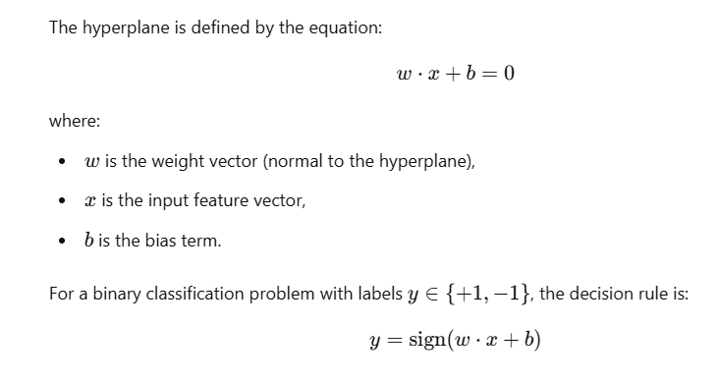

Slide 12
Our Goal is to find out w and b such that
w^{T}x + b > 0 for y_{i}= +1
w^{T}x + b < 0 for y_{i}= -1
w^{T}x + b = 0
w^{T}x + b > 0
w^{T}x + b < 0
f(x) = sign(w^{T}x + b)

Slide 13
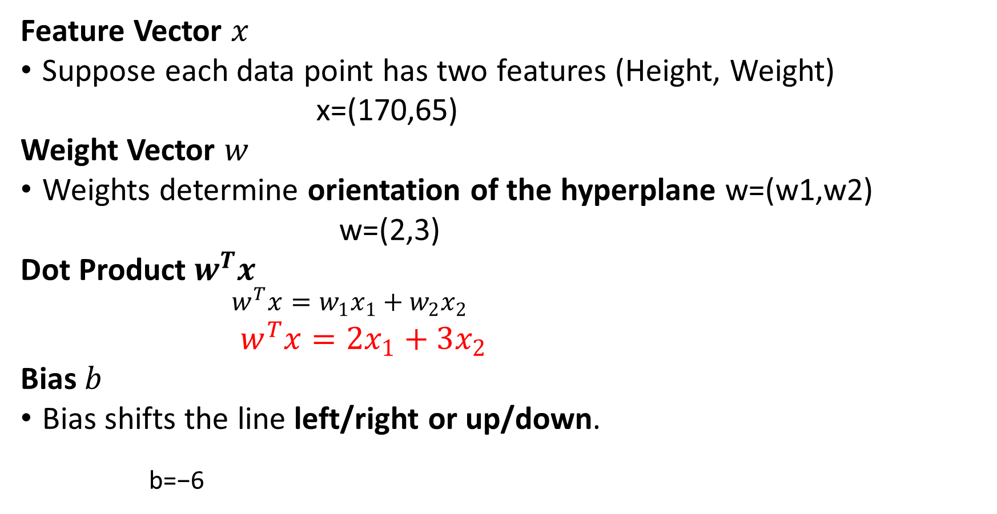
Example
Feature Vector $x$
Suppose each data point has two features (Height, Weight)
x=(170,65)
Weight Vector $w$
Weights determine orientation of the hyperplane w=(w1​,w2​)
w=(2,3)
Dot Product $w^{T}x$
$w^{T}x=w_{1}x_{1}+w_{2}x_{2}$
$w^{T}x=2x_{1}+3x_{2}$
Bias $b$
Bias shifts the line left/right or up/down.
b=−6

Slide 14
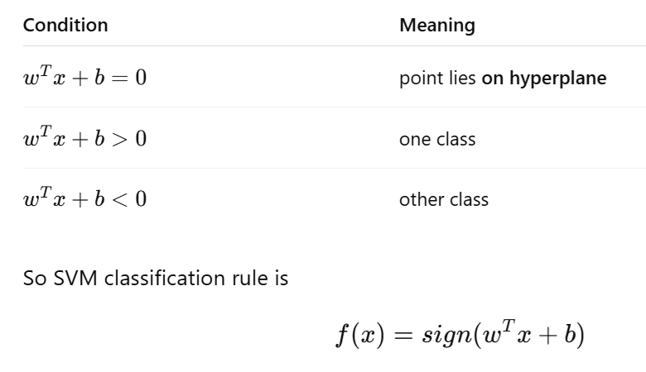
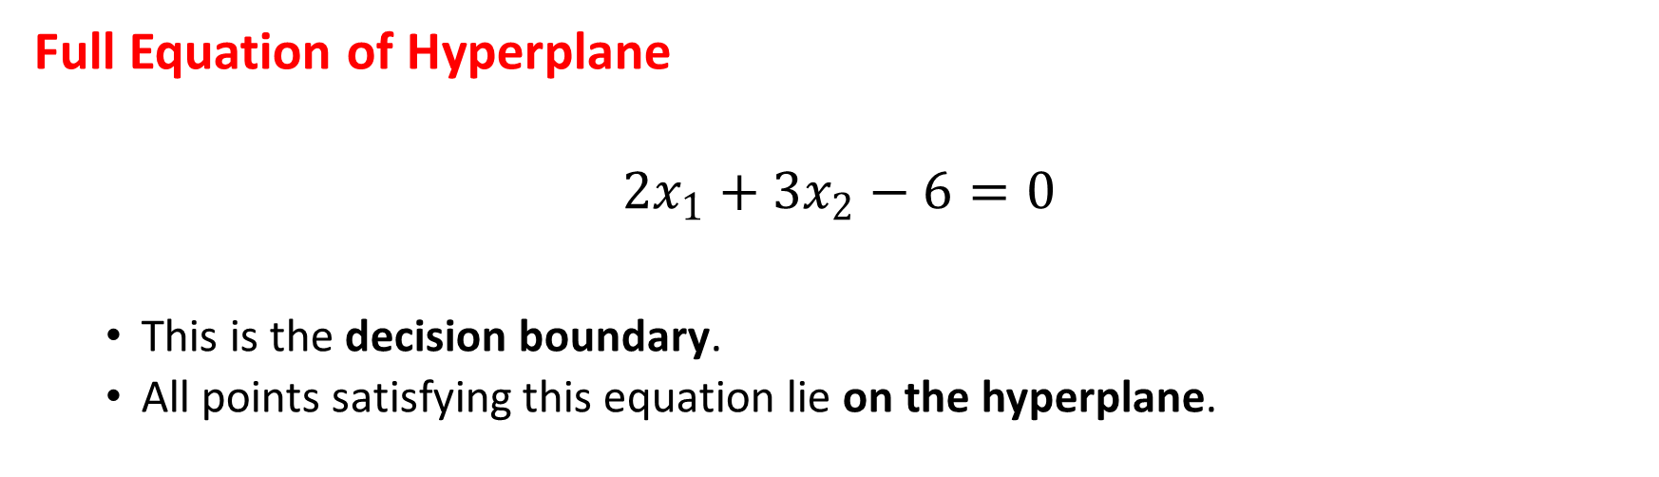
Full Equation of Hyperplane
$$2x_{1}+3x_{2}−6=0$$
This is the decision boundary.
All points satisfying this equation lie on the hyperplane.

Slide 15
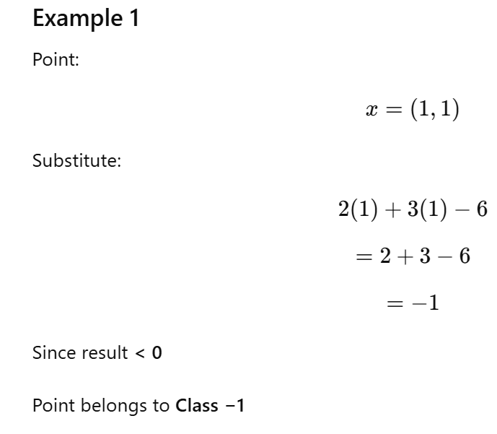
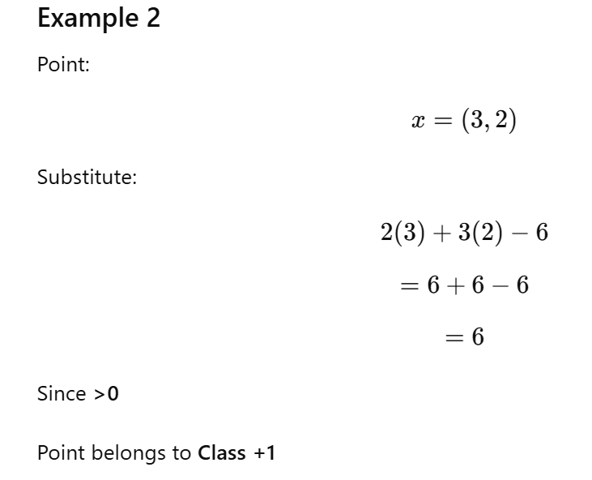
$$2x_{1}+3x_{2}−6=0$$

Slide 16
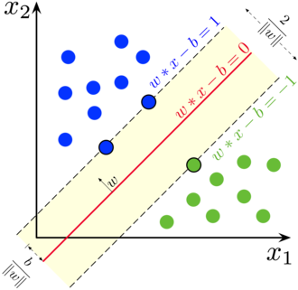

Slide 17
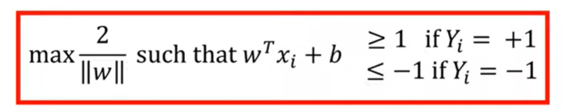
Math behind SVM
Notes:
To get started with introduction to AI, I would like you to watch this 2 minute from Boston Dynamics
After watching
What you have observed in this video, it is natural or artificial ?
Boston Dynamics a Robotics Company

Slide 18
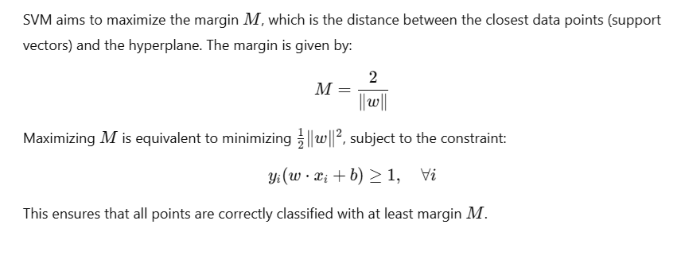
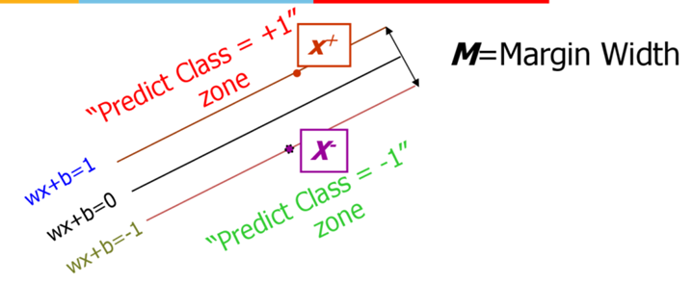
Maximum Margin Concept

Slide 19
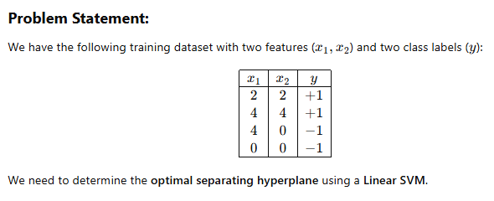
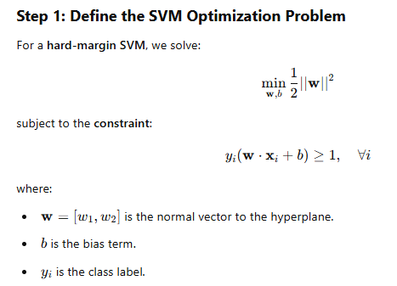

Slide 20
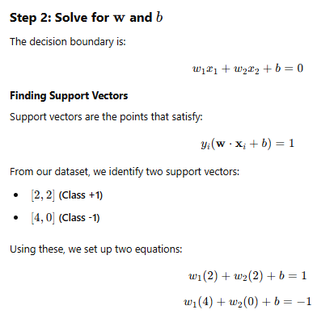

Slide 21
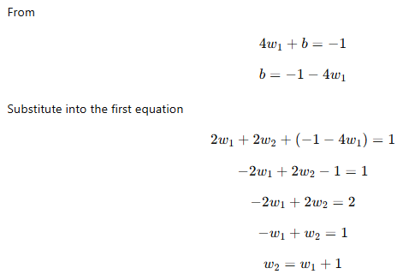
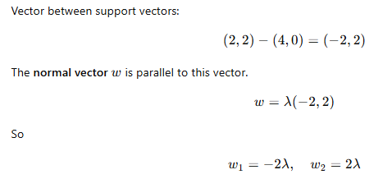
Use SVM geometric property

Slide 22
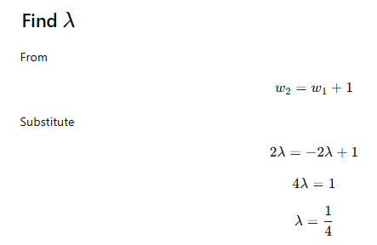
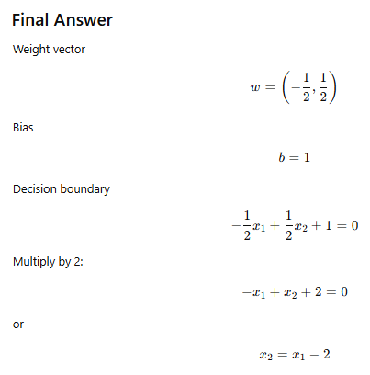
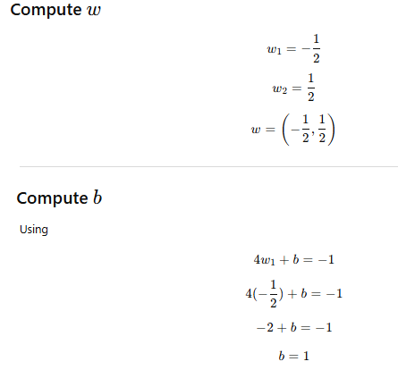

Slide 23
Hard Margin SVM
Hard margin SVM assumes that the data is perfectly linearly separable.
It tries to find a hyperplane that separates the classes without any misclassification.
Key Idea
No point is allowed inside the margin
No misclassification allowed

Slide 24
Soft Margin SVM
Soft margin SVM allows some classification errors so that the model becomes robust to noise and overlapping classes.
Soft margin SVM introduces slack variables ξ_{i}​ that allow some training samples to lie:
Inside the margin
On the wrong side of the decision boundary
This enables the classifier to balance margin maximization and classification error.

Slide 25
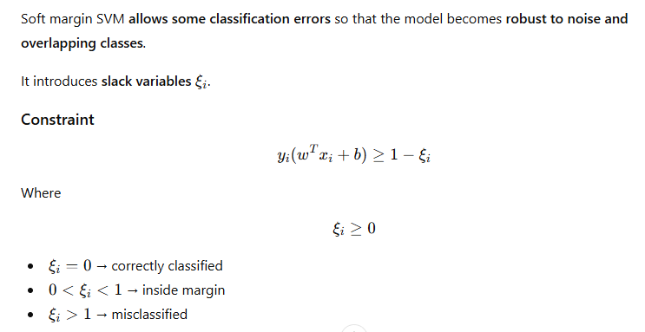

Slide 26
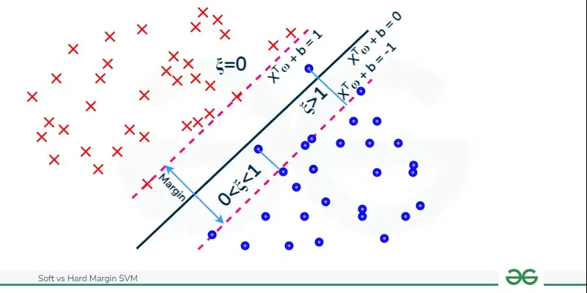
Soft Margin

Slide 27
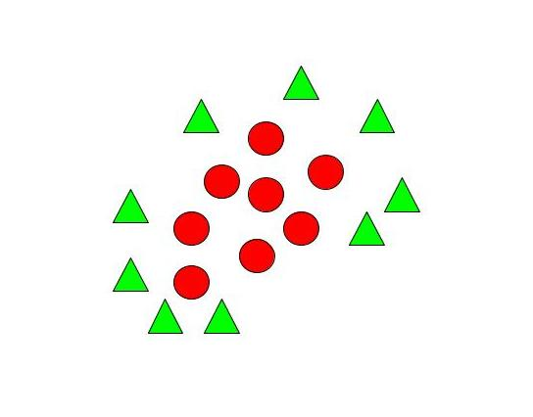
Non – Linear SVM.
When we can easily separate data with hyperplane by drawing a straight line is Linear SVM.
When we cannot separate data with a straight line we use Non – Linear SVM. In this, we have Kernel functions. They transform non-linear spaces into linear spaces. It transforms data into another dimension so that the data can be classified.
It transforms two variables x and y into three variables along with z. Therefore, the data have plotted from 2-D space to 3-D space. Now we can easily classify the data by drawing the best hyperplane between them

Slide 28
Much of the data in real-world scenarios are not linearly separable, and that’s where nonlinear SVMs come into play.
In order to make the data linearly separable, preprocessing methods are applied to the training data to transform it into a higher-dimensional feature space. That said, higher dimensional spaces can create more complexity by increasing the risk of overfitting the data and by becoming computationally taxing.
The “kernel trick” helps to reduce some of that complexity, making the computation more efficient, and it does this by replacing dot product calculations with an equivalent kernel function.
There are a number of different kernel types that can be applied to classify data. Some popular kernel functions include:
Polynomial kernel
Radial basis function kernel (also known as a Gaussian or RBF kernel)
Sigmoid kernel

Slide 29
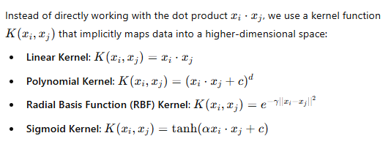
Kernel Trick

Slide 30
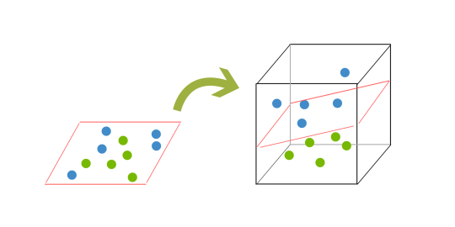
Support Vector Machines (SVM) can handle highly non-linear problems using a kernel trick which implicitly maps the input vectors to higher-dimensional feature spaces.

Slide 31
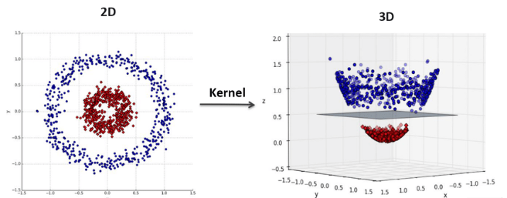
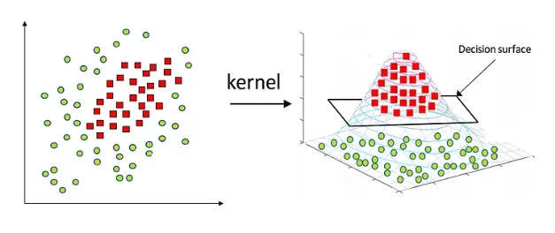

Slide 32
SVM
The SVM algorithm is widely used in machine learning as it can handle both linear and nonlinear classification tasks.
However, when the data is not linearly separable, kernel functions are used to transform the data higher-dimensional space to enable linear separation.
This application of kernel functions can be known as the “kernel trick”, and the choice of kernel function, such as linear kernels, polynomial kernels, radial basis function (RBF) kernels, or sigmoid kernels, depends on data characteristics and the specific use case

Slide 33
SVM for Classification and Regression
SVM for Classification (SVC): Uses hyperplanes to separate data into different classes.
SVM for Regression (SVR): Uses an alternative objective to fit a regression model while minimizing the margin violations.

Slide 34
Linear SVM vs Non-Linear SVM
Linear SVM | Non-Linear SVM
It can be easily separated with a linear line. | It cannot be easily separated with a linear line.
Data is classified with the help of hyperplane. | We use Kernels to make non-separable data into separable data.
Data can be easily classified by drawing a straight line. | We map data into high dimensional space to classify.

Slide 35
Advantages of SVM
Effective in high-dimensional spaces.
Works well with a clear margin of separation.
Can handle non-linearly separable data using kernels.
Robust to overfitting with proper regularization.

Slide 36
Disadvantages of SVM
Computationally expensive for large datasets.
Choosing the right kernel and hyperparameters can be complex.
Less effective with noisy data.

Slide 37
Applications of SVM
Text Classification: Spam detection, sentiment analysis.
Image Classification: Handwritten digit recognition.
Medical Diagnosis: Cancer detection from medical images.
Bioinformatics: Protein classification and gene expression analysis.

