Slide 1
UNIT 4
Ensemble Techniques And Unsupervised Learning: Combining multiple learners: Model combination schemes, Voting, Ensemble Learning - bagging, boosting, stacking, Unsupervised learning: Introduction to Clustering, K-means clustering, Dimensionality reduction-Principal Component Analysis

Slide 2
Bias and Variance in Machine Learning
Bias and Variance are two major sources of error that affect a machine learning model's performance
Understanding them helps in designing models that generalize well to unseen data.
Balance bias and variance to achieve optimal model performance.

Slide 3
Bias
Bias refers to errors due to overly simplistic assumptions in the learning algorithm
Models with high bias tend to underfit the data, meaning they fail to capture the underlying patterns in the dataset.
Bias measures how far the model’s average prediction is from the true value.
Example
Suppose the true relationship is: y=x²
But the model you use is linear regression: y=ax+b
A straight line cannot represent a quadratic curve, so the model will consistently make errors.
Characteristics of High Bias
Model is too simple
Underfitting
Training error is high
Validation/test error is also high

Slide 4
Variance
Variance measures the model’s sensitivity to fluctuations in the training data.
Variance measures how much the model’s predictions change if the training data changes slightly.
If a model learns noise in the data instead of the real pattern, it has high variance.
Characteristics of High Variance
Model is too complex
Overfitting
Training error very low
Test error high

Slide 5
Ensemble Learning
Ensemble technology in machine learning refers to techniques that combine multiple models to produce better performance than any single model alone.
The main idea is that a group of "weak learners" (models that perform slightly better than random guessing) can be combined to form a "strong learner.“
Ensembles offer more accuracy than individual or base classifier.
Ensemble methods can decrease variance using bagging approach, bias using a boosting approach, or improve predictions using stacking approach.

Slide 6
Real life examples
Let's take a real example to build the intuition.
Suppose, you want to invest in a company XYZ. You are not sure about its performance though.
So, you look for advice on whether the stock price will increase by more than 6% per annum or not?
You decide to approach various experts having diverse domain experience

Slide 7
The survey prediction
Employee of Company XYZ:
– In the past, he has been right 70% times.
• Financial Advisor of Company XYZ:
– In the past, he has been right 75% times.
• Stock Market Trader:
– In the past, he has been right 70% times.
• Employee of a competitor:
– In the past, he has been right 60% times.
• Market Research team in the same segment:
– In the past, he has been right 75% times.
• Social Media Expert:
– In the past, he has been right 65% times.

Slide 8
Inference
Given the broad spectrum of access you have, you can probably combine all the information and make an informed decision.
In a scenario when all the 6 experts/teams verify that it’s a good decision(assuming all the predictions are independent of each other), you will get a combined accuracy rate of 1 - (30% . 25% . 30% . 40% . 25% . 35%) = 1 - 0.07875 = 99.92125%
The assumption used here that all the predictions are completely independent is slightly extreme as they are expected to be correlated. However, you can see how we can be so sure by combining various forecasts together.
Well, Ensemble learning is no different.

Slide 9
Ensembling
An ensemble is the art of combining a diverse set of learners (individual models) together to improvise on the stability and predictive power of the model.
In our example, the way we combine all the predictions collectively will be termed as Ensemble learning.
Moreover, Ensemble-based models can be incorporated in both of the two scenarios, i.e., when data is of large volume and when data is too little.

Slide 10
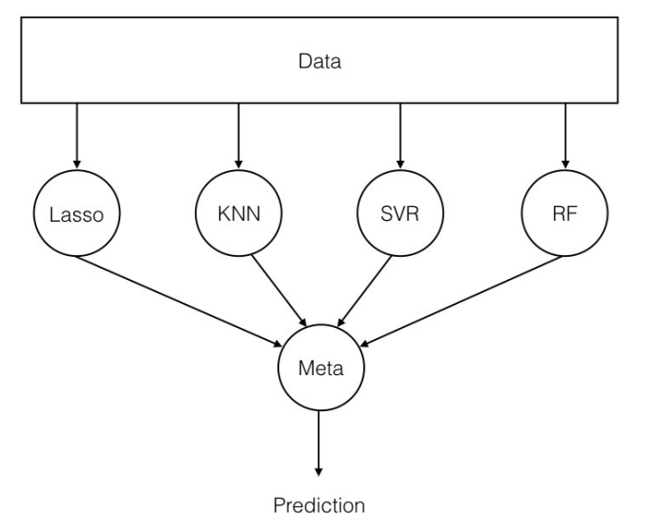
Basic Ensemble Structure

Slide 11
Summary
Use multiple learning algorithms (classifiers)
Combine the decisions
Can be more accurate than the individual classifiers
Generate a group of base-learners
Different learners use different
– Algorithms
– Hyperparameters
– Representations (Modalities)
– Training sets

Slide 12
Why ensembles ?
There are two main reasons to use an ensemble over a single model, and they are related; they are:
– Performance: An ensemble can make better predictions and achieve better performance than any single contributing model.
– Robustness: An ensemble reduces the spread or dispersion of the predictions and model performance.

Slide 13
Ensemble Learning Methods
Bagging
Boosting
Stacking
Voting

Slide 14
Bootstrapping
Bootstrapping is a technique where we create many new datasets from the original dataset by sampling randomly with replacement.
Each bootstrap sample is likely to have some repeated and some missing records.
These samples are then used to train different models.
It helps us understand the variability in our model and improves stability and accuracy when used in ensemble learning,

Slide 15
Bootstrapping
Original Dataset: [1, 2, 3, 4, 5]
You create bootstrap samples like
Sample 1: [1, 3, 4, 4, 5]
Sample 2: [2, 2, 3, 5, 1]
Sample 3: [5, 3, 1, 3, 4]

Slide 16
Bagging or Bootstrap Aggregation
Bagging, an abbreviation for Bootstrap Aggregating, is a machine learning ensemble strategy for enhancing the reliability and precision of predictive models.
Bagging involves training multiple base learners on different subsets of the training data, typically created through random sampling with replacement.
It can be used for both classification and regression

Slide 17
Bagging (Bootstrap Aggregating):
Goal: Reduce variance and avoid overfitting.
How it works:
Take many random samples (with replacement) from the original dataset.
Train a separate model on each sample.
Average (for regression) or vote (for classification) the predictions.
Popular example: Random Forest (many decision trees).

Slide 18
Variance
Variance means how much your model's predictions change if you use a different training dataset.
High variance = Model is too sensitive to the training data.
It learns noise or unnecessary details (overfitting).
Performs well on training data but poorly on new/unseen data.
Low variance = Model is more stable.
Even if the training data changes a little, predictions stay similar.

Slide 20
Multiple base models are trained independently and in parallel on different subsets of the training data.
Each subset is generated using bootstrap sampling, in which data points are picked at random with replacement.
In the case of the bagging classifier, the final prediction is made by aggregating the predictions of the all-base model using majority voting.
In the models of regression, the final prediction is made by averaging the predictions of the all-base model, and that is known as bagging regression.
Bagging helps improve accuracy and reduce overfitting, especially in models that have high variance.

Slide 21
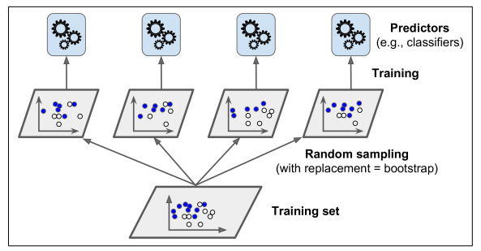
Use the same training algorithm for every predictor, but to train them on different random subsets of the training set.
When sampling is performed with replacement, this method is called bagging (short for bootstrap aggregating).
When sampling is performed without replacement, it is called pasting.

Slide 22
Random Forest
Random forest is a type of supervised machine learning algorithm based on ensemble learning.
Random forest combines multiple decision trees to make more accurate and stable predictions.
The random forest algorithm combines multiple algorithm of the same type i.e. multiple decision trees, resulting in a forest of trees, hence the name "Random Forest".
The random forest algorithm can be used for both regression and classification tasks.

Slide 23
Random Forest
Bootstrapping – Each tree is trained on a different random sample of the training data (with replacement).
Feature Randomness – At each split in a tree, a random subset of features is considered.
Ensemble of Trees – All trees vote, and the majority wins.

Slide 24
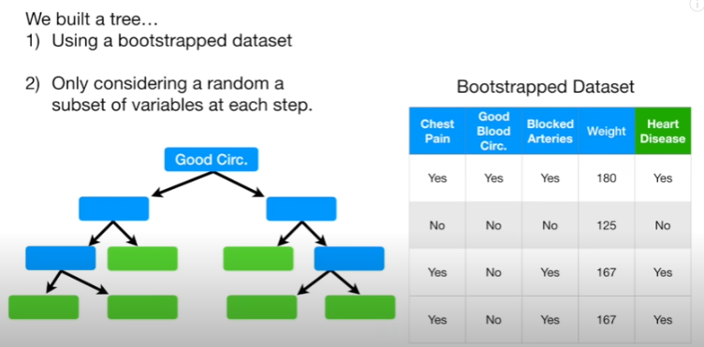
Random Forest

Slide 25
Majority voting

Slide 26
Random Forest
Pick N random records from the dataset.
Build a decision tree based on these N records.
Choose the number of trees you want in your algorithm and repeat steps 1 and 2.
In case of a regression problem, for a new record, each tree in the forest predicts a value for Y (output). The final value can be calculated by taking the average of all the values predicted by all the trees in forest. Or, in case of a classification problem, each tree in the forest predicts the category to which the new record belongs. Finally, the new record is assigned to the category that wins the majority vote.

Slide 27
Boosting
Boosting improves performance by training models sequentially.
Each new model tries to correct errors made by the previous one.
This is done by building a model from the training data, then creating a second model that attempts to correct the errors from the first model. Models are added until the training set is predicted perfectly or a maximum number of models are added.
Highly accurate classifier( or strong classifier) offer error rate close to 0.
Boosting algorithms are less affected by the overfitting problem.

Slide 28
Boosting
Goal: Reduce bias (and a little bit of variance).
How it works:
Train models sequentially.
Each model focuses more on the mistakes made by the previous model.
Combine all models into one strong model (weighted sum or voting).
Popular examples: AdaBoost, Gradient Boosting, XGBoost.

Slide 29
Boosting Models
Models that are typically used in Boosting technique are:
XGBoost (Extreme Gradient Boosting)
GBM (Gradient Boosting Machine)
ADABoost (Adaptive Boosting)

Slide 30
AdaBoost
AdaBoost is a boosting ensemble machine learning algorithm that combines multiple weak learners (usually decision stumps) to create a strong classifier.
The idea is
Instead of training all models equally, AdaBoost focuses more on the samples that previous models classified incorrectly.
So, each new model learns from the mistakes of the previous model.

Slide 31
Weak Learner
A model slightly better than random guessing.
Usually a decision stump (tree with depth = 1).
Sample Weights
Each training sample has a weight.
Initially all weights are equal.
Misclassified samples get higher weight in the next iteration
Model Weight (α)
Each weak learner is assigned a weight based on its accuracy

Slide 32
Adaboost
AdaBoost works in iterations
Start by giving equal weight to all training samples.
Train a weak learner (e.g., decision stump).
Check which samples were misclassified.
Increase weights of misclassified samples.
Train the next learner using the updated weights.
Combine all learners into a weighted majority vote.

Slide 33
Working Principle of Adaboost

Slide 34
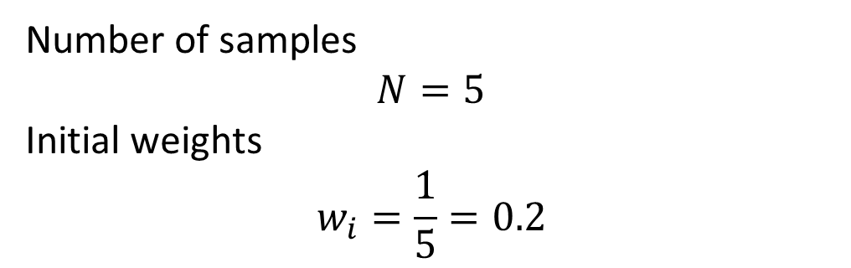
Training Dataset
Sample | x | y
1 | 1 | +1
2 | 2 | +1
3 | 3 | -1
4 | 4 | -1
5 | 5 | +1
Number of samples
$$N=5$$
Initial weights
$$w_{i}=\frac{1}{5}=0.2$$
Sample | x | y | Weight
1 | 1 | +1 | 0.2
2 | 2 | +1 | 0.2
3 | 3 | -1 | 0.2
4 | 4 | -1 | 0.2
5 | 5 | +1 | 0.2

Slide 35
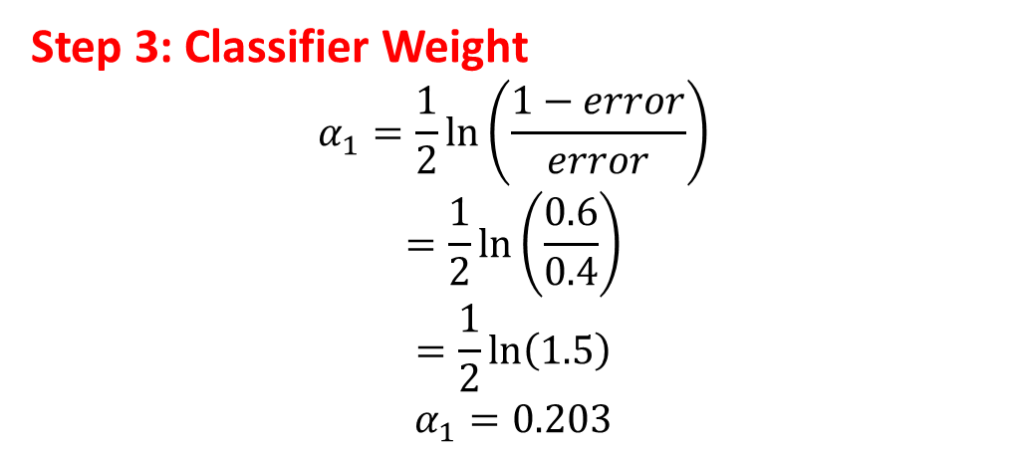
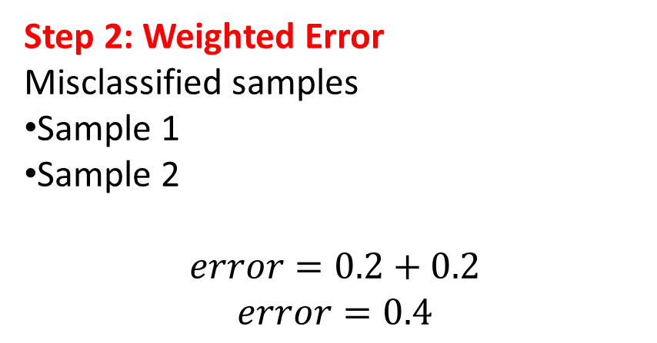
Predictions
ITERATION 1
Sample | x | True y | Prediction
1 | 1 | +1 | -1
2 | 2 | +1 | -1
3 | 3 | -1 | -1
4 | 4 | -1 | -1
5 | 5 | +1 | +1
Step 1: Train Decision Stump
Consider stump
x < 4.5 → -1 x ≥ 4.5 → +1
Step 2: Weighted Error
Misclassified samples
Sample 1
Sample 2
$$error=0.2+0.2$$
$$error=0.4$$
Step 3: Classifier Weight
$$α_{1}=\frac{1}{2}\ln\left(\frac{1−error}{error}\right)$$
$$=\frac{1}{2}\ln\left(\frac{0.6}{0.4}\right)$$
$$=\frac{1}{2}ln⁡\left(1.5\right)$$
$$α_{1}=0.203$$

Slide 36
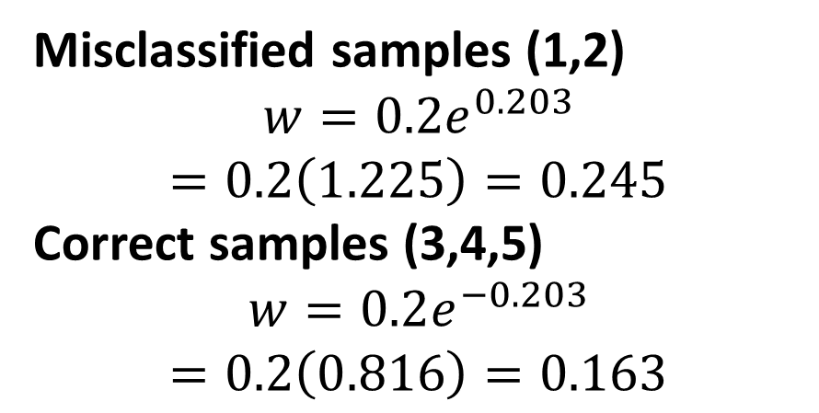
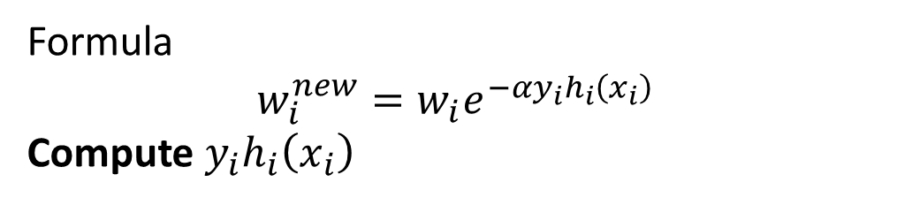
Update Weights
Sample | y | h(x) | (y h(x))
1 | +1 | -1 | -1
2 | +1 | -1 | -1
3 | -1 | -1 | +1
4 | -1 | -1 | +1
5 | +1 | +1 | +1
Formula
$$w_{i}^{new}=w_{i}e^{−αy_{i}h_{i}\left(x_{i}\right)}$$
Compute $y_{i}h_{i}\left(x_{i}\right)$
Misclassified samples (1,2)
$$w=0.2e^{0.203}$$
$$=0.2\left(1.225\right)=0.245$$
Correct samples (3,4,5)
$$w=0.2e^{−0.203}$$
$$=0.2\left(0.816\right)=0.163$$
Normalized weights
Sample | Weight
1 | 0.245
2 | 0.245
3 | 0.163
4 | 0.163
5 | 0.163
So samples 1 and 2 now have highest importance.

Slide 37
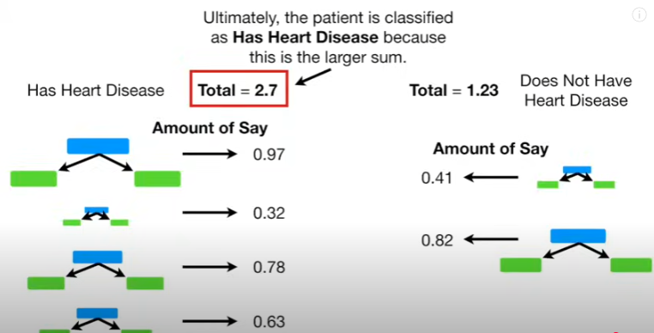
Now we train using updated weights.
Consider stump
x < 2.5 → +1 x ≥ 2.5 → -1

Slide 39
Stacking
Stacking is an ensemble learning technique where multiple different models are trained, and their predictions are used as inputs to another model (called a meta-model) that learns how to combine them.
So instead of simple voting, stacking learns the best way to combine models.

Slide 40
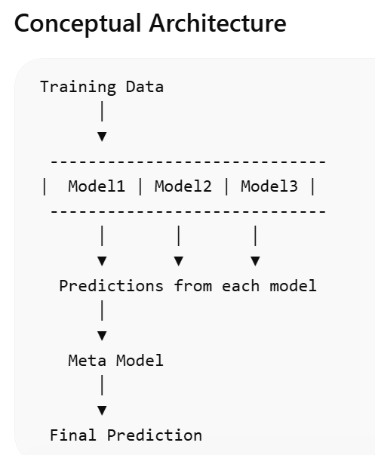

Slide 41
Suppose we want to predict whether a student will pass an exam.
Student | Study Hours | Attendance | Pass (y)
1 | 2 | 60 | 0
2 | 3 | 65 | 0
3 | 5 | 70 | 1
4 | 6 | 80 | 1
5 | 7 | 85 | 1
Step 1 — Train Base Models
We train three models:
Decision Tree
SVM
Logistic Regression

Slide 42
Step 2 — Base Model Predictions
After training, each model predicts outcomes.
Student | Tree | SVM | Logistic | True y
1 | 0 | 0 | 0 | 0
2 | 0 | 1 | 0 | 0
3 | 1 | 1 | 1 | 1
4 | 1 | 1 | 1 | 1
5 | 1 | 1 | 1 | 1
The above predictions become Meta Dataset for Meta Model
Train Meta Model on this new dataset.

Slide 43
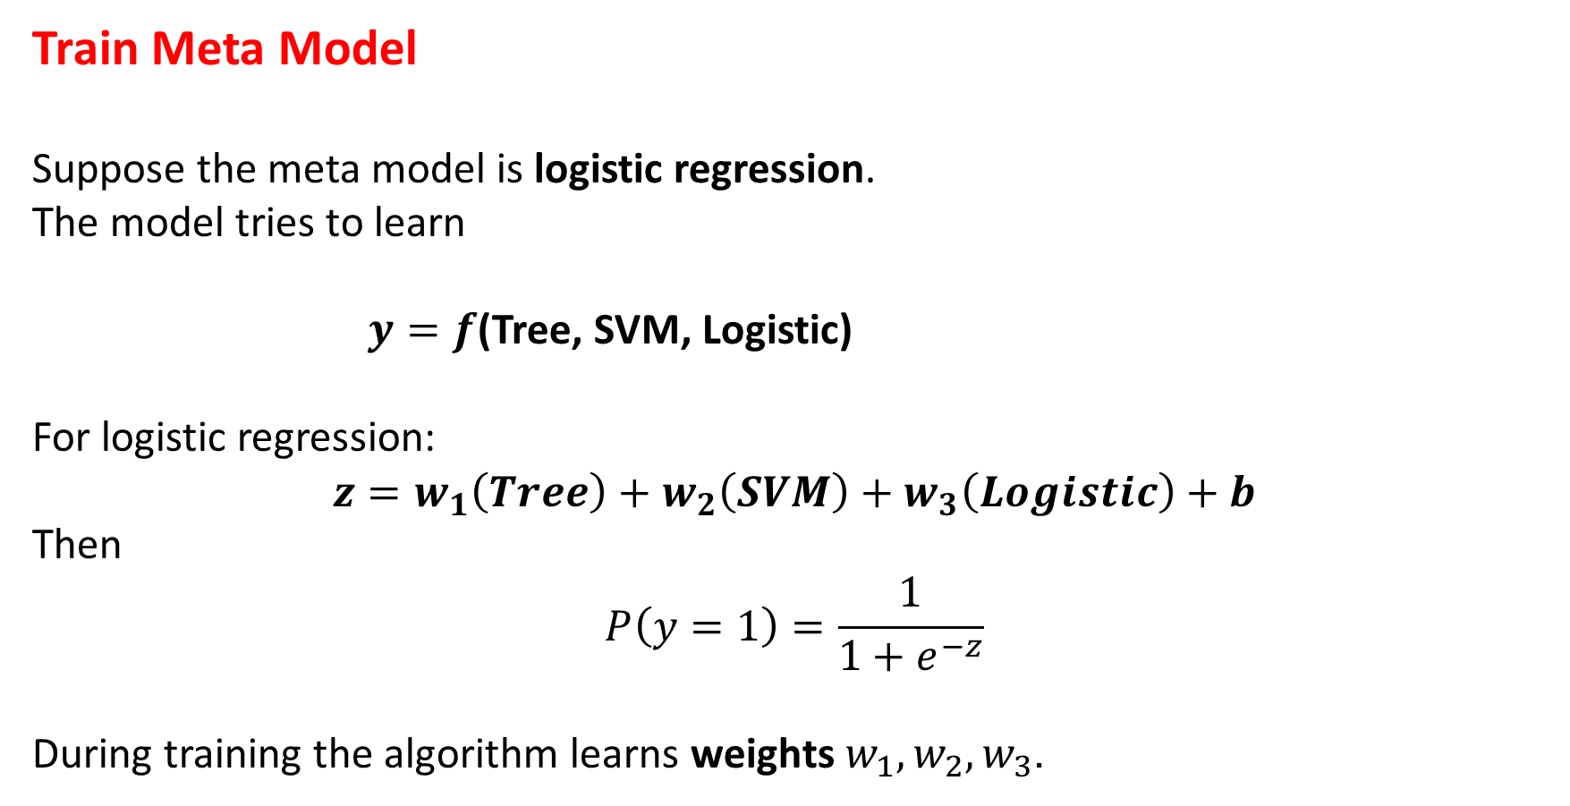
Train Meta Model
Suppose the meta model is logistic regression.
The model tries to learn
$y=f$(Tree, SVM, Logistic)
For logistic regression:
$$z=w_{1}\left(Tree\right)+w_{2}\left(SVM\right)+w_{3}\left(Logistic\right)+b$$
Then
$$P\left(y=1\right)=\frac{1}{1+e^{−z}}$$
During training the algorithm learns weights $w_{1},w_{2},w_{3}$.

Slide 44
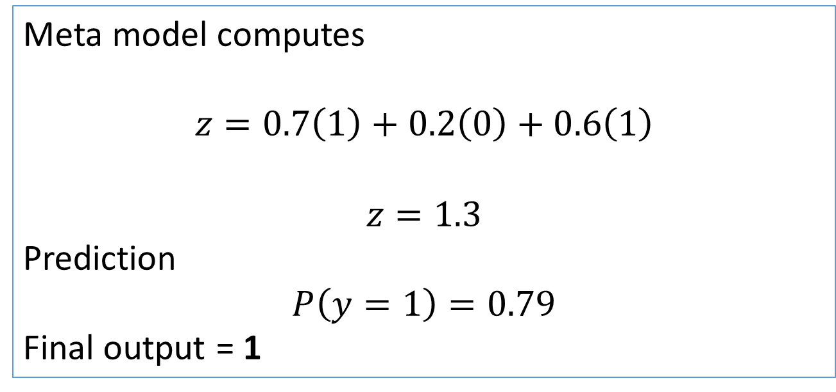
Final Prediction
New data point predictions:
Tree | SVM | Logistic
1 | 0 | 1
Meta model computes
$$z=0.7\left(1\right)+0.2\left(0\right)+0.6\left(1\right)$$
$$z=1.3$$
Prediction
$$P\left(y=1\right)=0.79$$
Final output = 1

Slide 45
Voting
Voting combines multiple models’ outputs by majority (classification) or average (regression).
It can be hard voting (final decision) or soft voting (based on predicted probabilities).
In classification, a hard voting ensemble involves summing the votes for crisp class labels from other models and predicting the class with the most votes.
A soft voting ensemble involves summing the predicted probabilities for class labels and predicting the class label with the largest sum probability.

Slide 46
Voting

Slide 47
Soft voting in Classification
In Soft Voting, multiple classifiers predict probabilities for each class. The average (or weighted average) of these probabilities is used to decide the final class.
Let’s say we have 3 classifiers predicting whether a patient has a disease (Yes = 1, No = 0). Here's how they assign probabilities:
Classifier | Prob(Yes) | Prob(No)
Model A | 0.90 | 0.10
Model B | 0.70 | 0.30
Model C | 0.40 | 0.60
Average Prob(Yes) = (0.90 + 0.70 + 0.40) / 3 = 0.67
Average Prob(No) = (0.10 + 0.30 + 0.60) / 3 = 0.33
🔚 Final prediction: Yes (1) because 0.67 > 0.33.

Slide 48
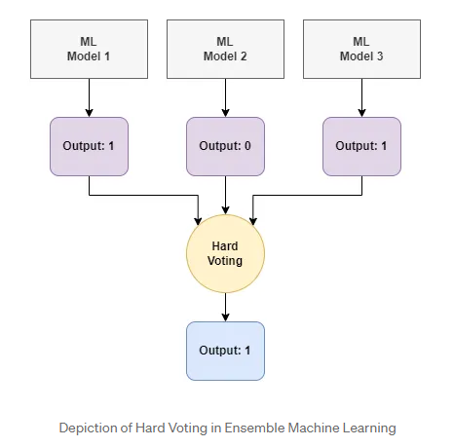
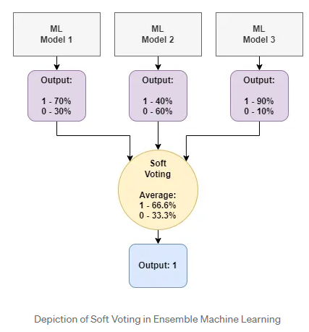

Slide 49
Unsupervised learning
Unsupervised learning is a type of machine learning where the model learns patterns from unlabeled data — meaning, the data doesn't have predefined categories or outputs.
Instead of being told what the "right answer" is (like in supervised learning), the model tries to:
Discover hidden structures (e.g., clusters, groups)
Find patterns, similarities, or differences
Reduce the dimensionality of the data to make it easier to understand

Slide 50
Example
If you give an unsupervised model a lot of pictures of animals without labels, it might figure out by itself that some images are "cats" and others are "dogs" — purely based on patterns like size, shape, fur texture, etc
Real-World Problem | Unsupervised Learning Application
Organizing a photo album | Clustering similar faces/images together
Customer segmentation in business | Grouping customers based on buying behavior
Detecting unusual credit card usage | Anomaly detection (flagging strange transactions)
Genetics research | Finding hidden structures in DNA sequences

Slide 51
Common techniques in unsupervised learning:
Clustering (e.g., K-Means, DBSCAN) — grouping similar data points
Dimensionality reduction (e.g., PCA, t-SNE) — simplifying data without losing important information
Anomaly detection — identifying unusual data points
Association rules (e.g., Market Basket Analysis) — finding relationships between variables

Slide 52
Introduction to Clustering
Clustering is a type of unsupervised learning where the goal is to group similar data points together based on their features — without having any predefined labels.
. . . . .
. . . .
. .
A clustering algorithm would group the left side dots into one cluster and the right-side dots into another cluster — without you telling it anything!

Slide 53
How clustering works (basic idea)
You give the model a set of points.
The model measures how close or similar the points are.
It groups points that are more alike into clusters.
Common Clustering Algorithms
Algorithm | What it does
K-Means | Divides data into 'k' groups, tries to minimize the distance inside each group
Hierarchical Clustering | Builds a tree of clusters based on distance
DBSCAN | Groups closely packed points and marks others as noise
Mean Shift | Finds clusters by shifting points toward the highest data density

Slide 54
Applications
Document Classification: Using k-means clustering, we can divide documents into various clusters based on their content, topics, and tags.
Customer segmentation: Supermarkets and e-commerce websites divide their customers into various clusters based on their transaction data and demography. This helps the business to target appropriate customers with relevant products to increase sales.
Cyber profiling: In cyber profiling, we collect data from individuals as well as groups to identify their relationships. With k-means clustering, we can easily make clusters of people based on their connection to each other to identify any available patterns.
Image segmentation: We can use k-means clustering to perform image segmentation by grouping similar pixels into clusters.
Fraud detection in banking and insurance: By using historical data on frauds, banks and insurance agencies can predict potential frauds by the application of k-means clustering.

Slide 55
K-MEANS CLUSTERING
K-means clustering is an unsupervised machine learning algorithm used to group data points into clusters based on their similarity
The algorithm works by iteratively assigning data points to the nearest cluster centroid (The mean of the data points within each cluster, serving as the center of the cluster) , and then recalculating the centroid positions until the clusters stabilize
The goal is to minimize the distance between data points and their assigned cluster centroids.

Slide 56
K-MEANS CLUSTERING
1. Initialization
The algorithm starts by randomly selecting k data points as initial cluster centroids.
2. Assignment:
Each data point is assigned to the closest centroid, creating k clusters.
3. Update
The centroids are recalculated as the mean of all data points assigned to each cluster.
4. Iteration:
Steps 2 and 3 are repeated until the cluster assignments no longer change significantly.

Slide 57
K-means Clustering Numerical Example
Point | Coordinates
A1 | (2,10)
A2 | (2,6)
A3 | (11,11)
A4 | (6,9)
A5 | (6,4)
A6 | (1,2)
A7 | (5,10)
A8 | (4,9)
A9 | (10,12)
A10 | (7,5)
A11 | (9,11)
A12 | (4,6)
A13 | (3,10)
A14 | (3,8)
A15 | (6,11)
We are also given the information that we need to make 3 clusters. It means we are given K=3

Slide 58
K-means Clustering Numerical Example
Point | Coordinates
A1 | (2,10)
A2 | (2,6)
A3 | (11,11)
A4 | (6,9)
A5 | (6,4)
A6 | (1,2)
A7 | (5,10)
A8 | (4,9)
A9 | (10,12)
A10 | (7,5)
A11 | (9,11)
A12 | (4,6)
A13 | (3,10)
A14 | (3,8)
A15 | (6,11)
Randomly choose 3 centroids from the given data.
Let us consider A2 (2,6), A7 (5,10), and A15 (6,11) as the centroids of the initial clusters
Centroid 1=(2,6) is associated with cluster 1.
Centroid 2=(5,10) is associated with cluster 2.
Centroid 3=(6,11) is associated with cluster 3.

Slide 59
Point | Distance from Centroid 1 (2,6) | Distance from Centroid 2 (5,10) | Distance from Centroid 3 (6,11) | Assigned Cluster
A1 (2,10) | 4 | 3 | 4.123106 | Cluster 2
A2 (2,6) | 0 | 5 | 6.403124 | Cluster 1
A3 (11,11) | 10.29563 | 6.082763 | 5 | Cluster 3
A4 (6,9) | 5 | 1.414214 | 2 | Cluster 2
A5 (6,4) | 4.472136 | 6.082763 | 7 | Cluster 1
A6 (1,2) | 4.123106 | 8.944272 | 10.29563 | Cluster 1
A7 (5,10) | 5 | 0 | 1.414214 | Cluster 2
A8 (4,9) | 3.605551 | 1.414214 | 2.828427 | Cluster 2
A9 (10,12) | 10 | 5.385165 | 4.123106 | Cluster 3
A10 (7,5) | 5.09902 | 5.385165 | 6.082763 | Cluster 1
A11 (9,11) | 8.602325 | 4.123106 | 3 | Cluster 3
A12 (4,6) | 2 | 4.123106 | 5.385165 | Cluster 1
A13 (3,10) | 4.123106 | 2 | 3.162278 | Cluster 2
A14 (3,8) | 2.236068 | 2.828427 | 4.242641 | Cluster 1
A15 (6,11) | 6.403124 | 1.414214 | 0 | Cluster 3
Iteration 1
Find the Euclidean distance between each point and the centroids.
m
Based on the minimum distance of each point from the centroids, we will assign the points to a cluster.
d=SQRT(x₂​−x₁​)²+(y₂​−y₁​)²​

Slide 60
In cluster 1, we have 6 points i.e. A2 (2,6), A5 (6,4), A6 (1,2), A10 (7,5), A12 (4,6), A14 (3,8). To calculate the new centroid for cluster 1, we will find the mean of the x and y coordinates of each point in the cluster. Hence, the new centroid for cluster 1 is (3.833, 5.167).
In cluster 2, we have 5 points i.e. A1 (2,10), A4 (6,9), A7 (5,10) , A8 (4,9), and A13 (3,10). Hence, the new centroid for cluster 2 is (4, 9.6)
In cluster 3, we have 4 points i.e. A3 (11,11), A9 (10,12), A11 (9,11), and A15 (6,11). Hence, the new centroid for cluster 3 is (9, 11.25).

Slide 61
Calculate the distance of each data point from the new centroids. Then, we will assign the points to clusters based on their distance from the centroids.
Point | Distance from Centroid 1 (3.833, 5.167) | Distance from centroid 2 (4, 9.6) | Distance from centroid 3 (9, 11.25) | Assigned Cluster
A1 (2,10) | 5.169 | 2.040 | 7.111 | Cluster 2
A2 (2,6) | 2.013 | 4.118 | 8.750 | Cluster 1
A3 (11,11) | 9.241 | 7.139 | 2.016 | Cluster 3
A4 (6,9) | 4.403 | 2.088 | 3.750 | Cluster 2
A5 (6,4) | 2.461 | 5.946 | 7.846 | Cluster 1
A6 (1,2) | 4.249 | 8.171 | 12.230 | Cluster 1
A7 (5,10) | 4.972 | 1.077 | 4.191 | Cluster 2
A8 (4,9) | 3.837 | 0.600 | 5.483 | Cluster 2
A9 (10,12) | 9.204 | 6.462 | 1.250 | Cluster 3
A10 (7,5) | 3.171 | 5.492 | 6.562 | Cluster 1
A11 (9,11) | 7.792 | 5.192 | 0.250 | Cluster 3
A12 (4,6) | 0.850 | 3.600 | 7.250 | Cluster 1
A13 (3,10) | 4.904 | 1.077 | 6.129 | Cluster 2
A14 (3,8) | 2.953 | 1.887 | 6.824 | Cluster 2
A15 (6,11) | 6.223 | 2.441 | 3.010 | Cluster 2
Iteration 2

Slide 62
In cluster 1, we have 5 points i.e. A2 (2,6), A5 (6,4), A6 (1,2), A10 (7,5), and A12 (4,6). To calculate the new centroid for cluster 1, we will find the mean of the x and y coordinates of each point in the cluster. Hence, the new centroid for cluster 1 is (4, 4.6).
In cluster 2, we have 7 points i.e. A1 (2,10), A4 (6,9), A7 (5,10) , A8 (4,9), A13 (3,10), A14 (3,8), and A15 (6,11). Hence, the new centroid for cluster 2 is (4.143, 9.571)
In cluster 3, we have 3 points i.e. A3 (11,11), A9 (10,12), and A11 (9,11). Hence, the new centroid for cluster 3 is (10, 11.333).

Slide 63
Point | Distance from Centroid 1 (4, 4.6) | Distance from centroid 2 (4.143, 9.571) | Distance from centroid 3 (10, 11.333) | Assigned Cluster
A1 (2,10) | 5.758 | 2.186 | 8.110 | Cluster 2
A2 (2,6) | 2.441 | 4.165 | 9.615 | Cluster 1
A3 (11,11) | 9.485 | 7.004 | 1.054 | Cluster 3
A4 (6,9) | 4.833 | 1.943 | 4.631 | Cluster 2
A5 (6,4) | 2.088 | 5.872 | 8.353 | Cluster 1
A6 (1,2) | 3.970 | 8.197 | 12.966 | Cluster 1
A7 (5,10) | 5.492 | 0.958 | 5.175 | Cluster 2
A8 (4,9) | 4.400 | 0.589 | 6.438 | Cluster 2
A9 (10,12) | 9.527 | 6.341 | 0.667 | Cluster 3
A10 (7,5) | 3.027 | 5.390 | 7.008 | Cluster 1
A11 (9,11) | 8.122 | 5.063 | 1.054 | Cluster 3
A12 (4,6) | 1.400 | 3.574 | 8.028 | Cluster 1
A13 (3,10) | 5.492 | 1.221 | 7.126 | Cluster 2
A14 (3,8) | 3.544 | 1.943 | 7.753 | Cluster 2
A15 (6,11) | 6.705 | 2.343 | 4.014 | Cluster 2
Iteration 3

Slide 64
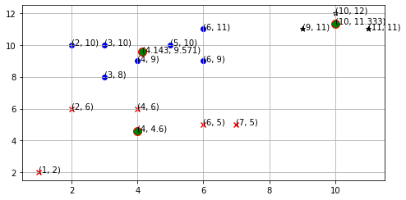
Now, we will calculate the new centroid for each cluster for the third iteration.
In cluster 1, we have 5 points i.e. A2 (2,6), A5 (6,4), A6 (1,2), A10 (7,5), and A12 (4,6). Hence, the new centroid for cluster 1 is (4, 4.6).
In cluster 2, we have 7 points i.e. A1 (2,10), A4 (6,9), A7 (5,10) , A8 (4,9), A13 (3,10), A14 (3,8), and A15 (6,11). Hence, the new centroid for cluster 2 is (4.143, 9.571)
In cluster 3, we have 3 points i.e. A3 (11,11), A9 (10,12), and A11 (9,11). Hence, the new centroid for cluster 3 is (10, 11.333).
Here, you can observe that no point has changed its cluster compared to the previous iteration. Due to this, the centroid also remains constant. Therefore, we will say that the clusters have been stabilized. Hence, the clusters obtained after the third iteration are the final clusters made from the given dataset. If we plot the clusters on a graph, the graph looks like as follows.

Slide 65
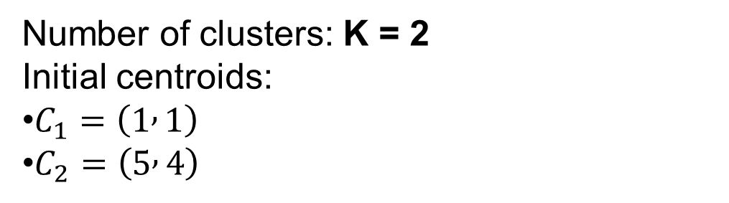
Given Dataset
Point | x | y
P1 | 1 | 1
P2 | 2 | 1
P3 | 4 | 3
P4 | 5 | 4
Number of clusters: K = 2
Initial centroids:
$C_{1}=\left(1 , 1\right)$
$C_{2}=\left(5 , 4\right)$

Slide 66
Final Result After One Iteration
Cluster 1 P1 (1,1) P2 (2,1)
New centroid → (1.5 , 1)
Cluster 2 P3 (4,3) P4 (5,4)
New centroid → (4.5 , 3.5)

Slide 67
https://mitu.co.in/wp-content/uploads/2022/04/Ensemble-Learning.pdf

