Slide 1
Dimensionality Reduction

Slide 2
Machine Learning –Bottlenecks
With the availability of high-performance CPUs and GPUs, it is pretty much possible to solve every regression, classification, clustering, and other related problems using machine learning and deep learning models.
However, there are still various portions that cause performance bottlenecks while developing such models.
A large number of features in the dataset are one of the major factors that affect both the training time as well as the accuracy of machine learning models.

Slide 3
The Curse of Dimensionality
In machine learning, “dimensionality” simply refers to the number of features (i.e. input variables) in your dataset.
While the performance of any machine learning model increases if we add additional features/dimensions, at some point a further insertion leads to performance degradation that is when the number of features is very large commensurate with the number of observations in your dataset, several linear algorithms strive hard to train efficient models. This is called the “Curse of Dimensionality”.

Slide 4
Dimensionality Reduction
Dimensionality Reduction is simply reducing the number of features (columns) while retaining maximum information

Slide 5
Dimensionality Reduction
Dimensionality Reduction helps in data compression, and hence reduced storage space.
It reduces computation time.
It also helps remove redundant features, if any.
Removes Correlated Features.
Reducing the dimensions of data to 2D or 3D may allow us to plot and visualize it precisely. You can then observe patterns more clearly.
It is helpful in noise removal also and as a result of that, we can improve the performance of models.

Slide 6
Dimensionality Reduction Techniques
The various techniques used for dimensionality reduction include:
Principal Component Analysis (PCA)
Linear Discriminant Analysis (LDA)
Generalized Discriminant Analysis (GDA)
Multi-dimension Scaling (MDS)
LLE
IsoMap
Autoencoders

Slide 7
Principal Component Analysis (PCA)
PCA is a linear dimensionality reduction technique which converts a set of correlated features in the high dimensional space into a series of uncorrelated features in the low dimensional space.
These uncorrelated new features are also called principal components.
PCA is an orthogonal linear transformation which means that all the principal components are perpendicular to each other.
Each principal component captures a different aspect of the data’s variation.
They don’t repeat or overlap in the information they carry
It transforms the data in such a way that the first component tries to explain maximum variance from the original data

Slide 8
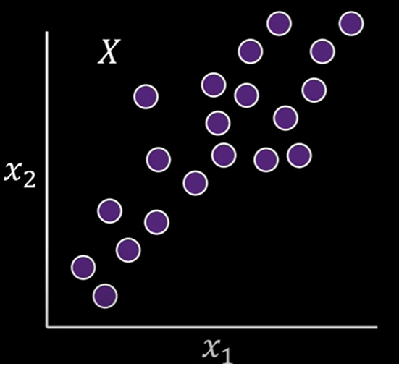
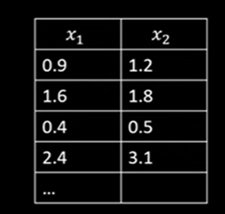
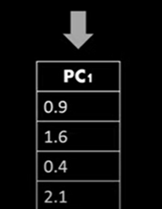
The main idea of PCA is to reduce the number of dimensions by finding principal components

Slide 9
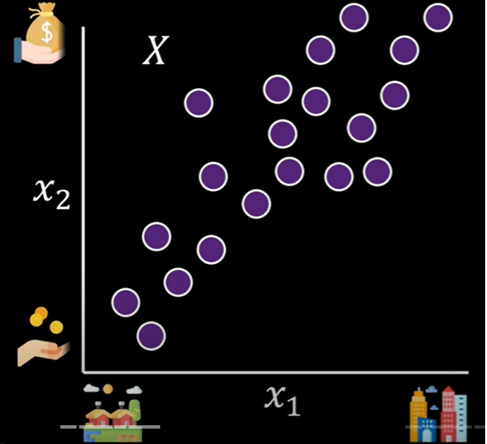
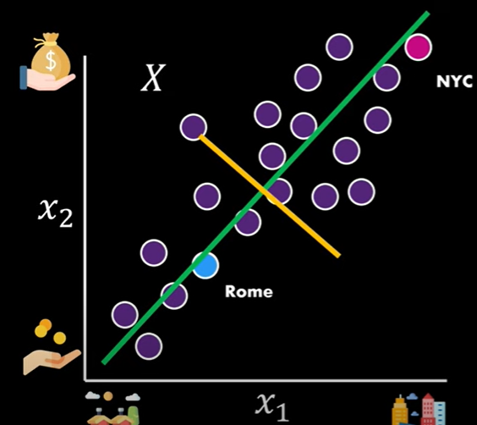
City Vs Cost of Living
The following possibilities are available
X axis feature
Y axis feature
Green line
Yellow line
How to reduce to single dimension preserving as much information as possible?

Slide 10
The following possibilities are available
X axis feature
Y axis feature
Green line
Yellow line
We choose the one captures the more of the data

Slide 11
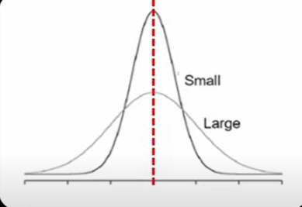
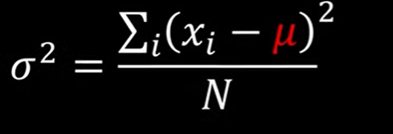
Variance of Single Feature
Variance Formula : Subtract the mean from all values and square them then summed up and divided by the number of variables
Variance is the measure for the spread of data
When the data points are far away from the center of the distribution then we have large variance
If they are closer to the center then we have smaller variance

Slide 12
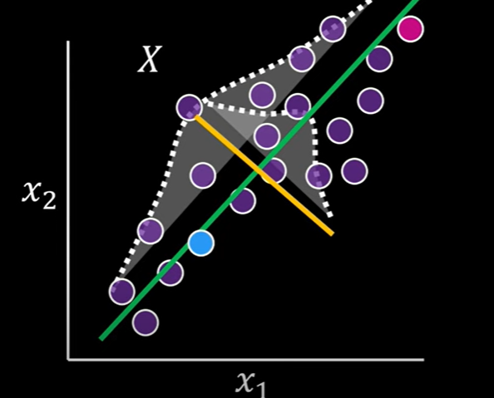
Variance
Green line has more variance. Yellow line has small variance

Slide 13
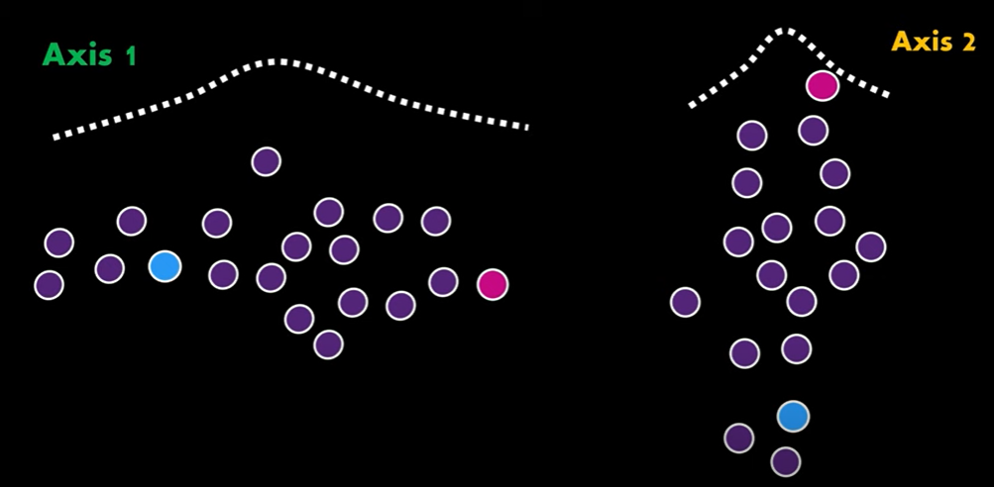
Axis representation to understand the variance of data

Slide 14
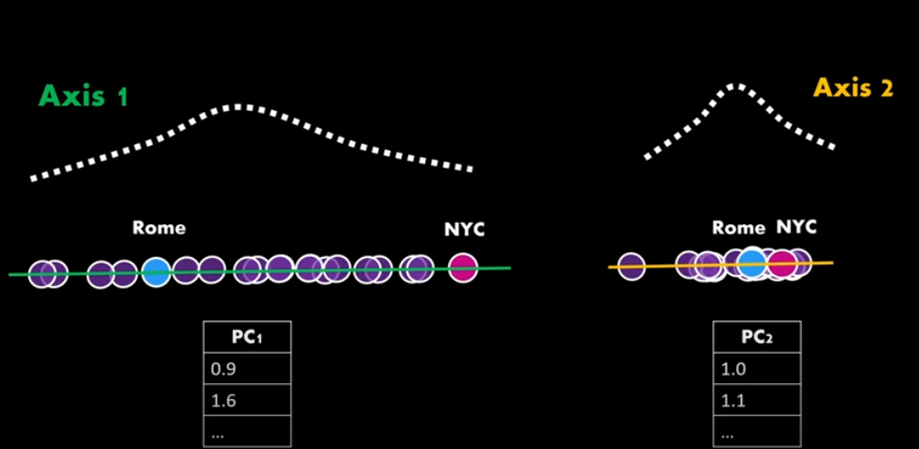
Projecting 2D data into new axis by mapping original data into 1D. Axis1 capture the relationship of the features better

Slide 15
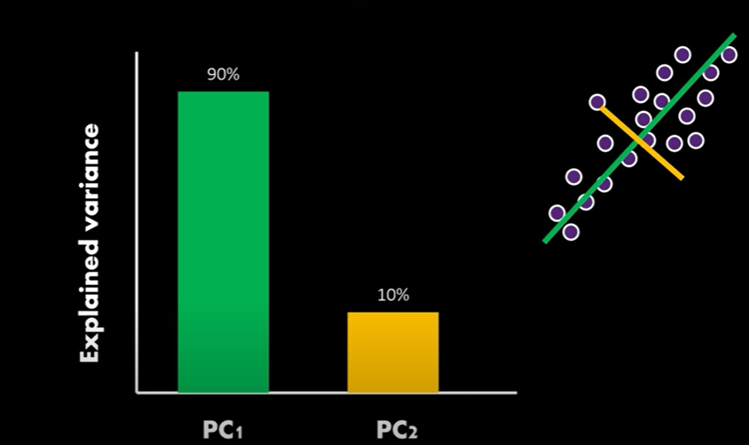
The below graph explains the variance of each Principal components
Keep the PC which captures more data and discard the PC which captures less data

Slide 16
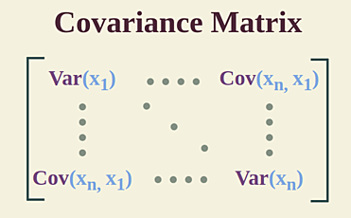
PCA using Covariance Matrix
Principal Component Analysis (PCA) using the covariance matrix reduces data dimensionality by finding orthogonal vectors (principal components) that capture the most variance.
Covariance matrix tells us about the variance and joint direction of the variables.

Slide 17
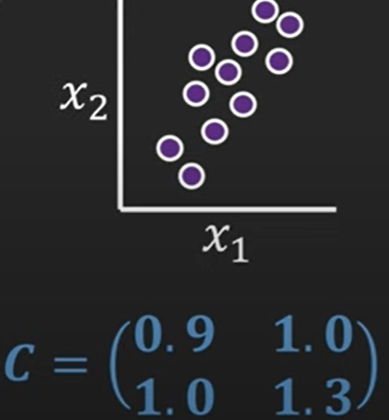
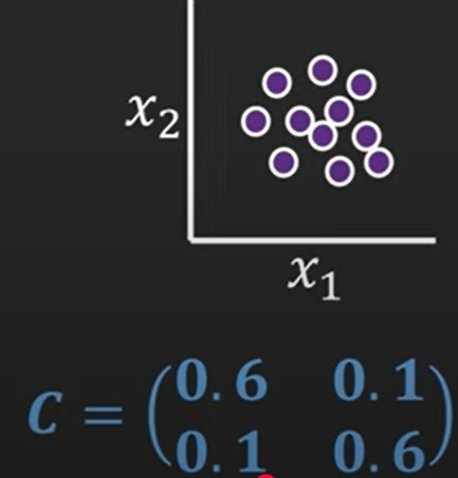
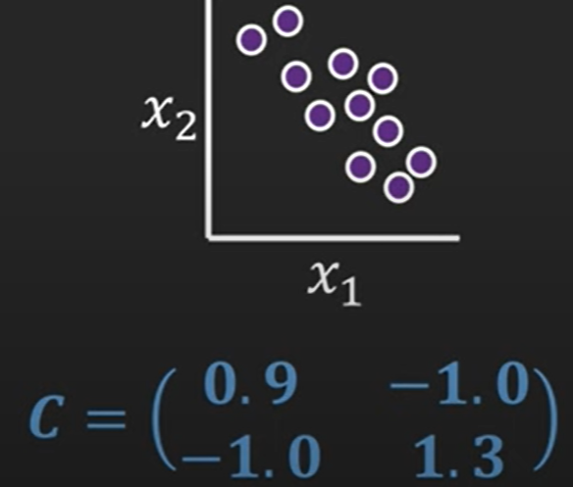
Slightly higher variance of 1.3 for feature X2 and both the variables move in the same direction that is why covariance between variables also high
As like first example, variance for feature X2 is higher. Covariance is negative Trend
Slightly lower variance for each of the variables and no clear trend how they would move together therefore the covariance is quite low

Slide 18
Covariance value and interpretation
If both variables increase or decrease together, covariance is positive.
If one increases while the other decreases, covariance is negative.
If there’s no consistent relationship, covariance is near zero.

Slide 19
Steps for PCA
Data Preparation:
Collect and preprocess your data.
Covariance Matrix Computation:
Compute the covariance matrix of your centered data. The covariance matrix describes the relationships between the different features in your dataset.
Eigenvalue and Eigenvector Computation:
Calculate the eigenvalues and eigenvectors of the covariance matrix. These represent the magnitude and direction of the principal components.
The eigenvalues indicate the variance explained by each principal component, and the eigenvectors define the direction of these components.

Slide 20
Sort Eigenvalues
Sort the eigenvalues in descending order. The largest eigenvalues correspond to the most significant principal components.
Select Principal Components
Decide how many principal components to keep. You can select a specific number or choose based on the explained variance (e.g., keep components that explain 95% of the variance).
Projection onto Principal Components
Project your original data onto the selected principal components to obtain a new set of features (variables) that are linear combinations of the original features

Slide 21



The following are the data points or features given. Let us start with 4 data points
Step 1: Arrange Data (columns = features)
$$X=\left[\begin{matrix}2 & 4 \\ 3 & 6 \\ 4 & 8 \\ 5 & 10\end{matrix}\right]$$
Step 2: Compute Mean

Slide 22
Step 3: Subtract Mean (Center the Data)
X1 | X2 | X1 - 3.5 | X2 - 7
2 | 4 | -1.5 | -3
3 | 6 | -0.5 | -1
4 | 8 | 0.5 | 1
5 | 10 | 1.5 | 3

Slide 23
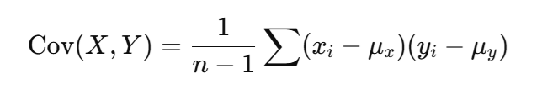
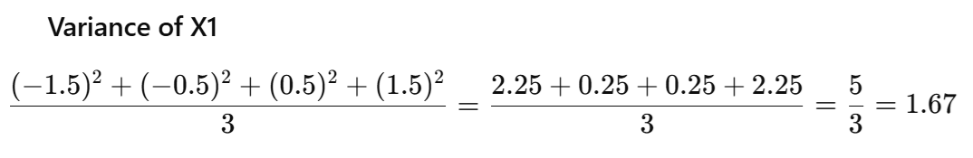
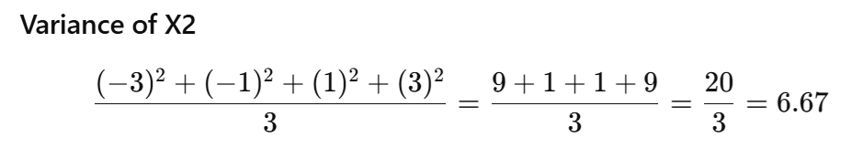
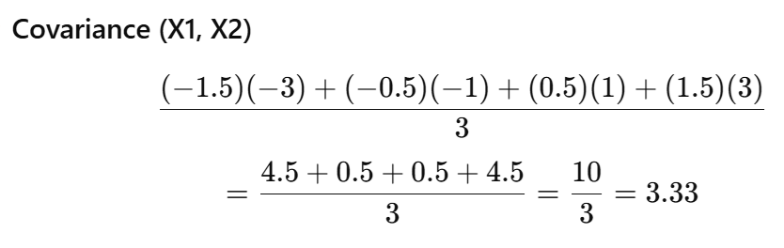
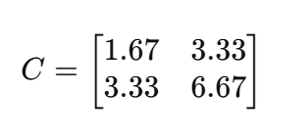
Step 4: Covariance Matrix Computation

Slide 24

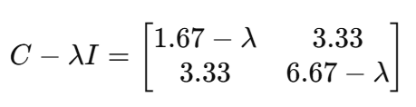
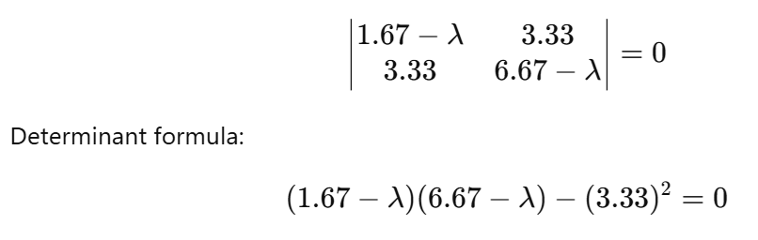
Step 5: Eigen values Computation
Eigenvalue Formula
Subtract λ from diagonal
Find Determinant

Slide 25

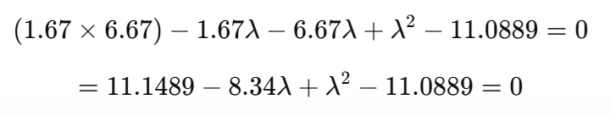
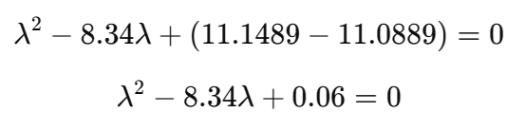
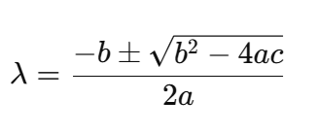
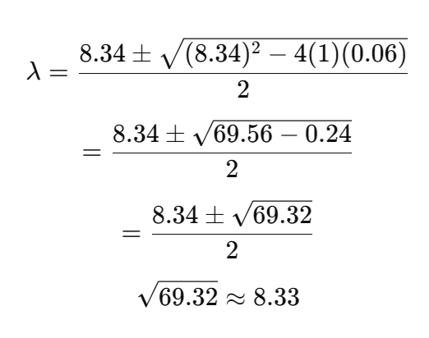
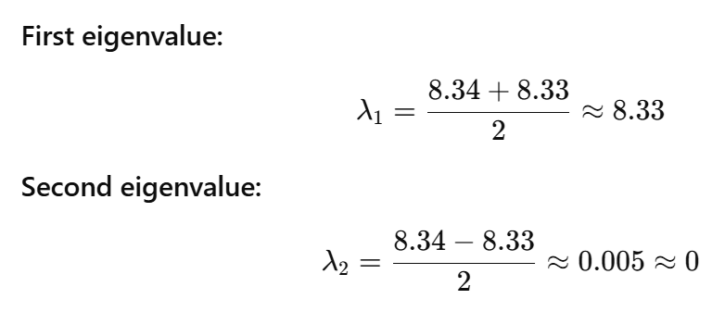
Solve Quadratic Equation

Slide 26
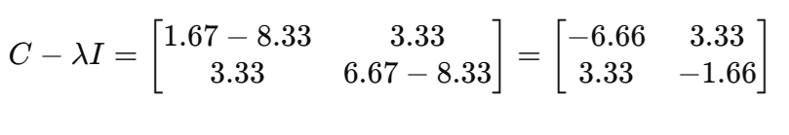

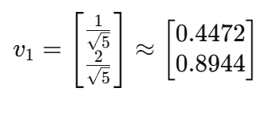

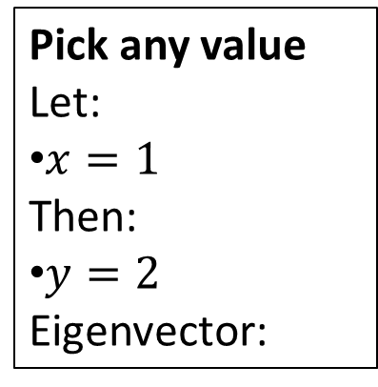
Eigen Vectors
Subtract λ from diagonal
Take first row
−6.66x+3.33y=0
Simplify { divide the equation by 3.33
−2x+y=0
Express one variable
Normalize
Pick any value
Let:
$x=1$
Then:
$y=2$
Eigenvector:
y=2x

Slide 27
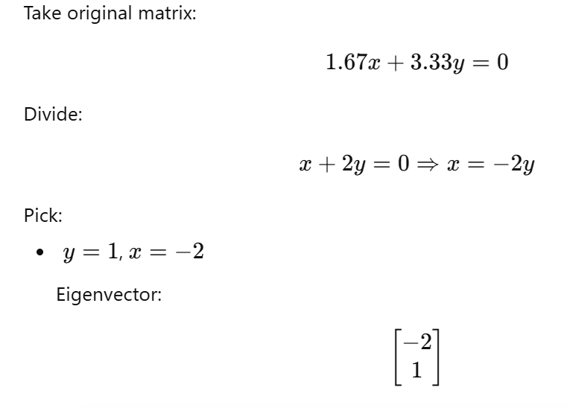
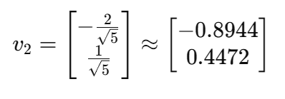
For λ = 0

Slide 28
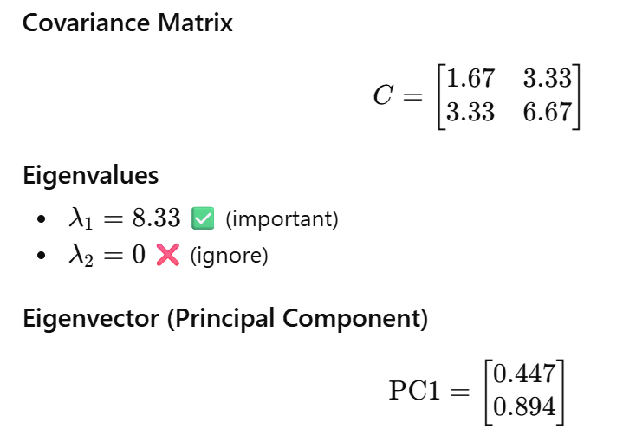

Slide 29
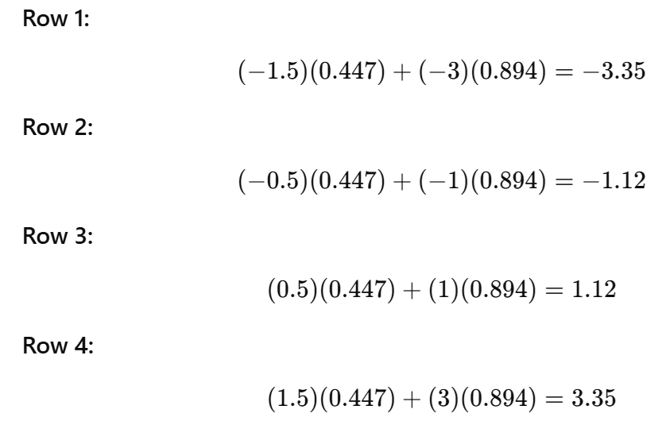
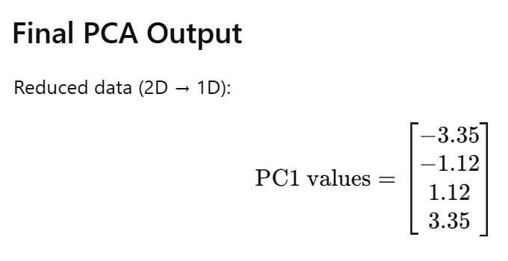
X1 | X2 | X1 - 3.5 | X2 - 7
2 | 4 | -1.5 | -3
3 | 6 | -0.5 | -1
4 | 8 | 0.5 | 1
5 | 10 | 1.5 | 3
New value=X⋅PC1
Project Data onto PC1:

Slide 30
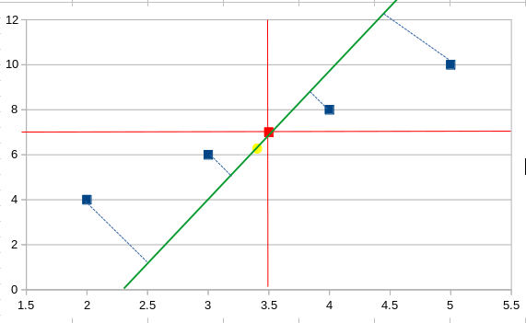
Blue points are the data points, the red point is the average point, the yellow circle is the eigen vector point (-0.45,-0.89) and the green line is the first principal component.

Slide 31
Exercise
Given Dataset
Consider the following 2D data points:
(2,4), (3,6), (4,8), (5,10)

Slide 32



Slide 33
https://www.youtube.com/watch?v=ne6vnKoTHwk
https://medium.com/@dhanyahari07/principal-component-analysis-a-numerical-approach-88a8296dc2dc

