Slide 1
Linear Regression

Slide 2
Linear Regression
Linear regression is a supervised learning algorithm used for modeling the relationship between a dependent variable (Y) and one or more independent variables (X).
It assumes a linear relationship between the variables.
A linear regression is a data plot that graphs the linear relationship between an independent and a dependent variable(s).

Slide 3
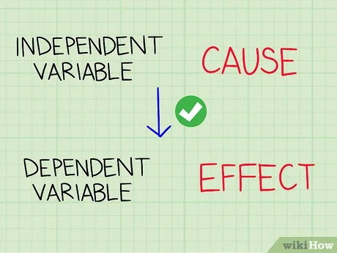
Linear Regression
The variable you want to predict is called the dependent variable. The variable you are using to predict the other variable's value is called the independent variable

Slide 4
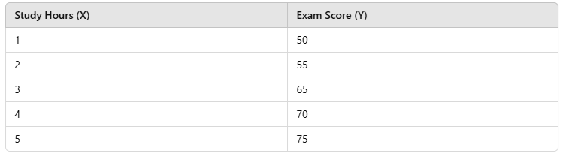
Dependent and Independent Variable
Predict a student's exam score based on the number of study hours
Independent Variable
Dependent Variable

Slide 5
Linear Regression
Regression analysis is the process of estimating a functional relationship between X and Y. A regression equation is often used to predict a value of Y for a given value of X
Y: is referred to as the dependent variable, the response variable or the predicted variable.
X: is referred to as the independent variable, the explanatory variable or the predictor variable.

Slide 6
Types of Linear Regression
Simple Linear Regression
One independent variable (X) and one dependent variable (Y).
Multiple Linear Regression
More than one independent variable (X1, X2, X3, ... Xn).

Slide 7
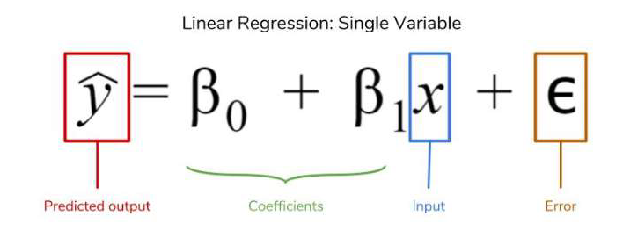
Linear Regression : Single Variable
Where,
Y = Dependent variable (Target)
X = Independent variable (Feature)
β0​ = Intercept (Constant term)
β1​ = Slope (Coefficient)
ε = Error term (Difference between predicted and actual value)

Slide 8
Deterministic Component of Model
y-intercept
∆y
(slope)=∆y/∆x
∆x
x

Slide 9
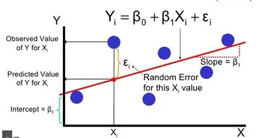

Slide 10
Single Linear Regression : Problem
Let's us consider an example where the five weeks sales data in (Thousands) is given as below. Apply linear regression technique to predict the 7th and 9th month sales
Week (X) | Sales (Y) in Thousands
1 | 1.2
2 | 1.8
3 | 2.6
4 | 3.2
5 | 3.8

Slide 11
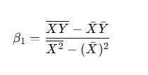



Compute Slope (β1)Using Different Formulas
1. Using Mean-Based Formula
Compute Intercept (β0​)
2. Using OLS Summation Formula
3. Using Standard Least Squares Formula

Slide 12
Compute Slope (β1)Using Mean Based Formula

Slide 13
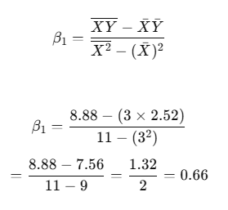
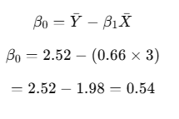

The Fitted line for above dataset is

Slide 14
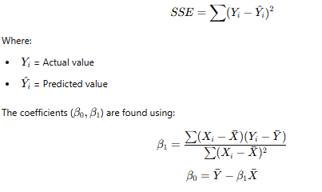
Finding the Best Fit Line (Ordinary Least Squares Method - OLS)
The best fit line minimizes the sum of squared errors (SSE):

Slide 15
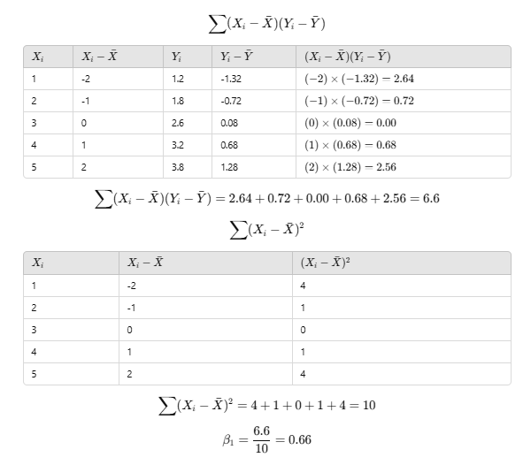
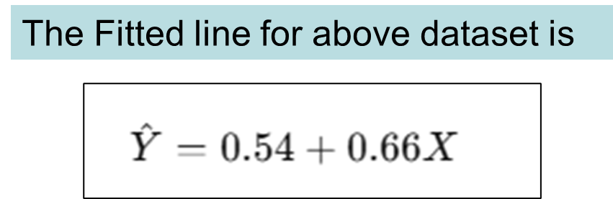

Slide 16

A company wants to predict sales based on advertising expenses. Given the dataset
Advertisement Spend (X) | Sales (Y)
10 | 25
15 | 30
20 | 32
25 | 35
30 | 40

Slide 17

Error Metrics
The following key metrics help measure its accuracy and performance. The given below error metrics measure how far the predicted values are from the actual values.
Mean Squared Error (MSE)
Measures the average squared difference between actual and predicted values.
Lower values indicate a better fit.

Slide 18


Root Mean Squared Error (RMSE)
The square root of MSE, making it easier to interpret since it has the same units as the target variable.
Mean Absolute Error (MAE)
Measures the average absolute difference between actual and predicted values.
Less sensitive to outliers compared to MSE.
Mean Absolute Percentage Error (MAPE)
Expresses the error as a percentage of actual values.
Used when the target variable is strictly positive.

Slide 19
Uses of Regression
Determining the strength of predictors
Relationship between Strength of sales and marketing spending
Relationship between age and income
Forecasting an effect
How much additional sale income will I get for each Thousands of Rupee spent on marketing
Trend Forecasting /Point Estimates
What will be the price of GOLD in next six months

Slide 20


Which of the following data are likely to be most appropriately modelled using a linear regression model?
1.
2.
Correct
Errors change
Not straight
3.

Slide 21
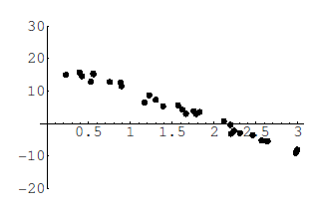
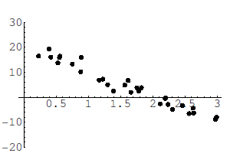
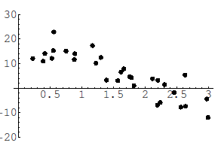
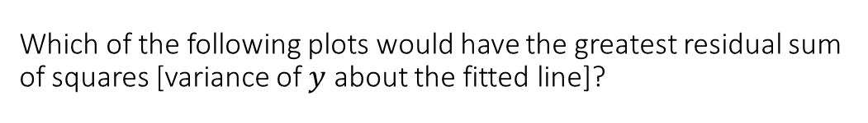
Which of the following plots would have the greatest residual sum of squares [variance of $y$ about the fitted line]?
Question from Derek Bruff
1.
2.
Pic1
Pic2
Pic correct
3.

Slide 22
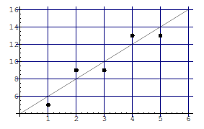
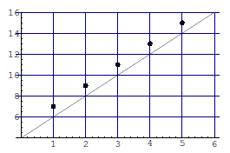
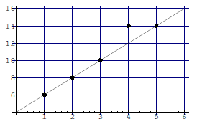
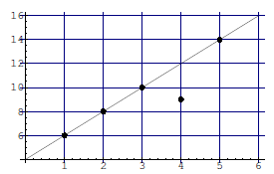
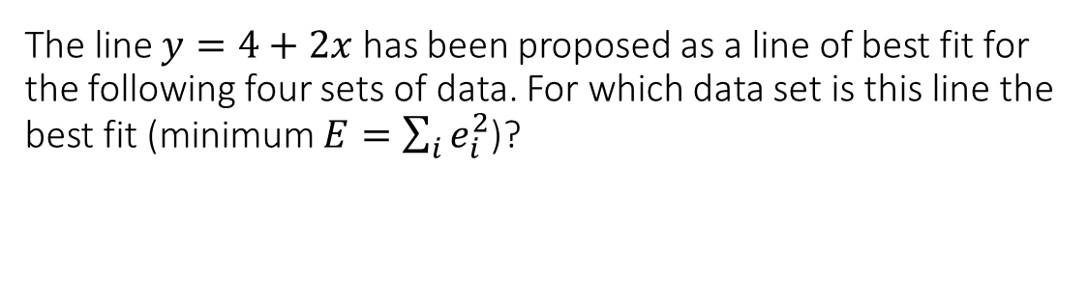
The line $y=4+2x$ has been proposed as a line of best fit for the following four sets of data. For which data set is this line the best fit (minimum $E=\sum_{i}{e_{i}^{2}}$)?
Question from Derek Bruff
1.
2.
Pic1
Pic2
Pic correct
pic4
3.
4.

Slide 23
Multiple Linear Regression
Multiple Linear Regression is an extension of simple linear regression where multiple independent variables (X1,X2,X3,.....) are used to predict a dependent variable (Y).
Regression model for k independent variables:

Slide 24
Example of Multiple Linear Regression
Let’s consider an example where we predict the house price (Y) based on three independent variables:
Size (sq ft) (X1​)
Number of Bedrooms (X2)
Age of the House (years) (X3​)
Equation for Multiple Linear Regression
Price=β0​+β1​(Size)+β2​(Bedrooms)+β3​(Age)+ϵ

Slide 25

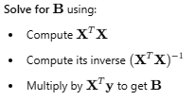
Least Squares Method (Normal Equation)
The best-fit line minimizes the sum of squared errors (SSE):
Steps to Compute Using the Normal Equation : Matrix Form
X is the matrix of input features (including a column of 1s for the intercept).
y is the target variable (dependent variable).
B is the vector of regression coefficients (β0,β1,β2,... ).

Slide 26
Let's consider a dataset where we want to predict salary based on:
Years of Experience (X₁)
Number of Certifications (X₂)
Years of Experience (X₁) | Certifications (X₂) | Salary (Y) ($1000s)
1 | 1 | 40
2 | 1 | 45
3 | 2 | 50
4 | 2 | 55
5 | 3 | 60
Y=β₀​+β₁​X1​+β₂​X2​
where:
β₀ = Intercept
β₁= Coefficient for Years of Experience
β₂= Coefficient for Certifications

Slide 27



Constructing Matrices
The feature matrix X (without the intercept):
Adding a column of ones to 𝑋 for the intercept:
The target variable vector y:

Slide 28
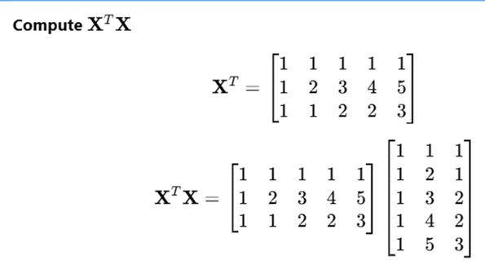
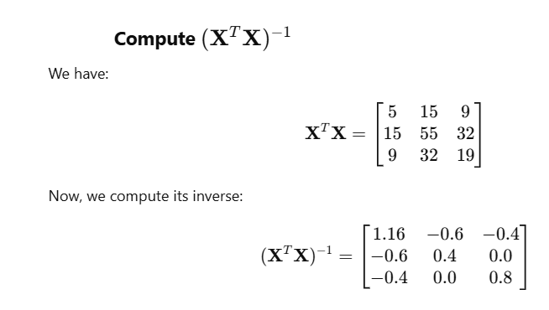
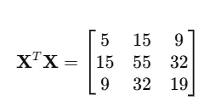

Slide 29
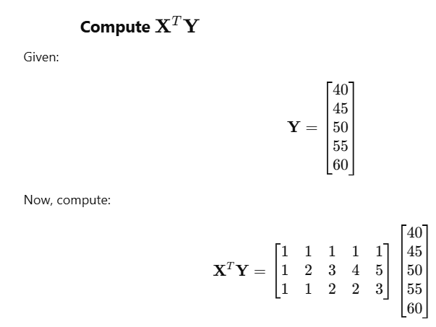
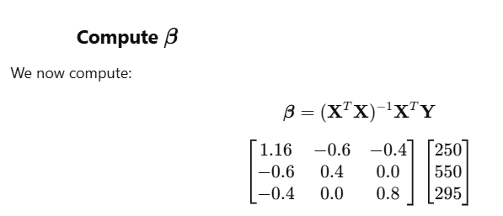
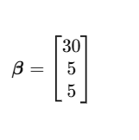
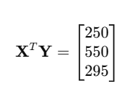
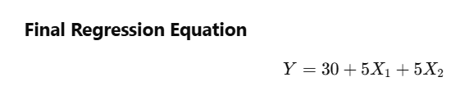

Slide 30
Logistic regression
Logistic regression is similar to linear regression except that Logistic regression predicts whether something is true or False instead predicting something continuous (e.g., predicting salary based on years of experience).
In logistic regression, the goal is to predict a probability which is then converted into a binary outcome (e.g., spam or not spam).

Slide 31
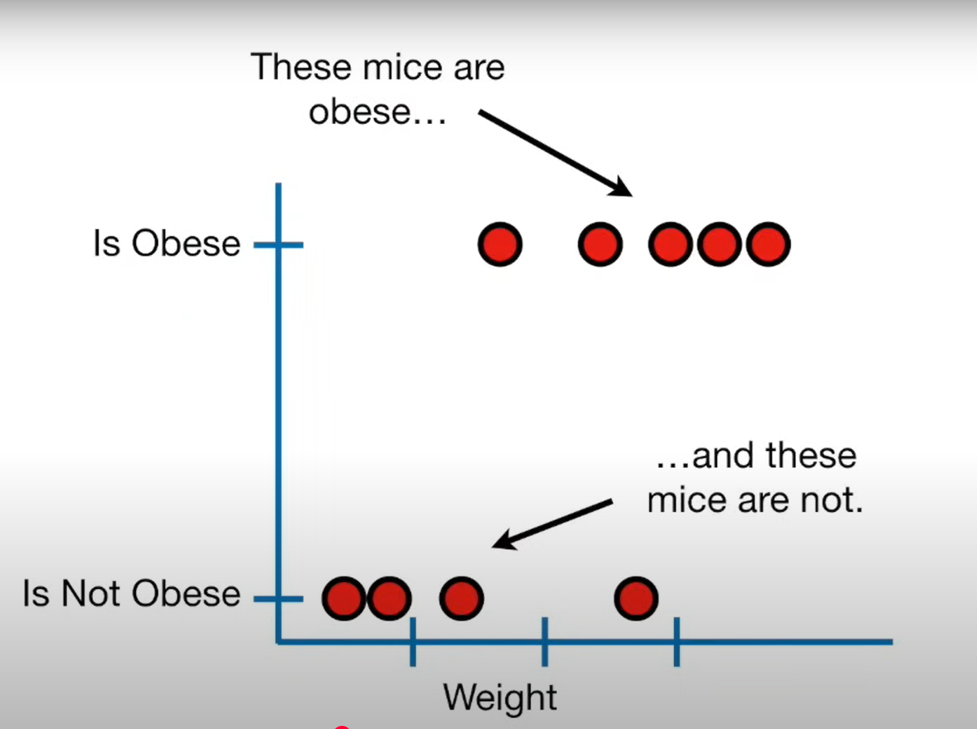
Logistic regression predicts whether something is true or False

Slide 32
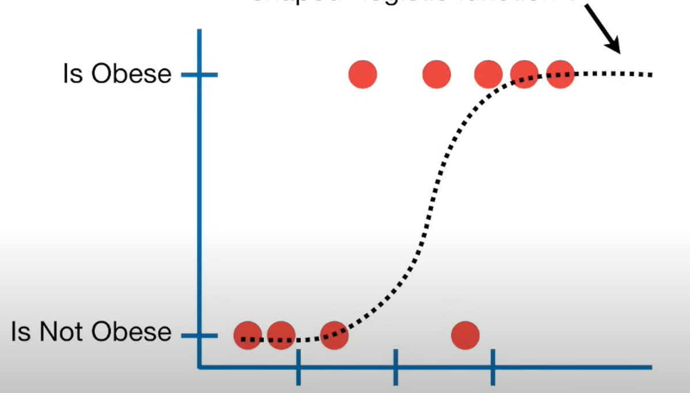
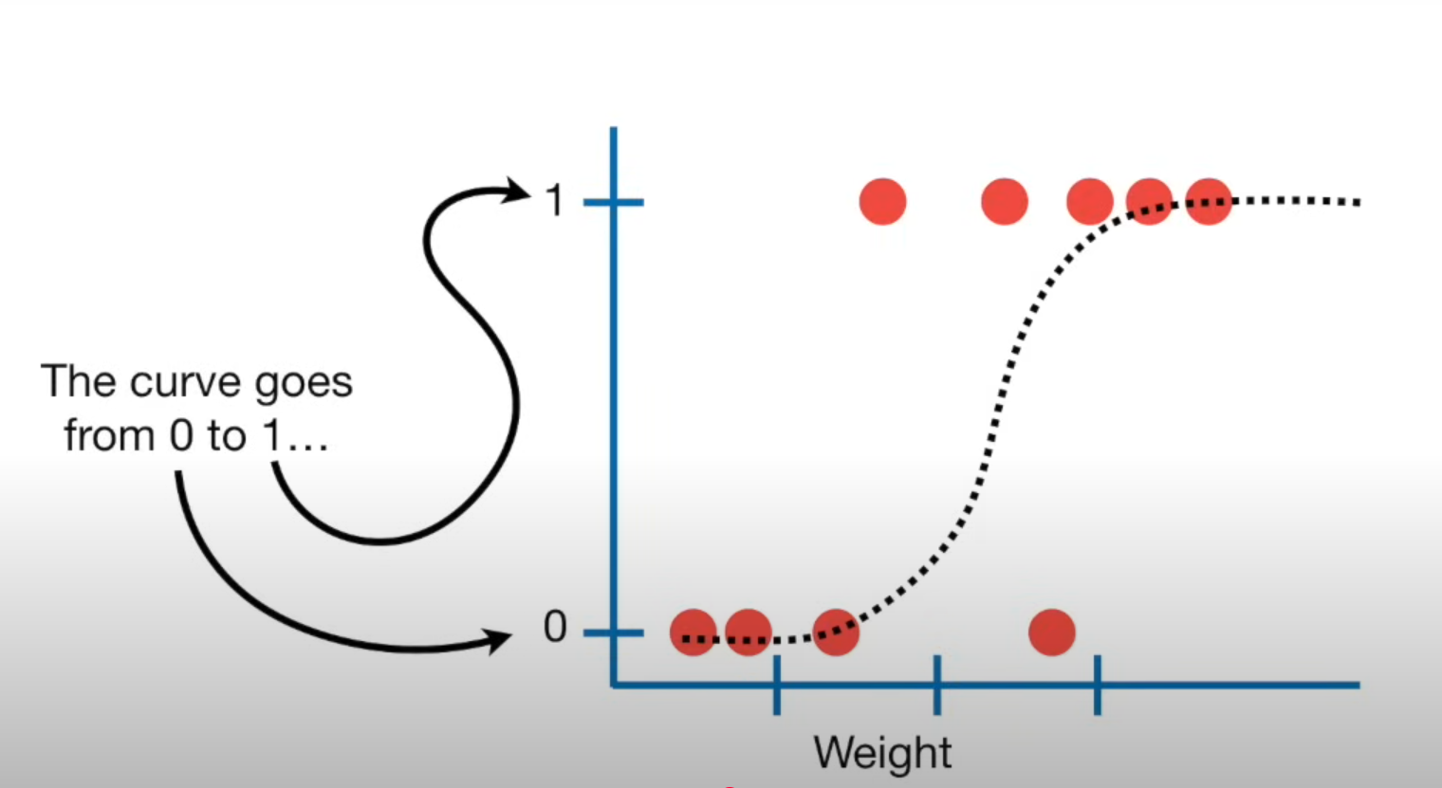
Instead of fitting a line to the data, logistic regression fits an “S” Shaped “Logistic Function”
The curve goes from o to 1
The curve tells you the probability that mouse is Obese based on its weight

Slide 33
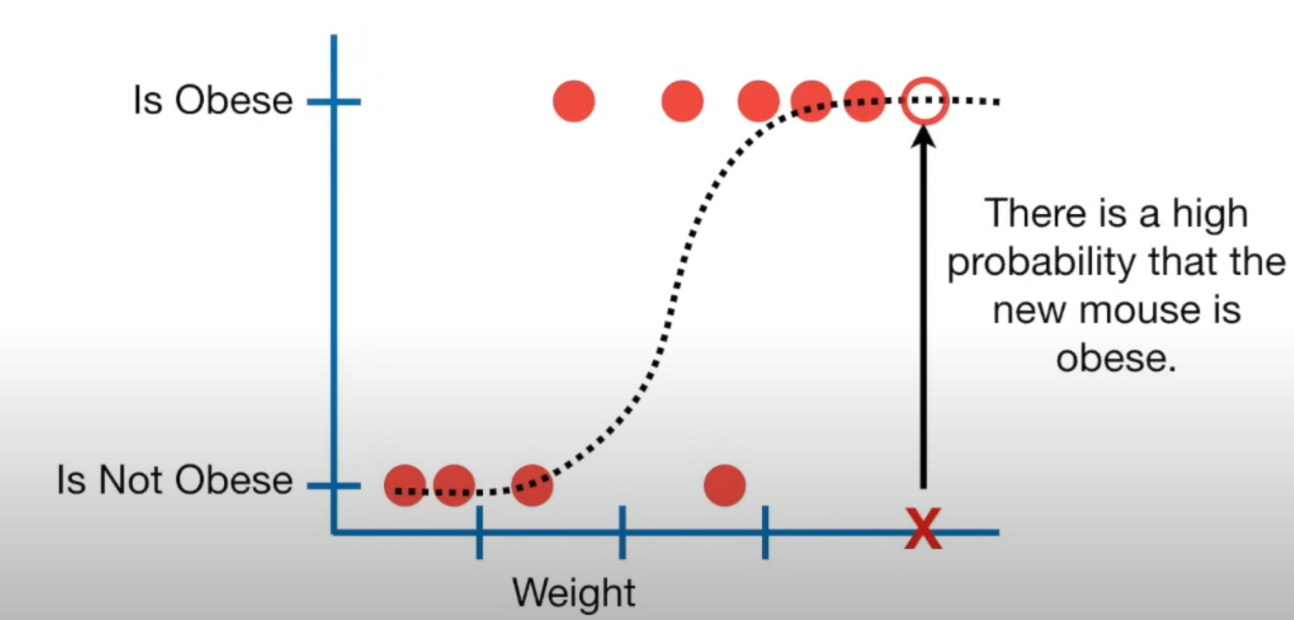
If it weighted a heavy mouse, then there is high probability that the new mouse is obese

Slide 34
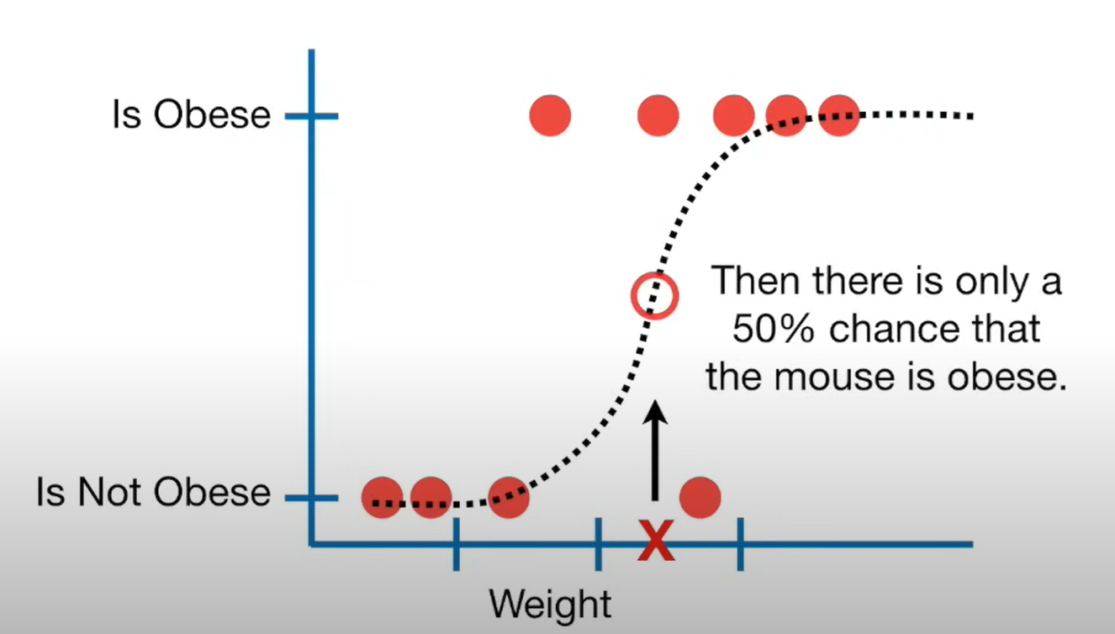
If we weighted an intermediate mouse then there is only 50% chance that the mouse is obese

Slide 35
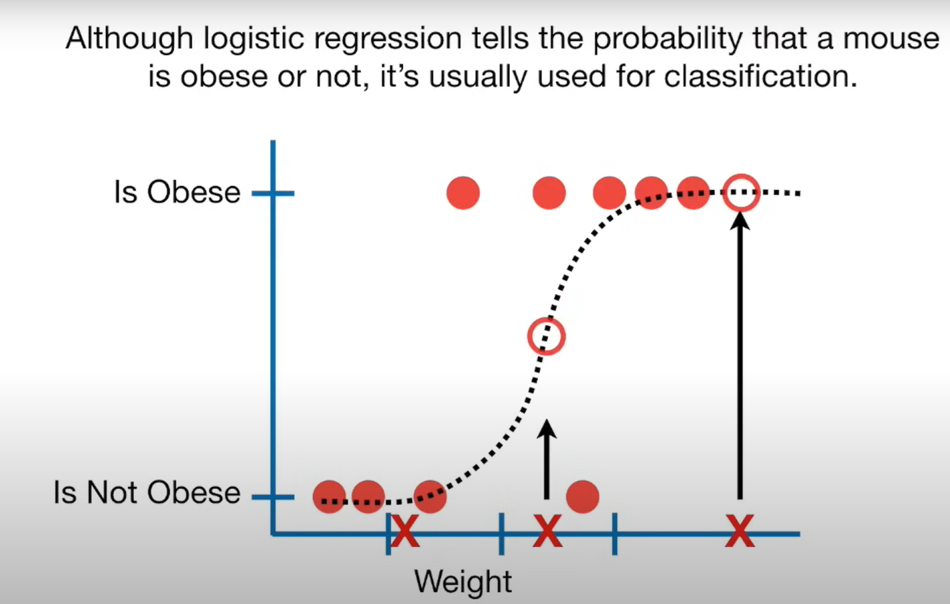
For Example, if the probability a mouse is obese is >50%, then we will classify it as “obese”, Otherwise we will classify it as “not obese”

Slide 36
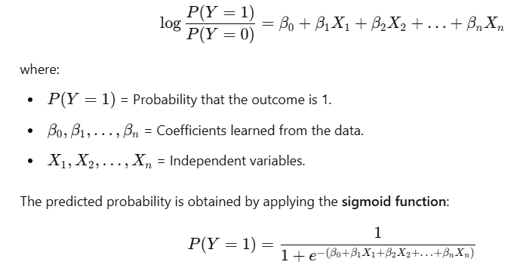
Logistic Regression
Logistic regression models the log-odds (or logit) of the outcome as a linear combination of the independent variables:

Slide 37

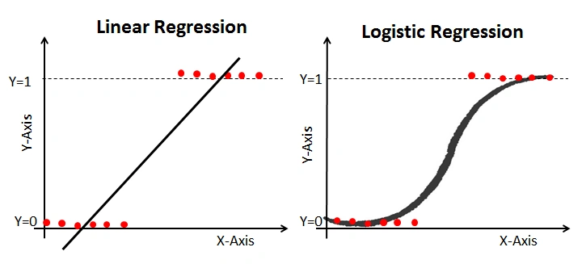
Formula for Logistic Function
Logistic function, also called a sigmoid function.
This function squeezes a straight line into an S-curve.

Slide 38
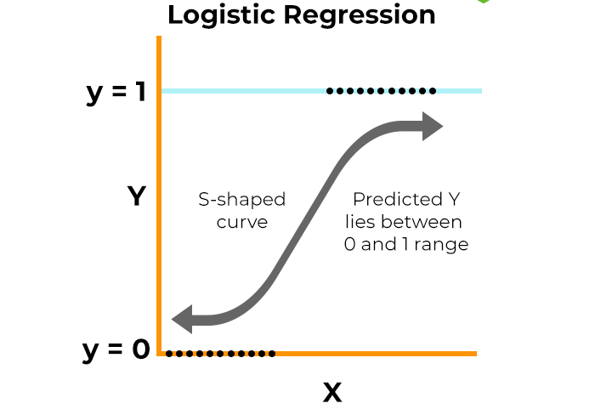
Sigmoid function
Logistic regression uses a logistic function called a sigmoid function to map the predicated linear combination of independent variables to probability between 0 and 1
The sigmoid function refers to an S-shaped curve that converts any real value to a range between 0 and 1.
Notes:
The sigmoid function produces an S-shaped curve (also called a logistic curve). It smoothly transitions from 0 to 1, making it useful for modeling probabilities.

Slide 39
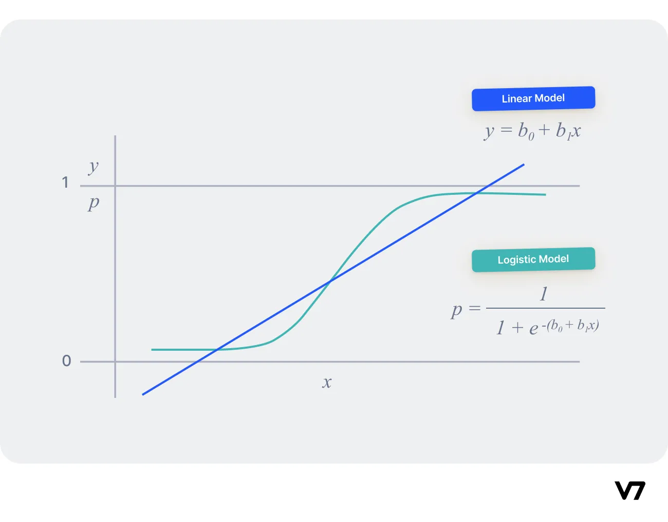

Slide 40
Example of Logistic Regression Converting a Linear Combination to Probability
Let's say we want to predict whether a student will pass or fail an exam based on the following input features
X1= Number of study hours
X2 = Number of practice tests taken

Slide 41
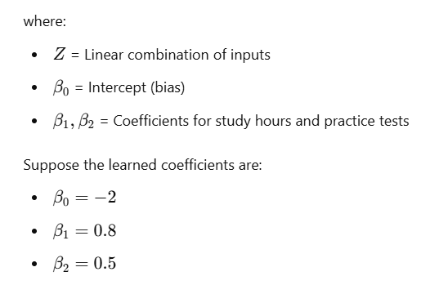
Step 1: Define the Logistic Regression Model
Z=β₀​+β_{1​}X1​+β₂​X2​

Slide 42
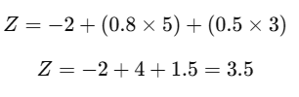
Step 2: Compute the Linear Combination
If a student studies for 5 hours and takes 3 practice tests, the linear combination becomes:

Slide 43
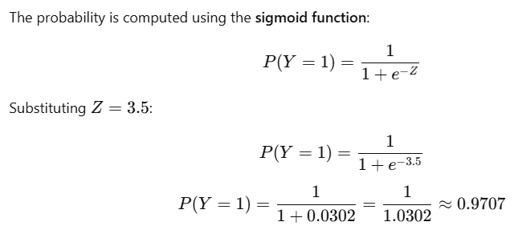
Step 3: Convert to Probability using Sigmoid Function
The model predicts that the student has a 97.07% probability of passing the exam based on 5 study hours and 3 practice tests.

Slide 44
Reference
https://www.youtube.com/watch?v=yIYKR4sgzI8&t=189s

