Slide 1
K-Nearest Neighbors Algorithm

Slide 2
Instance Based Classifiers
Instance-based Classifiers do not create a model but use training examples directly to classify unseen examples (“lazy” classifiers).
Examples
Rote-learner
Memorizes entire training data and performs classification only if attributes of record match one of the training examples exactly
Nearest neighbor
Uses k “closest” points (nearest neighbors) for performing classification

Slide 3
K-Nearest Neighbor
All instances correspond to points in an n-dimensional Euclidean space
Classification is delayed till a new instance arrives
Classification done by comparing feature vectors of the different points
Target function may be discrete or real-valued

Slide 4
kNN— k Nearest-Neighbor Classifiers
Requires three things
The set of stored records
Distance Metric to compute distance between records
The value of k, the number of nearest neighbors to retrieve
To classify an unknown record:
Compute distance to other training records
Identify k nearest neighbors
Use class labels of nearest neighbors to determine the class label of unknown record (e.g., by taking majority vote)

Slide 5
1-Nearest Neighbor
One of the simplest of all machine learning classifiers
Simple idea: label a new point the same as the closest known point
Label it red.

Slide 6
k – Nearest Neighbor
Generalizes 1-NN to smooth away noise in the labels
A new point is now assigned the most frequent label of its k nearest neighbors
Label it red, when k = 3
Label it blue, when k = 7

Slide 7
K-Nearest Neighbor Classification
Compute distance between two points (Euclidean distance)
Determine the class from nearest neighbor list
Take the majority vote of class labels among the k-nearest neighbors
Weigh the vote according to distance
weight factor, w = 1/d²

Slide 8
K-Nearest Neighbor Classification
Choosing the value of k
If k is too small, sensitive to noise points
If k is too large, neighborhood may include points from other classes

Slide 9
K-Nearest Neighbor Classification
Step #1 - Assign a value to K.
Step #2 - Calculate the distance between the new data entry and all other existing data entries. Arrange them in ascending order.
Step #3 - Find the K nearest neighbors to the new entry based on the calculated distances.
Step #4 - Assign the new data entry to the majority class in the nearest neighbors.

Slide 10
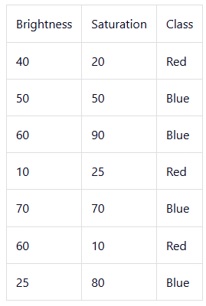
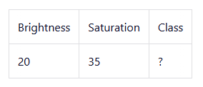
let's assume the value of K is 5.

Slide 11
To calculate the distance from the new entry to other entries in the data set using the Euclidean distance formula.
√(X₂-X₁)²+(Y₂-Y₁)²
Where:
X₂ = New entry's brightness (20).
X₁= Existing entry's brightness.
Y₂ = New entry's saturation (35).
Y₁ = Existing entry's saturation.

Slide 12
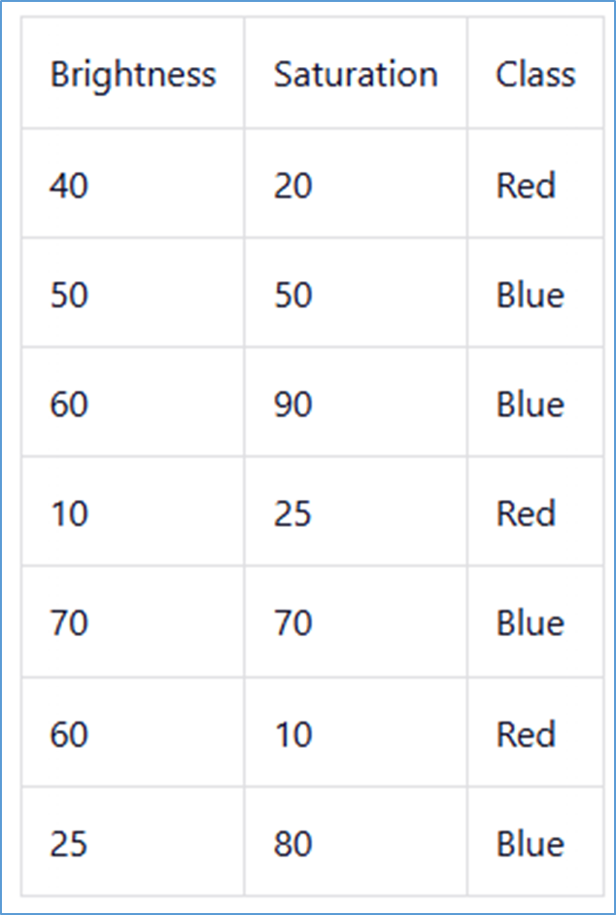
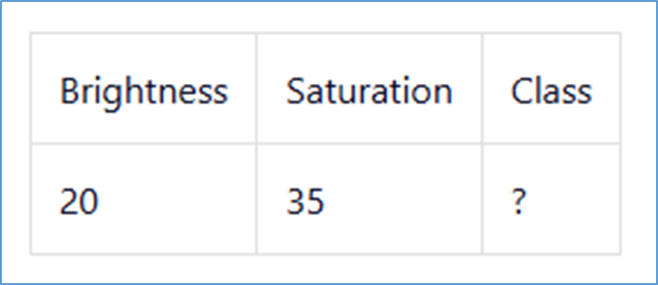
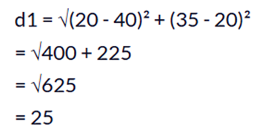

Slide 13
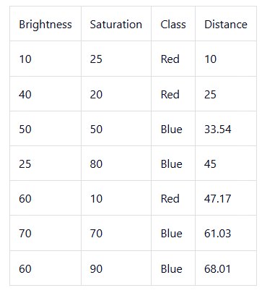
We chose 5 as the value of K, we'll only consider the first five rows.
The majority class within the 5 nearest neighbors to the new entry is Red. Therefore, we'll classify the new entry as Red.

Slide 14
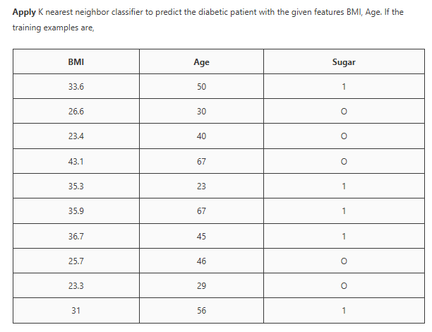

Slide 15
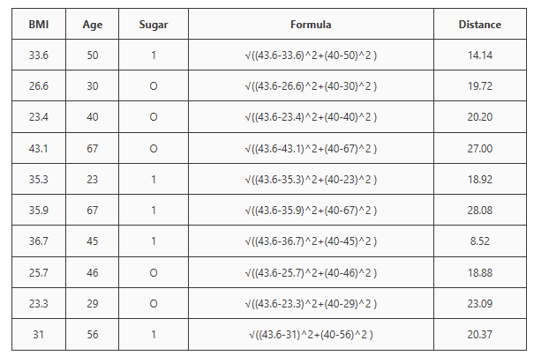

Slide 16
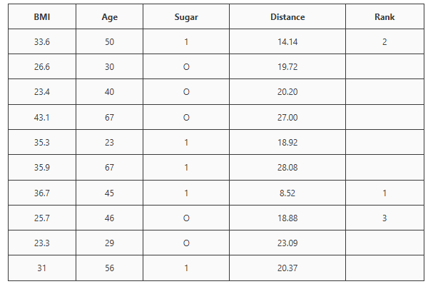
Now, we need to apply the majority voting technique to decide the resulting label fro the new example. Here the 1st and 2nd nearest neighbors have target label 1 and the 3rd nearest neighbor has target label 0. Target label 1 has the majority. Hence the new example is classified as 1, That is the diabetic patient has Sugar

Slide 17
KNN Regression
In KNN regression, we predict the value of a dependent variable for a data point based on the average or mean of the target values of its K nearest neighbors in the training data.
The value of K is a user-defined hyperparameter. It determines the number of nearest neighbors used to make the prediction.

Slide 18
KNN Regression Algorithm
Choose a value for K: We first choose a value for K. This determines the number of nearest neighbors used to make the prediction.
Calculate the distance: After choosing K, we calculate the distance between each data point in the training set and the target data point for which a prediction is being made. For this, we can use a variety of distance metrics, including Euclidean distance, Manhattan distance, or Minkowski distance.
Find the K nearest neighbors: After calculating the distance between the existing data points and the new data point, we identify K nearest neighbors by selecting the K data points nearest to the new data point.
Calculate the prediction: After finding the neighbors, we calculate the value of the dependent variable for the new data point. For this, we take the average of the target values of the K nearest neighbors.

Slide 19
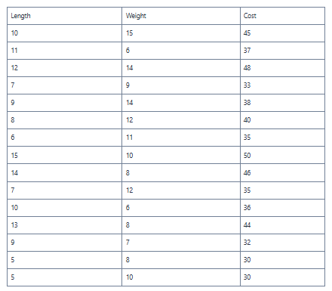
The dataset contains the length and weight of metal rods along with their cost.
Now, suppose that we want to calculate the cost for a rod with a length of 7 and a weight of 8.

Slide 20
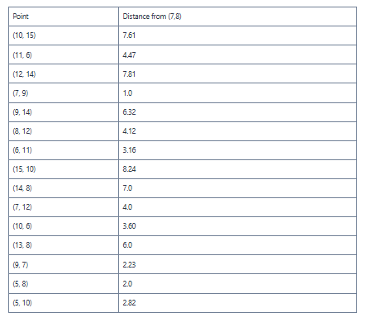

Slide 21
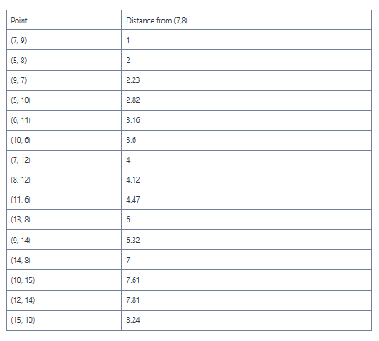
Find the three closest points in the dataset. For this, we will sort the points according to their distances from (7, 8).
you can observe that the three points closest to (7, 8) are (7, 9), (5, 8), and (9, 7). These points have costs of 33, 30, and 32.
To calculate the cost of a rod with length 7 and weight 8, we can take the average of the above costs. Hence, the cost for (7, 8) will be 31.67.

