Slide 1
UNIT 3

Slide 2
Design and Analysis of Machine Learning Experiments
Design of machine learning experiments to assess and compare the performances of learning algorithms in practice and the statistical tests to analyze the results of these experiments

Slide 3
Design and Analysis of Machine Learning Experiments
We explored various learning algorithms and observed that multiple algorithms can be suitable for a given application. Now, we focus on two key questions
How can we assess the expected error of a learning algorithm on a problem?
For instance, after training a classifier on a dataset from a specific application, can we confidently predict that its error rate in real-world use will be below a certain threshold, such as 2%?
Suppose we train a spam detection model using a classification algorithm on a dataset of emails. To deploy it in real-world scenarios, we need to estimate its expected error rate. If our evaluation methods (e.g., cross-validation, test set analysis) indicate that the model misclassifies less than 2% of emails, we can be reasonably confident that its real-world error rate will also stay within this limit.

Slide 4
Design and Analysis of Machine Learning Experiments
Given two learning algorithms, how can we say one has less error than the other one, for a given application?
The algorithms being compared may differ in type, such as parametric versus nonparametric, or in their hyperparameter settings.
For instance, when evaluating a multilayer perceptron with four hidden units versus one with eight, we need a method to identify which has a lower expected error. Similarly, in the case of the k-nearest neighbor classifier, we must determine the optimal value of k for better performance.

Slide 5
Guidelines for Machine Learning Experiments
Aim of the Study
Selection of the Response Variable
Choice of Factors and Levels
Choice of Experimental Design
Performing the Experiment
Statistical Analysis of the Data
Notes:
Before we start experimentation, we need to have a good idea about what
it is we are studying, how the data is to be collected, and how we are planning
to analyze it. The steps in machine learning are the same as for any
type of experimentation (Montgomery 2005). Note that at this point, it is
not important whether the task is classification or regression, or whether
it is an unsupervised or a reinforcement learning application. The same
overall discussion applies; the difference is only in the sampling distribution
of the response data that is collected.

Slide 6
Aim of the Study
Clearly define the problem and objectives.
Common goals include estimating a learning algorithm's expected error and ensuring it meets an acceptable threshold.
Given two algorithms and a dataset, we aim to determine which has lower generalization error.
Comparisons can involve:
Different algorithms
Variants of the same algorithm (e.g., improved feature extraction)
In broader cases, we may:
Compare multiple algorithms and rank them by error.
Evaluate algorithms across multiple datasets for a comprehensive assessment.

Slide 7
Selection of the Response Variable
Common Measures
Classification: Misclassification error (0/1 loss)
Regression: Mean Squared Error (MSE)
Alternative Metrics
Risk measures (generalized loss functions)
Information Retrieval: Precision, Recall
Cost-Sensitive Learning: Considers both output accuracy and system complexity.

Slide 8
Choice of Factors and Levels
Factors depend on study objectives
Hyperparameter tuning: Factors are the algorithm’s parameters.
Algorithm comparison: The learning algorithm itself is a factor.
Dataset variations: Different datasets become a factor.
Choosing Factor Levels
Carefully select levels to avoid missing optimal configurations or unnecessary experiments.
Normalize factor levels when needed (e.g., scale-dependent parameters like Parzen window spread).
Best Practices:
Use domain expertise but remain open to exploring all relevant factors.

Slide 9
Choice of Experimental Design
Factorial Design:
Preferred unless factors are proven to be independent.
Most factors interact, so factorial analysis ensures better insights.
Replication & Dataset Size:
Large datasets require fewer replications.
Too few replicates lead to unreliable comparisons and invalid statistical tests.
Train-Test Splitting & Resampling:
Reserve a portion of data for testing, using resampling for training and validation.
Poor splitting can lead to high variance and inconclusive results.
Choice of Datasets:
Avoid synthetic and toy datasets; prefer real-world data.
Simple datasets help with intuition but may not reflect real-world complexity in high-dimensional spaces

Slide 10
Performing the Experiment
Preliminary Checks:
Conduct trial runs with random settings before large experiments.
Save intermediate results or random seeds for reproducibility.
Experimental Integrity:
Be aware of software aging effects in long experiments.
Maintain unbiased evaluation, especially when comparing algorithms.
Ideally, separate developers from testers in large-scale studies.
Reliable Code & Documentation:
Use well-tested libraries instead of writing custom implementations.
Maintain clear documentation, especially for collaborative work.
Apply software engineering best practices to ensure experiment quality.

Slide 11
Statistical Analysis of the Data
Ensuring Reliable Conclusions:
Avoid subjective or chance-based interpretations.
Use hypothesis testing to validate claims.
Example:
Instead of asking, "Is Algorithm A more accurate than B?"
Formulate as: "Is the average error of A significantly lower than B?"
Visualization Techniques:
Histograms, box plots, range plots help analyze error distributions.

Slide 12
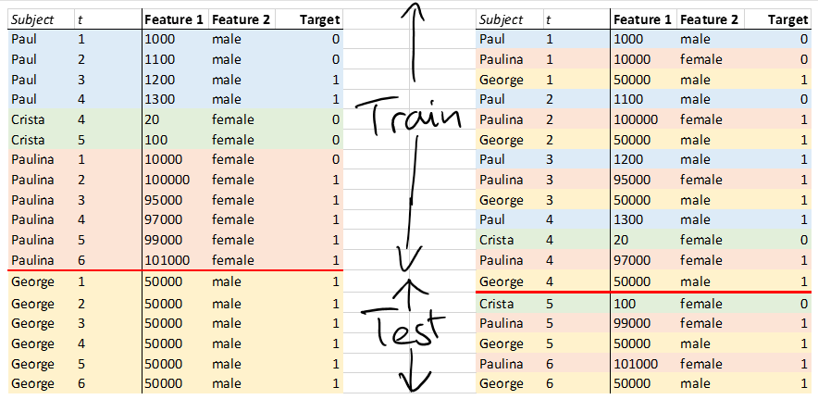
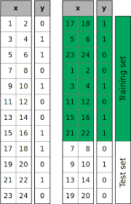

Slide 13
Cross-Validation (CV)
Cross-validation is a technique used in machine learning to assess the performance and generalizability of a model by splitting the dataset into multiple subsets.
It helps prevent overfitting and ensures that the model performs well on unseen data.

Slide 14
Types of Cross-Validation
Holdout Validation: The dataset is split into training and testing sets (e.g., 80% training, 20% testing).
k-Fold Cross-Validation: The dataset is divided into k equal-sized folds. The model is trained on k-1 folds and tested on the remaining one. This is repeated k times, and the results are averaged.
Stratified k-Fold Cross-Validation: Similar to k-Fold but ensures that class distributions are maintained in each fold (useful for imbalanced datasets).
Leave-One-Out Cross-Validation (LOOCV): A special case of k-Fold where k is equal to the number of samples, meaning each sample is used as a test set once.
Leave-P-Out Cross-Validation: p samples are left out for validation while the remaining are used for training.
Time Series Cross-Validation: Used for time-dependent data, where past data is used for training and future data for testing.

Slide 15
k-Fold Cross-Validation
k-Fold Cross-Validation is a technique used to evaluate the performance of a machine learning model by splitting the dataset into k subsets (folds).
The model is trained k times, each time using k-1 folds for training and the remaining one for testing.
The final model performance is the average of all k iterations.

Slide 16

Steps in k-Fold Cross-Validation
Shuffle the dataset (optional but recommended).
Split the dataset into k equal-sized subsets (folds).
Train the model k times, each time using k-1 folds for training and the remaining fold for validation.
Compute the evaluation metric (e.g., accuracy, F1-score) for each fold.
Average the results from all folds to get the final model performance.

Slide 17
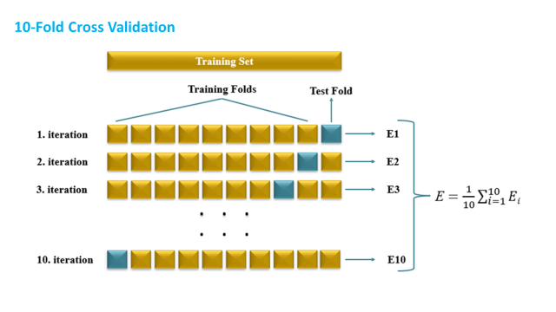

Slide 18
Let’s say we have 10 data samples, labeled S1 to S10:
We want to use 5-Fold Cross-Validation, so:
Total samples = 10
Number of folds (k) = 5
Each fold will contain 2 samples (10 ÷ 5)
Sample
S1
S2
S3
S4
S5
S6
S7
S8
S9
S10
Let’s divide the dataset into 5 folds:
Fold 1: [S1, S2]
Fold 2: [S3, S4]
Fold 3: [S5, S6]
Fold 4: [S7, S8]
Fold 5: [S9, S10]

Slide 19
🔂 Iteration 1
Test: Fold 1 → [S1, S2]
Train: [S3, S4, S5, S6, S7, S8, S9, S10]
🔂 Iteration 2
Test: Fold 2 → [S3, S4]
Train: [S1, S2, S5, S6, S7, S8, S9, S10]
🔂 Iteration 3
Test: Fold 3 → [S5, S6]
Train: [S1, S2, S3, S4, S7, S8, S9, S10]
🔂 Iteration 4
Test: Fold 4 → [S7, S8]
Train: [S1, S2, S3, S4, S5, S6, S9, S10
]🔂 Iteration 5
Test: Fold 5 → [S9, S10]
Train: [S1, S2, S3, S4, S5, S6, S7, S8]
Fold | Accuracy
1 | 80%
2 | 90%
3 | 70%
4 | 85%
5 | 75%
Average Accuracy = (80 + 90 + 70 + 85 + 75) ÷ 5 = 80%

Slide 20
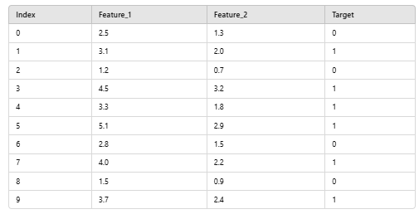
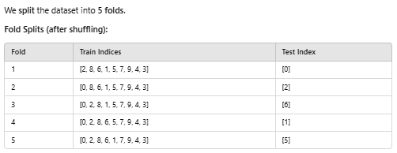
Small dataset with 10 samples and 2 features
The accuracy varies across 5 folds.
4 out of 5 folds had 100% accuracy.
1 fold (Fold 3) had 0% accuracy due to a misclassification.
The final average accuracy is 80% (0.8000).

Slide 21
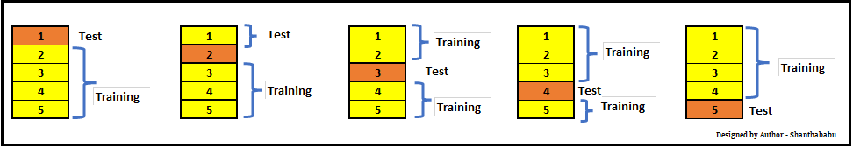
Let’s have a generalized K value. If K=5, it means, in the given dataset and we are splitting into 5 folds and running the Train and Test. During each run, one fold is considered for testing and the rest will be for training and moving on with iterations, the below pictorial representation would give you an idea of the flow of the fold-defined size.

Slide 22
The Problem with Imbalanced Data
Standard K-Fold cross-validation, while a robust method for many scenarios, randomly divides the dataset into K equal-sized folds. This randomness does not guarantee the representation of minority classes in each fold.
This could severely impact the model’s ability to learn and generalize about those minority classes, leading to biased or inaccurate models.

Slide 23
Stratified k-Fold Cross-Validation
Stratified k-Fold Cross-Validation is a variation of k-Fold CV that ensures each fold maintains the same proportion of class labels as the entire dataset.
This is particularly useful for imbalanced datasets, where some classes appear much less frequently than others.
Prevents biased training when class distributions are uneven.
Ensures that each fold has a similar class proportion as the full dataset.
Useful for classification problems, especially when some classes are rare.

Slide 24
Order Samples Per Class: First, the samples in the dataset are ordered by class, grouping all samples belonging to the same class together.
Creating Strata: For each class, the samples are divided into K non-overlapping sets or strata. It ensures each class is proportionally represented in every fold. These strata are created in such a way that the number of samples in each stratum is approximately equal, or as close as possible if the class size is not divisible by K.
Combining Strata into Folds: The stratified folds are then created by taking the first stratum from each class and combining them into the first fold, the second stratum from each class into the second fold, and so on. This way, we form folds that reflect the dataset’s original class distribution.
Perform K-Fold Cross-Validation: The K-Fold Cross-Validation process is then carried out as usual, with one fold serving as the test set and the remaining K-1 folds used for training in each iteration.

Slide 25
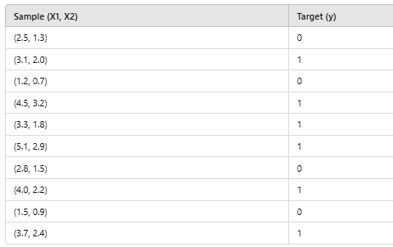
10-sample dataset with 2 features and an imbalanced class distribution.
Class Distribution: Class 0: 4 samples Class 1: 6 samples

Slide 26
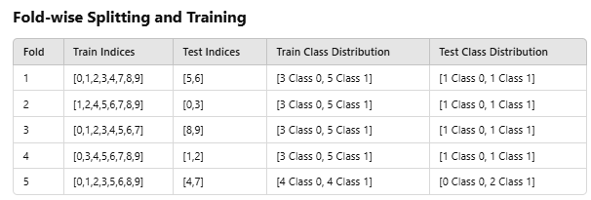
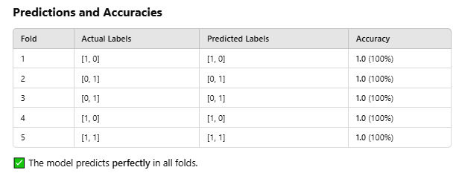
Stratified k-Fold Cross-Validation to maintain class proportions across 5 folds.
Dataset into 5 folds, ensuring that each fold has a similar class proportion.

Slide 27
Measuring classifier performance
Evaluating a machine learning classifier involves several key metrics. These help us understand how well the model is making predictions.
Common Classification Metrics
Accuracy
Precision (Positive Predictive Value)
Recall (Sensitivity or True Positive Rate)
F1 Score (Harmonic Mean of Precision & Recall)
Confusion Matrix

Slide 28

Accuracy
Accuracy is the proportion of correctly classified instances out of the total instances. It is one of the most commonly used metrics to measure a classifier’s performance.
TP (True Positives): Correctly predicted positive cases
TN (True Negatives): Correctly predicted negative cases
FP (False Positives): Incorrectly predicted as positive
FN (False Negatives): Incorrectly predicted as negative
Good for balanced datasets, but misleading for imbalanced data.

Slide 29

Accuracy :Example
Imagine a classifier that predicts whether an email is spam or not. If we have the following results:
TP = 50 (Spam emails correctly classified as spam)
TN = 40 (Non-spam emails correctly classified as non-spam)
FP = 5 (Non-spam emails wrongly classified as spam)
FN = 5 (Spam emails wrongly classified as non-spam)

Slide 30
Limitations of Accuracy
Accuracy is useful when the dataset is balanced (i.e., classes have nearly equal representation). However, it can be misleading when the dataset is imbalanced (one class significantly outnumbers the other).
Example of misleading accuracy: If a dataset contains 95% negative cases and 5% positive cases, a model that always predicts "negative" will have 95% accuracy but is useless for detecting positive cases.
To handle imbalanced datasets, consider additional metrics like Precision, Recall, F1-Score, and MCC.

Slide 31

Precision (Positive Predictive Value)
Precision (also called Positive Predictive Value) measures how many of the predicted positive instances are actually correct. It is particularly useful when false positives (FP) are costly, such as in spam detection.
Where:
TP (True Positives): Correctly predicted positive instances
FP (False Positives): Incorrectly predicted positive instances (Type I error)
Punishes Wrong Alarms

Slide 32

Precision: Example
Imagine a classifier predicting whether an email is spam (positive class) or not spam (negative class).
If the model predicts 100 emails as spam, but only 80 are actually spam, and 20 are wrongly classified as spam:
TP = 80 (Correctly predicted spam emails)
FP = 20 (Non-spam emails wrongly classified as spam)

Slide 33
When is Precision Important?
When false positives are more harmful than false negatives.
Example scenarios:
Spam filtering: Predicting an important email as spam (FP) could cause a user to miss critical messages.

Slide 34

Recall (Sensitivity or True Positive Rate)
Recall (also called Sensitivity or True Positive Rate) measures how many of the actual positive instances were correctly predicted by the model. It is crucial when missing positive cases (false negatives) is costly, such as in medical diagnoses
Where:
TP (True Positives): Correctly predicted positive instances
FN (False Negatives): Positive instances incorrectly classified as negative (Type II error)
Punishes Missed Cases

Slide 35

Recall : Example
Imagine a medical test for cancer detection:
100 patients have cancer (actual positives).
The model correctly identifies 80 as cancerous (TP = 80).
However, it misses 20 cases (FN = 20).
This means the model correctly detects 80% of cancer cases, but misses 20%.

Slide 36
When is Recall Important?
When false negatives (FN) are more dangerous than false positives (FP).
Example scenarios:
Medical Diagnosis: Missing a cancer diagnosis (FN) is much worse than a false alarm (FP).
Security Systems: Letting an intruder pass undetected (FN) is more critical than a false alert (FP).

Slide 37

F1 Score
The F1-score is the harmonic mean of Precision and Recall. It provides a single metric that balances both values, making it useful when a dataset has an imbalanced class distribution (i.e., one class is much more frequent than the other)

Slide 38
F1 Score
Fraud Detection (Balanced/Context Dependent)
Scenario: A bank flags credit card transactions.
High Recall (Focus): The system flags every transaction that looks slightly suspicious, reducing the chance of missed fraud, even if many valid customer transactions are temporarily blocked.
High Precision (Focus): The system only flags transactions it is absolutely certain are fraudulent. This results in fewer customer complaints about blocked cards, but actual fraudulent transactions might go unnoticed

Slide 39
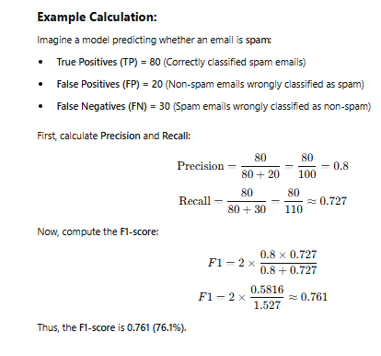

Slide 40
When is F1-Score Important?
F1-score is useful when:
The dataset is imbalanced (e.g., fraud detection, rare disease classification).
Both false positives (FP) and false negatives (FN) need to be minimized.
A model must balance precision and recall, instead of focusing on just one.

Slide 41
Exercise Problem
A model for disease detection reports:
Accuracy = 97%
Recall = 0.22
Questions:
What does this tell you about the dataset?
What does Recall = 0.22 imply in real life?
Would you approve this model for hospital deployment?

Slide 42
Answer
What does this tell you about the dataset?
This strongly suggests the dataset is highly imbalanced.
Why?
If Recall is only 0.22, the model is detecting only 22% of actual disease cases.
Yet Accuracy is 97%, meaning overall predictions are mostly correct
This can only happen if the majority of patients are healthy.
So most likely:
Disease cases are rare.
The model is correctly predicting healthy cases
It is missing many actual disease cases.
In other words:
The model is performing well on the majority class and poorly on the minority (disease) class.

Slide 43
What does Recall = 0.22 imply in real life?
Recall = 0.22 means:
Out of 100 actual sick patients, the model correctly detects only 22.
That means:
78% of sick patients are missed (False Negatives).
In real life:
Patients may go untreated. Disease may worsen.
Legal and ethical consequences may occur.
The hospital may lose trust.
In healthcare, False Negatives are often far more dangerous than False Positives.

Slide 44
Would you approve this model for hospital deployment?
No.
Reason:
Missing 78% of actual patients is unacceptable in medical diagnosis.
High accuracy is misleading.
The model is effectively acting like a “mostly healthy predictor.”
This model is unsafe for deployment.

Slide 45
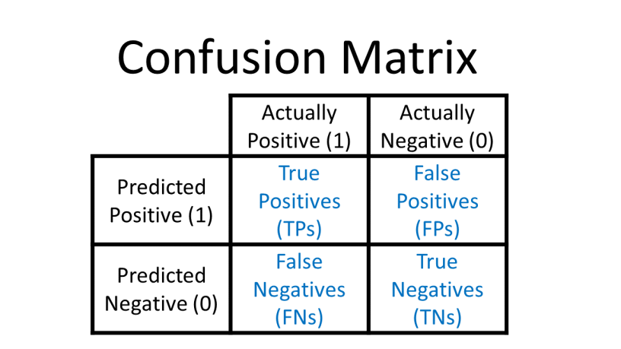
Confusion Matrix
A confusion matrix is a table that helps evaluate a classification model’s performance by showing the actual vs. predicted classifications. It is especially useful for understanding model errors.
A table that shows the counts of TP, TN, FP, FN for a classifier. Example:

Slide 46
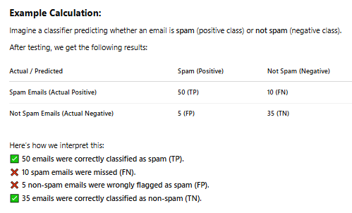

Slide 47
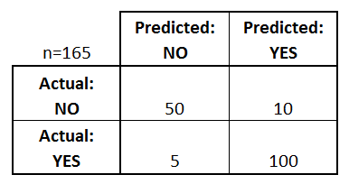
What can we learn from this matrix?
There are two possible predicted classes: "yes" and "no". If we were predicting the presence of a disease, for example, "yes" would mean they have the disease, and "no" would mean they don't have the disease.
The classifier made a total of 165 predictions (e.g., 165 patients were being tested for the presence of that disease).
Out of those 165 cases, the classifier predicted "yes" 110 times, and "no" 55 times.
In reality, 105 patients in the sample have the disease, and 60 patients do not.

Slide 48
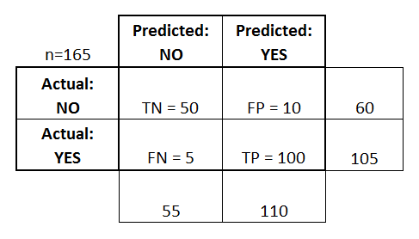
Accuracy: Overall, how often is the classifier correct?
(TP+TN)/total = (100+50)/165 = 0.91
Misclassification Rate: Overall, how often is it wrong?
(FP+FN)/total = (10+5)/165 = 0.09
equivalent to 1 minus Accuracy
also known as "Error Rate"

Slide 49
True Positive Rate: When it's actually yes, how often does it predict yes?
TP/actual yes = 100/105 = 0.95
also known as "Sensitivity" or "Recall"
False Positive Rate: When it's actually no, how often does it predict yes?
FP/actual no = 10/60 = 0.17
True Negative Rate: When it's actually no, how often does it predict no?
TN/actual no = 50/60 = 0.83
equivalent to 1 minus False Positive Rate
also known as "Specificity"

Slide 50
Precision: When it predicts yes, how often is it correct?
TP/predicted yes = 100/110 = 0.91
Prevalence: How often does the yes condition actually occur in our sample?
actual yes/total = 105/165 = 0.64

Slide 51
ROC Curve
The receiver operating characteristic (ROC) curve is frequently used for evaluating the performance of binary Classification algorithms
ROC is a probability curve that depicts the TPR (rate of true positives) on the y-axis against the FPR (rate of false positives) on the x-axis.
It essentially distinguishes the ‘signal’ from the ‘noise’, thereby highlighting the Sensitivity of the classifier model.
Measures how well the model differentiates between classes.

Slide 52
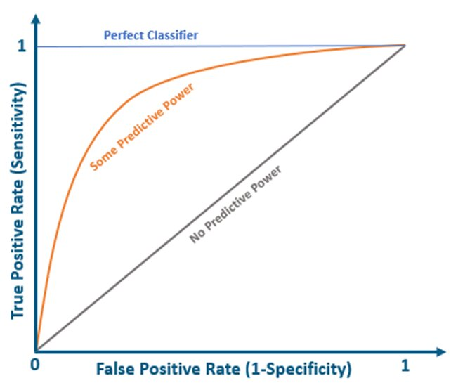
The graph below demonstrates theoretically how the ROC curve would be plotted for a classifier model.
A perfect classifier will have a ROC where the graph would hit a true positive rate of 100% with zero false positives.
The grey diagonal line represents a classifier with no predictive power – one that guesses randomly
Nearly all real-world classifiers would fall between these two extremes – having some predictive power. Generally, we look for a classifier that maintains a high TPR while also low FPR.
ROC Curves help determine the exact trade-off between the TPR and FPR for a classifier using different measures of probability thresholds.

Slide 53
Which Model should you use?
 | False Positive Rate | False Negative Rate
Model 1 | 41% | 3%
Model 2 | 5% | 25%
Mistakes have different costs:
Disease Screening – LOW FN Rate
Spam filtering – LOW FP Rate
Conservative vs Aggressive settings:
The same application might need multiple tradeoffs
Actually, the same model
- different thresholds

Slide 54
Classifications and Probability Estimates
Logistic regression produces a score between 0 – 1 (probability estimate)
Use threshold to produce classification
What happens if you vary the threshold?

Slide 55
Example of Changing Thresholds
 | Threshold = .5
False Positive Rate | 33%
False Negative Rate | 0%
Score | Prediction | Y
.25 |  | 0
.45 |  | 0
.55 |  | 1
.67 |  | 0
.82 |  | 1
.95 |  | 1
 | Threshold = .6
False Positive Rate | 33%
False Negative Rate | 33%
 | Threshold = .7
False Positive Rate | 0%
False Negative Rate | 33%

Slide 56
ROC Curve
(Receiver Operating Characteristic)
Percent of 0s classified as 1
Perfect score:
0% of 1s called 0
0% of 0s called 1
This model’s distance
from perfect
Sweep threshold from 0 to 1
Threshold 0: ‘all’ classified as 1
Threshold 1: ‘all’ classified as 0
Percent of 1s classified as 0

Slide 57
Operating Points
Threshold .04
Threshold .05
Threshold .03
2) Target FN Rate
3) Explicit cost:
FP costs 10
FN costs 1
Threshold: 0.8
- 5FPs + 60FNs → 110 cost
Threshold: 0.83
- 4FPs + 65FNs → 105 cost
Interpolate between nearest measurements:
- To achieve 30% FPR, use threshold of ~0.045
Threshold: 0.87
- 3FPs + 90FNs → 120 cost
1) Target FP Rate

Slide 58
Comparing Models with ROC Curves
Model 1 better than Model 2 at every FPR or FNR target
Area Under Curve (AUC)
Integrate Area under the curve
Perfect score is 1
Higher scores allow for generally better tradeoffs
AUC of 0.5 indicates model is essentially randomly guessing
AUC of < 0.5 indicates you’re doing something wrong…
Model 1 better than Model 2 at this FNR
Model 1: AUC ~97
Model 2: AUC ~89.5
Model 1 better than Model 2 at this FPR

Slide 59
More ROC Comparisons
ROC Curves Cross
Model 1 better at low FNR
Model 2 better at low FPR
Zoom in on region of interest
Model 2:
Worse AUC
May be better at what you need…
Model 1: AUC ~97
Model 2: AUC ~93.5

Slide 60
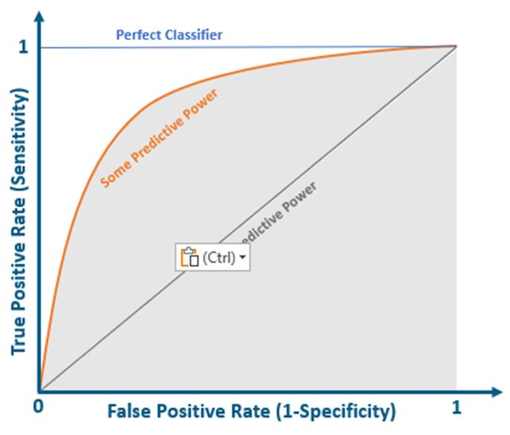
Area Under the Curve (AUC)
It is another important evaluation metric generally used for binary classification problems. AUC represents the degree of separability. The higher the AUC, the better the classifier can distinguish between the positive and negative classes.
The graph below demonstrates the area under the curve. AUC is used to summarize the ROC Curve as it measures the entire 2D area present underneath the ROC curve.

Slide 61
The value of AUC ranges from 0 to 1. If AUC=1, the model can distinguish between the Positive and the Negative class points correctly.
Similarly, a model with 100% false predictions, i.e., predicting all Negatives as Positives, and all Positives as Negatives, would have AUC=0.
When an AUC=0.5, it means the model possesses no class separation capacity and cannot distinguish between the Positive and Negative class points.

Slide 62
Difference Between ROC and AUC
Feature | ROC (Receiver Operating Characteristic) Curve | AUC (Area Under the Curve)
Definition | A graphical plot showing the trade-off between True Positive Rate (Recall) and False Positive Rate at different thresholds. | A numerical value representing the total area under the ROC curve, summarizing the classifier’s performance.
Purpose | Visualizes the performance of a classification model across various thresholds. | Quantifies the model’s ability to distinguish between positive and negative classes.
Interpretation | Helps understand the trade-off between sensitivity and specificity. | A higher AUC means a better-performing model.
Range | The ROC curve extends from (0,0) to (1,1) on a graph. | AUC value ranges from 0 to 1 (with 1 being perfect and 0.5 being random guessing).
Use Case | Used to analyze and compare different classification models. | Used to summarize the performance of a classifier in a single metric.

Slide 63
Comparing Two Classification Models Using a Paired t-Test
A paired t-test is used to determine whether the performance difference between two classification models evaluated on the same dataset is statistically significant.

Slide 64
Why We Use a Paired t-Test
When comparing models like:
Logistic Regression
Random Forest
their accuracies may differ slightly.
Split | Model A Accuracy | Model B Accuracy
1 | 0.84 | 0.86
2 | 0.82 | 0.85
3 | 0.83 | 0.84
4 | 0.85 | 0.87
5 | 0.81 | 0.84
Is Model B really better, or is the difference due to random sampling?
The paired t-test answers this.

Slide 65
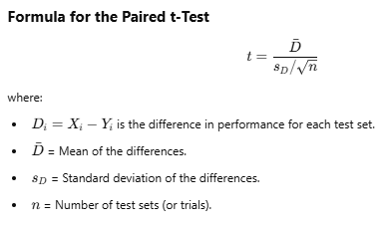
Paired t-Test

Slide 66
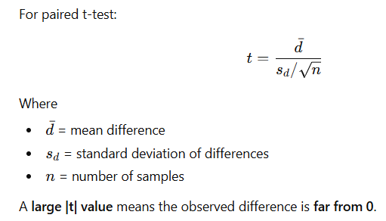
t-value
The t-value measures how far the observed result is from the null hypothesis.

Slide 67
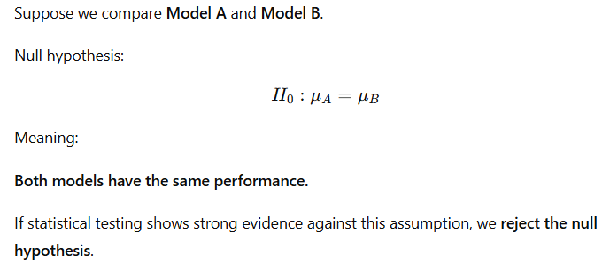
Null Hypothesis

Slide 68
Steps for Comparing Two Models Using a Paired t-Test
Step 1: Train and Evaluate Both Models
Choose two classification models (e.g., Random Forest vs. SVM).
Train and test them on the same dataset multiple times (e.g., 5 different train-test splits).
Record their performance scores (e.g., accuracy).

Slide 69
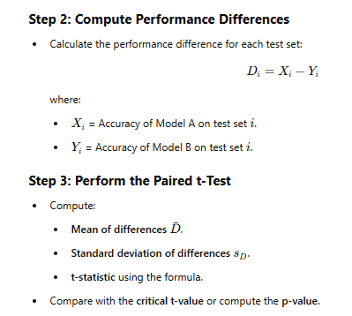

Slide 70
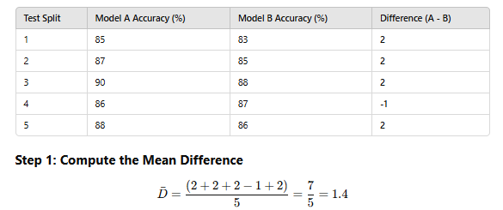
Numerical Example
Let's compare Random Forest (Model A) and SVM (Model B) on 5 different train-test splits.

Slide 71
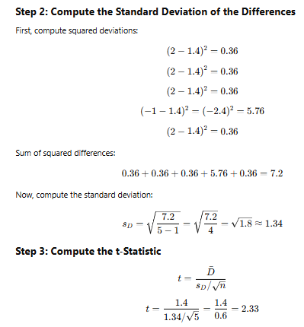
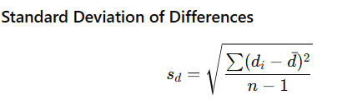

Slide 72
Step 4: Determine the p-Value
For df = 5 - 1 = 4 at a 95% confidence level, the critical t-value for a two-tailed test is 2.776.
If |t| ≥ 2.776, reject H₀​ (significant difference).
If |t| < 2.776, fail to reject H₀​ (no significant difference).
Since 2.33 < 2.776, we fail to reject the null hypothesis, meaning no significant difference between the models at a 95% confidence level.

Slide 73
When to Use This Method
Use a paired t-test when:
You compare two models using multiple independent train-test splits.
You want to determine if one model significantly outperforms the other.
You are using hold-out validation instead of cross-validation.
Don't use it when:
You're using K-fold cross-validation → Use a K-fold CV paired t-test instead.
You have only one train-test split → Not enough data for statistical testing.

Slide 74
Exercise problem
Two machine learning classifiers are evaluated on the same 6 datasets.
Classifier A → Random Forest
Classifier B → Support Vector Machine (SVM)
The accuracy obtained on each dataset is given below.
Dataset | Classifier A | Classifier B
D1 | 0.88 | 0.84
D2 | 0.90 | 0.86
D3 | 0.87 | 0.85
D4 | 0.91 | 0.88
D5 | 0.89 | 0.87
D6 | 0.92 | 0.90

Slide 75
Answer
t=7.08>2.571
Reject the null hypothesis
There is significant evidence that Classifier A performs better than Classifier B.

Slide 76
Comparing Two Classification Algorithms Using K-Fold Cross-Validation (K-Fold CV) Paired t-Test
When comparing two classification models, K-Fold Cross-Validation (CV) paired t-test is a robust statistical method.
It reduces variance by evaluating both models on the same K-fold splits, making the comparison more reliable than a single train-test split.

Slide 77
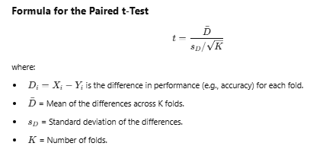
K-Fold CV Paired t-Test
A paired t-test checks whether the difference in performance between two models is statistically significant.
In K-Fold CV paired t-test, both models are evaluated on K different folds, and a paired t-test is applied to the K-fold results.

Slide 78
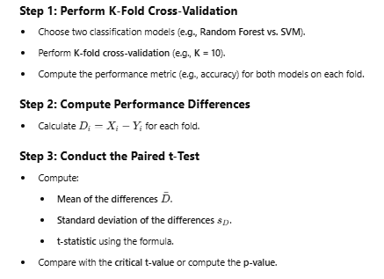

Slide 79
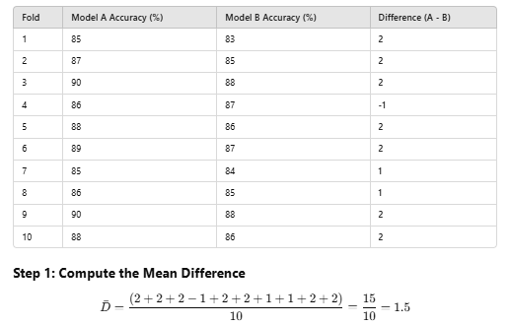
Let's compare Random Forest (Model A) and SVM (Model B) using 10-fold cross-validation.

Slide 80
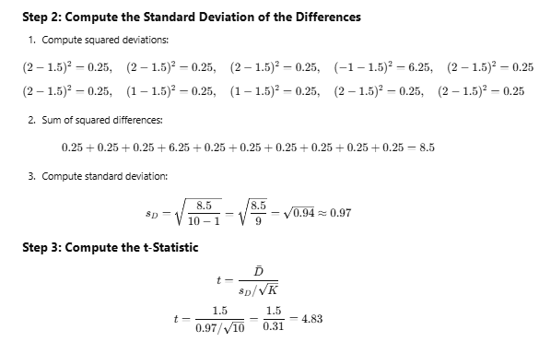

Slide 81
Step 4: Determine the p-Value
For df = 10 - 1 = 9 at a 95% confidence level, the critical t-value for a two-tailed test is 2.262.
If |t| ≥ 2.262, reject H₀​ (significant difference).
If |t| < 2.262, fail to reject H_{0​} (no significant difference).
Since 4.83 > 2.262, we reject the null hypothesis, meaning Model A (Random Forest) significantly outperforms Model B (SVM).

Slide 82
When to Use This Method
Use K-Fold CV paired t-test when:
You use K-fold cross-validation.
You want a more stable comparison (reduces variance).
You have a small dataset.
Don't use it when:
You only have one train-test split → Use a paired t-test instead.

Slide 83
Key Takeaways
K-Fold CV paired t-test provides a more reliable comparison than a standard paired t-test.
K-Fold CV reduces bias and variance, making results more stable.

Slide 84
McNemar’s Test for Comparing Two Classifiers
McNemar’s test is a statistical test used to compare two classifiers based on their misclassification differences on the same dataset.
It helps determine whether one classifier makes significantly different types of errors compared to another.

Slide 85
When to Use McNemar’s Test?
When comparing two classifiers on paired data (i.e., both models are evaluated on the same test set).
Best for binary classification problems.
Suitable when sample size is small and data does not follow a normal distribution.

Slide 86
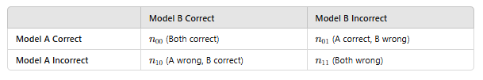
McNemar’s Test
It analyzes the disagreements in classification outcomes using a contingency table:

Slide 87
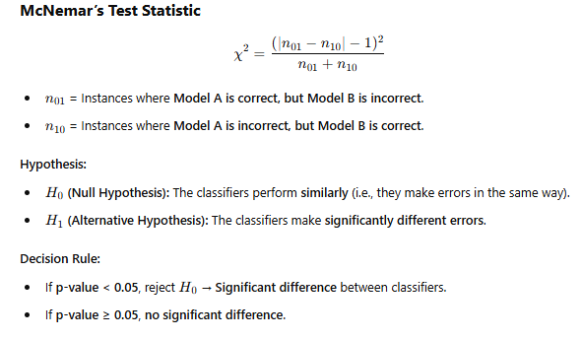

Slide 88
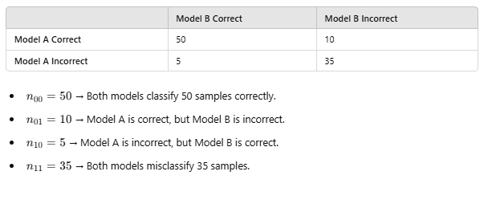
Example
Suppose we evaluate two classifiers (A & B) on 100 samples, and their predictions result in the following contingency table:
McNemar’s test focuses on the disagreements: n₀₁​=10,n₁₀​=5

Slide 89
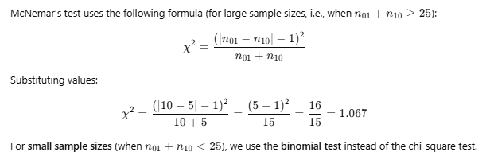
McNemar’s Test Statistic Calculation

Slide 90
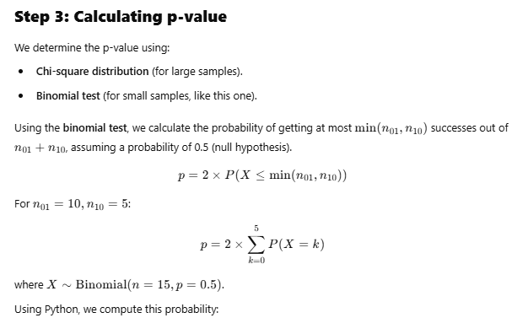

Slide 91
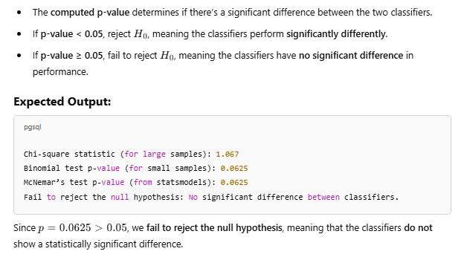
Interpretation of Results

Slide 92
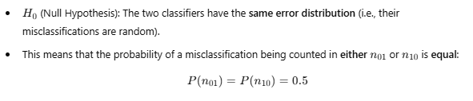
Steps to Calculate the Binomial Test for McNemar’s Test
Define the Null Hypothesis

Slide 93
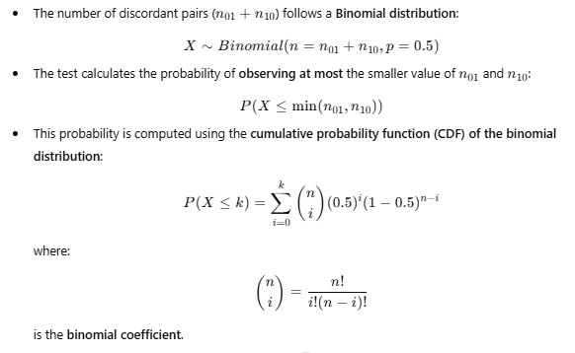
Compute the Probability Distribution

Slide 94

Compute the Two-Tailed p-value

Slide 95
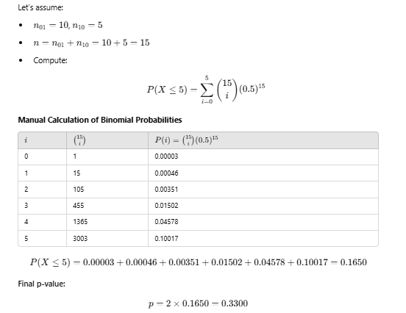
Thus, the p-value = 0.33, which is greater than 0.05, so we fail to reject the null hypothesis.

