Slide 1

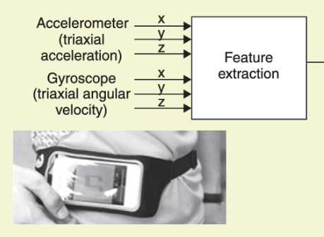
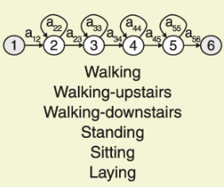
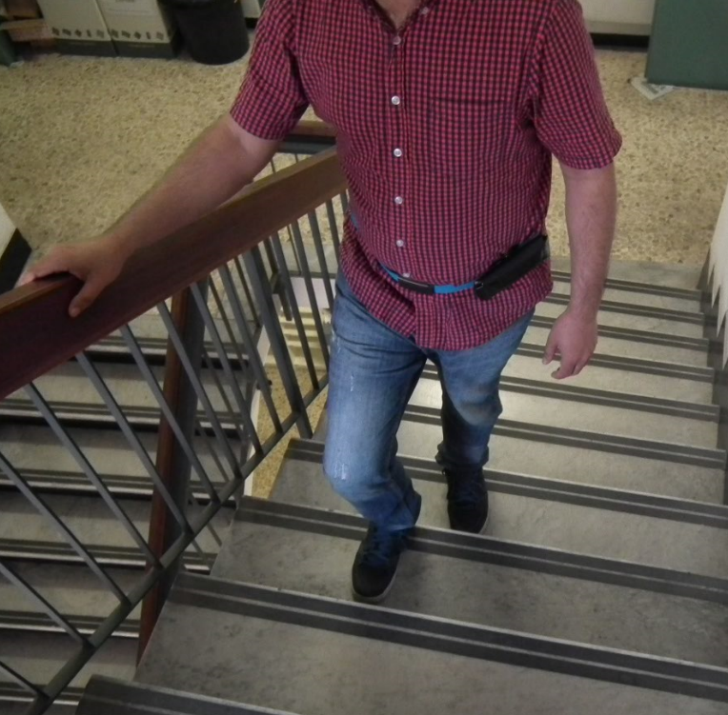
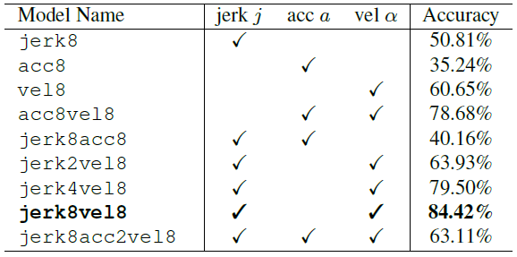
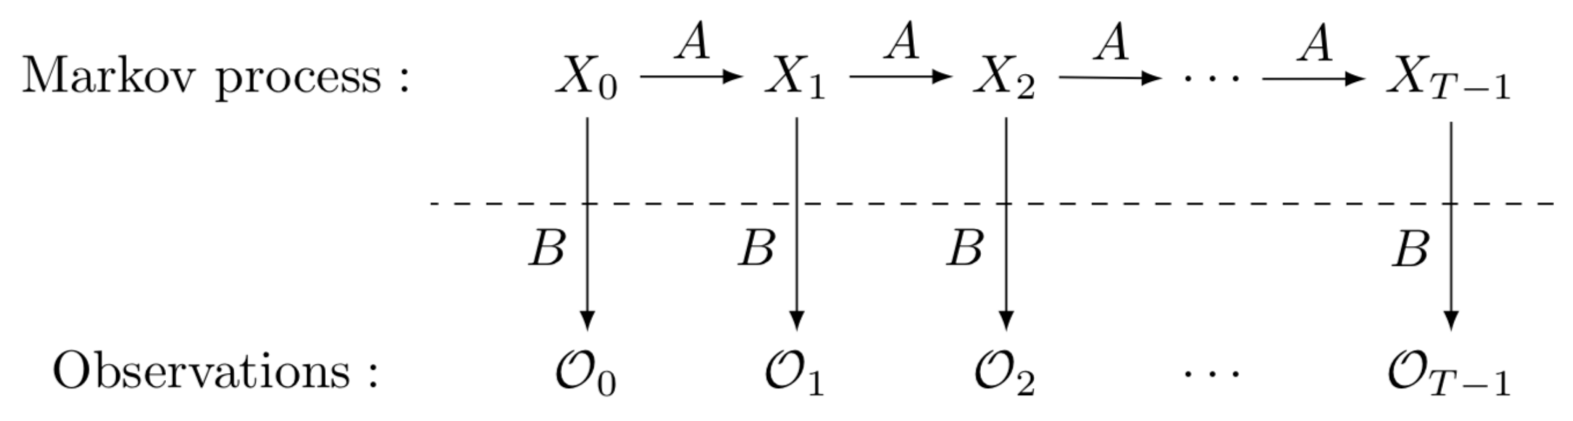
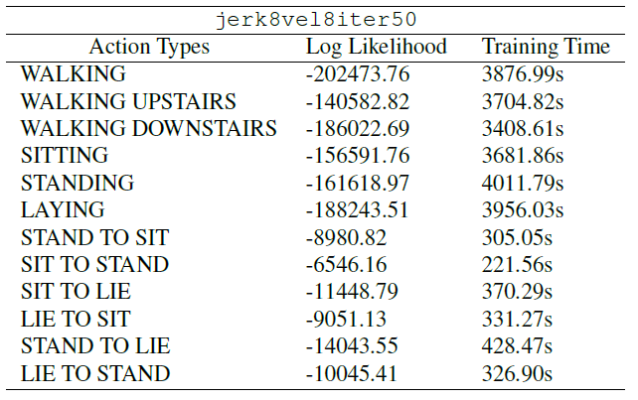
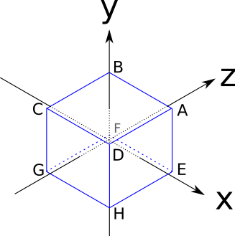
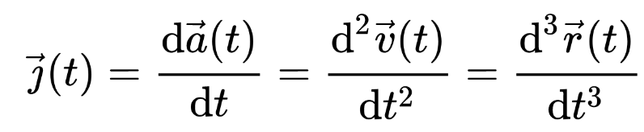
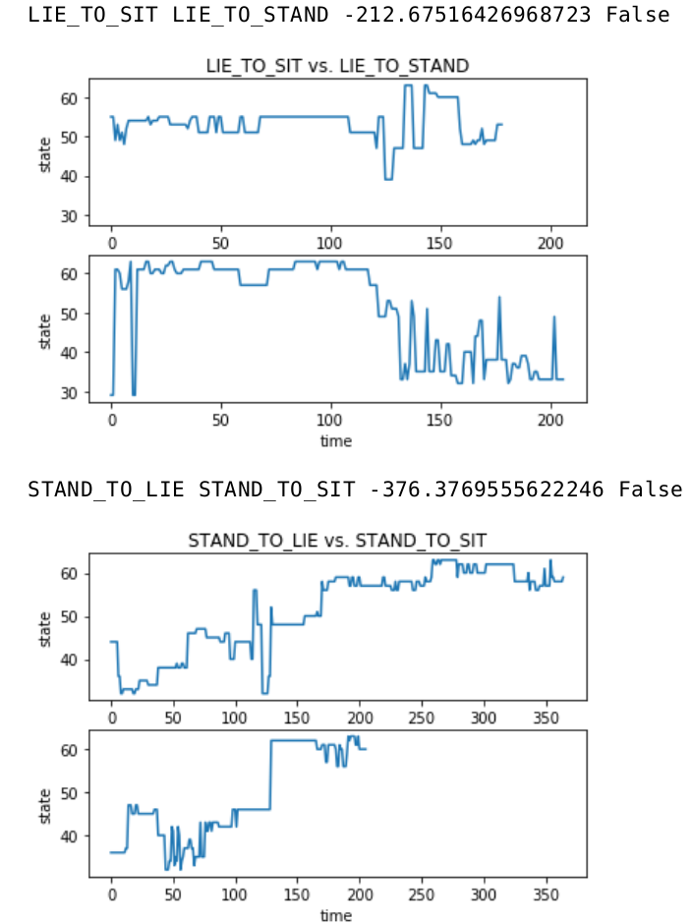



Project 2. Human Action Recognition
using Hidden Markov Model
Sangjun Son
Department of Computer Science & Engineering, Seoul National University
lucetre@snu.ac.kr
Backgrounds
Experimental Results
Human Activity Recognition is nowadays an active research field which aims to understand human.
Human Activities and Postural Transitions datasets (HAPT) → Data selection
Performs basic activities and postural transitions while carrying a waist-mounted smartphone with embedded inertial sensors.
Includes 61 experiments and was measured 50Hz in 400s duration.
Temporal models like HMM enables to learn the observation patterns from time serial dataset. → Time-serial
Data Manipulation Flow
One-iteration Trained Model Comparison
Feature Metric Approach
Angular velocity as significant evaluation metric
jerk8 vs. vel8 vs. acc8
Combination of jerk and velocity directions were used as observations.
acc8vel8 vs. jerk8vel8 vs. jerk8acc8
Model Complexity Approach
Avoid overfitting issues for constructing model with too many states.
jerk4vel8 vs. jerk8vel8 vs. jerk2vel8, jerk8acc2vel8
Selected our model as jerk8vel8 and trained for 50 iterations, jerk8vel8iter50
Model jerk8vel8iter50
92.62% as test accuracy and 24623.64s as total training time
Train Data
Train Data
Train Data
Train Data
Test Data
Train Data
Train Data
Train Data
Train Data
Train Data
Action Type
Walking | Stand to Sit
Walking Upstairs | Sit to Stand
Walking Downstairs | Sit to Lie
Sitting | Lie to Sit
Standing | Stand to Lie
Laying | Lie to Stand
Train–Test Split
HMM Train
Research Goals
To study the Hidden Markov Model and its applications
Build a model finding a latent temporal pattern.
Fast and accurate Human Action Recognition system
Extract relevant features from sensor data (acceleration, gyro sensors)
Use the multinomial HMM package
Model complexity vs. Accuracy trade-offs
Preliminaries
Hidden Markov Model
Probabilistic model that infers hidden states with observation events as causal factors.
Three Fundamental Problems in HMM
1. Likelihood 2. Decoding 3. Learning
Methodology
Feature Extraction
Feature metric describing our hidden states.
Jerk and Angular velocity
Direction separated into 8 sections
Multinomial HMM
Observation values are all in discrete number.
12 Activity Models
Each model learns corresponding activity and classifies test data set with one vs rest method (OVR) with maximum likelihood.
Concluding Remarks
Constructed a fast and accurate HMM model to recognize human action
A probabilistic model simply learning the observation patterns
Found latent states by appropriate feature extraction.
Future works to improve our model
Train with numerous instances created from more experiments.
Use other additional sensors to extract various states features.
Lie To Stand
Lie To Sit
Seoul National University | Artificial Intelligence

