Slide 1
WALKING BOT
By Lucas
May 2025

Slide 2
Development Pipeline
Create code for device
Compile (change code into 0s and 1s)
Upload (put the compiled code onto device)
Have fun!

Slide 3
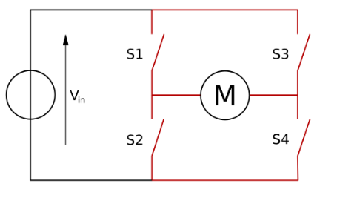
H-bridge
A h bridge is how a motor works. If S1 and S4 are turned on, then the motor will spin one way. If S2 and S3 are turned on, then the motor will spin the other way.
If S1/S2 or S3/S4 are turned on at the same time then the battery will do at least one of these three things:
Heat up
Blow up
Burn your house down
This is because that connecting the positive and negative of a battery together causes the electricity to go extremely fast between the terminals. When the electricity goes through the motor, the motor creates resistance for the electricity as the electricity has to make the motor spin before it can go back to the other battery terminal.

Slide 4
What is a PWM?
A PWM (Pulse Width Modulation) is something that converts digital (on and off) power to analog (any amount of power). It is in every single type of electronic device that has some kind of processer, as it is used for computing things.
For example, if you wanted to get half the power from a 1(max power) a computer would have to use a PWM so that it could find it out. It would do this by saying that 1 was 100 analog power then it sent analog 50 power. This is what H-briges are used for.

Slide 5
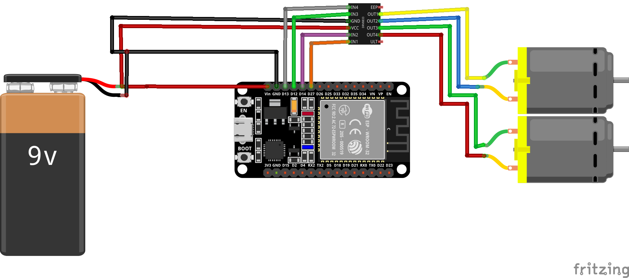
Schematic

Slide 6
What is a PWM?
A PWM (Pulse Width Modulation) is something that converts digital (on and off) power to analog (any amount of power). It is in every single type of electronic device that has some kind of processer, as it is used for computing things.
For example, if you wanted to get half the power from a 1(max power) a computer would have to use a PWM so that it could find it out. It would do this by saying that 1 was 100 analog power then it sent analog 50 power. This is what H-briges are used for.

Slide 7
How to use
Switch on from battery (or plug in USB wire)
Connect to WiFi network “LucasPotato” with password “mypotato”
If the captive portal does not appear, go to http://192.168.4.1 in your web browser
Set WiFi credentials
Press Submit
Restart the ESP32
Connect to set WiFi network in Captive Portal
Visit http://esp32.local in web browser
Wait until it says “Ready” in top right corner
Use it!

Slide 8
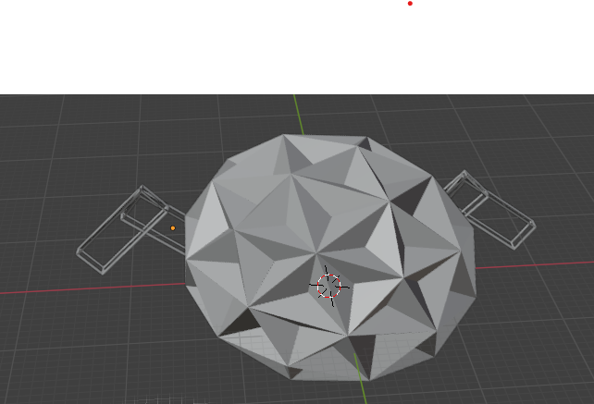
My very bad 3-D model

