Slide 1
MyBatis Study

Slide 2
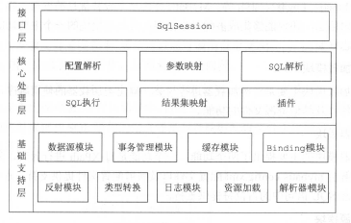
MyBatis整体架构

Slide 3
