Slide 1







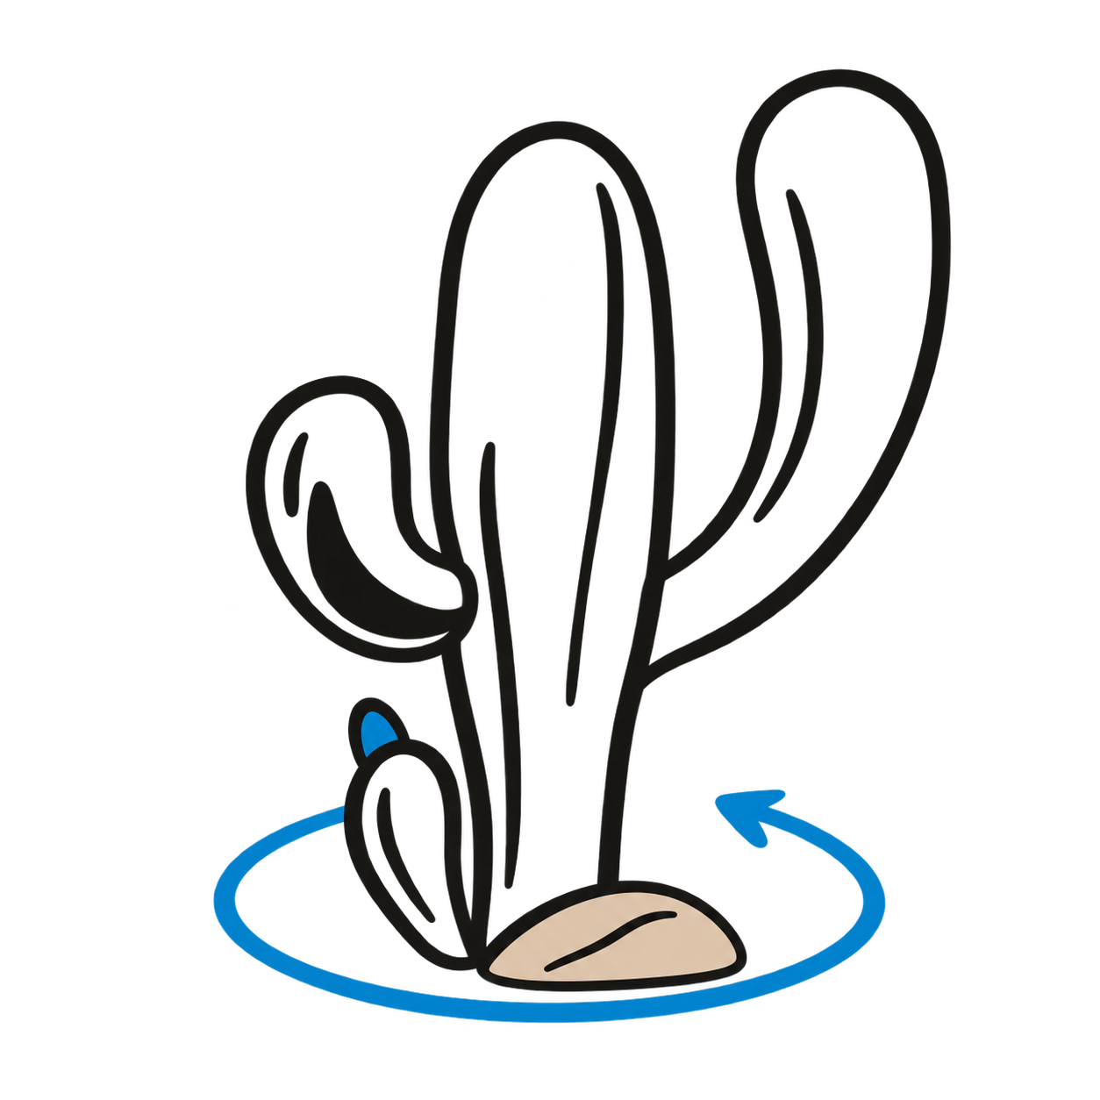
Our delivery & growth methodology
Six delivery stages. Continuous improvement after go-live.
Learning informs the next priorities
01
02
03
04
05
06
Seedling
Budding
Growing
Nurturing
Pruning
Harvest
Discover
Design
Build
Integrate
Test / Train
Deploy
Align on the problem
Define the solution
Configure and develop
Connect systems,
Validate quality
Go live, stabilize
and desired outcomes
and delivery backlog
the solution
data and channels
and prepare users
and capture value
07 / REGROWTH
Optimize / Grow
Measure results. Learn from use.
Improve adoption, AI and the next release.
Optimize / Grow is the proposed extension to the six-stage delivery method.
Notes:
The Capptus Way delivery sequence supplied by the user: Seedling / Discover; Budding / Design; Growing / Build; Nurturing / Integrate; Pruning / Test / Train; Harvest / Deploy. Discover covers problem, objectives, users, processes, data, constraints and expected outcomes. Design covers journeys, architecture, data, integrations, experience and backlog. Test / Train includes QA, UAT, corrections, operational readiness, training and adoption. The user suggested adding Optimize / Grow for Agentforce, Managed Services and Marketing Cloud as a Service; Regrowth is a proposed narrative label. Learning returns to discovery and design. Artwork: existing Capptus Way icons-v1 final PNGs and primary-side-negative-v4 logo. Typography: approved Lora and Montserrat.

