Slide 1

Regression Analysis on King County House Prices
Xinlin Zhang, Qi Hua, Binyao Cheng, Zhenyu Jia, Lu Cheng, Haoxuan Su, Hongshan Lin, Tianshu Zhang

Slide 2
Describe & Clean Data
Variable | Description
Id | Unique ID for each home sold
Date | Date of the home sale
Price | Price of each home sold
Bedrooms | Number of bedrooms
Bathrooms | Number of bathrooms, where .5 accounts for a room with a toilet but no shower
Sqft_living | Square footage of the apartments interior living space
Sqft_lot | Square footage of the land space
Floors | Number of floors
Waterfront | A dummy variable for whether the apartment was overlooking the waterfront or not
View | An index from 0 to 4 of how good the view of the property was
Condition | An index from 1 to 5 on the condition of the apartment
Grade | An index from 1 to 13, where 1-3 falls short of building construction and design, 7 has an average level of construction and design, and 11-13 have a high quality level of construction and design
Sqft_above | The square footage of the interior housing space that is above ground level
Sqft_basement | The square footage of the interior housing space that is below ground level
Yr_built | The year the house was initially built
Yr_renovated | The year of the house’s last renovation
Zipcode | What zipcode area the house is in
Lat | Lattitude
Long | Longitude
Sqft_living15 | The square footage of interior housing living space for the nearest 15 neighbors
Sqft_lot15 | The square footage of the land lots of the nearest 15 neighbors

Slide 3
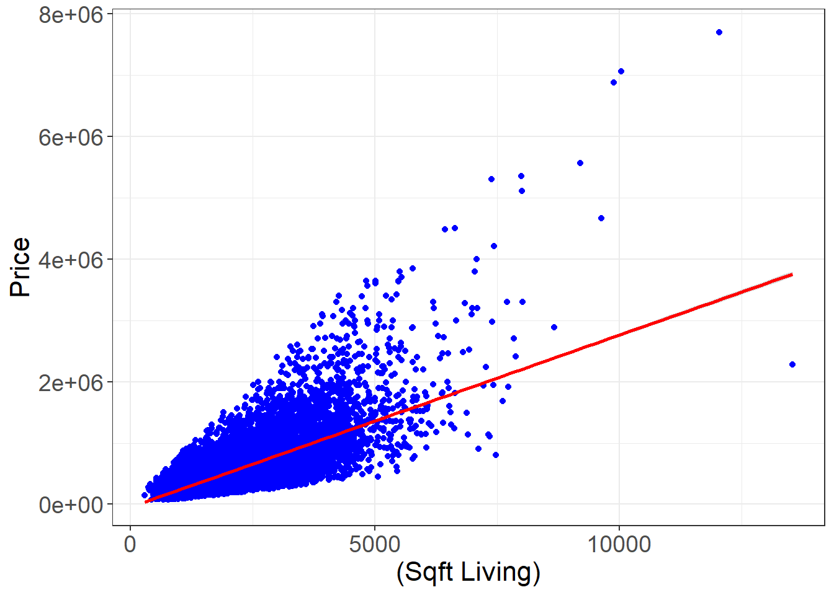
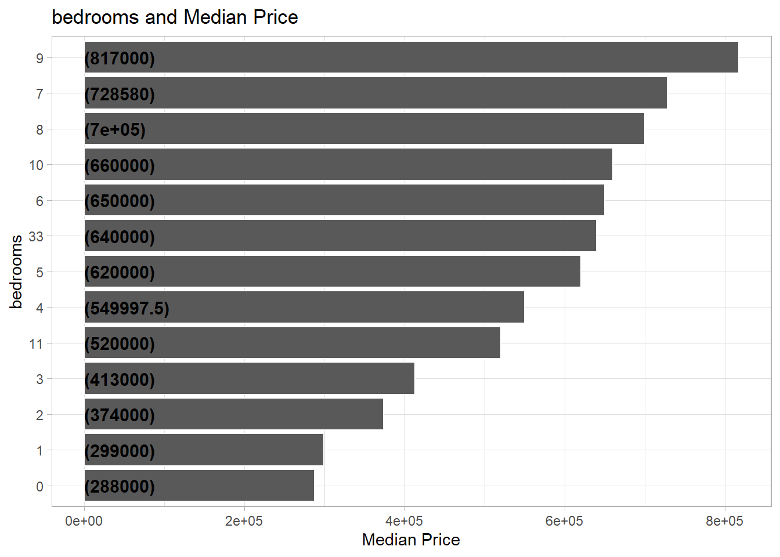
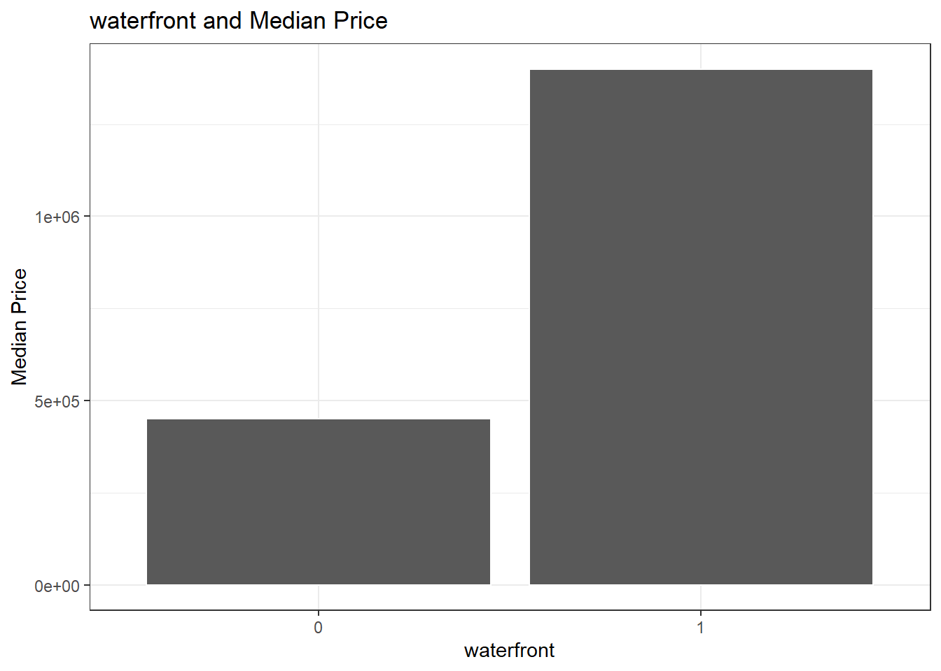
Glance & Split Data
Sqrt_living
Bedrooms
Waterfront

Slide 4
Stepwise Selection
Set: F-limit = 10
Predictor Variables Selected:
sqft_living
lat
waterfront
grade
age
bedrooms
bathrooms
long
sqft_living15
condition
renovated
floors
quarter
sqft_lot15
sqft_lot

Slide 5
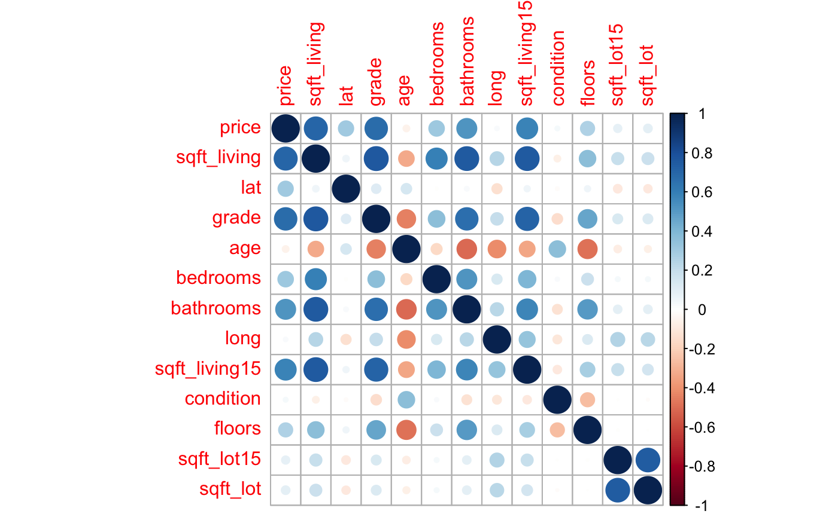
Correlation

Slide 6
Fit Model
Fit the selected model.
Extract the fitted value and residual.

Slide 7
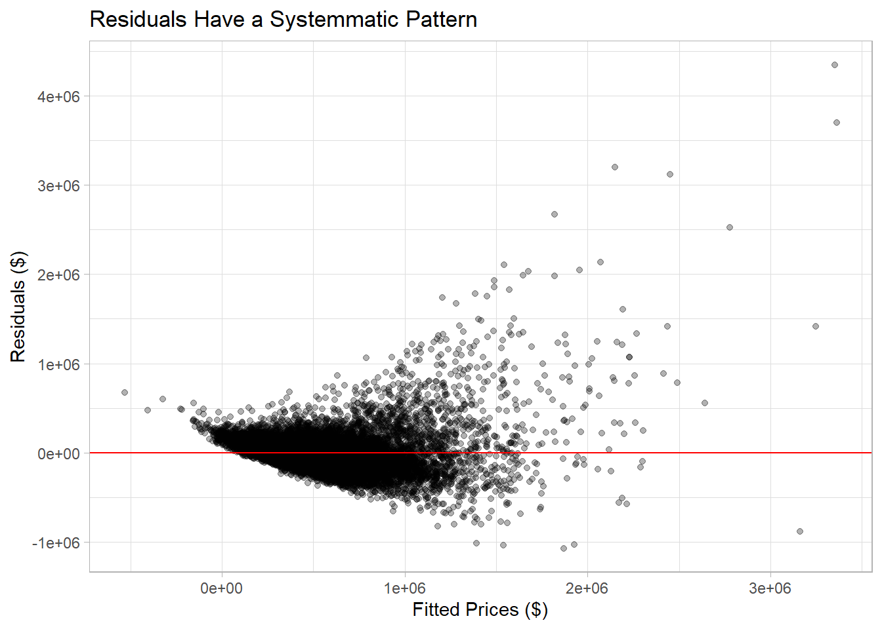
Residual plot
Plot residuals against fitted prices.
The error terms are not constant and
Box-Box Transformation is needed.

Slide 8
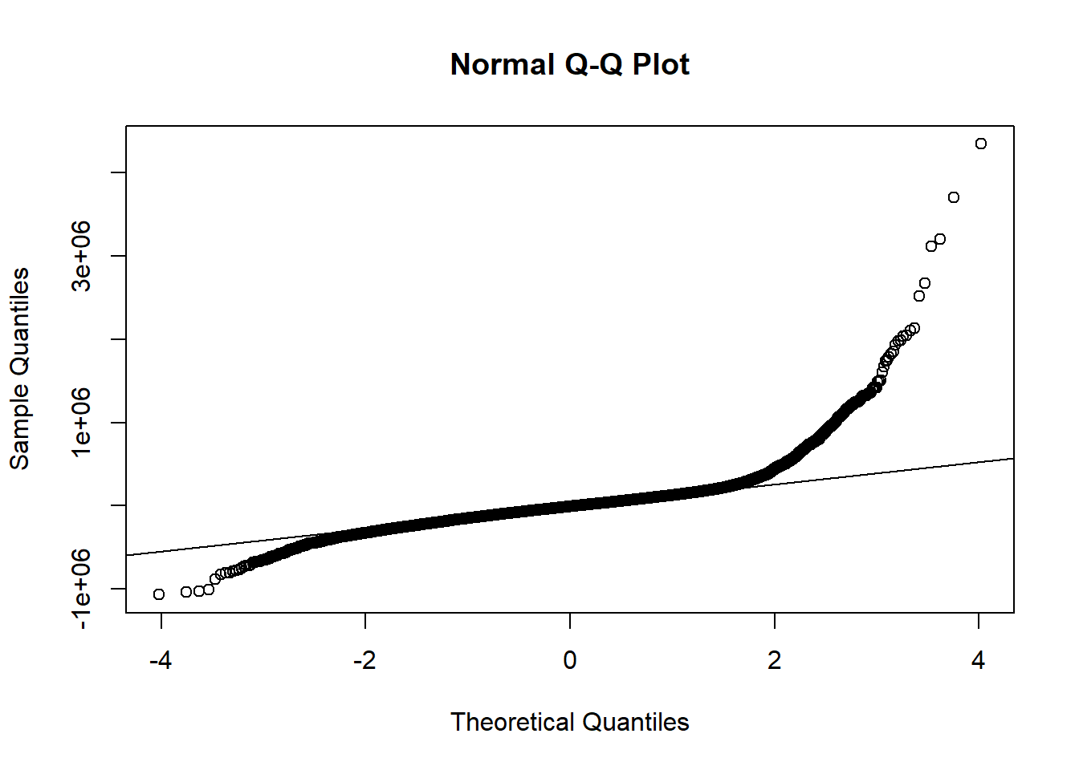
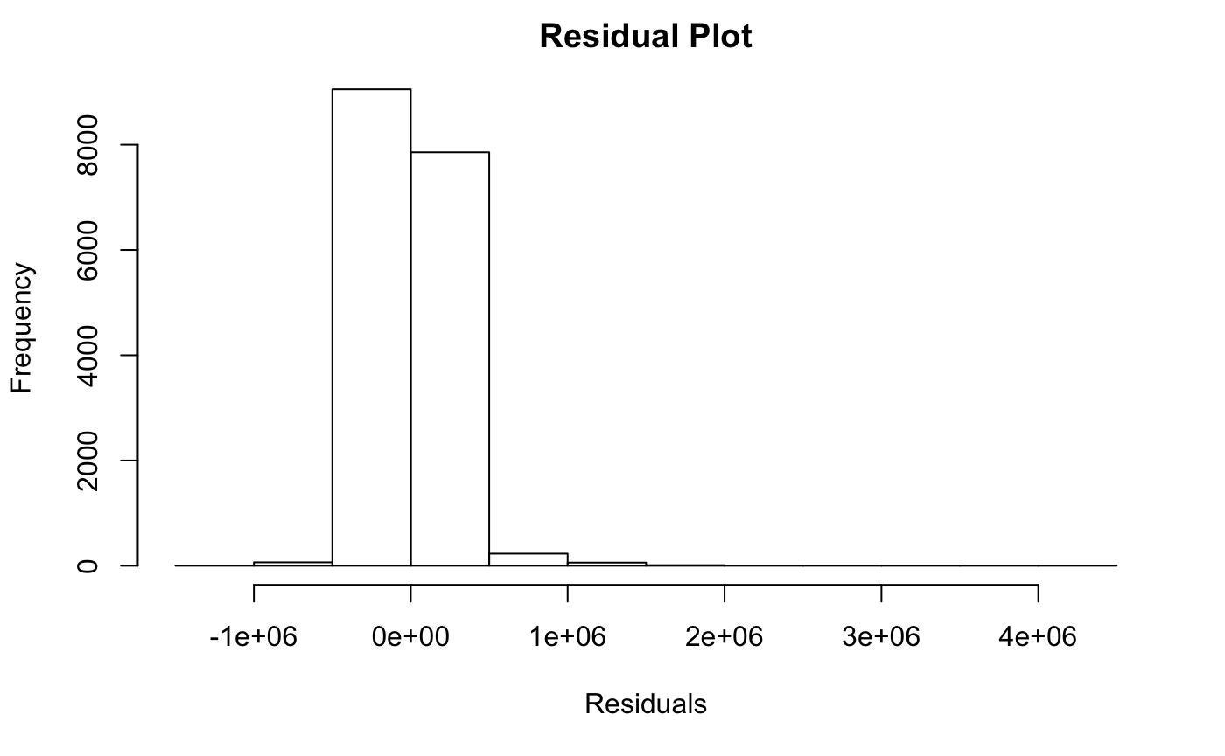
Hist Plot & QQ Plot
From the plots, see that normality assumption is violated badly.

Slide 9
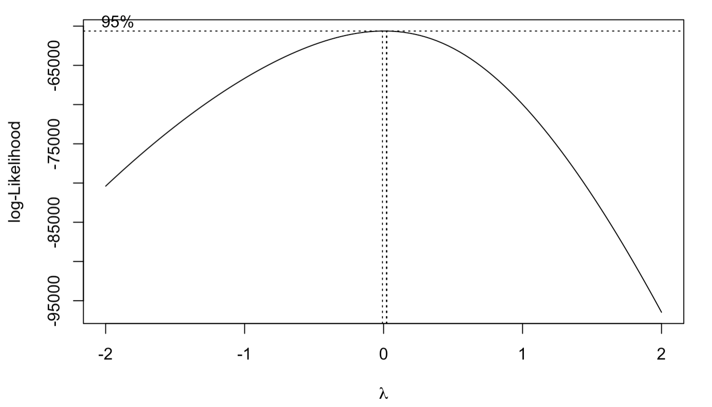




Box-Cox
Use box-cox transformation to transform the price variable.
According to box-cox, lambda = 0
Hence we take log(price) in a new model.

Slide 10
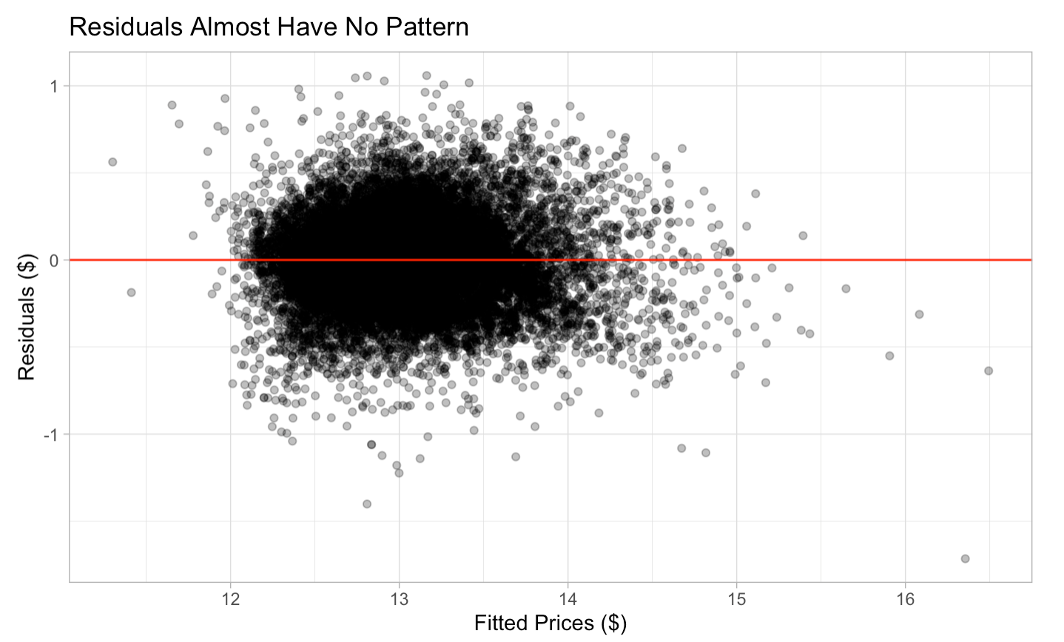
Residual Plot
The new residuals against fitted price plot shows that residuals have no systematic pattern

Slide 11
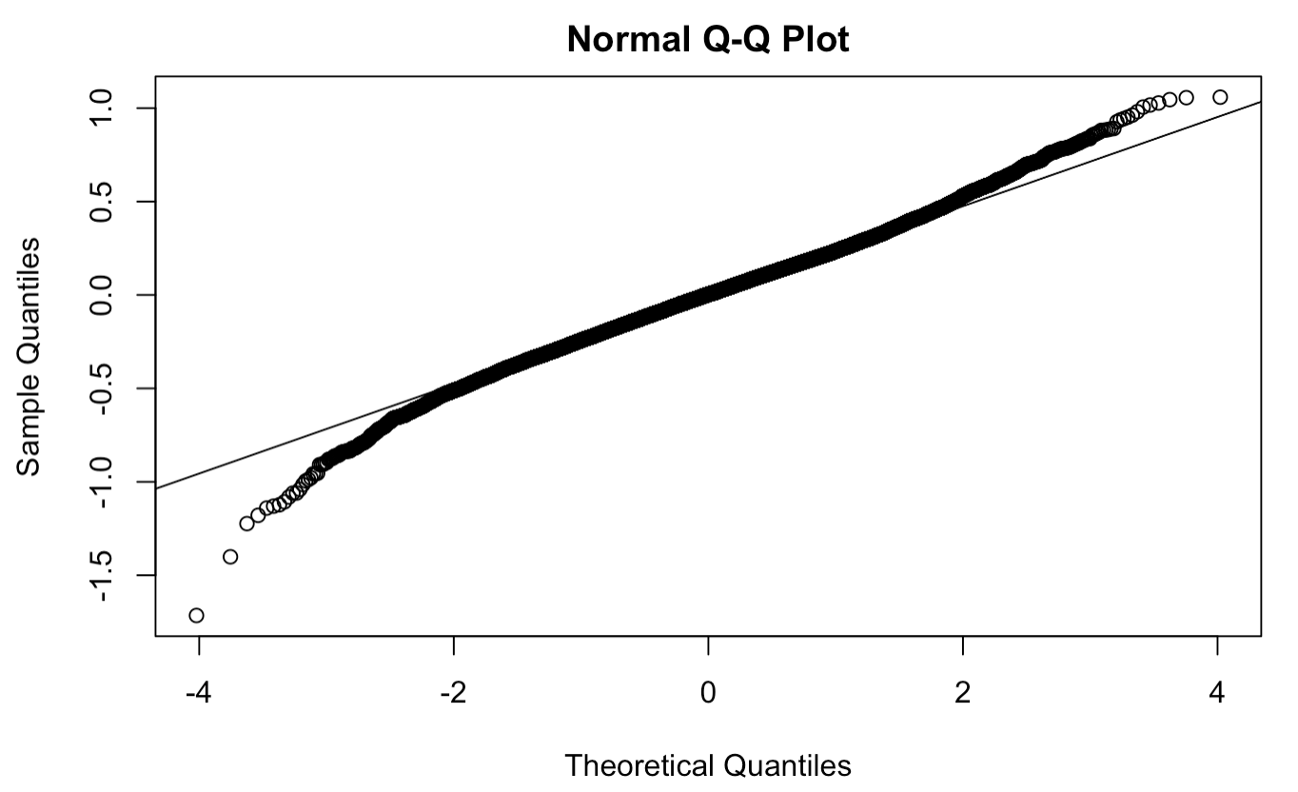
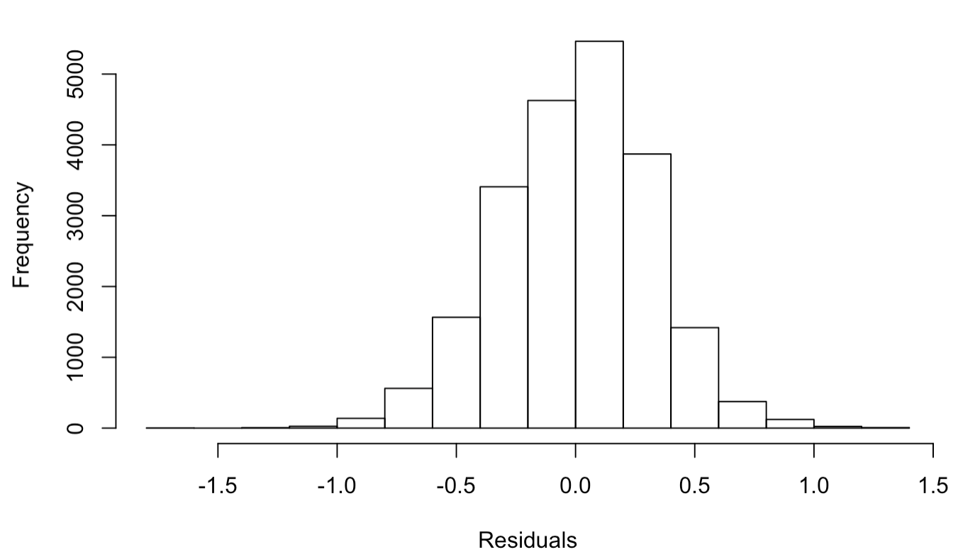
Hist & QQ Plot
basically normal
several outliers spotted

Slide 12
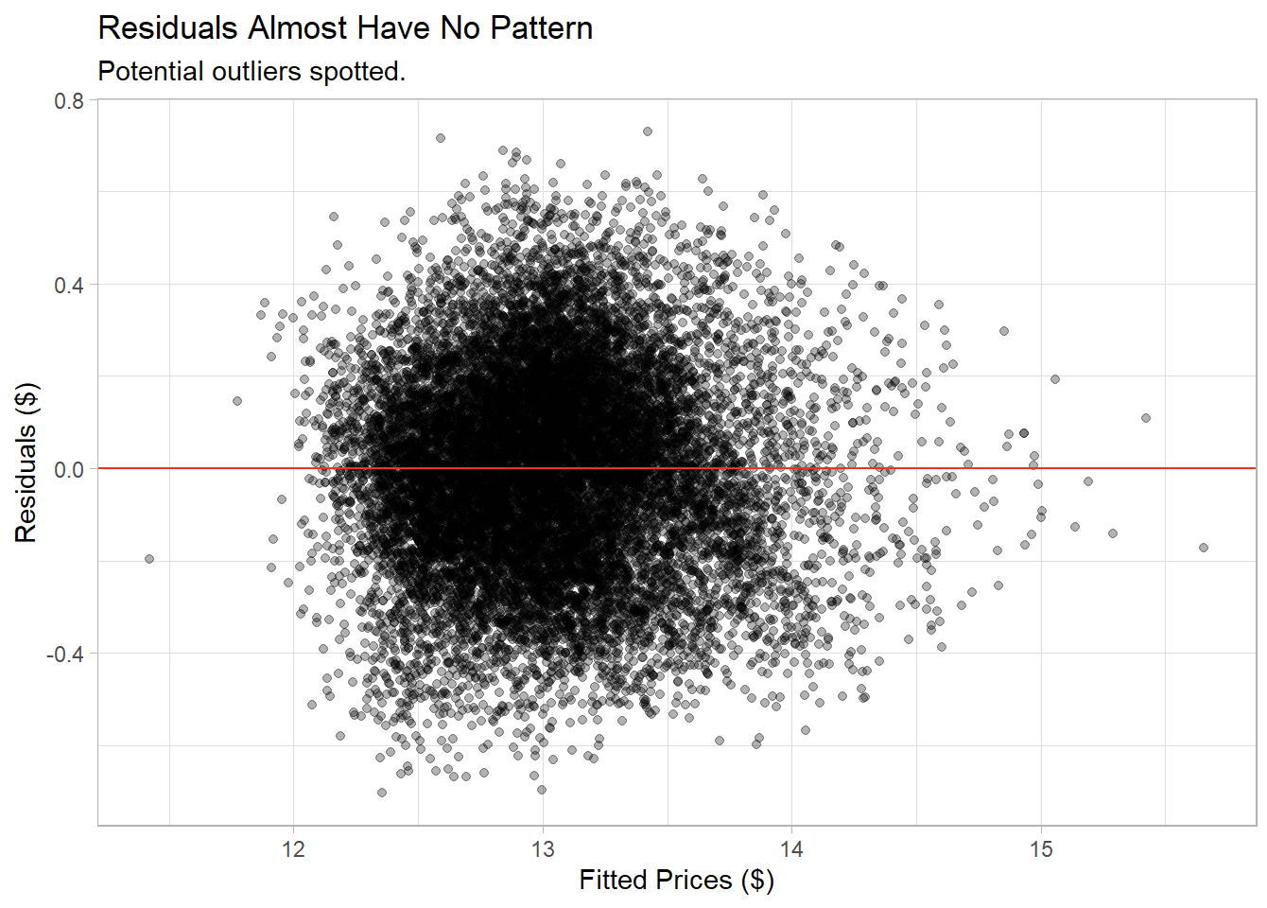
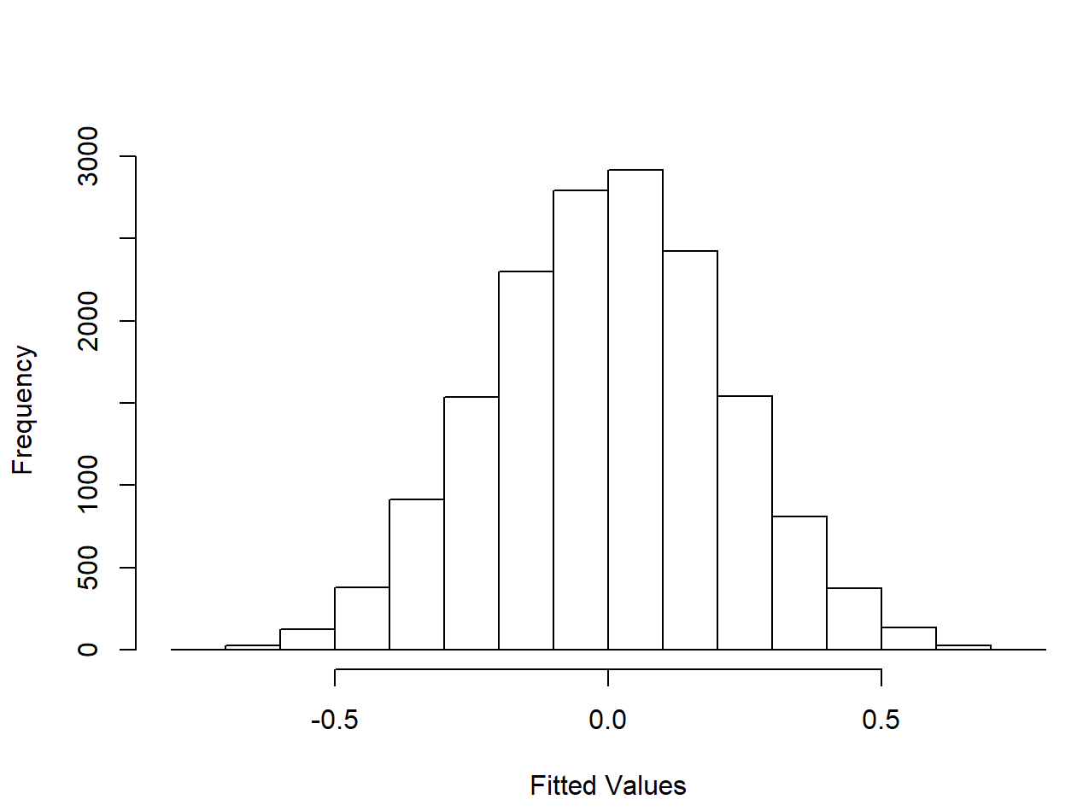
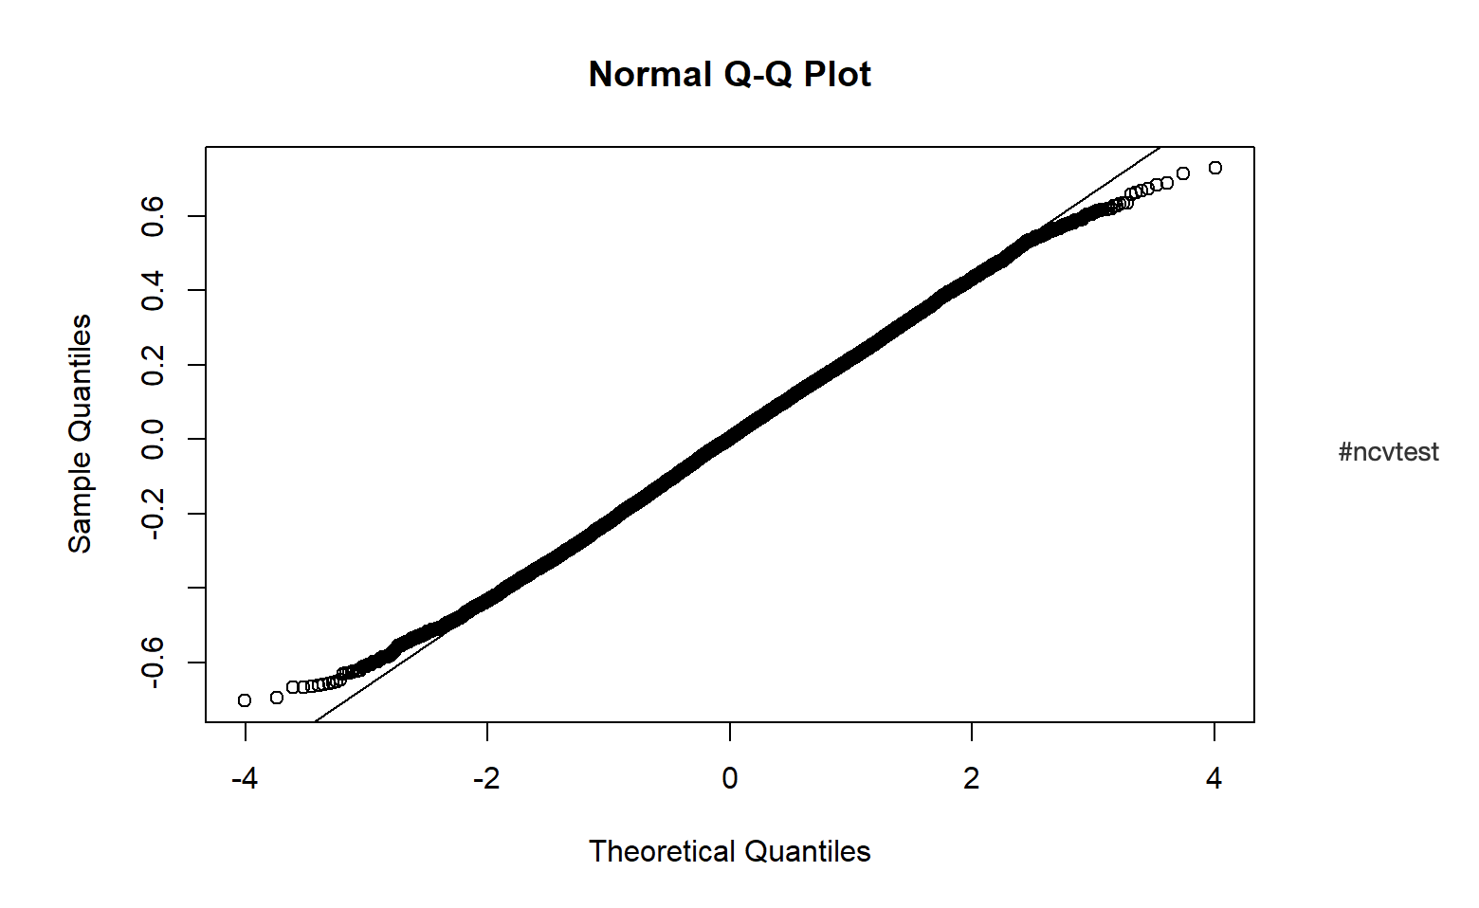
Update the Data by Removing Outliers
First Use Cook’s Distance to identify the outliers and remove the outliers
Update the data and observe the Residuals Plot, the new Hist plot and Q-Q Plot again
Residuals Plot
Hist plot
Normal Q-Q Plot

Slide 13
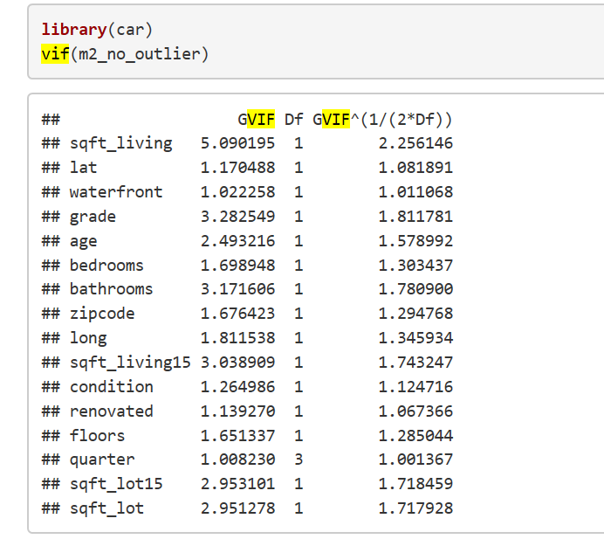
Multicollinearity
Multicollinearity:
Predictor variables are (highly) correlated among themselves
The model can still be fitted the data as long as variables are
not completely correlated.
Detecting Multicolinearity：
Here we use the VIF （Variance Inflation Factors) to measure multicollinearity:
If A Maximum VIF >10; is nonignorable Multicollinearity
.
Conclusion:
We have no VIF larger than 10, so this indicates no multicollinearity Also the mean VIF is around 1, so no bias here.
Notes:
Multicollinearity is predictors variables are highly correlated among themselves. Although the model can still fitted for the data as long as variables are not completely correlated, there will be large standard deviation on the regression coefficient and imprecise effects on the extra sum of square. There are many ways to detect multicollinearity, both formal and informal, for instance we can find pearson correlation between each variable or use the VIF test. Here we use toe VIF test to detect multicollinearity. If the maximum vif >10, we will consider the variable has issue with Multicollinearity. The result shows that all the variable we choose has VIF lower than 10 which means no Multicolinearity, and the mean VIF is around 1 so no bias here.

Slide 14
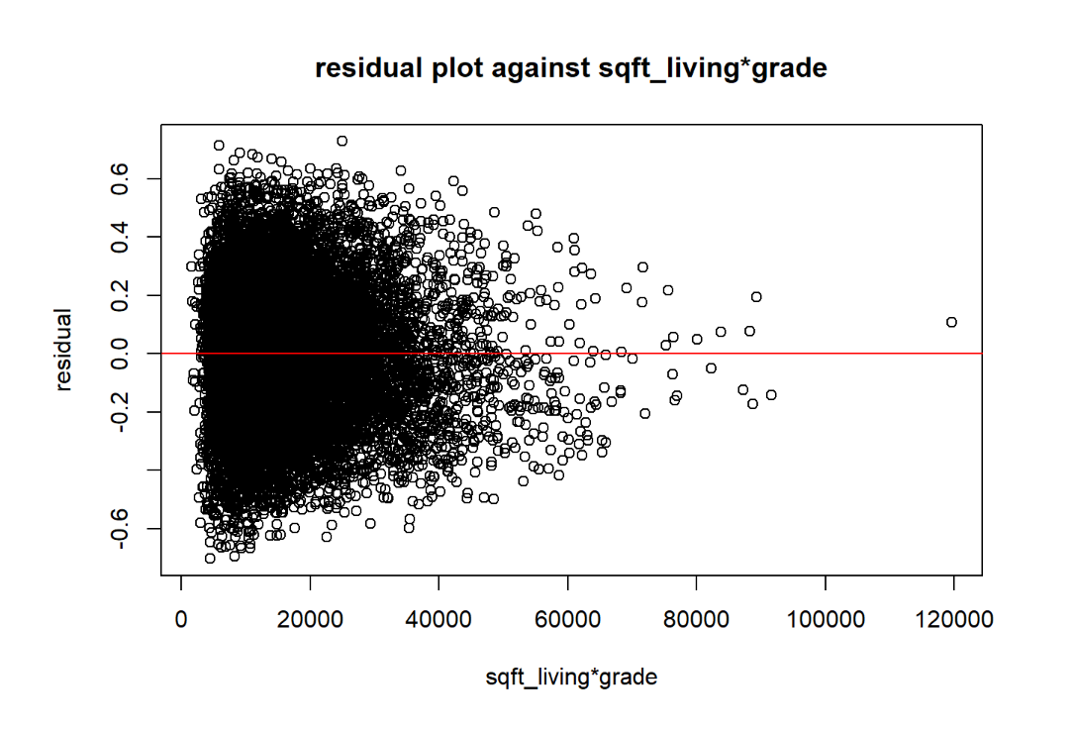
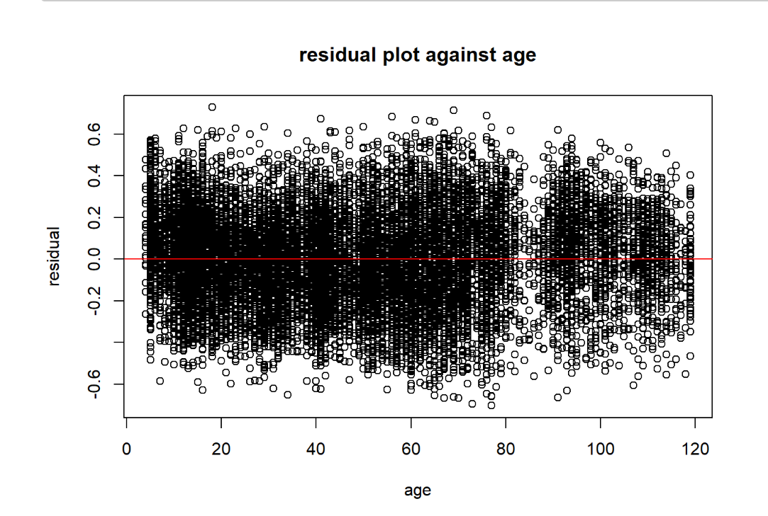
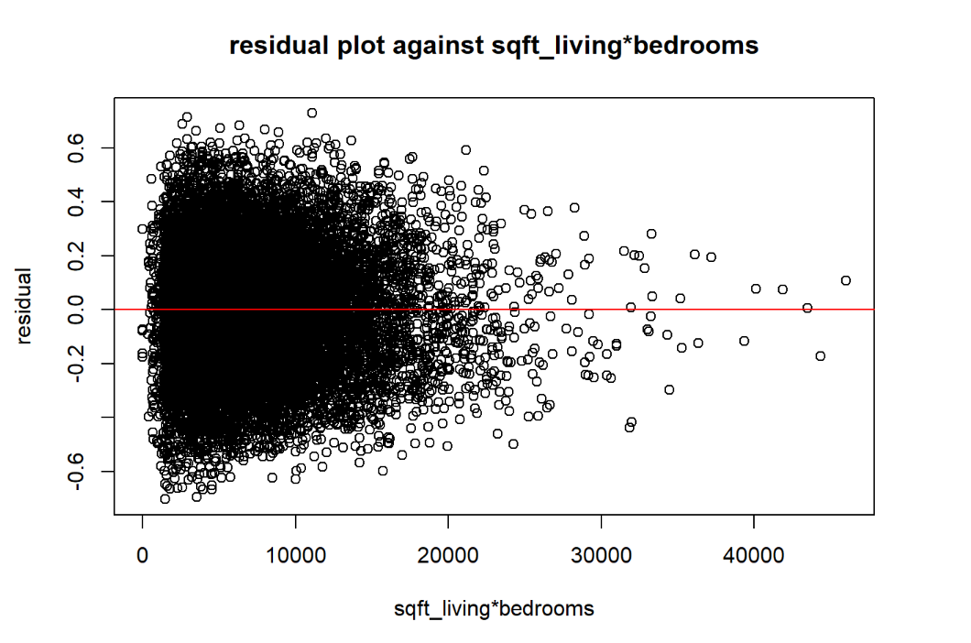
Interaction Residual Plot
An interaction effect exists when the effect of an independent variable on a dependent variable changes, depending on the value(s) of one or more other independent variables.
In two factor-interaction graph, we can see that there is no interaction between variables.
No significant pattern against interaction term and single predictor.
Notes:
Next, we will see whether we need to add some interaction term in our model. An interaction effect exists when the effect of an independent variable on a dependent variable changes, depending on the value(s) of one or more other independent variables. We draw both individual residual graph and two factor interaction graph, and we can see there is no significant pattern against interaction term graph and single predictor graph. We can conclude there is not necessary to add interaction terms in our model

Slide 15
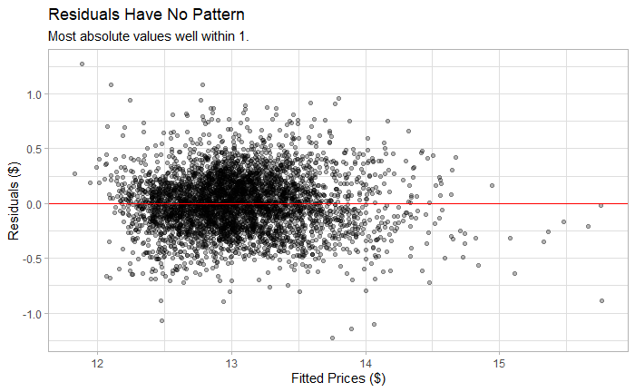
Test & Improvements
Several Improvements Could be Done
Backwards Stepwise Feature Reduction.
Feature Engineering to avoid multicollinearity and overfitting.
Principal Component Analysis to reduce dimensionality.

Slide 16
Thank You

