Slide 1

Data Science Club
(2025-2026)

Slide 2
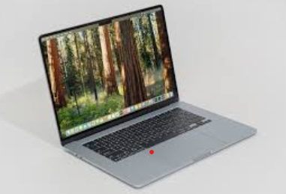
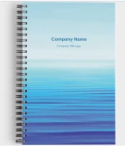
Welcome to Data Science Club
What do you need to bring?
Laptop - To work on exercises and projects
Notebook - To write down notes

Slide 3
Overview
Topics We’ll Be Covering This Year
Python, Excel, Jupyter Notebook
Data visualization
Exploratory data analysis
Statistical models
Machine learning models
Neural Networks
Projects
Research topics
Kaggle competitions

Slide 4

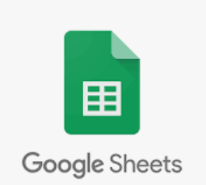



Introduction to Basic Tools
Excel/Google Sheet
Python programming
Pandas for data manipulation
Jupyter Notebook/ Google Colab for interactive coding

Slide 5

Exploratory Data Analysis (EDA)
Understanding datasets
Data cleaning and preprocessing
Visualization techniques

Slide 6
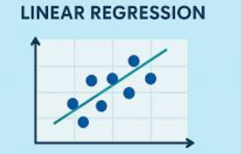
Statistical Models
Linear regression
Logistic regression

Slide 7
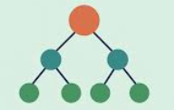
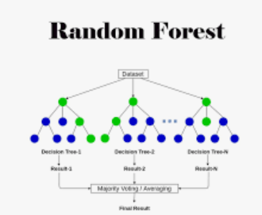
Machine Learning Models
Decision Tree
Ensemble Model
Random Forest
Gradient Boosting

Slide 8

AI
Deep Neural Network
Large Language Model (LLM)

Slide 9

Projects
Projects
Topic selection based on member’s experience and interest
Kaggle competitions

Slide 10
Practice with Google Spreadssheets
Dataset
https://tinyurl.com/msppnape
https://tinyurl.com/3b6yjnzy

Slide 11
Any Questions?

