Slide 1





Authors
Articles
This entails making interpretative descriptions of various research components:
Typical measures include
citation count,
the number of publications,
the H-index,
and the G-index.
Journals
Universities
Countries

Slide 2
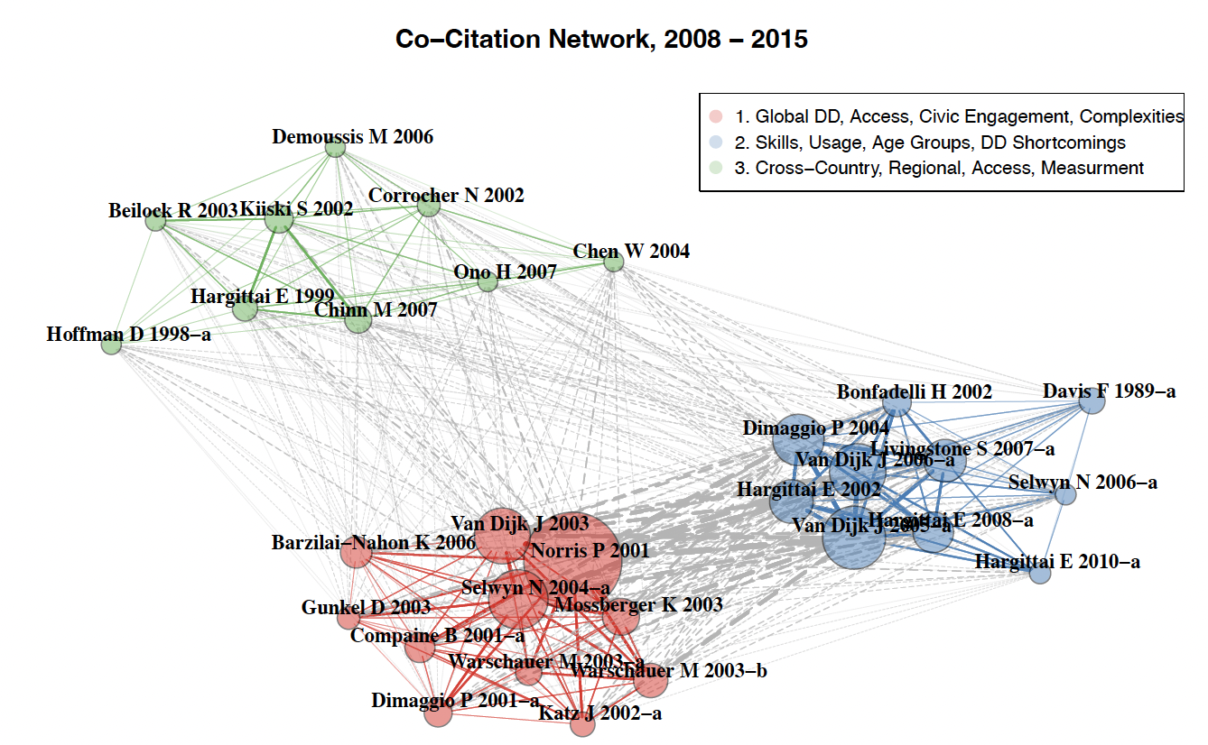
Typical metrics include similarity measures, such as co-citation analysis, bibliographic coupling, and co-authorship analysis.
This refers to a set of techniques designed to visualise and examine structures, relationships, and trends within any field.

Slide 3
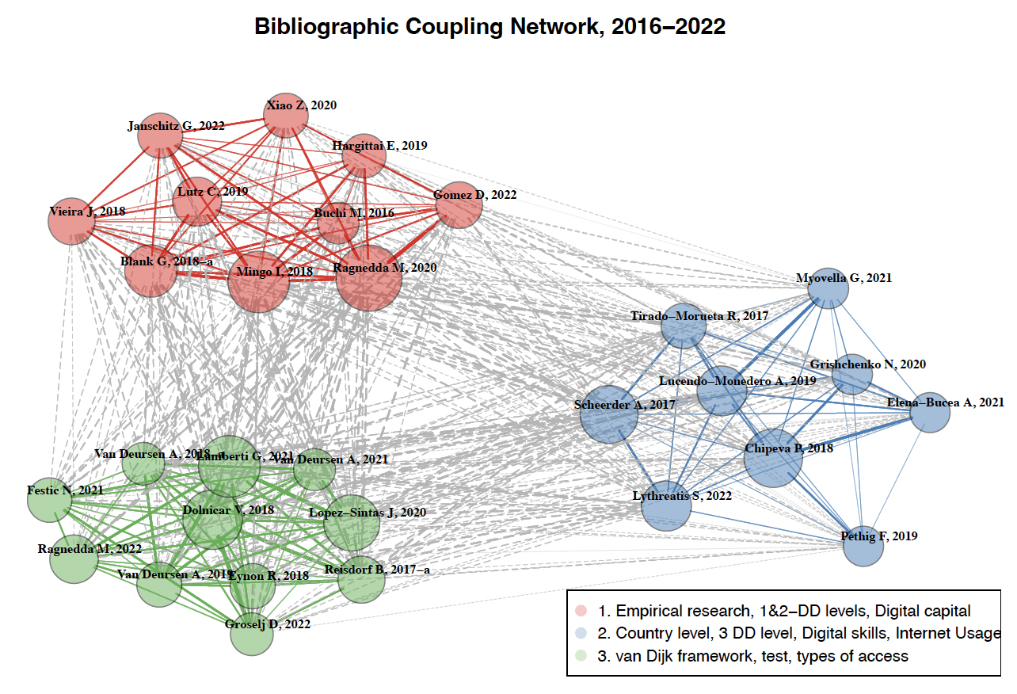
This involves utilising measures and principles from graph theory to comprehend various connections among elements of research.
Standard metrics used include the degree of centrality and betweenness centrality, among others.

Slide 4









Slide 5

