Slide 1





Authors
Articles
This entails making interpretative descriptions of various research components:
Typical measures include
citation count,
the number of publications,
the H-index,
and the G-index.
Journals
Universities
Countries

Slide 2
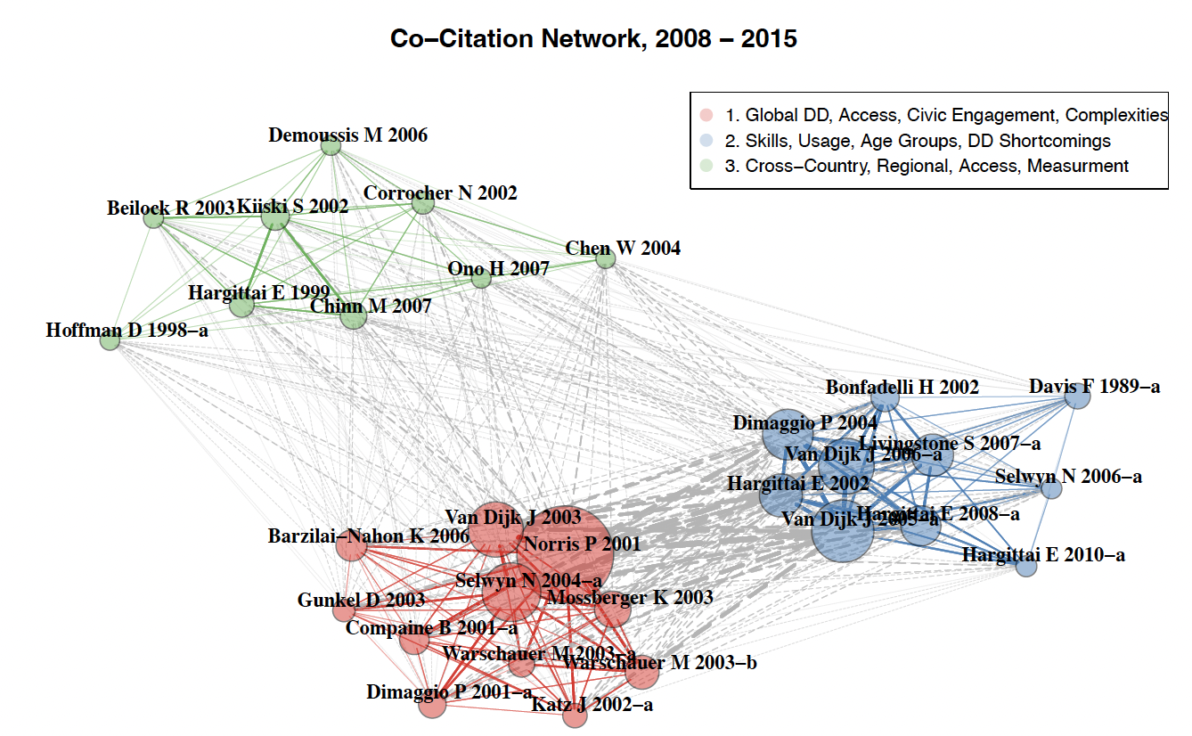
Typical metrics include similarity measures, such as co-citation analysis, bibliographic coupling, and co-authorship analysis.
This refers to a set of techniques designed to visualise and examine structures, relationships, and trends within any field.

Slide 3
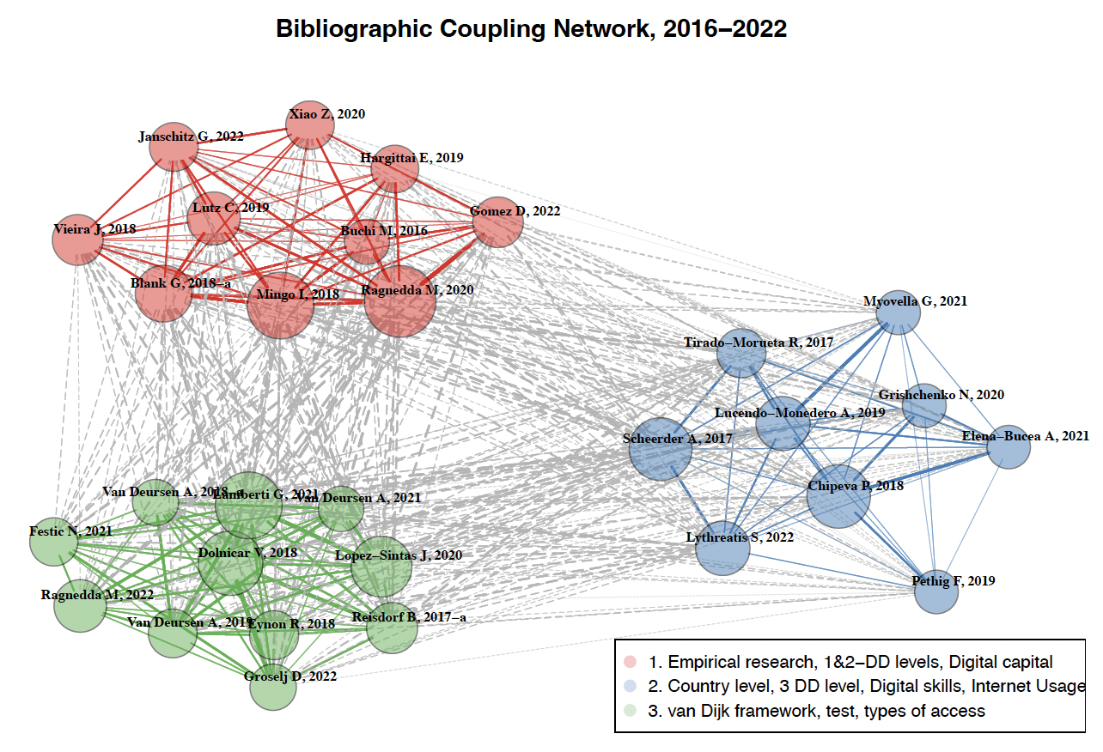
This involves utilising measures and principles from graph theory to comprehend various connections among elements of research.
Standard metrics used include the degree of centrality and betweenness centrality, among others.

