Slide 1
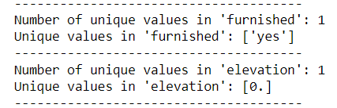
Drop duplicates, ‘furnished’, ‘elevation’, ‘’town’,’street_name’, ‘subzone’ and ‘block’
01
‘town’ and ‘planning_area’ are the two features that are roughly the same but ‘planning area’ is more informative, so I choose to keep it and drop ‘town’
‘block’ is not that useful
‘furnished’ and ‘elevation’ have only one possible value.
‘street name’ has over a thousand unique values and some of them have low frequency therefore overfitting might be incurred if target encoding is applied to this feature. (maybe we can try binary encoding)

Slide 2
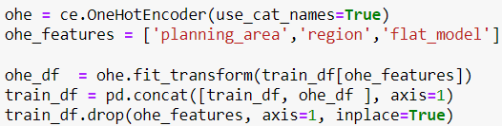
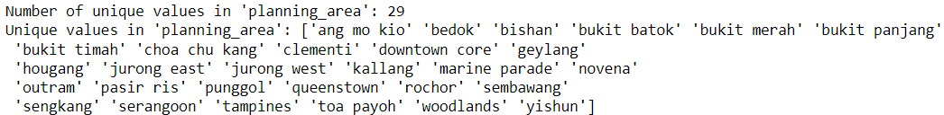
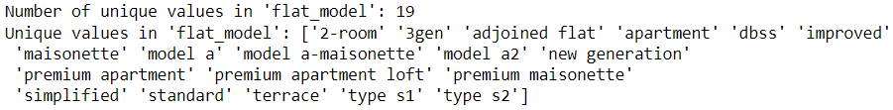
One hot encoding – ‘planning_area’, ‘region’, and ‘flat_model’
02
These three features are predictive, and they don’t have too many unique values so we can preserve all the info with ohe.
Notes:
(can check value_counts for low frequent value)

Slide 3

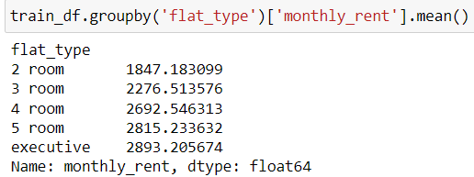
03
Ordinal Encoding – 'flat_type’
Merge categories in 'flat_type' e.g. 5-room and 5 room
Find the order
Implementation

