Slide 1
Progress Report CS5228 Project
Group 40
Lu Chung I, Lo Yin-Fan, Khurush Khushrov Bengali and Anocha Sutaveephamochanon

Slide 2
Core Data – Dropping Variables
Variables to drop
‘furnished’, ‘elevation’, ’street_name’, ‘subzone’ and ‘block’
Rationale
‘furnished’ and ‘elevation’ have only one possible value hence do not contain any predictive information
‘street_name’ ‘subzone’ and ‘block’ appears too granular and similar location information is contained in other variables

Slide 3
Core Data – Location / Zone
Location variables
These include ‘planning_area’, ‘town’, and ‘region’
Analysis
Coarser grained location zoning compared to variables that were dropped in previous slide
These variables have 29, 26 and 5 unique values respectively
Information contained is overlapping
More analysis required to determine predictive value

Slide 4
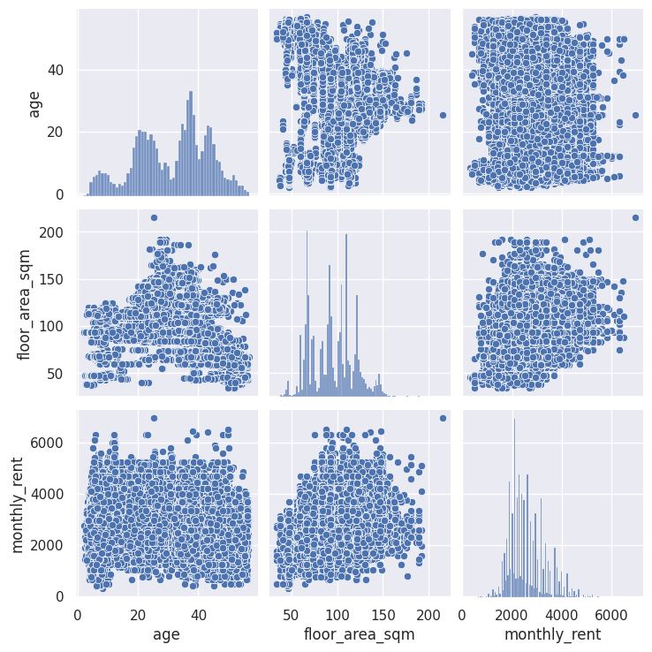
Core Data – Age of the Flat
Transformation
Transform “lease_commence_date” into “flat_age’
Age has no outliers and a mean at 35 apprx.
Analysis
Eyespotting covariance relationship between features via pairplot
Rent and age (bottom left) are negatively correlated
Similar for floor_area_sqm and age which indicate younger flats are smaller
Histograms show peaks mostly on left side which could indicate a need of augmentation data for high rent and large area

Slide 5
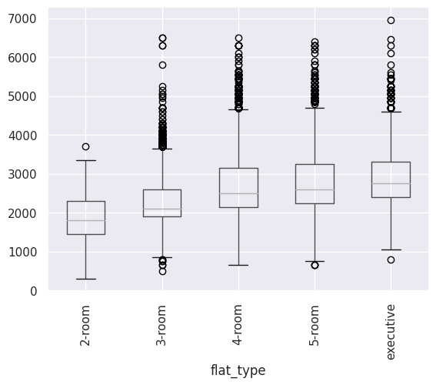
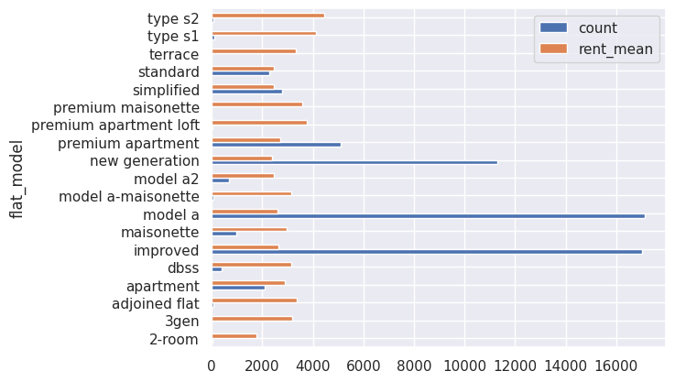
Core Data – Flat Type
Transformation
Flat type is linked to size of the flat
It also correlates with rent price hence converted to ordinal variables
Analysis
Type s1,s2 have the top 2 highest rent average in the data

Slide 6
Auxiliary Data - Schools
Importance of variable
Singaporean parents spend great effort and resources to get their kids into a “good” school
School places are assigned based on a balloting exercise annually
Proximity to a school increases the priority in the balloting exercise
It is common to move temporarily through renting to gain proximity to a “good” school
Proximity to a “good” school should increase rental prices
Ranking schools
Some form of ranking is required as not all schools are viewed equally
We obtained balloting results of 2023 from sgschooling
We categorise schools based on level of “oversubscribed-ness”
Three categories are created – “Top”, “Good”, “Normal”
We calculate the number of schools within 1km and 2km of the HDB for each category as these are the priority cut-offs
These serve as ordinal variables for prediction

Slide 7
Auxiliary Data - Malls
Importance of variable
Malls provide convenience e.g. food from restaurants, supermarket for groceries, etc
Closeness to a mall should increase the monthly rent
Shortest distance as predictor
Distance would the obvious metric to use
One location can have proximity to multiple malls
Having more than one mall in proximity is unlikely to significantly increase the rental value
The shortest distance to a mall as a numerical variable is used as the final predictor

Slide 8
Auxiliary Dataset - MRT
Importance of this dataset:
MRTs are one of the most used transportation in Singapore.
Closeness to a MRT station would increase the rental.
Clustering:
Using the MRT locations on each line, KMeans Clustering is carried out.
This will help us find the relative distance of a cluster of HDBs from the nearest MRT station.
It is possible to have 2 closest MRTs from different lines.
The shortest distance to a MRT station as a numerical variable is used as the final predictor.

Slide 9
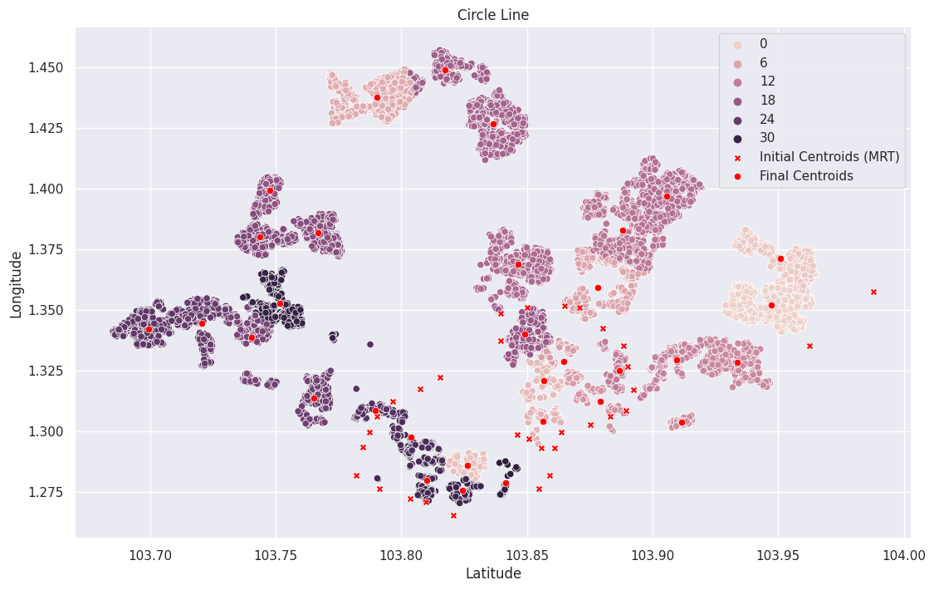
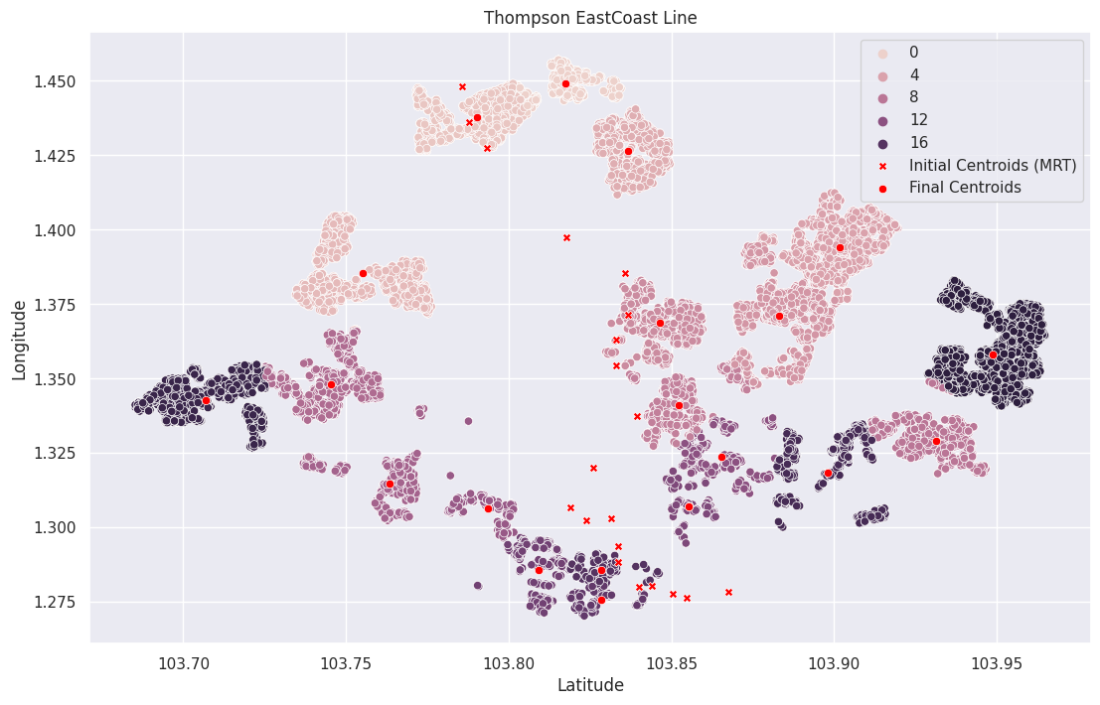
Auxiliary Dataset - MRT
Clustering Example:

Slide 10
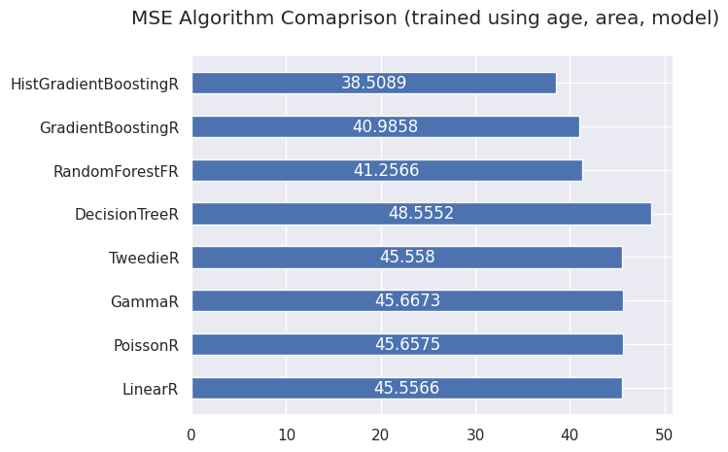
Training Attempts
Input is 20% of training set. All came from correlation studies
Rent is scaled by factor of 0.01 hence lower MSE compared to leaderboard
Next, use same normalization as other attributes and reduce outlier threshold

Slide 11
Next Steps
Feature engineering
Continue analysis and feature engineering to improve predictive model
For example, the location based variables would require engineering to merge the overlapping information
Model selection
Gradient boosting tree type models appear the most promising if we do not include neural networks in the list of potential models
Popular libraries such as XGBoost, LightGBM and CatBoost will be tested

