Slide 1
CLASSES, CLASS INHERITANCE, SUPER
By Eduard Luchuk

Slide 2
AGENDA
Classes: definition, syntax and using
Class inheritance
“Super” key word
Summary

Slide 3
CLASS DEFINITION
In object-oriented programming, a class is an extensible program-code-template for creating objects, providing initial values for state (member variables) and implementations of behavior (member functions or methods).

Slide 4
THE “CLASS” SYNTAX
class MyClass {
// class methods
constructor() { ... }
method1() { ... }
method2() { ... }
method3() { ... }
...
}
class User {
constructor(name) {
this.name = name;
}
sayHi() {
alert(this.name);
}
}
// usage:
let user = new User("John");
user.sayHi();

Slide 5
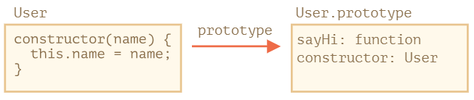
WHAT IS A CLASS?
class User {
constructor(name) {
this.name = name;
}
sayHi() {
alert(this.name);
}
}
// proof: User is a function alert(typeof User); // function

Slide 6
WHAT IS A CLASS?
// rewriting class User in pure functions
// 1. Create constructor function
function User(name) {
this.name = name;
}
// 2. Add the method to prototype
User.prototype.sayHi = function() {
alert(this.name);
};
// Usage:
let user = new User("John");
user.sayHi();
Difference class from function constructor:
[[FunctionKind]]: "classConstructor“
enumarable: false
use strict

Slide 7
CLASS EXPRESSION
let User = class {
sayHi() {
alert("Hello");
}
};
// "Named Class Expression“
// (no such term in the spec, but that's similar to Named Function Expression) let User = class MyClass {
sayHi() {
alert(MyClass); // MyClass name is visible only inside the class
}
};
new User().sayHi(); // works, shows MyClass definition
alert(MyClass); // error, MyClass name isn't visible outside of the class

Slide 8
CLASS FIELDS
class User {
name = "John";
sayHi() {
alert(`Hello, ${this.name}!`);
}
}
new User().sayHi(); // Hello, John!
class User {
name = "John";
}
let user = new User();
alert(user.name); // John alert(User.prototype.name); // undefined

Slide 9
INHERITANCE
In object-oriented programming, inheritance is the mechanism of basing an object or class upon another object (prototype-based inheritance) or class (class-based inheritance), retaining similar implementation.
Also defined as deriving new classes (sub classes) from existing ones such as super class or base class and then forming them into a hierarchy of classes.

Slide 10
INHERITANCE
class Animal {
constructor(name) {
this.speed = 0;
this.name = name;
}
run(speed) {
this.speed = speed;
alert(`${this.name} runs with speed ${this.speed}.`);
}
stop() {
this.speed = 0;
alert(`${this.name} stands still.`);
}
}
let animal = new Animal("My animal");
class Rabbit {
constructor(name) {
this.name = name;
}
hide() {
alert(`${this.name} hides!`);
}
}
let rabbit = new Rabbit("White Rabbit");

Slide 11
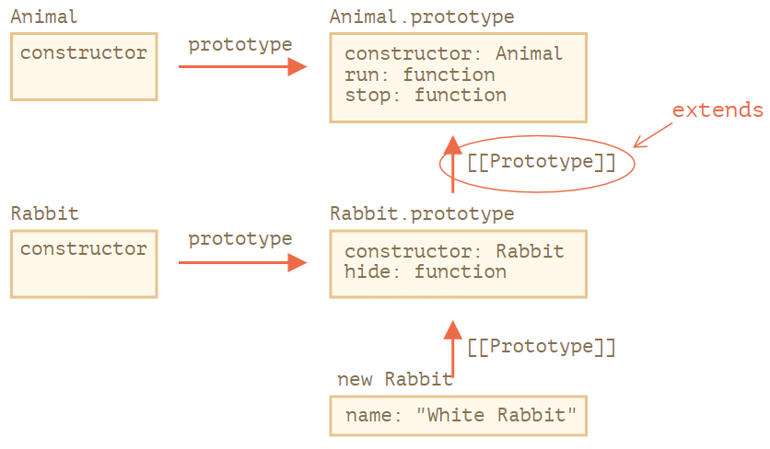
THE “EXTENDS” KEYWORD
class Rabbit extends Animal {
hide() {
alert(`${this.name} hides!`);
}
}
let rabbit = new Rabbit("White Rabbit");
rabbit.run(5); // White Rabbit runs with speed 5. rabbit.hide(); // White Rabbit hides!

Slide 12
OVERRIDING A METHOD
class Rabbit extends Animal {
hide() {
alert(`${this.name} hides!`);
}
stop() {
super.stop(); // call parent stop
this.hide(); // and then hide
}
}
let rabbit = new Rabbit("White Rabbit");
rabbit.run(5); // White Rabbit runs with speed 5.
rabbit. stop(); // White Rabbit stands still. White rabbit hides!
super.method(...) to call a parent method.
super(...) to call a parent constructor (inside our constructor only).

Slide 13
OVERRIDING CONSTRUCTOR
class Rabbit extends Animal {
// generated for extending classes without own constructors constructor(...args) {
super(...args);
}
}
class Rabbit extends Animal {
constructor(name, earLength) {
super(name)
this.earLength = earLength;
}
}

Slide 14
SUMMARY
Class is technically a function (the one that we provide as constructor), while methods, getters and setters are written to Class.prototype.
To extend a class: class Child extends Parent. That means Child.prototype.__proto__ will be Parent.prototype, so methods are inherited.
When overriding a constructor: we must call parent constructor as super() in Child constructor before using this.
When overriding another method: we can use super.method() in a Child method to call Parent method.

Slide 15


