Slide 1
IBM University Engagement Project Submission
“Exploring the Power of Agentic AI with IBM Granite and LangFlow”

Slide 2

Project Tile – AI-Powered Network Intrusion Detection System using Machine Learning
Domain of Project –Network Security
Student Name | Recent Passport Photo | Email ID | Mobile number [WhatsApp]
Anwesha Sural |  | lucia67217@gmail.com | 8420419545

Slide 3
Problem Statement -
Problem Statement : CyberShield AI – Network Intrusion Detection
The Challenge
In modern communication networks, cyber-attacks are increasing rapidly. Network traffic may contain normal activities as well as malicious activities such as DoS attacks, Probe attacks, R2L attacks, and U2R attacks. Manually monitoring network traffic is difficult, time-consuming, and error-prone. There is a need for an intelligent machine learning-based system that can automatically analyze network traffic data and identify whether the activity is normal or suspicious/anomalous.
The Objective
Build an ML-based Network Intrusion Detection System that can classify network traffic as Normal or Intrusion/Anomaly using machine learning. The solution should help in early detection of malicious network activities and improve cybersecurity monitoring.
The solution should include:
Network Traffic Data Analysis – Analyze network traffic features such as protocol type, service, flag, source bytes, destination bytes, and connection details.
Data Preprocessing – Handle categorical values, clean the dataset, and prepare it for machine learning.
ML Model Training – Train classification models using IBM watsonx.ai AutoAI.
Intrusion Detection – Predict whether network traffic is Normal or Anomaly/Intrusion.
Model Evaluation – Evaluate the model using accuracy and other performance metrics.
IBM Cloud Deployment – Deploy the trained model using IBM watsonx.ai online deployment.
Frontend Interface – Use a Streamlit web app where users can upload test CSV data and get prediction results.
Visualization/Result Dashboard – Show uploaded data, prediction output, and classification results.

Slide 4
Technology Used
Tech Stack
IBM Cloud Lite Services IBM watsonx.ai IBM watsonx.ai Runtime IBM AutoAI Machine Learning Python Streamlit Pandas Network Intrusion Detection Dataset
I used IBM Cloud Lite + IBM watsonx.ai AutoAI + watsonx.ai Runtime + Streamlit

Slide 5
Proposed Solution -
Proposed Solution: CyberShield AI – Network Intrusion Detection System
The proposed solution is an ML-based Network Intrusion Detection System built using IBM Cloud Lite, IBM watsonx.ai AutoAI, watsonx.ai Runtime, and Streamlit. The system analyzes network traffic data and predicts whether the traffic is normal, malicious or anomalous. The solution uses a supervised machine learning classification approach. The dataset contains network traffic features such as duration, protocol type, service, flag, source bytes, destination bytes, and other connection-related attributes. The target column is class, which identifies whether the traffic is normal or anomaly. The system workflow includes: 1. Dataset Upload – The network intrusion detection dataset is uploaded into IBM watsonx.ai AutoAI. 2. Data Preprocessing – AutoAI handles feature processing, categorical encoding, and model preparation. 3. Model Training – IBM AutoAI generates multiple ML pipelines and selects the best-performing model. 4. Best Model Selection – The best pipeline selected was a Snap Decision Tree Classifier with high accuracy. 5. Model Deployment – The trained model is saved and deployed as an online deployment using watsonx.ai Runtime. 6. Frontend Integration – A Streamlit web application is created where users can upload test CSV data. 7. Prediction Output – The frontend connects to the IBM deployment endpoint and displays predictions as normal or anomaly. The final system provides a simple and practical cybersecurity solution that can help identify suspicious network activity at an early stage. It demonstrates the use of IBM Cloud services, machine learning, deployment, and frontend integration in one complete project.

Slide 6
IBM watsonx.ai Components Used -
1) IBM Cloud Object Storage – Stores the uploaded Network Intrusion Detection dataset.
2) IBM watsonx.ai AutoAI – Automatically trains multiple machine learning pipelines for intrusion detection.
3) Data Asset – Train_data.csv is uploaded as a data asset for model training.
4) Prediction Column – The target column used is “class”, which predicts Normal or Anomaly.
5) Best ML Model – Snap Decision Tree Classifier selected as the best-performing model.
6) IBM watsonx.ai Runtime – Used to deploy the trained model as an online deployment.
7) Public API Endpoint – Provides a secured endpoint to send test data and receive predictions.
8) Streamlit Frontend – Allows users to upload test CSV files and view prediction output.
These components together complete the workflow:
dataset upload → AutoAI training → model deployment → Streamlit prediction output.

Slide 7
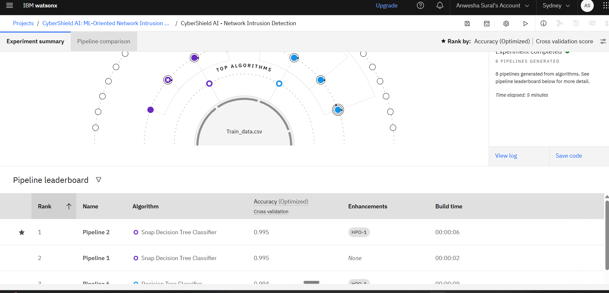
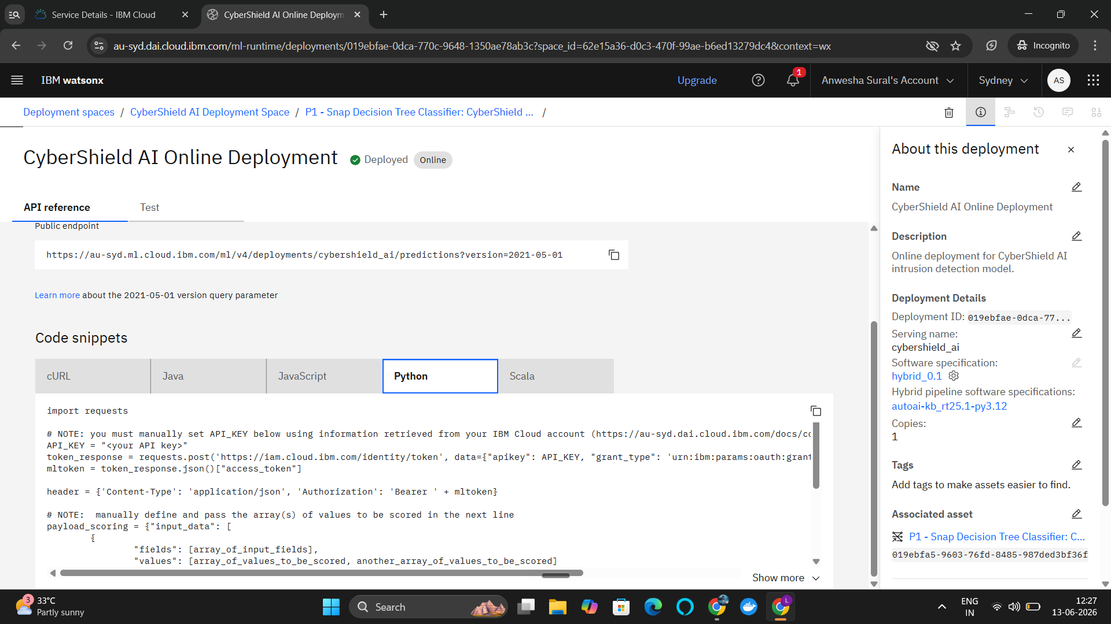
AutoAI Leaderboard & IBM Online Deployment

Slide 8
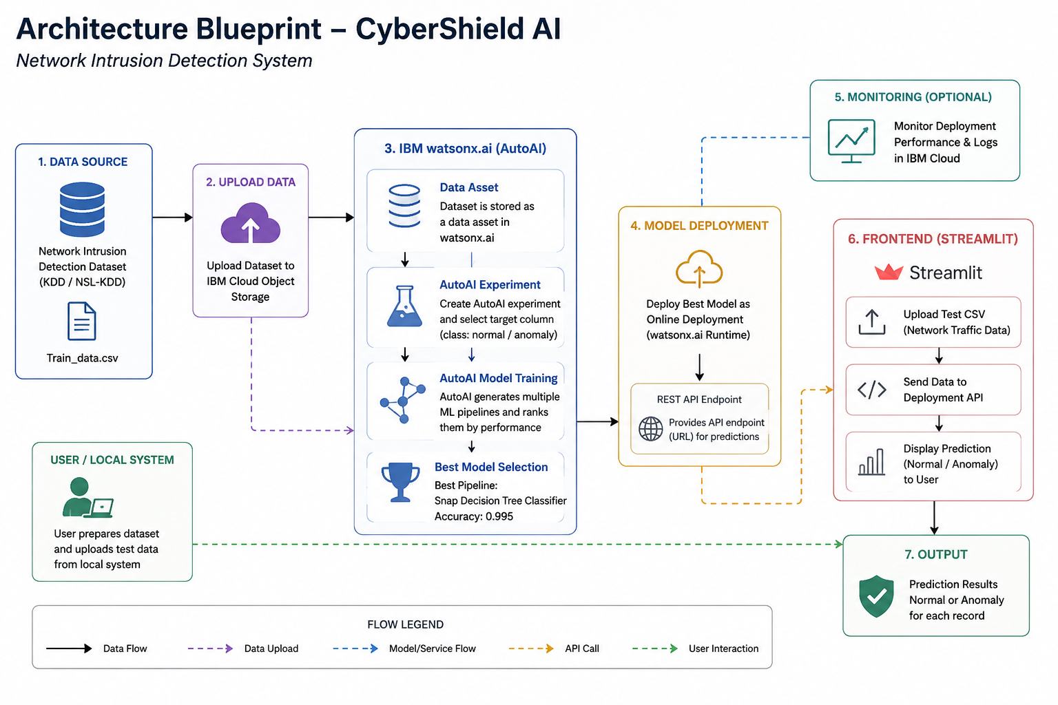

Slide 9
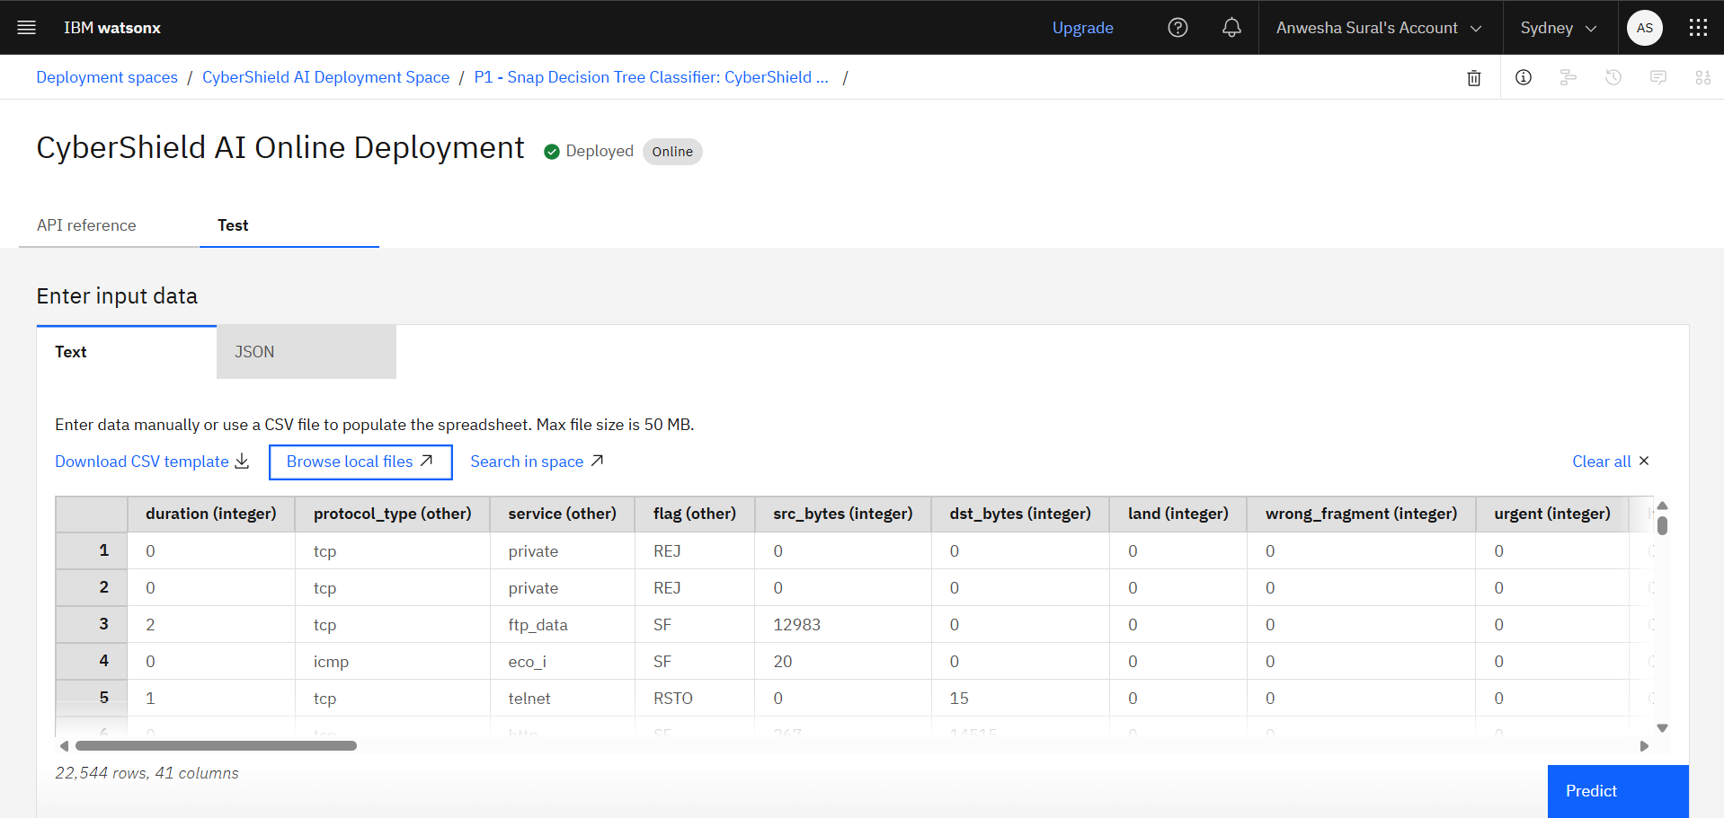
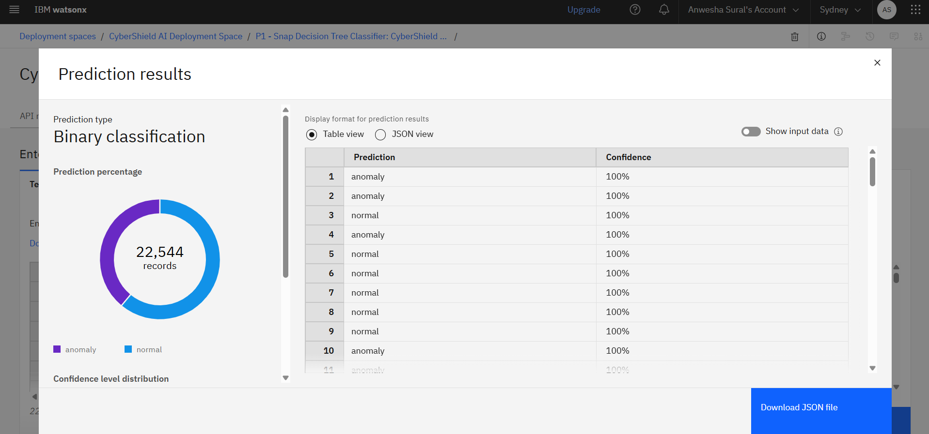
Test dataset & Prediction Results:

Slide 10

Role of Machine Learning in the Solution
Role of Machine Learning in CyberShield AI
Machine Learning plays the main role in CyberShield AI by automatically analyzing network traffic data and identifying whether the activity is normal or malicious.
The system uses IBM watsonx.ai AutoAI to train classification models on the Network Intrusion Detection dataset. The dataset contains features such as protocol type, service, flag, source bytes, destination bytes, and other connection-related attributes.
AutoAI generates multiple machine learning pipelines and selects the best-performing model based on accuracy. In this project, the best model was a Snap Decision Tree Classifier with high accuracy.
The trained model is deployed using IBM watsonx.ai Runtime as an online deployment. A Streamlit frontend is connected to the deployed model through the IBM API endpoint.
When a user uploads test network traffic data, the model predicts whether each record is Normal or Anomaly. This helps in early detection of suspicious network activity and supports cybersecurity monitoring.
Overall, Machine Learning makes the system intelligent, automated, and useful for detecting network intrusions efficiently.

Slide 11
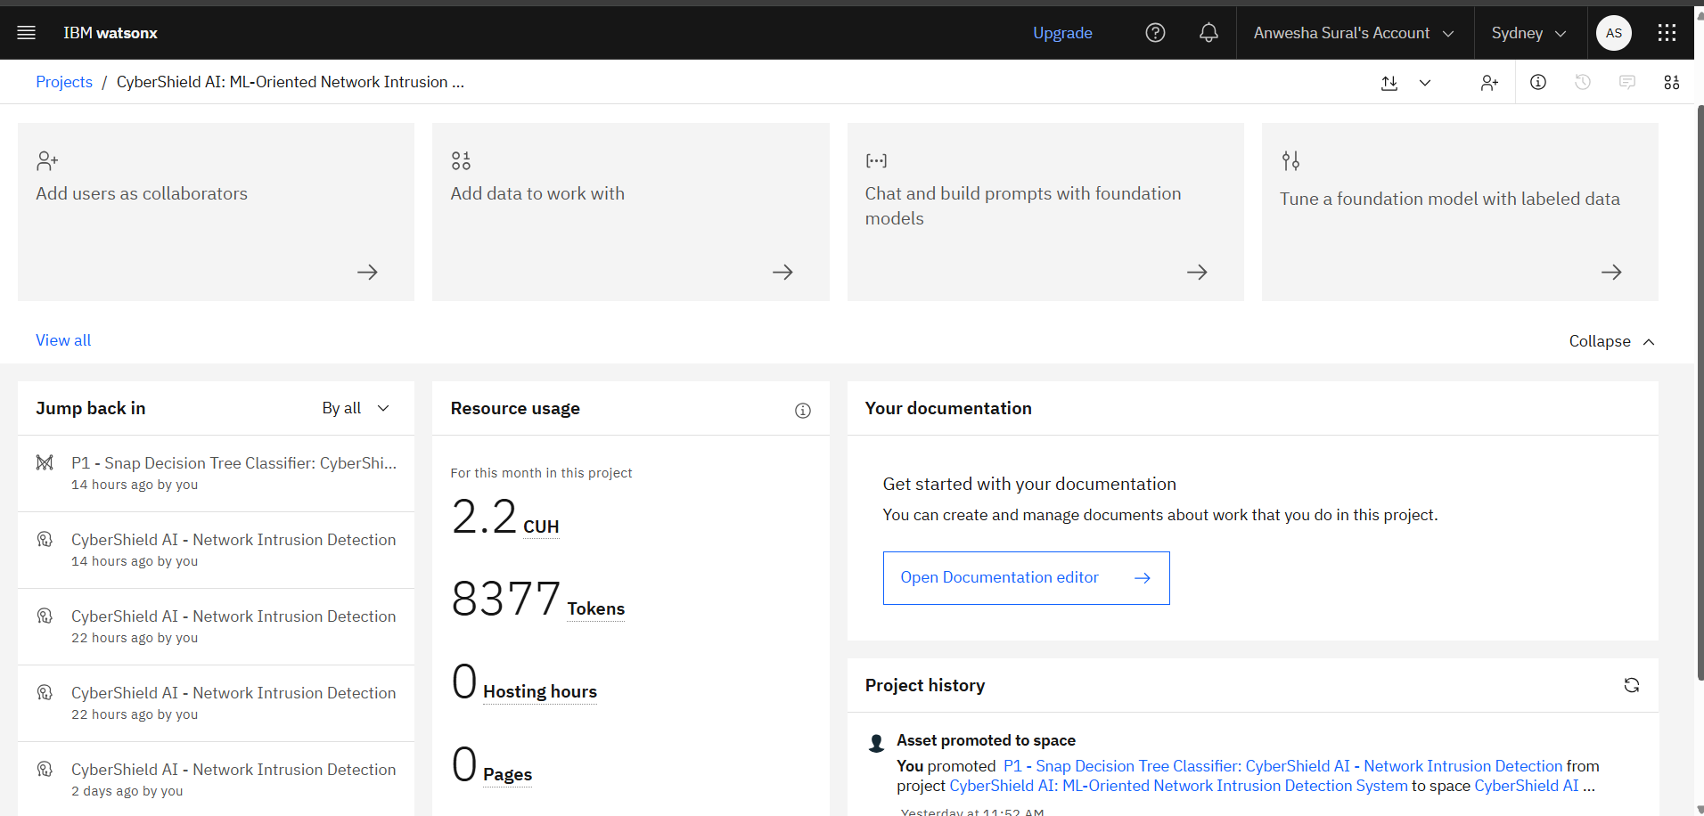
IBM Cloud Resource Usage
IBM watsonx.ai AutoAI was used to train and deploy the ML model. I have used 8377 tokens for completing this project.
·
·
·

Slide 12
Novelty and Uniqueness
The proposed CyberShield AI system stands out by combining Machine Learning, IBM watsonx.ai AutoAI, cloud deployment, and a Streamlit frontend into a complete network intrusion detection solution. ML-Based Intrusion Detection – Uses machine learning to automatically classify network traffic as normal or anomaly. IBM AutoAI Automation – IBM watsonx.ai AutoAI generates multiple ML pipelines and selects the best-performing model automatically. High Accuracy Model – The best pipeline achieved 0.995 accuracy using a Snap Decision Tree Classifier. Cloud-Based Deployment – The trained model is deployed online using IBM watsonx.ai Runtime, making it accessible through an API endpoint. Frontend Integration – A Streamlit web app allows users to upload test CSV files and receive prediction results. Real-Time Prediction Support – The deployed model can classify new network traffic records through the online deployment link. Cybersecurity Relevance – The project focuses on detecting suspicious network activity, which is highly useful in modern communication networks. End-to-End Project – It includes dataset processing, model training, deployment, frontend integration, and prediction output. This makes CyberShield AI a practical, automated, and resume-worthy ML-based cybersecurity project.

Slide 13
Git Hub Link
GitHub Link
Public GitHub Repository: https://github.com/lucia-builds/cybershield-ai-network-intrusion-detection.git
Repository contains:
1. app.json
2. problemstatement.pdf
3. projectpresentation.pptx
4. app.py
5. requirements.txt
6. README.md
7. .gitignore
Deployement:
Public Endpoint: https://au-syd.ml.cloud.ibm.com/ml/v4/deployments/cybershield_ai/predictions?version=2021-05-01
Note: The .env file is not uploaded because it contains the IBM API key.
·
·
·

Slide 14
Future Scope
1. Real-Time Network Traffic Monitoring – The system can be enhanced to analyze live network packets in real time instead of using only uploaded CSV files. This will help detect suspicious activities instantly. 2. Multi-Class Attack Classification – Currently, the model predicts traffic as normal or anomaly. In the future, it can be improved to classify specific attack types such as DoS, Probe, R2L, and U2R. 3. Alert and Notification System – The system can be integrated with email, SMS, or dashboard alerts to notify administrators when malicious network activity is detected. 4. Advanced Deep Learning Models – Future versions can use deep learning models such as CNN, LSTM, or hybrid models to improve detection accuracy for complex cyber-attacks. 5. Security Dashboard – A detailed dashboard can be added to show attack trends, risk levels, prediction history, and network security reports.
·
·
·

Slide 15


