Slide 1
IBM University Engagement Project Submission
“Exploring the Power of Agentic AI with IBM Granite and LangFlow”

Slide 2

Project Tile – LearnMate –Agentic AI for Personalized Course Pathways
Domain of Project – Education Technology (EdTech) – AI-based Personalized Learning
Student Name | Recent Passport Photo | Email ID | Mobile number [WhatsApp]
Anwesha Sural |  | lucia67217@gmail.com | 8420419545

Slide 3
Problem Statement -
Problem Statement: Predictive Maintenance of Industrial Machinery
The Challenge
Industrial machines can fail suddenly due to tool wear, overheating, torque issues, or power faults. These failures cause downtime, high maintenance cost, and production delays.
The Objective
Build a Machine Learning-based Predictive Maintenance System that predicts machine failure type using sensor data.
The system uses:
Machine type ,Air temperature ,Process temperature ,Rotational speed ,Torque ,Tool wear
Model Used
A Random Forest Classifier was trained to classify failure types such as:
No Failure ,Power Failure ,Tool Wear Failure ,Heat Dissipation Failure ,Overstrain Failure ,Random Failure
IBM Cloud Usage
The model was trained in IBM watsonx.ai Studio and deployed as an online backend service using IBM watsonx.ai Runtime / Watson Machine Learning.
Final Output
The deployed model predicts the machine condition from input values.
Example output:
Prediction: No Failure
Model accuracy:
98.15%

Slide 4
Technology Used
Tech Stack Used
IBM watsonx.ai Studio – for Jupyter Notebook, data preprocessing, model training, and testing
IBM Cloud Object Storage – for storing dataset and model assets
IBM watsonx.ai Runtime / Watson Machine Learning – for deploying the trained model as an online backend service
IBM Granite Models – included as part of the IBM AI ecosystem requirement
Python – for ML implementation
Scikit-learn – for Random Forest Classifier
Used Tech Stack: IBM watsonx.ai Studio + IBM Granite Models + IBM Cloud Object Storage + IBM watsonx.ai Runtime / Watson Machine Learning

Slide 5
Proposed Solution -
Proposed Solution: Predictive Maintenance of Industrial Machinery
The proposed solution is a Machine Learning-based Predictive Maintenance System that predicts possible machine failures before they occur. The system uses machine sensor data such as temperature, rotational speed, torque, tool wear, and machine type to classify the failure condition.
The system works in the following steps:
Dataset Upload – The predictive maintenance dataset is uploaded and stored using IBM Cloud Object Storage.
Data Preprocessing – The data is cleaned, encoded, and prepared for machine learning.
Model Training – A Random Forest Classifier is trained using IBM watsonx.ai Studio.
Model Evaluation – The model is tested using accuracy, classification report, confusion matrix, and feature importance.
IBM Cloud Deployment – The trained model is deployed as an online backend service using IBM watsonx.ai Runtime / Watson Machine Learning.
Prediction Testing – The deployed model accepts machine sensor values and predicts the failure type.
The system can predict classes such as No Failure, Power Failure, Tool Wear Failure, Heat Dissipation Failure, Overstrain Failure, and Random Failure.
The final model achieved 98.15% accuracy and was successfully deployed on IBM Cloud as an online prediction service.

Slide 6
File component Used -
File Component – Stores and retrieves machine sensor dataset, trained model files, and prediction records for analysis, testing, and deployment.
Additional Components Used:
Dataset Component – Stores the predictive maintenance dataset used for model training.
Preprocessing Component – Handles encoding, feature selection, and train-test split.
ML Model Component – Uses Random Forest Classifier to predict machine failure type.
Deployment Component – Deploys the trained model using IBM watsonx.ai Runtime / Watson Machine Learning.
Prediction Component – Accepts machine sensor values and returns the predicted failure type.

Slide 7
IBM ML workflow -
IBM Cloud ML Workflow
Kaggle Dataset ↓ IBM Cloud Object Storage ↓ IBM watsonx.ai Studio Notebook ↓ Data Preprocessing ↓ Random Forest Classifier ↓ Model Evaluation ↓ IBM watsonx.ai Runtime / Watson Machine Learning ↓ Online Model Deployment ↓ Prediction Output
Workflow Explanation: The predictive maintenance dataset is uploaded to IBM Cloud Object Storage and processed in IBM watsonx.ai Studio Notebook. After preprocessing and label encoding, a Random Forest Classifier is trained and evaluated. The trained model is then deployed using IBM watsonx.ai Runtime / Watson Machine Learning as an online backend service. The deployed model accepts machine sensor values and predicts the failure type.

Slide 8
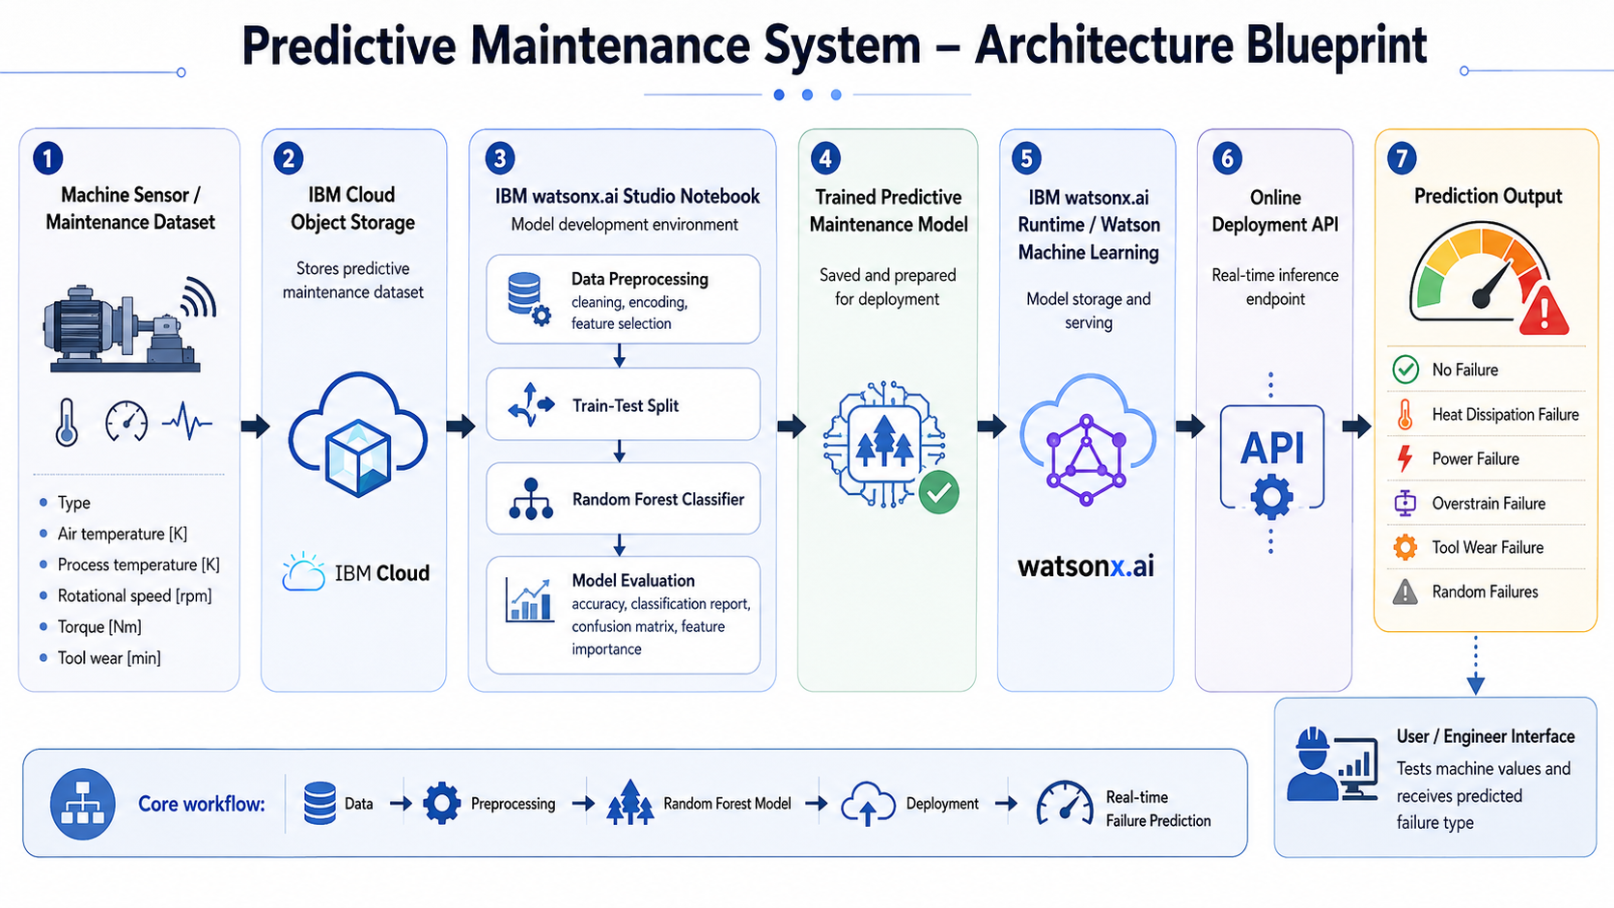
Architecture blueprint

Slide 9

Role of Machine Learning in the Solution
Role of Machine Learning in the Solution
Machine Learning plays the main role in this predictive maintenance system. It helps the system learn patterns from machine sensor data and predict possible failures before they happen.
The model analyzes inputs such as machine type, air temperature, process temperature, rotational speed, torque, and tool wear. Based on these values, it classifies the machine condition into failure types like No Failure, Power Failure, Tool Wear Failure, Heat Dissipation Failure, Overstrain Failure, or Random Failure.
Using IBM watsonx.ai Studio, the model was trained and tested with a Random Forest Classifier. After training, it was deployed using IBM watsonx.ai Runtime / Watson Machine Learning as an online backend service.
Overall, Machine Learning makes the system proactive by helping industries detect faults early, reduce downtime, and plan maintenance before breakdowns occur.

Slide 10
Technology Used
IBM watsonx.ai Studio – Used for creating the Jupyter Notebook, preprocessing the dataset, training the machine learning model, and evaluating results.
IBM Cloud Object Storage – Used to store the predictive maintenance dataset and model-related files securely in IBM Cloud.
IBM Granite Models – Included as part of the IBM AI ecosystem requirement for advanced AI capabilities and future intelligent explanation support.
IBM watsonx.ai Runtime / Watson Machine Learning – Used to store and deploy the trained Random Forest model as an online backend prediction service.
Python – Used for data preprocessing, model training, testing, and prediction.
Scikit-learn – Used to build the Random Forest Classifier for predicting machine failure types.
Random Forest Classifier – Used as the main ML model to classify machine conditions such as No Failure, Power Failure, Tool Wear Failure, Heat Dissipation Failure, Overstrain Failure, and Random Failure.

Slide 11
Novelty and Uniqueness
The proposed Predictive Maintenance System stands out by using Machine Learning and IBM Cloud deployment to predict machine failures before breakdowns occur.
Failure Type Prediction – Instead of only detecting whether a machine fails or not, the system predicts specific failure types such as Power Failure, Tool Wear Failure, Heat Dissipation Failure, Overstrain Failure, and Random Failure.
Sensor-Based Decision Making – The model uses real machine parameters like temperature, torque, rotational speed, and tool wear to make predictions.
Preventive Maintenance Focus – Helps industries take action before machine breakdown, reducing downtime and maintenance cost.
IBM Cloud Deployment – The trained model is deployed as an online backend service using IBM watsonx.ai Runtime / Watson Machine Learning.
Model Interpretability – Feature importance shows which machine parameters affect failure prediction the most, such as Tool Wear, Torque, and Rotational Speed.
This makes the solution a smart, practical, and cloud-deployed predictive maintenance system for industrial machinery.

Slide 12
Git Hub Link
A public GitHub repository has been created for this project. The repository contains all required project files, including the configuration file, problem statement, project presentation, notebook/code files, and supporting screenshots.
GitHub Repository URL: https://github.com/lucia-builds/predictive-maintenance-ibm-ml.git
Uploaded Files in Repository
The following files have been uploaded:
app.json – Project metadata and configuration file
problemstatement.pdf – Problem statement document
projectpresentation.pptx – Final project presentation
predictive_maintenance_notebook.ipynb – Jupyter Notebook containing training, testing, and deployment code
requirements.txt – Required Python libraries
screenshots – Output screenshots including model accuracy, deployment status, and prediction result
·
·
·

Slide 13
Future Scope
Real-Time Sensor Integration – The system can be integrated with IoT sensors installed on industrial machines to collect real-time values such as temperature, torque, rotational speed, vibration, and tool wear. This will help predict failures continuously during machine operation.
2. Alert and Maintenance Notification System – The system can be enhanced with automatic alerts through email, SMS, or dashboard notifications whenever a high-risk failure is predicted. This will help engineers take preventive maintenance action before breakdown occurs.
·
·
·

Slide 14


