Slide 1


Uppgift 4, Webbproduktion
by:
Svetla Tileva | Alvar

Slide 2
Presentation’s main points:
Inledning
Kravspecifikation
Design guidelines
Wireframes
Mockup

Slide 3
Inledning
Creative studio that shows it’s design and web development projects
Målgrupp: small business that need to make web site or redesign the existing one;

Slide 4
Krav
specifikation
responsive design
correct HTML/CSS and validated code
use SCSS
wireframes
design guidelines document
use at least one web font
use one icon-package like Font-awesome, Bootstrap Icons or Google Icons
use CSS grid/flexbox
at least one form
at least one proprietary JS that affects the DOM or CSS
present it and explain how you worked when building the page, what was the difficulties, what new learned, some useful trick
submit the webpage via github. Submit link to repositoryt at kunskap.nu

Slide 5
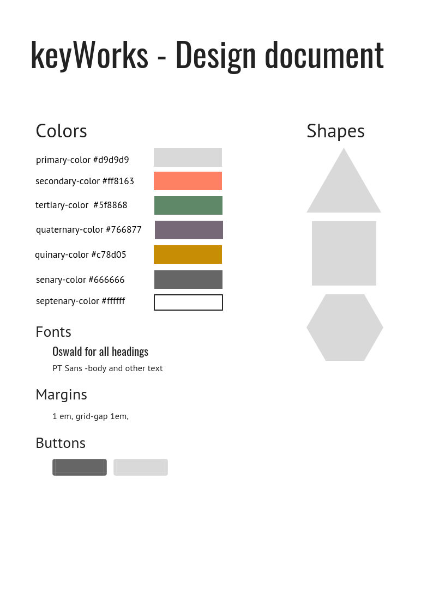
Design guidelines

Slide 6
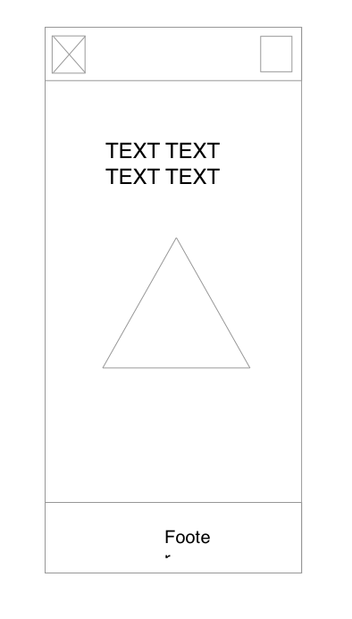
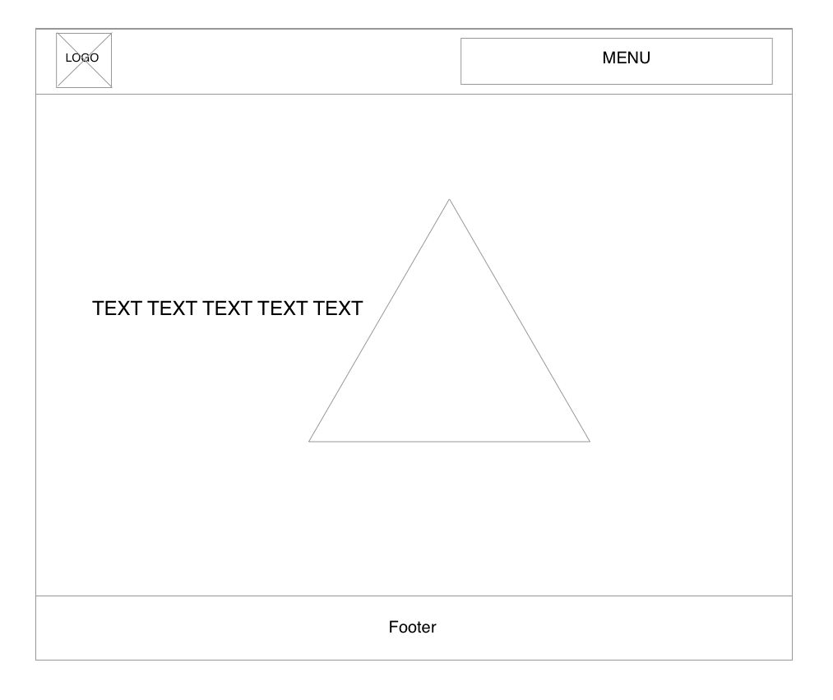
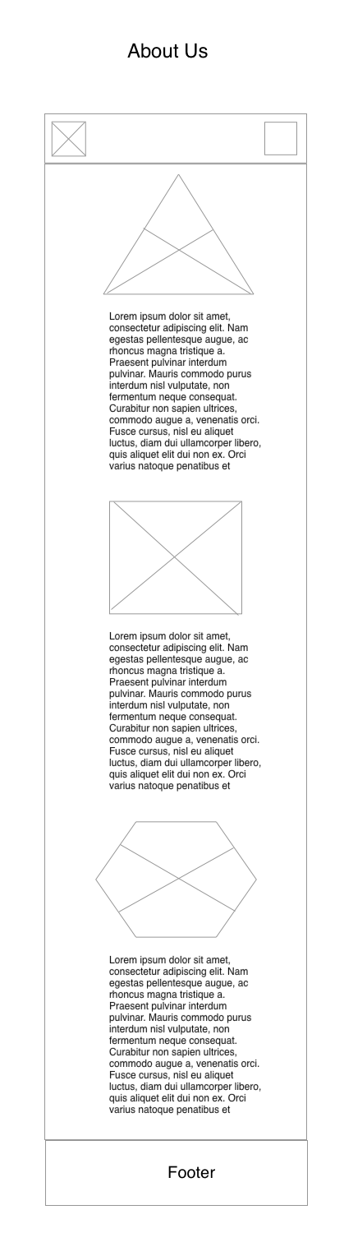
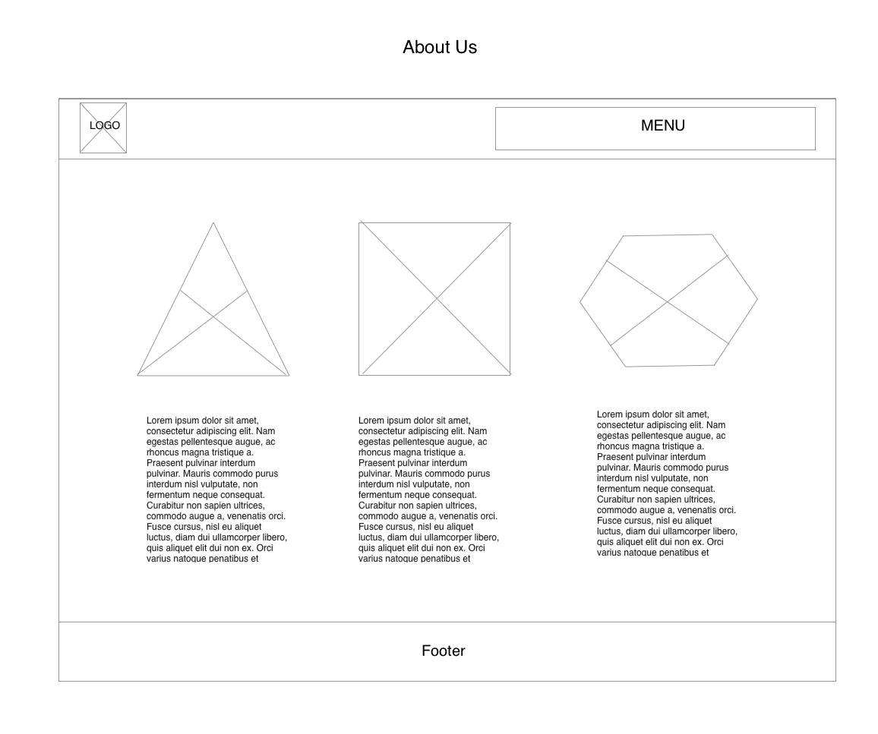
Wireframes
Home &
About Us

Slide 7
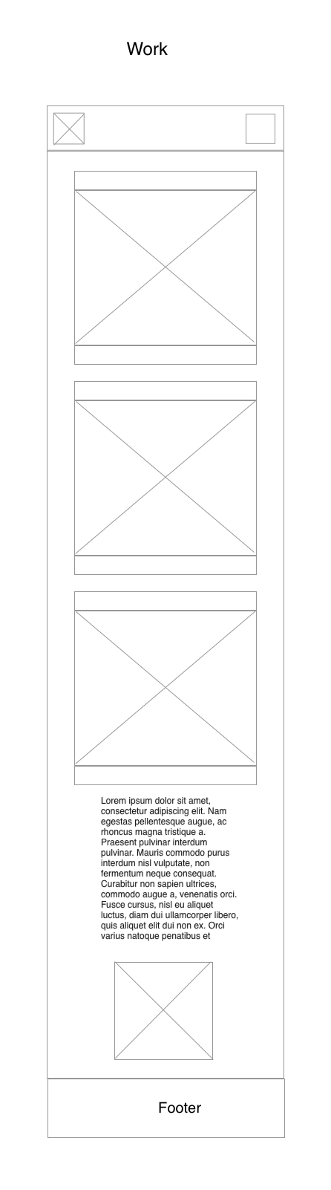
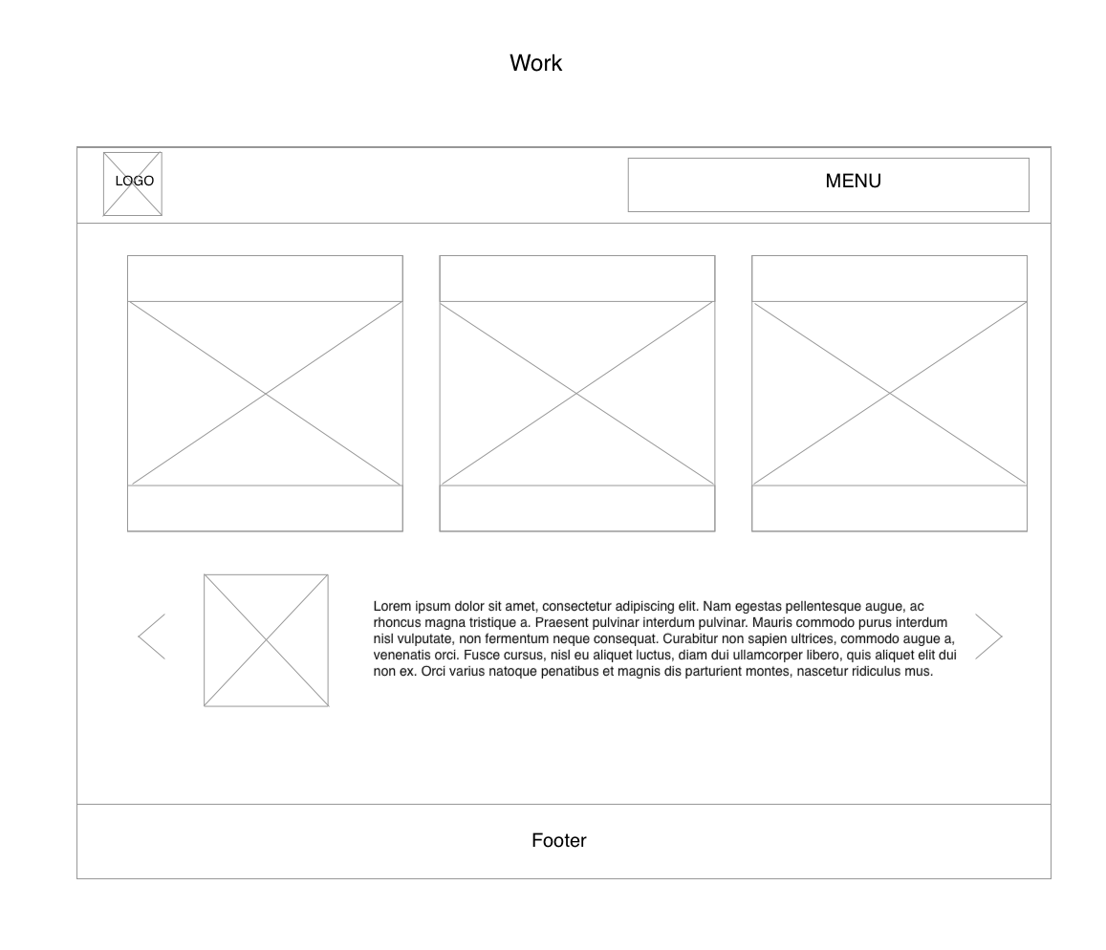
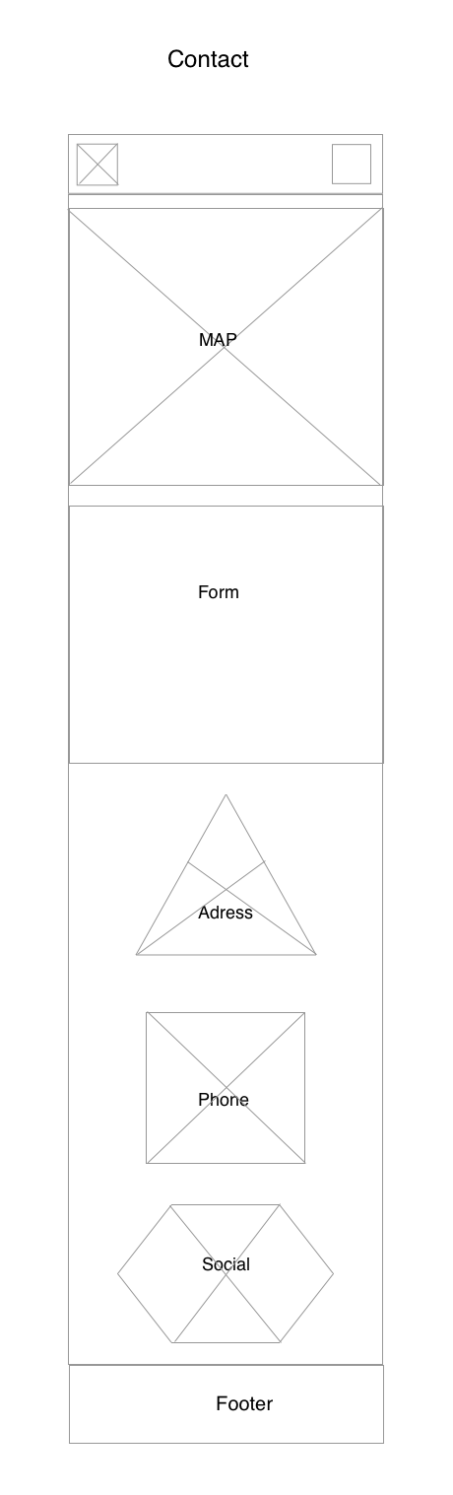
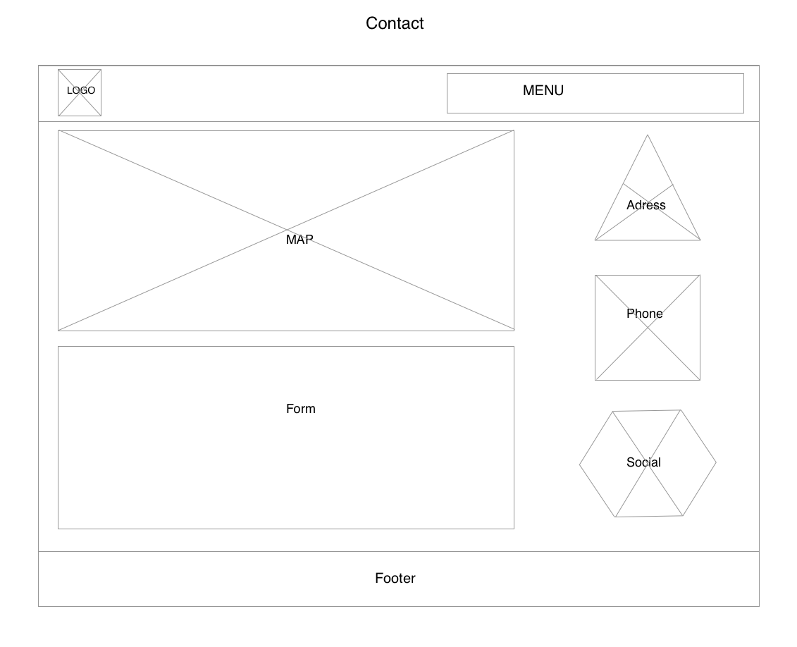
Wireframes
Our work &
Contacts

Slide 8
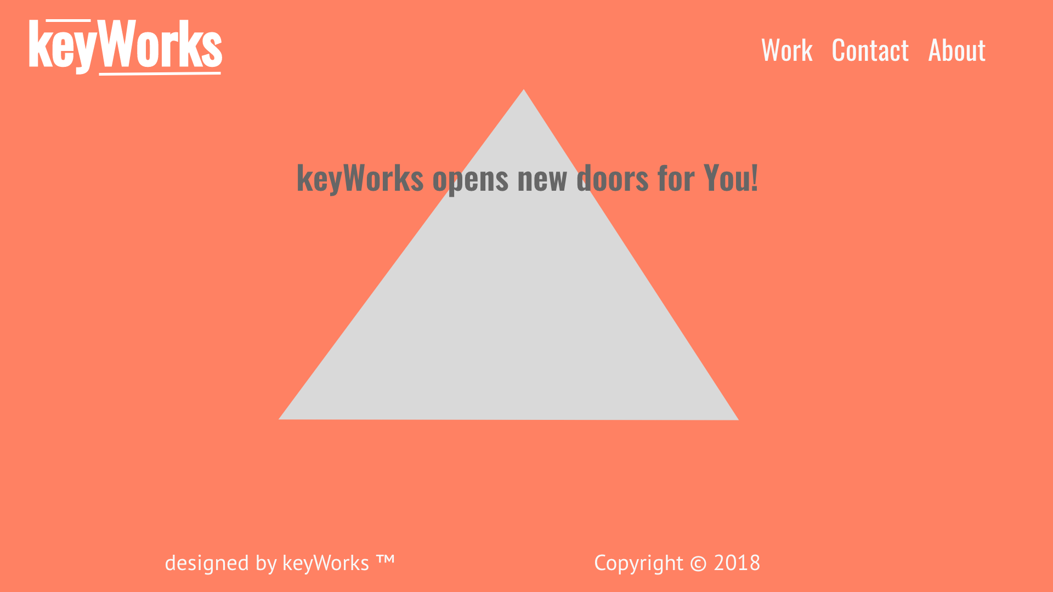
Mockup

