Slide 1
MACAFAST macadamia nut storage and transportation company
Authors
Sonia Laure Mota - sonia.laure10@e-uvt.ro
Ignacio Mauri Cáceres - ignacio.mauri10@e-uvt.ro
Andrés Romano Seijas - andres.romano10@e-uvt.ro
Santiago Delgado Ferreiro - santiago.delgado10@e-uvt.ro
Lucía Docampo Rodríguez - lucia.docampo10@e-uvt.ro

Slide 2
Business Performance Management
Goals
Be the largest and most efficient company in the macadamia nut market
Keep the product in the best existing conditions
Have warehouses at strategic points for better efficiency
Operational Plan
1. Procurement -> 2. Storage -> 3. Sorting and Packaging ->
-> 4. Quality Control -> 5. Transportation ->
-> 6. Delivery and Customer Service -> 7. Continuous Improvement.

Slide 3
Risk Management
BPM
Damage to the nuts during handling, loading and unloading
Macadamia nuts are fragile
Investing in appropriate packaging and transportation equipment
Contamination of the nuts during packaging and transport
Poor hygiene practices / exposure to contaminants
Establish and enforce strict hygiene standarts
Theft or loss of the macadamia nuts during transport
High-value commodity = target for theft
Investing in transportation methods and check all employees
Potential for legal liability
A customer becoming sick
Comprehensive quality control program
Supply chain disruptions
Natural dissasters or transportation strikes
Developing contingency plans

Slide 4
Key Performance Indicator
BPM
Increase efficiency in packaging and transport processes
Reduce time and resources while maintaining quality
Measuring it and tracking it over time -> Automatization, optimization of routes…
Percent of macadamia nuts delivered with zero damage
Reduce damage during handling and transport
Sampling method -> Purchase new packaging and transportation equipment
Reduce the incidence of theft or loss during transport
Reduce this risks during transport
Tracking incidents-> Security measures: GPS tracking systems, tamper-evident seals…
Improve customer satisfaction
High quality macadamia and excellent customers system
Surveys and reviews-> Improving on quality
Increase profitability
Optimizing costs and sales
Comparing with the previous years-> Costs optimization and increasing sales

Slide 5
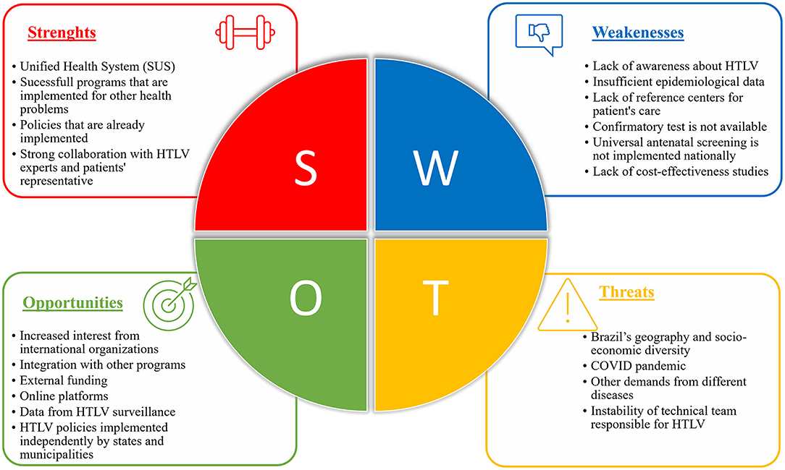
S.W.O.T
BPM
Strong brand reputation
Efficient distribution network
Well-established relationships with reliable suppliers.
Strong financial position and ability to invest in new technologies.
Limited diversification in product offerings
Reliance on a few key suppliers
Limited marketing and promotional activities, resulting in lower brand visibility.
High production costs
asas
Fire in the north peninsular area
Bankruptcy of a rival company
Supply chain disruption
Ukranian war (supplies for need)
Contamination of a plantation
Intense competition
Fluctuating market prices
Changes in consumer preferences
Potential disruptions in the global supply chain
Climate change and environmental factors

Slide 6
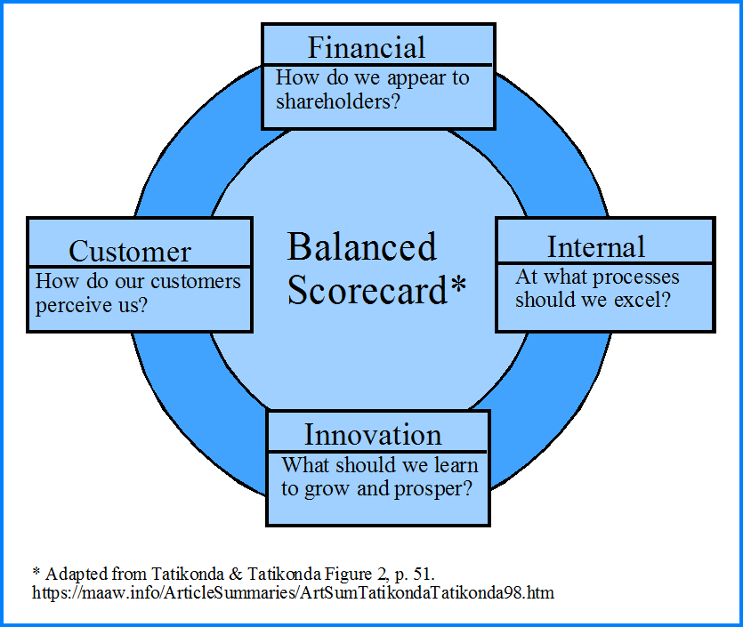
Balance Scorecard Analysis
BPM
Financial
Expand into new geological markets
Reduce costs
Maintain profitability (managing risk)
Improve cash flow management
Customer
Quality standards
Expand products offering
Brand reputation and loyalty
Competitive pricing and discounts
Internal Processes
Continuously improving risk management plans
Improve SCM
Implementation of quality controls
Just-in-time inventory systems
Learning and growth
Invest in employees training
Foster a culture of innovation and creativity
Partnerships
The triple R (Reduce, Reduce and Recicle)

Slide 7
Sources of Financing
BPM
Personal savings ($50,000)
Grants and subsidies ($37,000)
Private investors ($50,000)
Crowdfunding ($24,000)
Bank loans ($89,000)
FAO
Plan Sierra
Dominican Republic
Rabo Private Equity
BBVA (Choice)
Bank Santander
Citibank
JPMorgan

Slide 8
Return on Investment
BPM
Costs = $200,000
Funding = $250,000
ROI = (Profits - Costs) / Costs * 100
Profit = $300,000
ROI = ($300,000 - $200,000)/ $200,000 * 100 (≈ 50%)
This means that, relative to the initial investment of $250,000, profits were generated that exceeded costs by 50%

Slide 9
Supply Chain Management
Strategical level
Network Optimization:
Analyze demand and supply patterns.
Determine optimal facility locations.
Identify potential partners for shared facilities or outsourcing.
Stategic Partnerships:
Establish clear communication channels.
Develop performance metrics and incentives.
Continuously monitor partnership performance.
Information Technology Chain Operations:
Evaluate IT infrastructure for improvement.
Implement software solutions for efficiency.
Provide training and support for employees.
Make-buy Decisions and Overall Organization Strategy:
Assess core capabilities and competitive advantage.
Evaluate costs and benefits of in-house production versus outsourcing.
Continuously monitor make-buy decisions.
Resource Commitment for Long-Term Success:
Allocate resources for supply chain management.
Provide training and development opportunities.
Continuously monitor and adjust supply chain strategy.

Slide 10
Tactical level
SCM
Production decisions: contract definition, planning and schedulling
Inventory decisions: quantity, location and qualty
Transport strategy: frequencies, routes and contracts
Comparation with the competitors
Milestone billing
Focus on customer need and habits: feedback and preferences

Slide 11
Operational level
SCM
Quality control and assurance: ensure quality standards are met throughout the supply chain
Continuous process improvement: identify and address bottlenecks and inefficiencies.
Safety protocols: to protect personnel and ensure proper handling of materials and equipment.
Collaboration and communication: to streamline operations.
Environmental sustainability
Inventory management: to fulfill customer orders efficiently and prevent stockouts.
Transportation and logistics: delivery schedules, track shipments, and resolve any transportation issues.
Technology systems

Slide 12
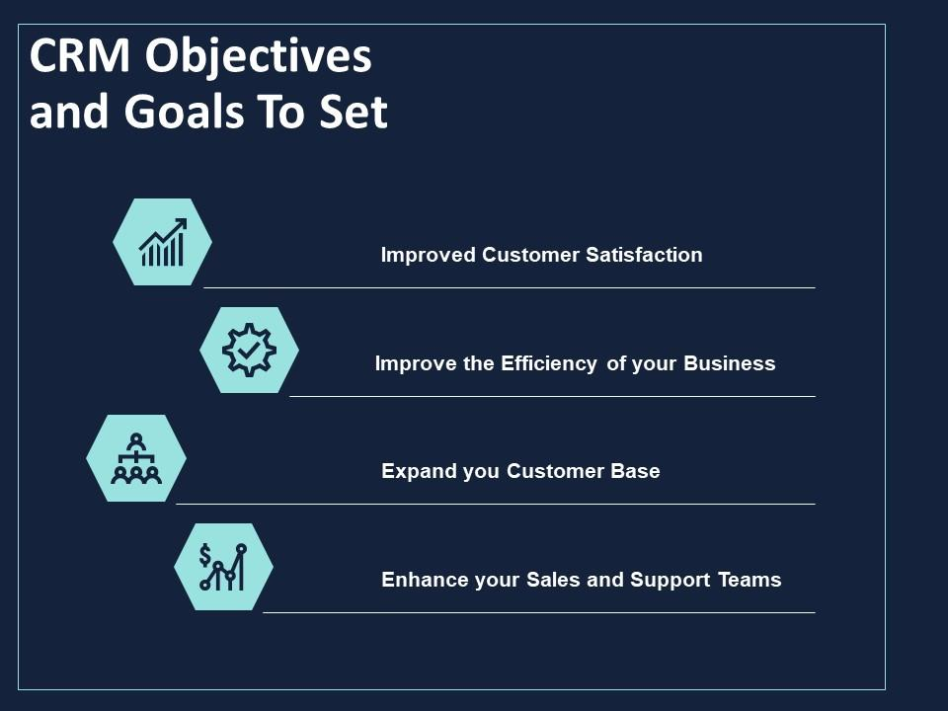

Customer Relationship Management
Goals and Objectives
Increasing Sales and Revenue
Enhancing Customer Satisfaction and Loyalty
Personalizing Marketing Efforts
Streamlining Customer Support and Communication
Analyzing Customer Data
Customer Segmentation
Factors for Segmentation
Location-Based Segmentation
Order Volume-Based Segmentation
Preferences-Based Segmentation

Slide 13

Mapping the Customer Journey
Order Placement Process: capture order preferences
Order Processing and Fulfillment: ensure timely
Delivery and Post-Sales Support: work close
Advanced Data Analysis
Leveraging Advanced Analytics Tools
Predictive Analysis for Upselling and Cross-Selling
Detailed Segmentation Analysis

Slide 14

Marketing Automation
Benefit: improve efficiency
Customized Email Campaigns
Automated Cart Abandonment Follow-ups
Customer Loyalty and Retention
Loyalty Programs: Points
Personalized Offers and Recommendations based on history pursache
Customer Feedback and Reviews

Slide 15
Continuous Improvement and Evaluation
Key Performance Indicators (KPIs): regular monitoring and analysis
Ongoing Training and Education
Data Security and Privacy
Data Protection Policies
Compliance with Data Regulations
Data Breach Response Plan
Customer Trust and Transparency
Data Retention and Deletion
Employee Training on Data Security

Slide 16
Decision Support System
Objectives:
Improving harvesting efficiency
Optimize inventory management
Optimize distribution planning
Ensure product quality
Maximize financial performance
Data:
Harvest data
Inventory data
Sales and distribution data
Quality data
Financial data

Slide 17
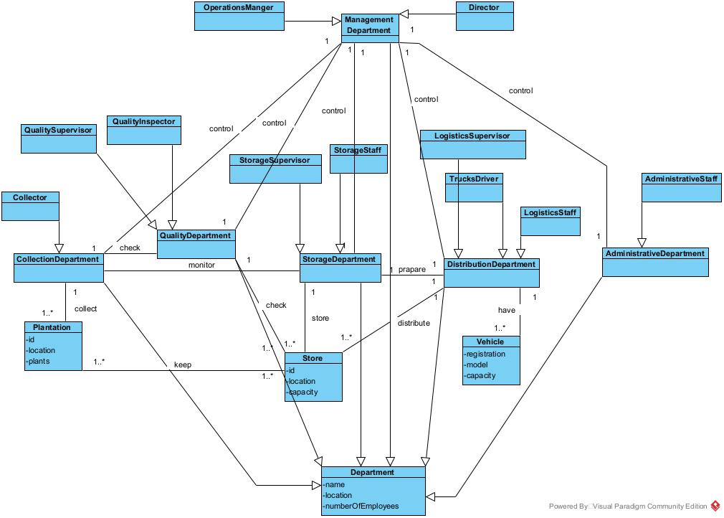
DSS

