Slide 1


§3 Shortest Path Algorithms
Given a digraph G = ( V, E ), and a cost function c( e ) for e ∈ E( G ). The length of a path P from source to destination is (also called weighted path length).
1. Single-Source Shortest-Path Problem
Given as input a weighted graph, G = ( V, E ), and a distinguished vertex, s, find the shortest weighted path from s to every other vertex in G.
Negative-cost cycle
2
2
Note: If there is no negative-cost cycle, the shortest path from s to s is defined to be zero.
v₁
v₂
v₁
v₂
4
1
3
10
4
1
–10
2
2
2
3
2
v₃
v₄
v₅
v₃
v₄
v₅
8
4
6
8
4
5
5
6
v₆
1
v₇
v₆
1
v₇
1/11

Slide 2

§3 Shortest Path Algorithms
➢ Unweighted Shortest Paths
❖ Sketch of the idea
1
v₁
v₂
2
0:  v₃
Breadth-first search
2
1: 
v₁ and v₆
0
v₃
v₄
v₅
3
2: 
v₂ and v₄
1
v₆
v₇
3
3: 
v₅
and v₇
❖ Implementation
Table[ i ].Dist ::= distance from s to v_{i} /* initialized to be ∞ except for s */
Table[ i ].Known ::= 1 if v_{i} is checked; or 0 if not
Table[ i ].Path ::= for tracking the path /* initialized to be 0 */
2/11

Slide 3
§3 Shortest Path Algorithms
void Unweighted( Table T )
{ int CurrDist;
Vertex V, W;
for ( CurrDist = 0; CurrDist < NumVertex; CurrDist ++ ) {
for ( each vertex V )
if ( !T[ V ].Known && T[ V ].Dist == CurrDist ) {
T[ V ].Known = true;
for ( each W adjacent to V )
if ( T[ W ].Dist == Infinity ) {
T[ W ].Dist = CurrDist + 1;
T[ W ].Path = V;
} /* end-if Dist == Infinity */
} /* end-if !Known && Dist == CurrDist */
} /* end-for CurrDist */
}
If V is unknown yet has Dist < Infinity, then Dist is either CurrDist or CurrDist+1.
 T = O( |V|² )
The worst case:
v₉
v₈
v₇
v₆
v₅
v₄
v₃
v₂
v₁
3/11

Slide 4

§3 Shortest Path Algorithms
❖ Improvement
1
2
void Unweighted( Table T )
{ /* T is initialized with the source vertex S given */
Queue Q;
Vertex V, W;
Q = CreateQueue (NumVertex ); MakeEmpty( Q );
Enqueue( S, Q ); /* Enqueue the source vertex */
while ( !IsEmpty( Q ) ) {
V = Dequeue( Q );
T[ V ].Known = true; /* not really necessary */
for ( each W adjacent to V )
if ( T[ W ].Dist == Infinity ) {
T[ W ].Dist = T[ V ].Dist + 1;
T[ W ].Path = V;
Enqueue( W, Q );
} /* end-if Dist == Infinity */
} /* end-while */
DisposeQueue( Q ); /* free memory */
}
v₁
v₂
0
2
3
v₃
v₄
v₅
v₆
v₇
1
3
Dist Path
v₁
∞
1
0
v₃
v₇
v₂
∞
2
0
v₁
v₅
v₃
0
0
v₄
v₄
∞
2
0
v₁
v₅
∞
v₂
3
0
v₂
v₆
∞
1
0
v₃
v₆
v₇
∞
3
0
v₄
v₃
v₁
T = O( |V| + |E| )
4/11

Slide 5
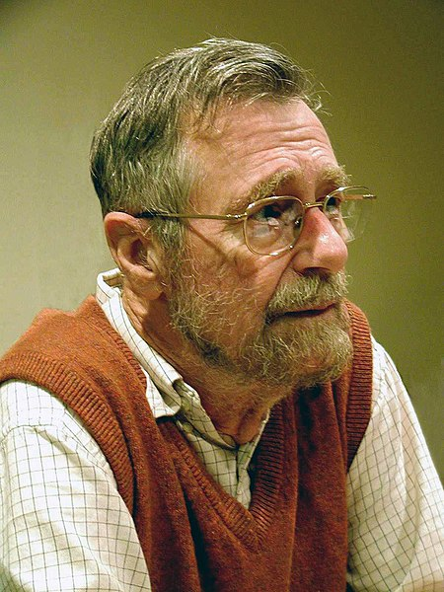
§3 Shortest Path Algorithms
➢ Dijkstra’s Algorithm (for weighted shortest paths)
Edsger W. Dijkstra
5/11

Slide 6
§3 Shortest Path Algorithms
➢ Dijkstra’s Algorithm (for weighted shortest paths)
Let S = { s and v_{i}’s whose shortest paths have been found }
For any u ∉ S, define distance [ u ] = minimal length of path { s → ( v_{i} ∈ S ) → u }. If the paths are generated in non-decreasing order, then
① the shortest path must go through ONLY v_{i} ∈ S ;
② u is chosen so that distance[ u ] = min{ w∉S | distance[ w ] } (If u is not unique, then we may select any of them) ; /* Greedy Method */
Why? If it is not true, then
there must be a vertex w on this path
that is not in S. Then ...
③ if distance [ u₁ ] < distance [ u₂ ] and we add u₁ into S, then distance [ u₂ ] may change. If so, a shorter path from s to u₂ must go through u₁ and distance’ [ u₂ ] = distance [ u₁ ] + length(< u₁, u₂>).
5/11

Slide 7



Slide 8
§3 Shortest Path Algorithms
void Dijkstra( Table T )
{ /* T is initialized by Figure 9.30 on p.303 */
Vertex V, W;
for ( ; ; ) {
V = smallest unknown distance vertex;
if ( V == NotAVertex )
break;
T[ V ].Known = true;
for ( each W adjacent to V )
if ( !T[ W ].Known )
if ( T[ V ].Dist + Cvw < T[ W ].Dist ) {
Decrease( T[ W ].Dist to
T[ V ].Dist + Cvw );
T[ W ].Path = V;
} /* end-if update W */
} /* end-for( ; ; ) */
}
v₁
2
v₂
4
1
3
10
v₃
2
v₄
2
v₅
/* O( |V| ) */
8
5
4
6
v₆
1
v₇
Dist Path
v₁
0
0
v₂
2
v₁
∞
0
v₃
3
v₄
∞
0
v₄
1
v₁
∞
0
v₅
∞
0
3
v₄
v₆
∞
0
9
8
6
v₄
v₃
v₇
/* not work for edge with negative cost */
v₇
∞
0
5
v₄
Please read Figure 9.31 on p.304 for printing the path.
6/11

Slide 9
§3 Shortest Path Algorithms
❖ Implementation 1
V = smallest unknown distance vertex;
/* simply scan the table – O( |V| ) */
T = O( |V|² + |E| )
Good if the graph is dense
❖ Implementation 2
V = smallest unknown distance vertex;
/* keep distances in a priority queue and call DeleteMin – O( log|V| ) */
Decrease( T[ W ].Dist to T[ V ].Dist + Cvw );
Good if the graph is sparse
/* Method 1: DecreaseKey – O( log|V| ) */
T = O( |V| log|V| + |E| log|V| ) = O( |E| log|V| )
/* Method 2: insert W with updated Dist into the priority queue */
/* Must keep doing DeleteMin until an unknown vertex emerges */
T = O( |E| log|V| ) but requires |E| DeleteMin with |E| space
❖ Other improvements: Pairing heap (Ch.12) and Fibonacci heap (Ch. 11)
7/11

Slide 10

Laboratory Project 3
Normal: Ambulance Dispatch
Hard: The 2nd-shortest Path
Due: see PTA

Slide 11
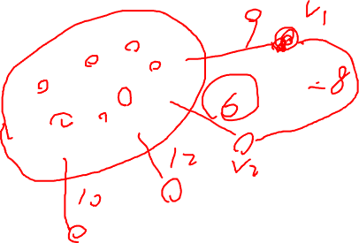

Slide 12

§3 Shortest Path Algorithms
➢ Graphs with Negative Edge Costs
Hey I have a good idea:
why don’t we simply add a constant
Δ to each edge and thus remove
negative edges?
Too simple, and naïve…
Try this one out:
void WeightedNegative( Table T )
{ /* T is initialized by Figure 9.30 on p.303 */
Queue Q;
Vertex V, W;
Q = CreateQueue (NumVertex ); MakeEmpty( Q );
Enqueue( S, Q ); /* Enqueue the source vertex */
while ( !IsEmpty( Q ) ) {
V = Dequeue( Q );
for ( each W adjacent to V )
if ( T[ V ].Dist + Cvw < T[ W ].Dist ) {
T[ W ].Dist = T[ V ].Dist + Cvw;
T[ W ].Path = V;
if ( W is not already in Q )
Enqueue( W, Q );
} /* end-if update */
} /* end-while */
DisposeQueue( Q ); /* free memory */
}
T = O( |V| × |E| )
2
1
2
– 2
1
3
/* each vertex can dequeue at most |V| times */
2
4
/* no longer once per edge */
/* negative-cost cycle will cause indefinite loop */
8/11

Slide 13
➢ Acyclic Graphs
§3 Shortest Path Algorithms
If the graph is acyclic, vertices may be selected in topological order since when a vertex is selected, its distance can no longer be lowered without any incoming edges from unknown nodes.
T = O( |E| + |V| ) and no priority queue is needed.
❖ Application: AOE ( Activity On Edge ) Networks
—— scheduling a project
a_{i} ::= activity
Signals the completion of a_{i}
v_{j}
 EC[ j ] \ LC[ j ] ::= the earliest \ latest completion time for node v_{j}
Index of vertex
EC Time
 CPM ( Critical Path Method )
Lasting Time
Slack Time
LC Time
9/11

Slide 14



§3 Shortest Path Algorithms
〖Example〗 AOE network of a hypothetical project
6
16
a0=6
1
a3=1
6
0
6
a6=9
16
a9=2
start
0
7
0
4
a1=4
7
8
18
2
a7=7
a10=4
finish
4
a4=1
14
18
2
2
7
6
14
a2=5
a11=0
a8=4
5
7
3
3
a5=2
5
5
7
Dummy activity
➢ Calculation of EC: Start from v0, for any a_{i} = <v, w>, we have
➢ Calculation of LC: Start from the last vertex v8, for any a_{i} = <v, w>, we have
➢ Slack Time of <v,w> =
➢ Critical Path ::= path consisting entirely of zero-slack edges.
10/11

Slide 15
§3 Shortest Path Algorithms
2. All-Pairs Shortest Path Problem
For all pairs of v_{i} and v_{j} ( i ≠ j ), find the shortest path between.
Method 1 Use single-source algorithm for |V| times.
T = O( |V|³ ) – works fast on sparse graph.
Method 2 O( |V|³ ) algorithm given in Ch.10, works faster on dense graphs.
11/11

