Slide 1

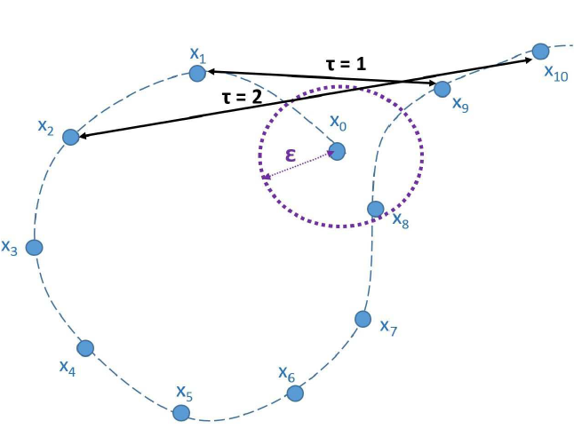
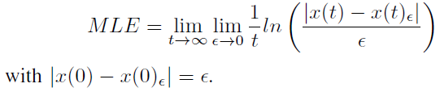

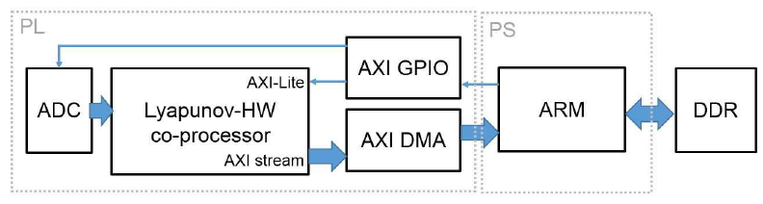

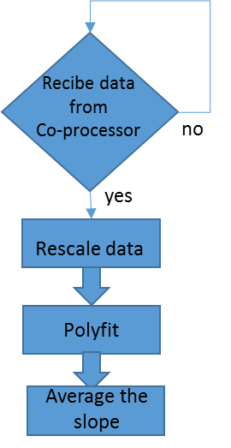
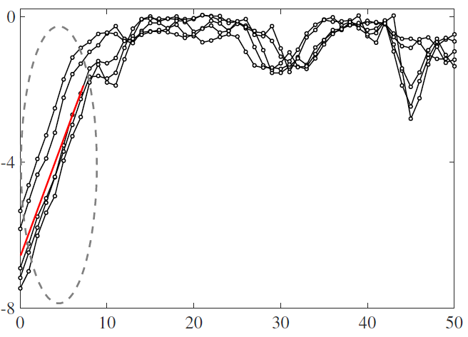
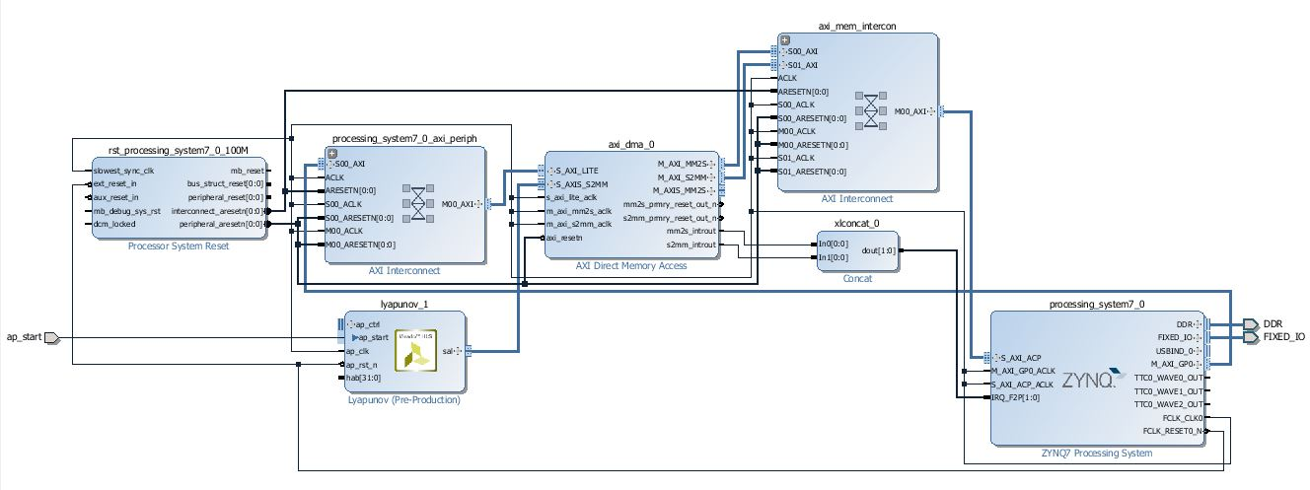


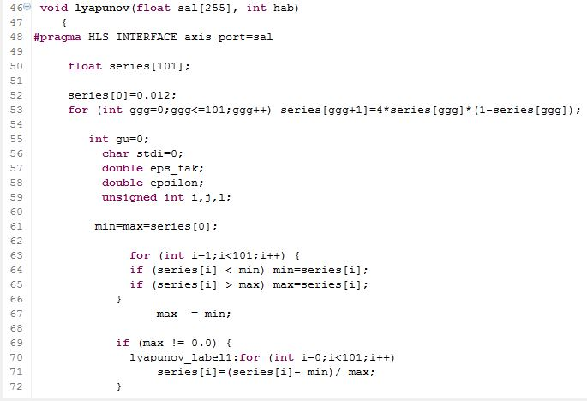
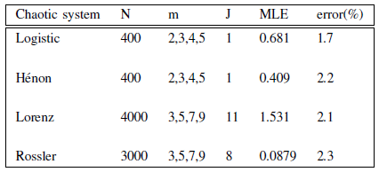
HW/SW Codesign of Maximum Lyapunov Exponent Estimator
1 ICYTE (Instituto de Investigaciones Científicas y Tecnológicas en Electrónica)
Facultad de Ingeniería, UNMDP, CONICET, Argentina.
2 ICTP (International Centre for Theoretical Physics), MLab (Multidisciplinary Laboratory) Trieste, Italy.
¹Luciana De Micco, ¹Maximiliano Antonelli , ²María Liz Crespo and ²Andrés Cicuttin
E-mail: ldemicco@fi.mdp.edu.ar
Abstract: The maximum Lyapunov exponent (MLE) of a dynamic system is a quantity that characterizes the degree of separation of two infinitesimally close paths, it gives a measure of the average rate of exponential divergence of nearby orbits. It is known as a general indicator of the presence of chaos in a dynamic system. This quantifier has been applied in diverse fields, such as biomedicine and finance, in many of these applications, the system is inaccessible and also a real-time measurement is required. In this work, Kantz’s estimator of the MLE [1] was implemented in a PSoC (Programmable System-on-Chip), Zedboard FPGA, that supports both software and hardware design. This algorithm is calculated over a stream of data already generated, does not need access to the system and presents a high level of immunity to noise. The algorithm requires calculation in parallel, and also sequential development so that the used platform presents optimal characteristics for its implementation.
MAXIMUM LYAPUNOV EXPONENT:
KANTZ’S ALGORITHM:
The general idea is to consider each value of the sequence as an initial condition and the closest point among all the sequence to be that initial condition but with a slight perturbation. In order to be able to estimate the separation rate of the sequences having just one time series of the system.
HARDWARE IMPLEMENTATION:
The development was implemented in the Hardware/Software Platform Zedboard, of Xilinx. It includes a dual Corex-A9 Processing System (PS) and a 85,000 cells Zynq-7000 FPGA (XC7Z020) (PL), 512 MB external DDR3 and Flash memories.
The implementation involves a HW/SW codesign, this is an integrated design that consists of hardware and software components. In this case, the codesign mainly implicates two steps, 1. programming the FPGA (PL) and 2. programming the microcontroller (PS). Also, the communication interface between them has to be taken into account.
2. Sequential computation:
The main processing unit of the PS is an ARM dual-core Cortex-A9 microprocessor. Data generated by the Lyapunov-HW co-processor should be transfer to the DDR memory in order to be later accessible for being processed, this is done through the PS. Moreover, the PS has to control the Lyapunov-HW co-processor, for this, there are necessary two AXI interfaces.
Block diagram of the system.
1. Parallel computation: Lyapunov-HW co-processor:
Suppose we have a time series
The first stage of the system was implemented in the programmable logic (PL) of the device.
The algorithm is in charge of getting a reconstruction of the dynamics of the system, this is done by embedding the time-series in a phase space where each point is a vector of the previous points in time (its embedding dimension), the separation is a lag of j units of times.
Experimental output of the circuit implemented in the PL, the Lyapunov-HW co-processor.
The design has been optimized in a way that leads to efficient parallelization and pipelining, and then packaged as an IP block called Lyapunov-HW co-processor. This stage consists of a main function that calls the following four sub-functions:
• rescale data: this routine is used only once, it is responsible for normalizing the input data.
• put in boxes: this routine depends on the value of epsilon. It determines which of the data are located inside each box delimited by epsilon. It is used as many times as different values of epsilon.
• lfind neighbors: this routine is responsible for identifying the points that are within epsilon for each data point.
These neighbors will make the role of the same initial condition with a small variation. It is used as many times as different values of epsilon.
• iterate points: this routine is responsible for calculating for each point the separation between the next point and the closest neighbors next point, the next point is determined by the delay, it increases the delay in this case up to 50. This routine is called for each value of the series.
C Simulation
C Synthesis
Export RTL
RESULTS:
Block Design.
Experimental values of the MLE obtained for three chaotic systems. There, the length of the time series (N), the lag (J) and the values of m employed are reported. Also, percentage errors with regard to theoretical values are shown there. Note that it does not exceed 2.3%.
CONCLUSION:
We have implemented a HW/SW codesign of Kantz’s algorithm for calculating the MLE. The system was optimized regarding resources and delay. For testing the correct operation, the MLE of various chaotic systems have been computed. In all cases the error was less than ±2.3% comparing with the expected analytical values.
ACKNOWLEDGMENT:
This material is based upon work supported by the Joint ICTP-IAEA School on Hybrid Reconfigurable Devices for Scientific Instrumentation (smr2737) and the International Atomic Energy Agency (IAEA) Department of Nuclear Sciences and Applications under the Nuclear Instrumentation Programme (1.4.3.3). This work was partially supported by the Consejo Nacional de Investigaciones Científicas y
Técnicas (CONICET), Argentina (PIP 112-200801-01420), ANPCyT (PICT-2013-2066), UNMDP.
REFERENCES:
[1] H. Kantz, “A robust method to estimate the maximal Lyapunov exponent of a time series,” Physics Letters A, vol. 185, pp. 77–87, Jan. 1994.
[2] A. Pavlov, N. Janson, V. Anishchenko, V. Gridnev, and P. Dovgalevsky, “Diagnostic of cardio-vascular disease with help of largest Lyapunov exponent of RR-sequences,” Chaos, Solitons and Fractals, vol. 11, p. 807814, 2000.
[3] N. Paivinen, S. Lammi, A. Pitkanen, J. Nissinen, M. Penttonen, and T. Gronfors, “Epileptic seizure detection: A nonlinear viewpoint,” Comput. Methods Prog. Biomed., vol. 79, no. 2, pp. 151–159, Aug. 2005.
[4] F. Shayegh, S. Sadri, R. Amirfattahi, and K. Ansari-Asl, “A model-based method for computation of correlation dimension, lyapunov exponents and synchronization from deptheeg signals,” Computer Methods and Programs in Biomedicine, vol. 113, no. 1, pp. 323–337, 2014.
[5] M. Bask, T. Liu, and A. Widerberg, “The stability of electricity prices: Estimation and inference of the lyapunov exponents,” Physica A: Statistical Mechanics and its Applications, vol. 376, no. C, pp. 565–572, 2007.
[6] L. D. Micco, M. Antonelli, C. M. Gonzlez, and H. A. Larrondo, “Hardware implementation of maximum lyapunov exponent,” in Embedded Systems (SASE/CASE), 2013 Fourth Argentine Symposium and Conference on, Aug 2013, pp. 1–4.
[7] J. Deppisch, H.-U. Bauer, and T. Geisel, “Hierarchical training of neural networks and prediction of chaotic time series,” Physics Letters A, vol. 158, no. 1, pp. 57 – 62, 1991.
[8] S. Ellner, A. R. Gallant, D. McCaffrey, and D. Nychka, “Convergence rates and data requirements for Jacobian-based estimates of Lyapunov exponents from data,” Physics Letters A, vol. 153, pp. 357–363, Mar. 1991.
[9] J. D. Farmer and J. J. Sidorowich, “Predicting chaotic time series,” Phys. Rev. Lett., vol. 59, pp. 845–848, Aug 1987.
[10] S. Sato, M. Sano, and Y. Sawada, “Practical Methods of Measuring the Generalized Dimension and the Largest Lyapunov Exponent in High Dimensional Chaotic Systems,” Progress of Theoretical Physics, vol. 77, no. 1, pp. 1–5, Jan. 1987
[11] Xilinx, “Vivado design suite user guide high-level synthesis,” http://www.xilinx.com/support/documentation, 2015.
[12] ——, “Axi reference guide, ug761,” https://www.xilinx.com/support/documentation/ip documentation/axi ref guide, 2012.
[13] A. Wolf, J. Swift, H. Swinney, and J. Vastano, “Determining lyapunov exponents from a time series,” Physica D: Nonlinear Phenomena, vol. 16, no. 3, pp. 285–317, 1985.

