Slide 1
CULTURE AS DATA · WEEK 2
Counting, Compared:
Is the Difference Real?
One session, one case: Bollen v. Schmidt, tried live on Google Books,
then replicated by this room on Reddit

Slide 2
TODAY
One case, six steps
What counts as a word
tf-idf
1
2
Tokenize, and a stop list's three rounds
Twelve communities, sight-read from their words
Elevated words
The statistics
3
4
Keyness: topic, and register underneath
z-scores, the shuffle test, the bootstrap: hands on
The trial
The replication
5
6
Bollen's evidence, pulled live
Yours: one community, fifteen years

Slide 3
DISCUSSION · BEFORE ANY CODE
What does it mean to count a feeling?
“I am a failure” appears in a book. List the possible reasons it was written. How many of them are distress?
If a phrase's frequency doubles, what claims does that support: about authors? readers? publishers? the age?
What would you accept as evidence that a society got sadder? Write it down; today tests your standard.

Slide 4
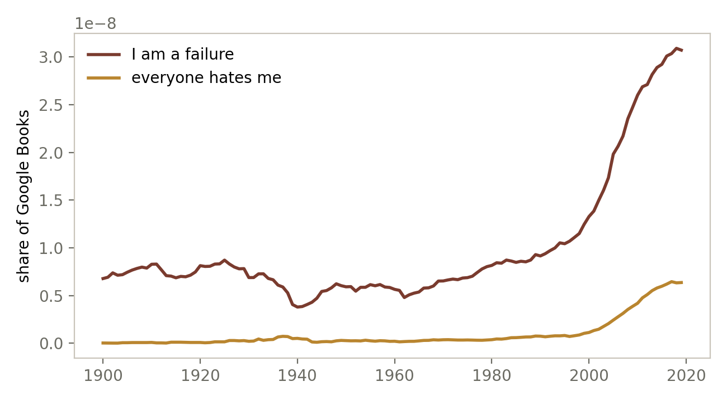
THE TRIAL · EXHIBIT A
The claim: a hockey stick of distress
Bollen et al. (PNAS 2021): cognitive-distortion phrases surge in Google Books after 2000.
An n-gram count over ~500 billion words: the biggest counting study you will meet.
This chart is not from the paper. The notebook pulled it minutes ago from the Ngram Viewer's JSON endpoint.

Slide 5
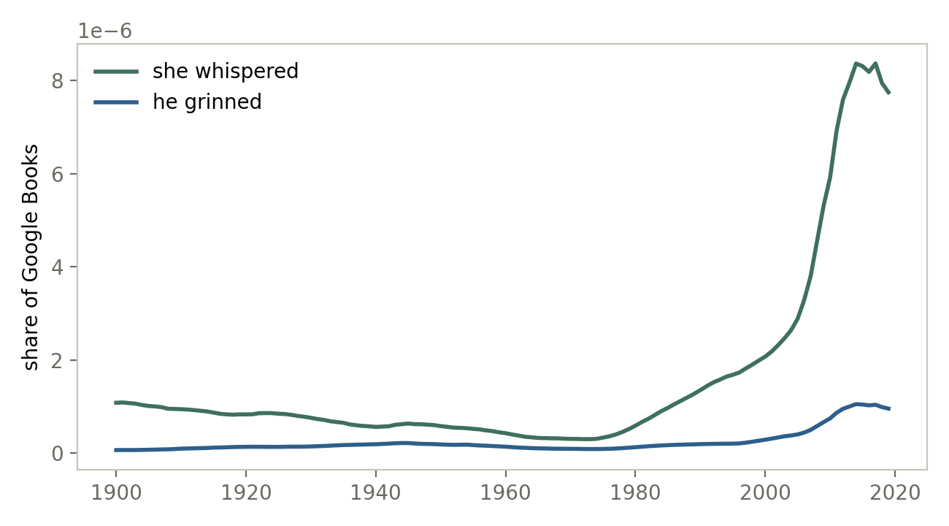
THE TRIAL · EXHIBIT B
The objection: the corpus changed under the count
Schmidt et al.: Google scanned more fiction over time. Maybe the surge is novels, not despair.
The test: phrases that mark fiction and nothing else. “She whispered.” “He grinned.”
They hockey-stick identically. Composition can manufacture a trend by itself.

Slide 6
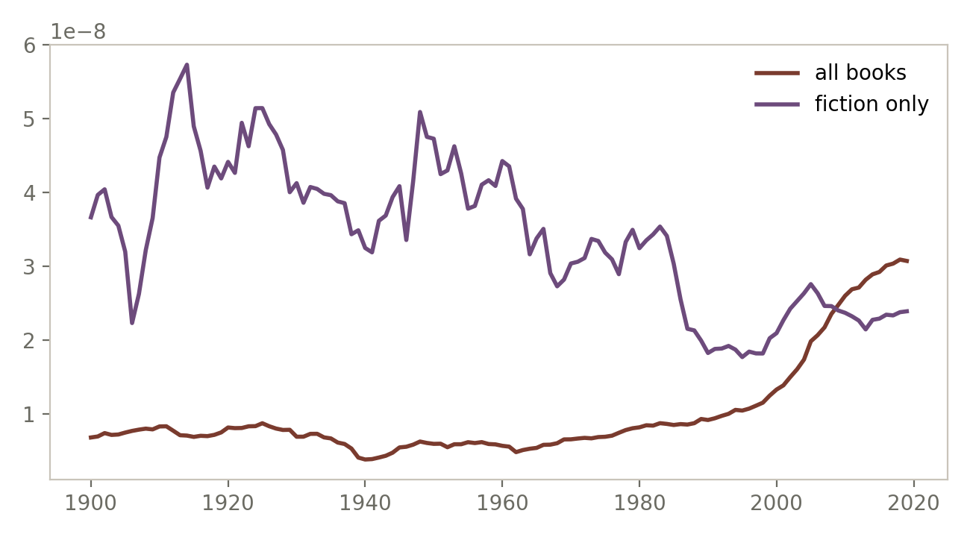
THE TRIAL · CROSS-EXAMINATION
The same phrase, fiction-only vs. all books
Inside fiction, “I am a failure” is roughly level for a century. The rise lives in the mixed corpus.
But the authors deleted fiction entirely, re-ran, and reported the pattern held. The trial is not over.
Hold that thought: what design would SETTLE it? You run one today.

Slide 7
THE TOOLS · 1
What counts as a word
Our tokenizer strips apostrophes: don't becomes don + t. One tool's choice is the next tool's cleanup job.
A stop list takes three rounds: obvious function words, then the shrapnel and fillers, then a judgment call.
The judgment: in r/relationship_advice, are her and him function words, or the cast of the stories?
three rounds on live comments
round 1
s · t · not · her · if · him
round 2
her · him · know · husband · need · want
round 3
know · husband · need · feel · yourself · life

Slide 8
THE TOOLS · 2
tf-idf: twelve communities, sight-read
r/Cooking
salt, veggies, protein
r/wallstreetbets
puts, bulls, premium
r/personalfinance
roth, account, rate
r/movies
movie, trailer, films
r/buildapc
cpu, fans, cooler
r/Parenting
kids, naps, teach
r/gardening
plant, sun, leaves
r/nba
player, shots, games
r/cats
cat, kitten, feed
r/relationship_advice
adult, deserve, ex
r/travel
flights, hotel, minute
r/askscience
math, animals, wildlife
One document per community. “Common here, rare overall” becomes “what this community talks about that the others don't.”

Slide 9
THE TOOLS · 3
Elevated words: keyness, then standardized keyness
raw log-odds → topic
standardized by variance → register
garden, plant, soil, seeds, water
i, we, them — a stories room
cpu, gpu, ram, motherboard, build
you, your, if — an advice room
A small gap in a very common word can be stronger evidence than a big gap in a rare one. Both lists are true; they answer different questions.
She Giggles, He Gallops is exactly this method: verbs after “she” vs. “he” in 2,000 screenplays.

Slide 10
THE STATISTICS, SIMPLIFIED
Three questions every counted claim must answer
1
2
3
Compared to what?
Could chance draw it?
How big, give or take?
A count needs a denominator. Bollen: share of ALL n-grams. Us: per 1,000 words, per control community.
Shuffle what should not matter (labels, years) 1,000 times. The fraction of shuffles that match the real gap IS the p-value.
Effect size with error bars (the bootstrap). Significant is not big; small is not false. Report both.
Every trap is a way of dodging one of the three: selection dodges 2, multiplicity cheats 2, a bare p dodges 3.

Slide 11
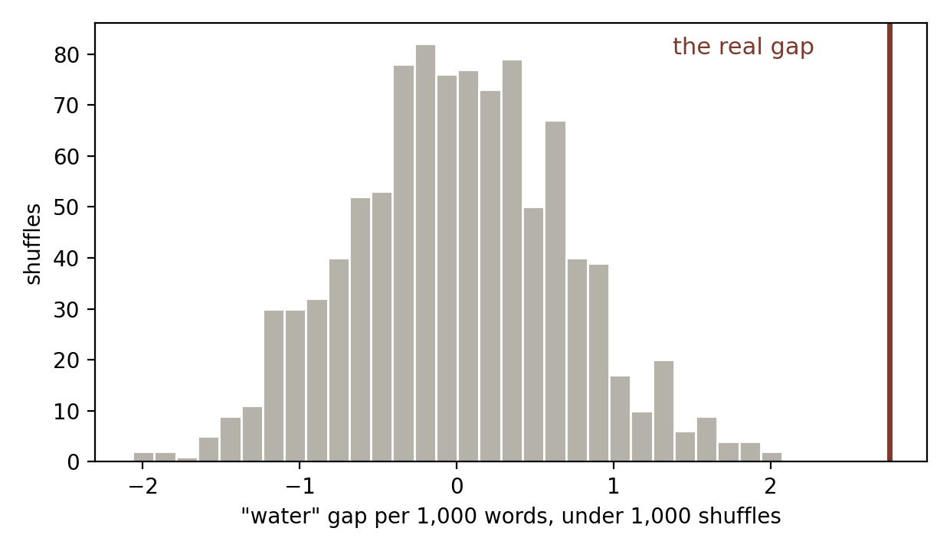
QUESTION 2, DRAWN
The shuffle test: could chance deal this gap?
The real gap: “water” appears 2.7 more times per 1,000 words in r/gardening than r/buildapc.
Shuffle the community labels 1,000 times, recount each time: the gray pile is what chance can do.
The real gap stands far outside the pile. Empirical p ≈ 0: this elevation is not luck.
Five moves, in the notebook with YOUR-TURN blanks: pick, predict, shuffle, read the effect, say the sentence.

Slide 12
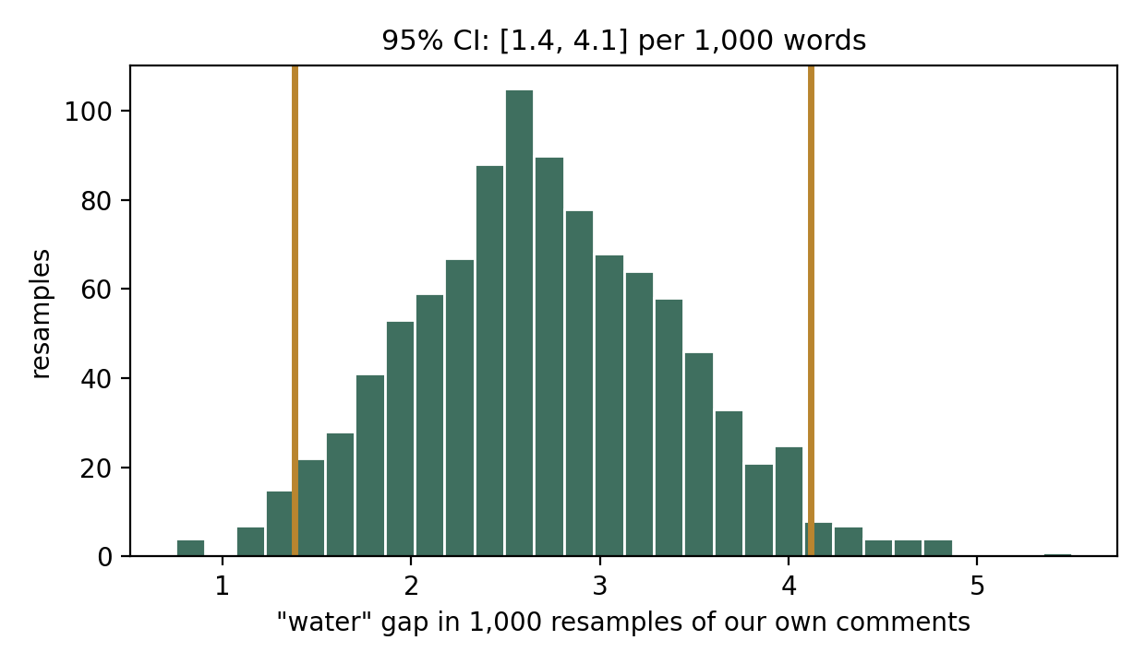
QUESTION 3, DRAWN
The bootstrap: how big, give or take?
The shuffle asked “could it be zero?” The bootstrap asks the other question: “what sizes are believable?”
Resample your own comments WITH replacement, 1,000 times; recompute the gap each time. Your data votes on its own uncertainty.
The middle 95% is the confidence interval: here, 1.4 to 4.1 per 1,000. Far from zero (a finding), wide (stay humble about the exact number).
The error bars on today's replication plot are exactly this, one bootstrap per year.

Slide 13
THE TRAPS, NAMED
Three ways significance fools you
Selection
We shuffle-tested our top keyness word: p = 0, guaranteed. We picked it FOR its extremity. State the hypothesis before looking.
Multiplicity
Split one community randomly in half: keyness still returns a convincing “distinctive vocabulary.” Pure noise. 1,500 words at p < .05: ~75 pass by luck.
Size
“Significant” answers “is it chance?”, never “does it matter?” Report the effect and the p, together, with the bootstrap's interval around the effect.

Slide 14
THE REPLICATION · YOURS
Bollen on Reddit: hold the community fixed
Schmidt's demand, satisfied: one subreddit, fifteen years, only the year varies. Composition cannot write this trend.
The honest adaptation: the paper's phrases are too rare for our samples, so we count the absolutist index (always, never, nothing...), 19 words that track distress language (Al-Mosaiwi & Johnstone 2018).
The room's protocol: predict the shape out loud → run the default together → each pair swaps in a community they know → bring the plot back.
Ten plots from ten communities is a real replication study, made in one classroom.
the design, in one line
rate(absolutist words | r/AskReddit, year)
for year in 2010 … 2024
…then the trend itself goes on trial:
correlate with year, and shuffle the years 1,000 times.

Slide 15
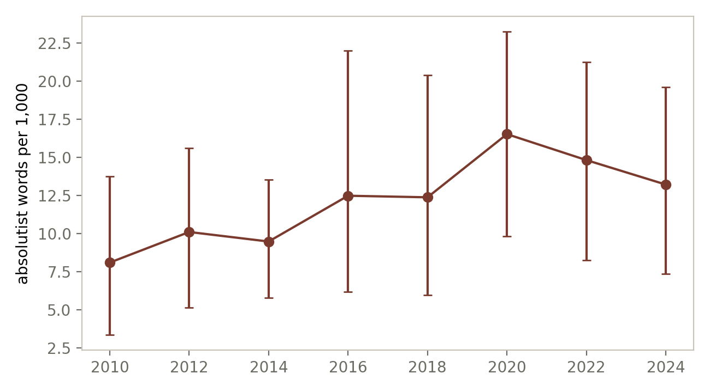
THE REPLICATION · A SAMPLE RUN
It climbs here too, with composition controlled
Our sample run: absolutist words climb from ~8 toward ~15 per 1,000 across fifteen years of one community. Trend r ≈ 0.8; shuffled years rarely match it.
Evidence the composition story cannot explain. Not proof of sadness: AskReddit's users drifted, the proxy is 19 words, each point is a few hundred comments (the error bars are the bootstrap saying so).
What survives a second community, another word list, and bigger samples, you may say out loud.

Slide 16
THE CAPSTONE IDEA
How do we prove anything with statistics?
We don't. Statistics never proves a claim; it eliminates rivals. A finding is the claim left standing after every challenger you and your critics could name has had its turn.
Rival 1: chance
“Randomly dealt data would show this too.” Answer: the shuffle test. Break the structure 1,000 times; if chance rarely draws your gap, this rival is out. That is all a p-value ever says.
Rival 2: something else did it
“The corpus changed under you” (Schmidt). Answer: design, not statistics. Hold the community fixed; remove the fiction; re-run without the suspect slice. Each control retires one rival by name.
Rival 3: true but trivial, or true but local
Answer: the bootstrap's interval for size, and scope stated out loud: announced-in-the-Times brides, one subreddit, 19 proxy words. A claim without its scope is not yet a claim.
So the argument's shape is: named claim → named rivals → a test or a design that retires each → the size, with its interval → the scope. Bollen argued this way; Schmidt answered this way; you replicated this way. Truth, here, is what survives.

Slide 17
DISCUSSION · COUNTING
What did the count actually measure?
Absolutist words rose. List every explanation: feelings, phones, age of users, comment length, moderation. Which could you test with today's tools?
Daniels ranked rappers by unique words; Aesop Rock wins. What is that number a measurement OF: skill, genre, era, or the denominator?
When is a zero a fact, and when is it a small sample? (Recall: “money” appeared 0 times in one gardening pull.)

Slide 18
DISCUSSION · VECTORS AND TRUTH
When numbers stand in for meaning
A comment became a row of numbers, a community a cloud of points. What survived the translation, and what did not? One example of each.
Two communities sit far apart in count-space. What exactly is far apart: the people, their topics, or the genre of writing? How would you tell?
Your trend beat shuffled years. Is the finding TRUE? What separates “not chance” from “what I said it means”?
The ratio climbed in books AND on Reddit. One truth measured twice, or two facts about two archives? What third corpus would decide?

Slide 19
BEFORE WEEK 3
Homework
Reading
Matt Daniels, “The Largest Vocabulary in Hip Hop” (The Pudding, ~10 min). Today's session in the wild: token analysis, a chosen denominator, honest caveats. Name three choices Daniels made.
Sketch
Finish your replication: your community, your prediction, the plot, and the three written answers from YOUR TURN 3.
Check (AI closed)
Explain: why two tokenizers split a sentence differently, and what your shuffle test can and cannot rule out.
Next week: the classifier. r/sandiego vs. r/SanDiegan, and the words that give a comment away.

