Slide 1
CULTURE AS DATA · WEEK 3
Classification:
Counting with Weights
Modelling in practice: one model built live on r/sandiego against r/bayarea,
then yours, in threes, in the blank notebook

Slide 2
TODAY
One method, four questions, then your turn
The article, argued
What a classifier is
1
2
Underwood's genres: what did he count, and who labelled it?
Every word votes; the model learns the weights and adds them up
Would you believe the score?
What did it learn?
3
4
Baseline, held-out rows, and the shape of the errors
Signed weights: topic, register, or community habit
What goes wrong
Your model
5
6
Memorising, imbalance, leakage, and no box for “neither”
Threes, one screen, a workbench, and one decision changed at a time

Slide 3
DISCUSSION · YOU READ IT, YOU ARGUE IT
Underwood, “The Life Cycles of Genres” (2016)
What did he actually count? Name the unit, the features, and the span of years before anyone defends or attacks the finding.
Who decided which novels were detective fiction, and on what evidence? Where in the paper is that decision visible?
The model misreads Pynchon's The Crying of Lot 49, a detective-fiction spoof. Is that a failure of the model, or a finding about genre?
What would have to be true for you to believe the figures? Name the one check you would want run.

Slide 4
THE FEATURED STUDY
A logistic regression, on a century of novels
Underwood trained the exact tool of today's session to recognise detective fiction and science fiction, then used it to trace how those genres consolidated.
The labels came from human judgment: shelf lists, reviews, a scholar's reading. What counts as science fiction is a choice made before any modelling.
Open data and code on Zenodo. You can rerun his argument, which is the standard this course holds you to as well.
the misread, and why it is the best part
“The Crying of Lot 49”
The classifier calls Pynchon's novel detective fiction. Critics call it a detective-fiction spoof — which means the machine read the surface correctly and the joke not at all.
Genre boundaries are real but fuzzy. The error showed that; the accuracy could not.
Carry this into the second hour: where would YOUR classifier fail, and what would that failure teach you?

Slide 5
THE IDEA
A classifier is counting, with weights
Every word casts a vote, for or against. The model adds the votes up. That is the whole mechanism.
Training means learning one weight per word from labelled examples — a few thousand numbers, tuned until the votes come out right.
Nothing understands anything. Spam filters have worked this way for twenty years.
The words you hand it are the only evidence it has. Sarcasm, tone, and irony are not in the bag.
six sentences, two piles (the notebook's warm-up)
tide, sand, shore
→ sea
butter, bread, pasta
→ kitchen
“in” (once each side)
weight ≈ 0.01
“salt” vs “salted”
two columns, opposite ways
Uninformative words earn small weights by themselves. And the model has no idea that salt and salted are the same word — Week 2's argument, now visible as two numbers.

Slide 6
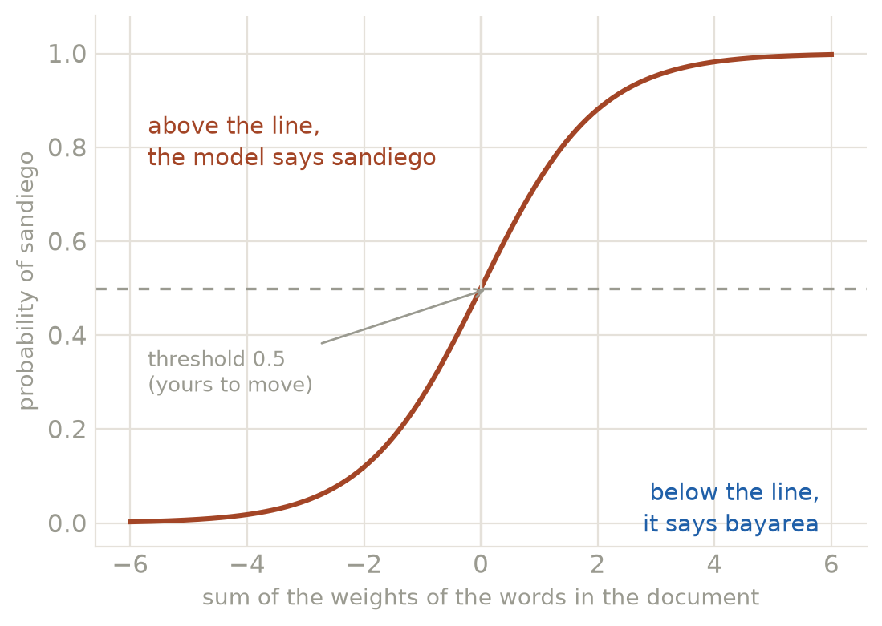
FROM VOTES TO A DECISION
The weighted sum, squeezed into a probability
Add the weights of the words present. That sum is one number on the horizontal axis, and it can be anything.
The logistic curve squeezes it into 0–1, which is where the name comes from.
Above 0.5 it answers one way, below the other. The threshold is a choice, not a law: move it when one kind of error costs more than the other.
A probability is not a confidence. The curve will hand you 0.85 on a sentence about nothing at all.

Slide 7
WHAT TRAINING ACTUALLY DOES
Four lines, and the search inside them
X = CountVectorizer().fit_transform(df["text"]) # text → a matrix of word counts
y = (df["label"] == "sandiego").astype(int) # labels → 0 and 1
Xtr, Xte, ytr, yte = train_test_split(X, y, test_size=0.25, stratify=y, random_state=0)
clf = LogisticRegression(max_iter=1000).fit(Xtr, ytr) # the search happens here
The search: find the set of weights that leans the right way for as many TRAINING documents as possible.
Our corpus: 887 documents, 2,333 word-columns after dropping words that appear once.
More columns than documents, which is why the next slide about held-out data is not a technicality.
the one line people skip
train_test_split
A quarter of the rows are set aside before any fitting, and never looked at until the score. Skip it and you are measuring memory.

Slide 8
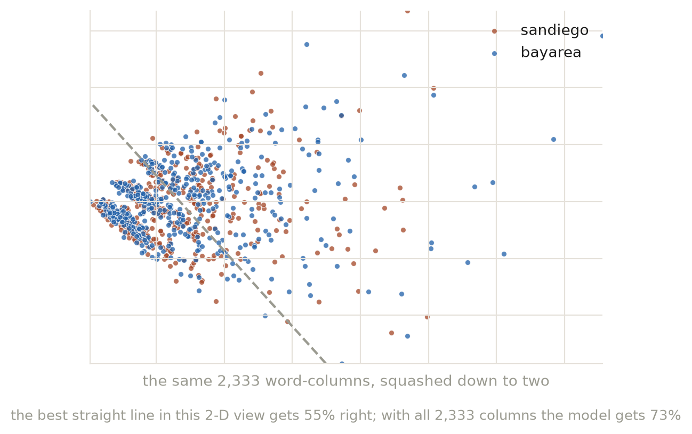
WHY THE NUMBER IS WHAT IT IS
Two regions, and how much they still overlap
Every document is a point in 2,333-dimensional word-space. Here it is flattened to the two directions that carry the most variation.
Even two different regions overlap heavily: the best straight line in this flattened view gets 55% right.
With all 2,333 columns the model reaches 73% — better, because the separating evidence lives in directions this picture cannot show.
Swap in r/sandiego against r/SanDiegan — the same city, two communities — and the same code drops to about 0.60. That is the honest hard case, and the notebook offers it as hard mode.

Slide 9
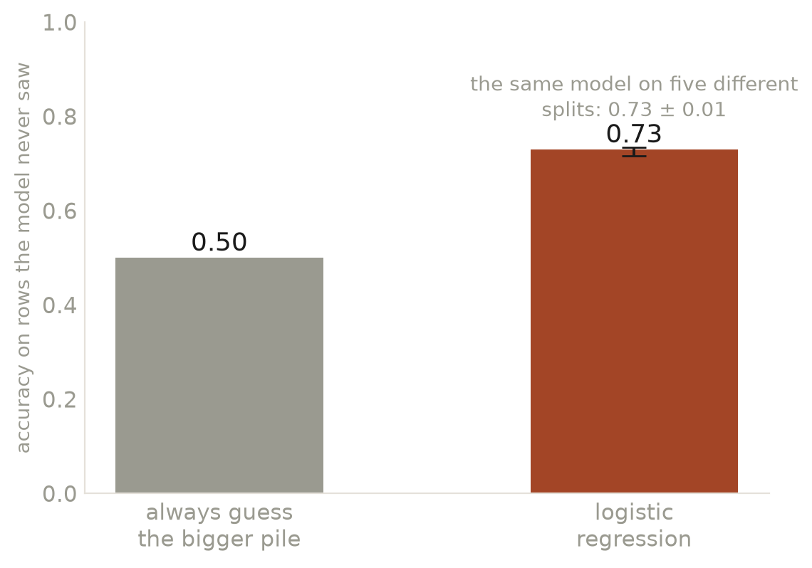
QUESTION 1 · COMPARED TO WHAT?
An accuracy alone means nothing
A model that always guesses the bigger pile scores 50% here, having read nothing. That is the floor.
Ours lands at 73% on rows it never saw: real, and modest.
Refit on five different splits it averages 0.73 ± 0.01 — so a two-point difference between two models is inside the noise.
Report the floor next to the score, always. A number without its baseline is a number designed not to be checked.

Slide 10
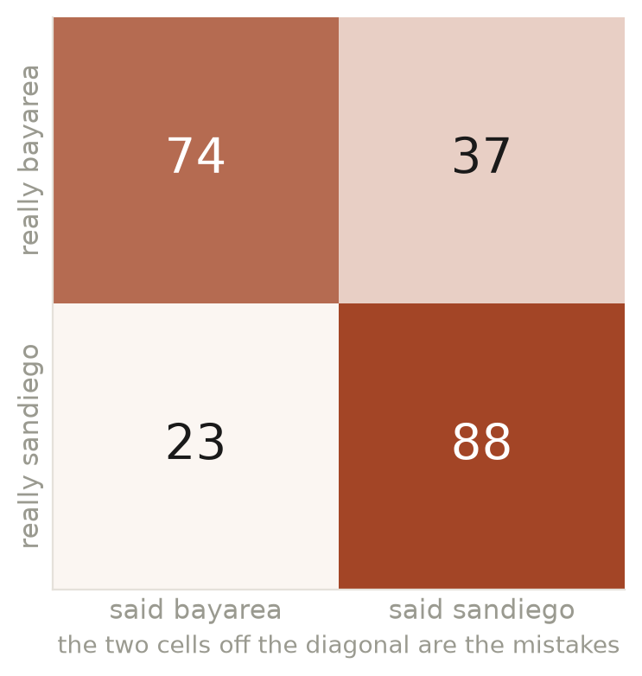
QUESTION 2 · WHICH ERRORS?
The same accuracy, two different animals
Rows are the truth, columns are what the model said. The diagonal is right; the other two cells are the mistakes.
Here: 23 comments from r/sandiego called r/bayarea, and 37 the other way. Roughly even, which is the healthy shape.
A model at the same accuracy that called almost everything one side would be a different thing entirely: it found the bigger pile, not the difference.
classification_report says the same in precision and recall, one row per side.

Slide 11
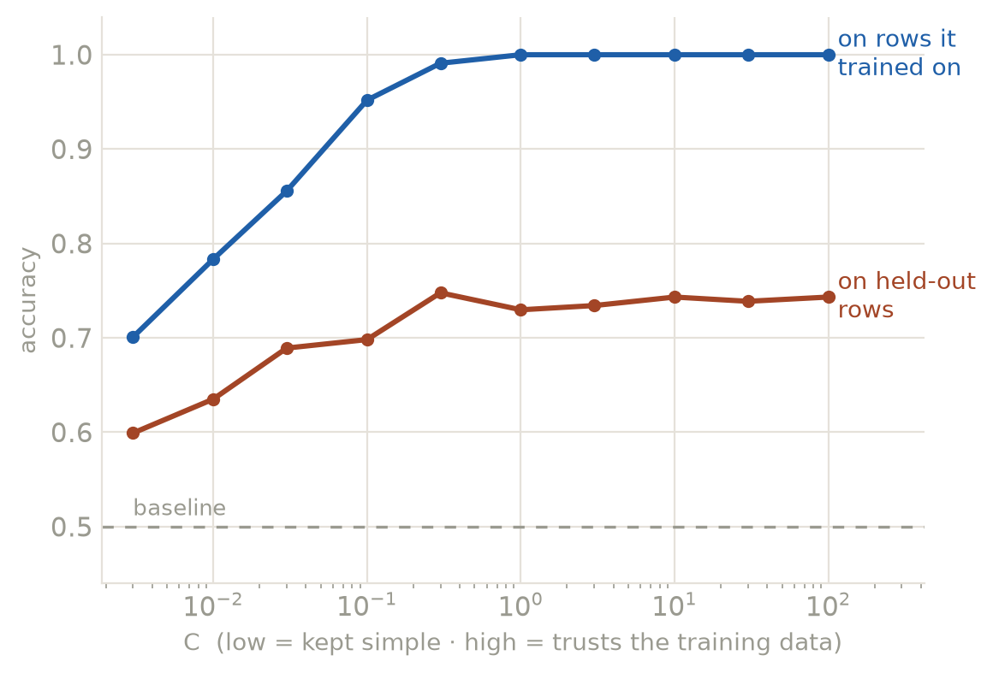
WHAT GOES WRONG · 1
Memorising is not reading
Turn C up and the model trusts the training data harder. At C=100 it scores 100% on rows it trained on and 74% on rows it didn't.
The blue line is memory. The terracotta line is reading. The gap between them is overfitting, drawn.
Best held-out score here: 75% at C=0.3. Note it is not at the far right.
This is why the score you quote must come from data the model never saw. On this corpus the difference is forty points.

Slide 12
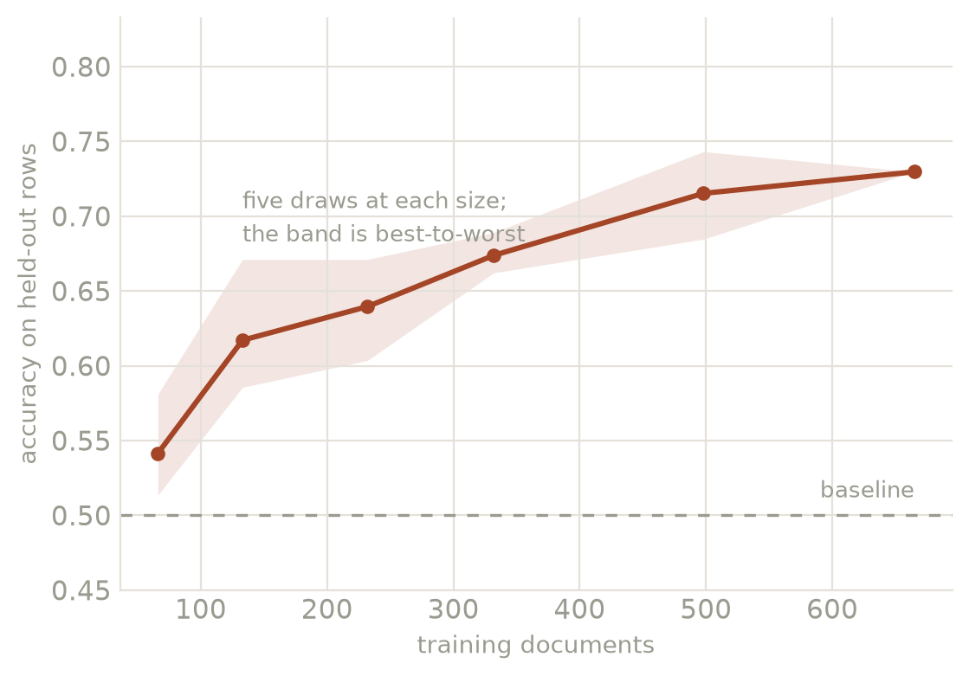
WHAT GOES WRONG · 2
One number is luck; the curve is the story
Accuracy against how many documents the model was allowed to train on, five draws at each size.
The band is best-to-worst across those draws. At small sizes it is wide enough to swallow most of the finding.
Useful before Week 4: more data helps, and it stops helping. Knowing where it flattens tells you how much collecting is worth doing.
If your result moves when you re-run it, you are reporting the draw, not the corpus.

Slide 13
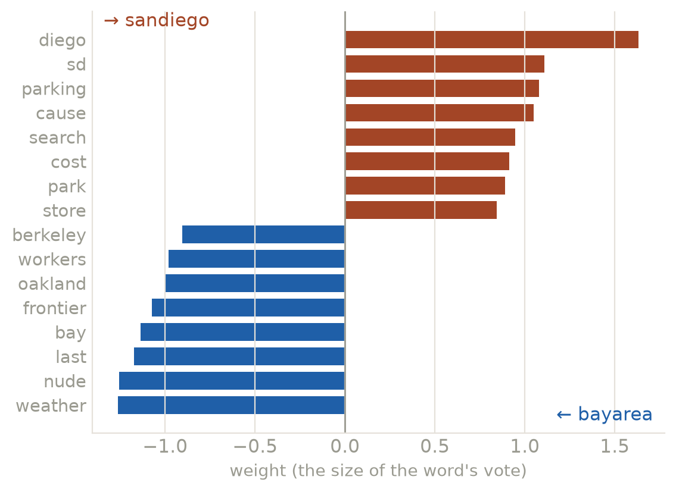
READ ITS MIND
The signed weights, all of them, on the table
One number per word. Positive pushes one way, negative the other, and you can read every one of them.
Most r/sandiego: diego, sd, parking, cause, search.
Most r/bayarea: weather, nude, last, bay, frontier.
Place names lead the list, and that is correct and uninteresting: the model found the giveaway. The question starts one step later.
Remove them and refit. If the accuracy collapses, the difference WAS the names. If it holds, the words underneath are the finding.
Week 7's annotator is far more powerful and will not let you do any of this.

Slide 14
THE READING, NOT THE SCORE
Three kinds of word, three different claims
1
2
3
Topic
Register
Habit
The two piles talk about different things.
beaches · lebron · espresso
The two piles talk in different styles.
citation · lol · therefore
The two piles have different rituals.
this sub · mods · OP · edit
Often the boring answer: you knew the subjects differed before you started.
The more interesting claim: same subject, different voice.
A finding about community, not language. Also the easiest to over-read.
Sort your top ten into these three before you say what the model found. The sort IS the finding; the accuracy is the ticket to make it.

Slide 15
WHAT GOES WRONG, NAMED
Four ways a classifier flatters you
Scoring on itself
Report accuracy on the training rows and you have measured memory. With more columns than documents it can hit 100 percent and mean nothing.
Imbalance
Nine parts A to one part B: guess A every time and you are 90 percent “accurate.” Always print the baseline, and reach for class_weight="balanced".
Leakage
A giveaway feature you never meant to hand it: the subreddit's own name, a bot's template, a scraping artifact. Accuracy near 1.00 is a red flag, not a triumph.
No “neither” box
Two boxes and no way to abstain. Hand it Shakespeare and it answers confidently anyway. Every classifier you meet has this property.
Three of the four are invisible in the accuracy number. That is the argument for reading the weights and the errors, every time.

Slide 16
SIXTY SECONDS, LIVE
Bias is not a ghost in the machine
Teachable Machine, two classes, trained in the browser while you watch: cats and dogs.
The reveal: it only ever saw orange cats and brown dogs.
Predict, out loud, before the test: what does it say about a black cat?
It learned colour, because colour was what separated the piles it was given. It was never asked to learn what a cat is.
the sentence to remember
The bias is the training set,
and you assembled it.
Your two piles were also a choice. Which comments the archive kept, which the moderators removed, which users post at all — each of those is in your weights.
For image projects: this IS a classifier on pixels. Same move, different features.

Slide 17
YOUR TURN · 32 MINUTES
Threes, one screen, stations not answers
Driver
Reader
Skeptic
types, and prompts the AI — never a line nobody has read aloud
says what the cell will do before it runs, then whether it did
asks: is that better than guessing? would that word survive elsewhere?
Rotate at every station.
0–1
warm-up (written for you), your question, your prediction
2–3
features, then fit
4
judge it: baseline, held-out, confusion matrix
5
read the weights, and sort them: topic / register / habit
6
break it: three inputs from neither pile, one real error read in full
7
the workbench: sweep min_df · tf-idf · bigrams · C · class_weight into one table
8 or 9
interrogate a weight (how many PEOPLE wrote it?) — or swap in your own two subreddits
Behind schedule? Stations 4, 5 and 7 are the ones that must happen. One model is a result; several are an argument — and 8 and 9 are where the homework starts.
10
report back: ninety seconds

Slide 18
DISCUSSION · AFTER THE BUILD
What did your model actually measure?
Your top words: topic, register, or habit? What claim about these communities does each kind license — and which one were you hoping for?
Your accuracy beat the baseline by a few points. What is the honest one-sentence finding, and what would a critic say to it?
You changed one decision and the words changed but the score didn't. Which model do you report, and how do you justify the choice in writing?
Underwood's misread taught something his accuracy could not. What did YOUR errors teach about the categories you chose?

Slide 19
BEFORE WEEK 4
Homework
Sketch
Take one of today's models to a labelled set you care about. Screenshot its five most positive and five most negative words — do they make sense?
Corpus existence proof
A screenshot showing you can load 50 rows of the data you want to use. The cookbook notebook works now; Week 4 teaches the how. No proof, no pitch.
Check (AI closed)
Read your classifier's top weights aloud — what did it learn — and name one input where it would fail, and why.
Next week: pick a corpus, pick two methods, commit. Bring the pitch and the 50 rows.

