Slide 1
CULTURE AS DATA · WEEK 4
How Machines Learn to Read:
Neural Networks and Word Embeddings
Your Week 3 classifier is one neuron. Today it grows, learns to place words by the
company they keep, and then you go and collect the data you will use it on

Slide 2
TODAY
Two ideas, then the practical half hour
A century, measured
One neuron, then many
1
2
Garg et al.: stereotype change read off an embedding space
Your classifier, stacked, and what that gains and costs
Words as vectors
The same rule on pixels
3
4
Same context pull together, different context push apart
Convolutions, and how CLIP searches a museum by typing
Reading an API
A careful scrape
5
6
What to look at before you write the loop
Finding the data in a page, and the four rules attached

Slide 3
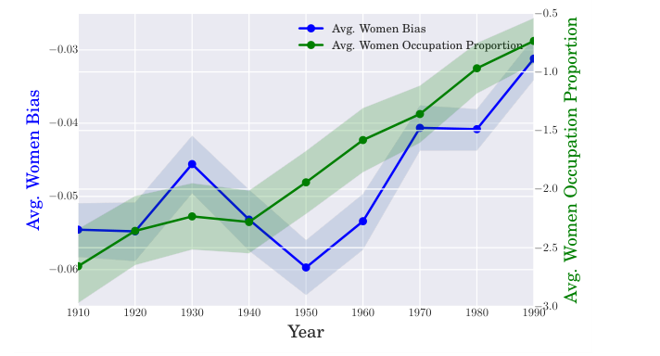
LOOK AT THIS · THIS WEEK'S READING
A century, measured as distance
Blue: how far occupation words sit from she-words versus he-words, decade by decade. Green: the share of women actually in those jobs.
Fig. 1b, Garg, Schiebinger, Jurafsky & Zou, PNAS 2018 (arXiv:1711.08412) · shown for teaching

Slide 4
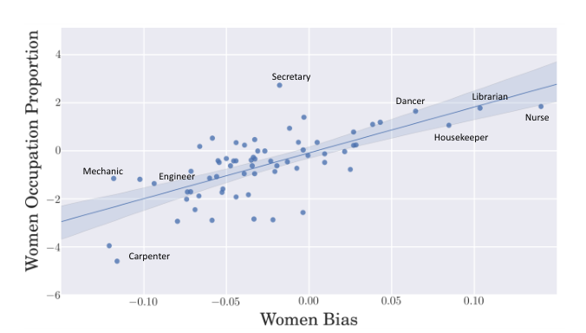
WHY IT IS EVIDENCE AND NOT A DEMO
The vectors agree with the census
One dot per occupation. Right on the x-axis: the word sits closer to she-words. Up on the y-axis: more women in the job.
Fig. 1a, Garg, Schiebinger, Jurafsky & Zou, PNAS 2018 (arXiv:1711.08412) · shown for teaching

Slide 5
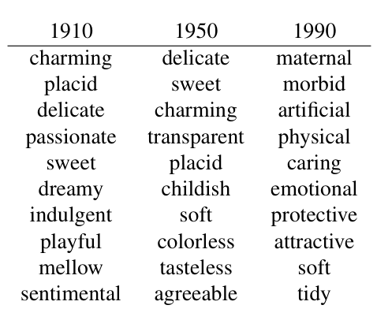
THE SAME METHOD, POINTED AT ADJECTIVES
Top words associated with women, by decade
1910 to 1990, from the same embeddings. Read the columns down, then argue about the last one.
Fig. 2a, Garg, Schiebinger, Jurafsky & Zou, PNAS 2018 (arXiv:1711.08412) · shown for teaching

Slide 6
QUESTION IT
Before you believe the curve
Whose century is it? Google Books and COHA are what got printed and digitised. Is the shift in the country, or in publishing?
Who chose the words? Someone decided which words count as female and which jobs count as occupations. Where in the paper is that list?
The bias it detects is the bias in the text - the same geometry that makes king - man + woman work. Can you keep one and refuse the other?
What would convince you? Name the check you would want run before repeating this finding out loud.

Slide 7
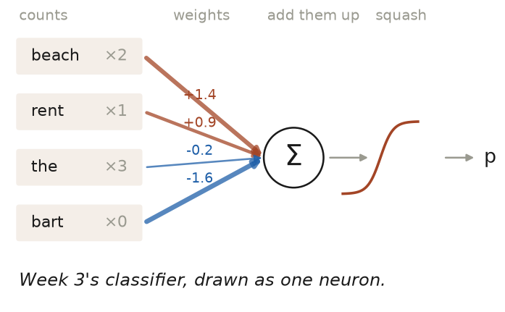
IDEA ONE
You already built a neuron
Counts in, one weight each, add them up, squash. Week 3's classifier is one neuron.

Slide 8
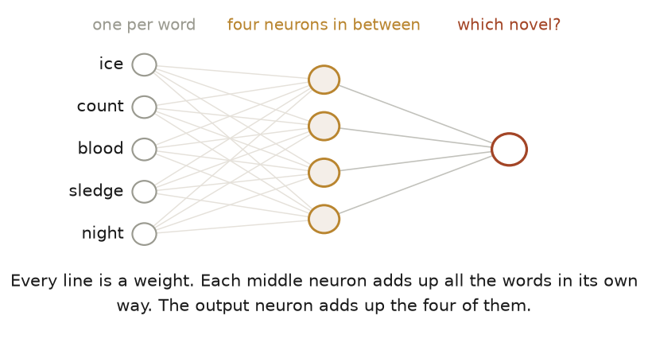
IDEA ONE
Stack them and they learn combinations
Four neurons in between, each adding up every word in its own way. Nobody chose those combinations.

Slide 9
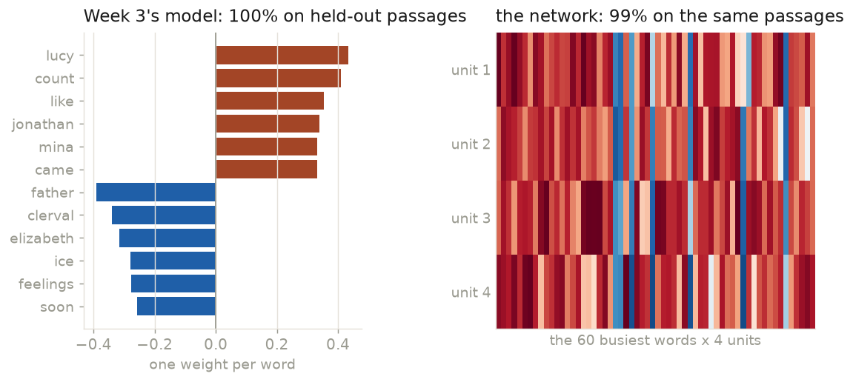
WHAT IT COSTS
You stop being able to read it
Same passages, same job: 100% against 99%. You can read the left panel. You cannot read the right one.
Both fitted for this slide on 563 passages of Frankenstein and Dracula.

Slide 10
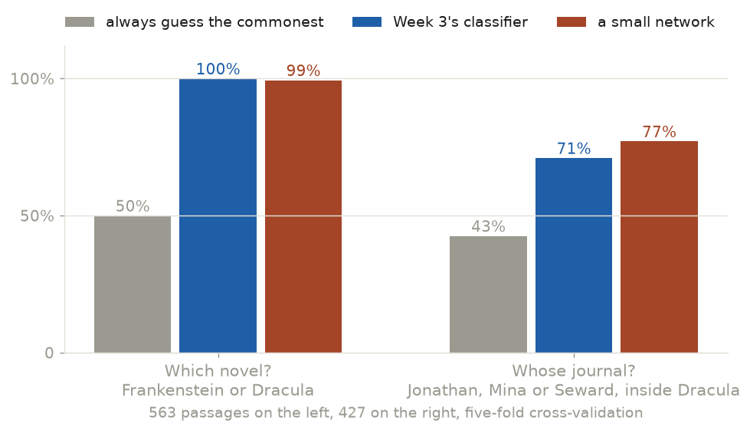
BEFORE YOU BELIEVE THE NUMBER
Ask a harder question and watch it drop
Two authors with different casts: anything gets that right. Three narrators inside one book is a real question, and the models drop to 71% and 77%.
The left-hand 100% is a fact about the question, not proof the method works. Journals parsed from the chapter headings: 427 passages, Jonathan, Mina and Seward.

Slide 11
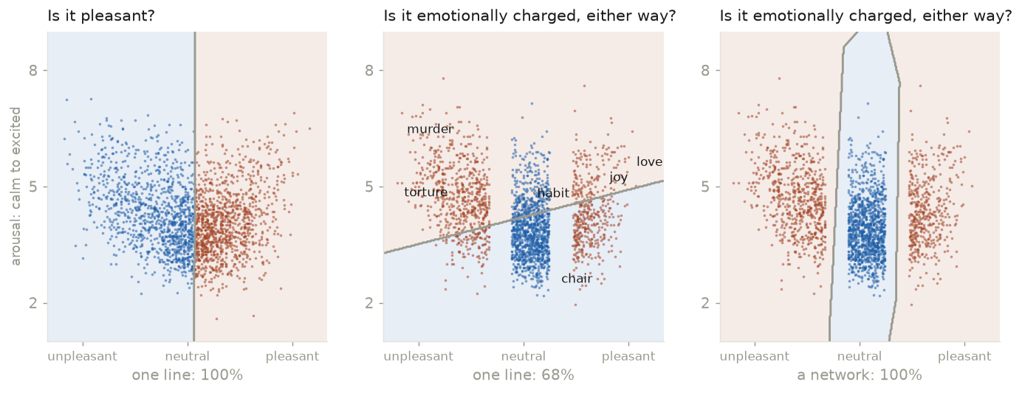
WHEN YOU NEED THE EXTRA LAYER
One question a line can answer, one it cannot
"Which side?" is a direction: a line gets 100%. "How far from the middle?" is a distance: 68% for the line, 100% for the network.
Valence and arousal for 13,915 words, Warriner, Kuperman & Brysbaert (2013), fetched at build time. Osgood's dimensions, measured again. Next: Playground on the XOR set.

Slide 12
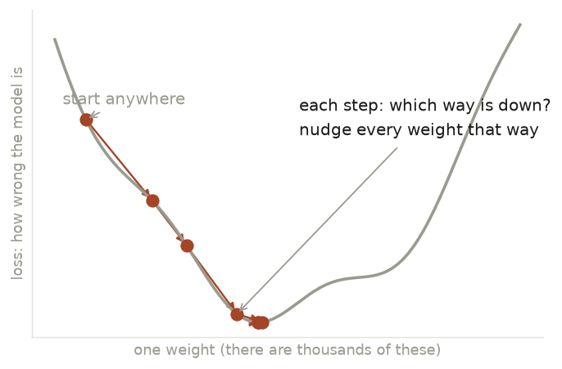
HOW IT LEARNS
Rolling downhill in fog
A loss is one number saying how wrong you are. Step downhill, repeat, for thousands of weights at once. No calculus today.

Slide 13
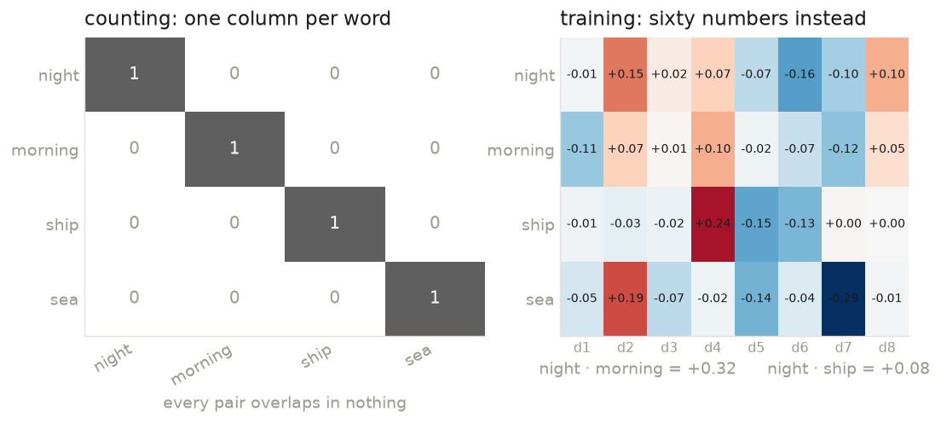
IDEA TWO
What counting cannot do
Week 2 gave every word its own column, so night and morning have nothing in common. Nor do night and ship.
And Week 3 puts one weight on each column, so what it learns about one word tells it nothing about the next. Trained vectors: night and morning 0.32, night and ship 0.08.

Slide 14
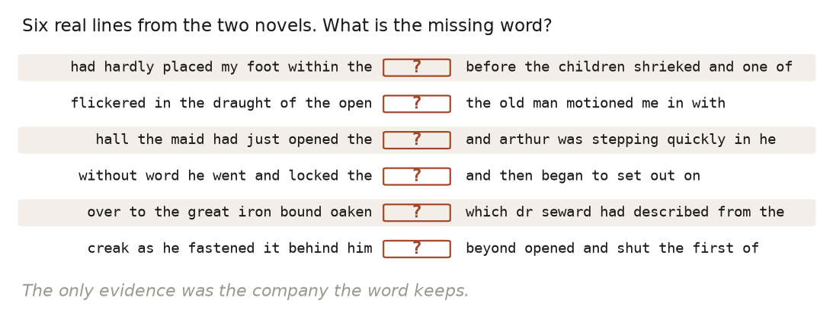
THE IDEA UNDERNEATH ALL OF IT
“You shall know a word by the company it keeps”
“The meaning of a word is its use in the language.” Wittgenstein, Philosophical Investigations §43 (1953)
Ask the room before you show the answer. Nobody needs a definition. The contexts are enough.
Frege 1884, never ask for the meaning of a word in isolation · Harris 1954, the distributional hypothesis · Firth 1957, the title. Lines drawn live from this week's corpus.

Slide 15
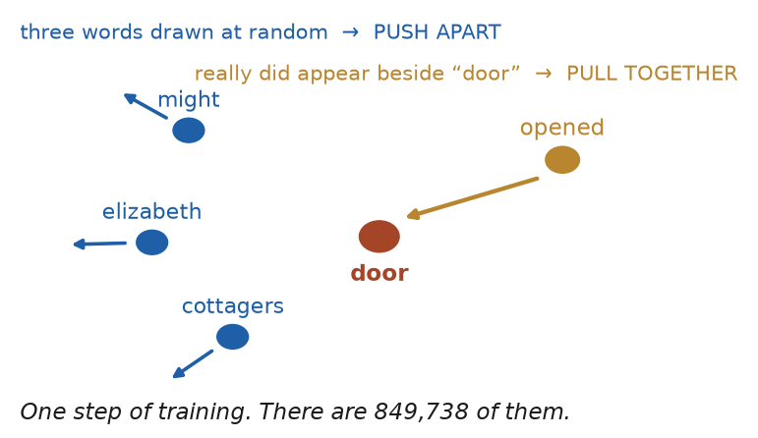
IDEA TWO
Same context, pull together. Different, push apart
For a word, a context is a few words of text. That is the whole rule, and it is how most modern embeddings are trained.
Underneath it, Week 3's four moves: multiply, add, squash, nudge. The prediction gets thrown away; the weights are what you keep. 849,738 pairs in one pass.

Slide 16
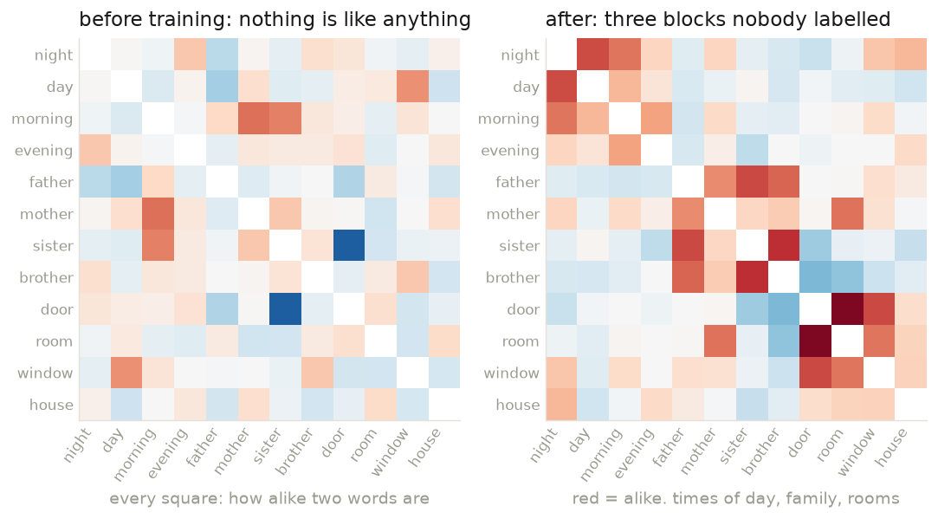
THE SAME VECTORS, BEFORE AND AFTER
Nobody labelled the blocks
Twelve words, every pair compared. On the left they start as noise. On the right, times of day, family and rooms have found each other.

Slide 17
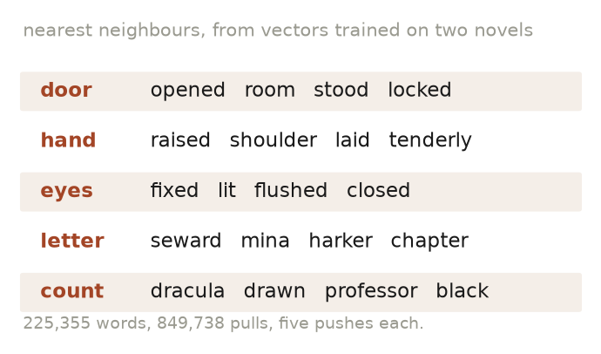
IT WORKS ON A SMALL CORPUS TOO
Trained on two novels, an hour ago
225,355 words of Frankenstein and Dracula. Nobody told it what a door is.

Slide 18
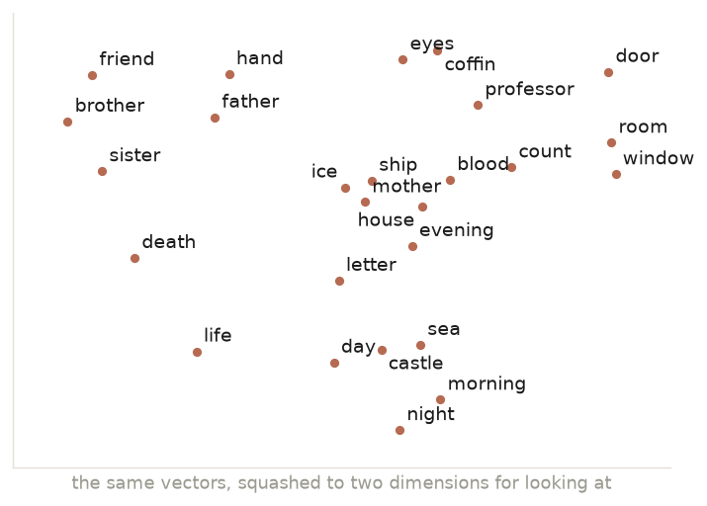
THE MAP
Meaning becomes geometry
Family words on one side. Door, room and window on the other. Night and morning at the bottom. Nothing was labelled.
Two dimensions out of sixty, so the picture loses a lot. Next: the Embedding Projector, live.

Slide 19
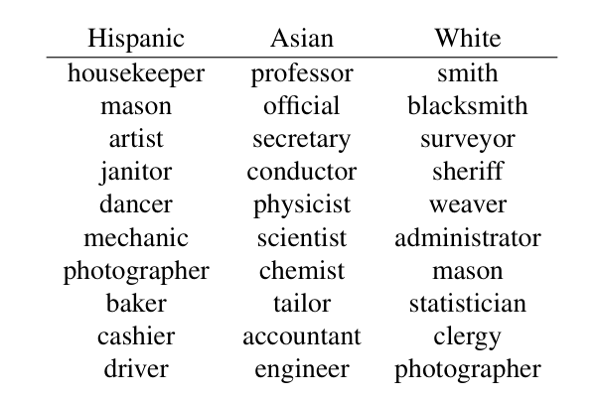
THE SAME GEOMETRY, THE OTHER RESULT
Occupations closest to each group's words
Nobody labelled any of this. It is what a century of printed English put side by side.
Fig. 1c, Garg, Schiebinger, Jurafsky & Zou, PNAS 2018 (arXiv:1711.08412) · shown for teaching

Slide 20
THE FAMOUS TRICK
king − man + woman ≈ queen
king − man + woman → queen paris − france + japan → tokyo
Directions carry relationships nobody labelled.
The arithmetic is nudged, and most analogies fail. The famous four are the ones that worked.
Same geometry, other result: doctor − man + woman → nurse.
static
one vector per word
contextual
one per occurrence
sentence
one per document — Week 5

Slide 21
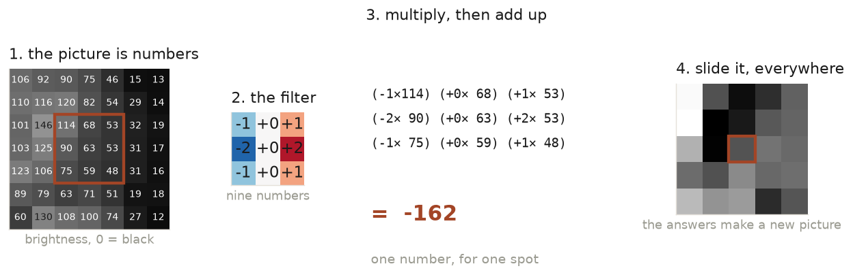
THE SAME TRICK, ON PIXELS
A convolution, all of it
A picture is a grid of numbers. Take nine of them, multiply by nine other numbers, add them up: -162. Move one pixel across and repeat.
Numbers read off a Met painting from the Week 1 data. Nothing else happens in a convolution.

Slide 22
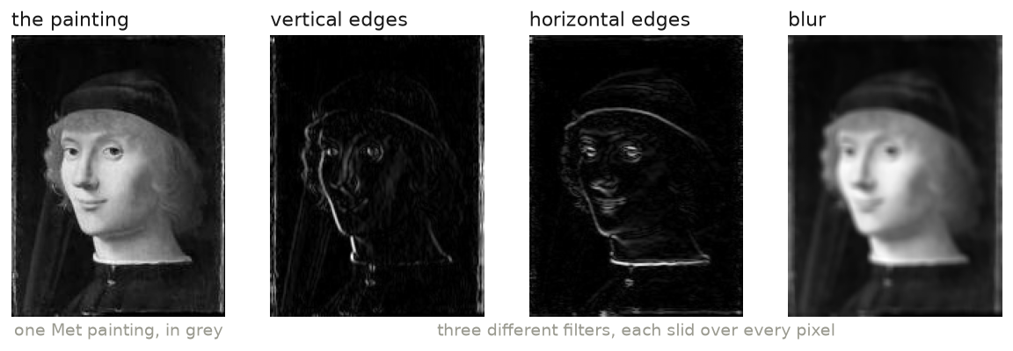
WHAT THE NINE NUMBERS DO
Change the filter, ask a different question
Each panel is the same painting under a different 3x3 grid. One finds vertical edges, one horizontal, one blurs.
A CNN is not given these. It starts with random grids and learns which ones are worth having, by the same downhill roll as before.

Slide 23
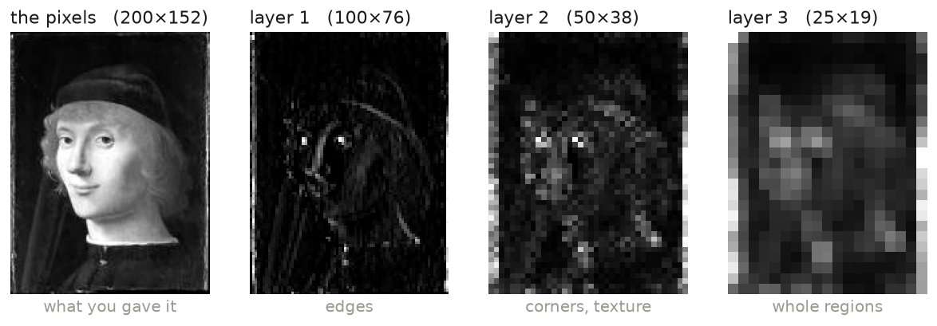
WHY A CNN IS DEEP
Filters on top of filters
Run a filter over the output of the last filter, then shrink. Edges turn into corners, and corners into regions.
Every panel is real arithmetic on the painting to its left. Stacking them is what a CNN does.

Slide 24
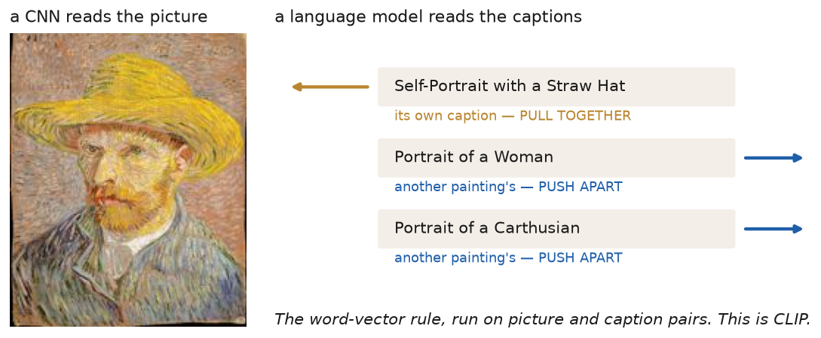
BOTH IDEAS AT ONCE
The same rule, where a context is a picture
Same context: a painting and its own caption, pulled together. Different context: anyone else's caption, pushed away. Two kinds of thing in one space.
This is why you can search an untagged museum by typing "a woman in a red hat". The notebook trains a small one on 18 paintings.

Slide 25
BREAK
Ten minutes
Then: where your corpus actually comes from.

Slide 26
GETTING THE DATA
Three routes, in the order you should try them
1
A prepared file
pd.read_csv(url) · gdown · load_dataset(). Most projects should stop here.
2
An API
A documented URL that returns JSON. Four words: endpoint, key, pagination, rate limit.
3
A careful scrape
Only when there is no file and no API. Slowly, and never republished.
The licensing line decides which routes are even open to you. That is the next slide.

Slide 27
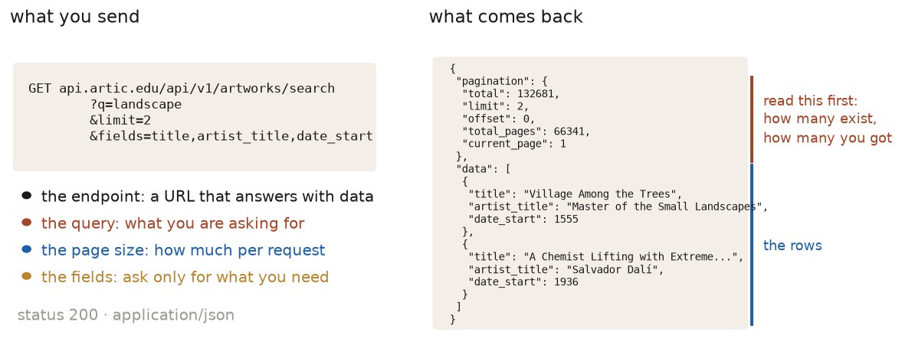
ROUTE TWO
Look at one reply before you write the loop
Ask for one item. The pagination block tells you how big the job is. The data block is your rows.
A live call made while this deck was built: 132,681 works match "landscape", handed over two at a time.

Slide 28
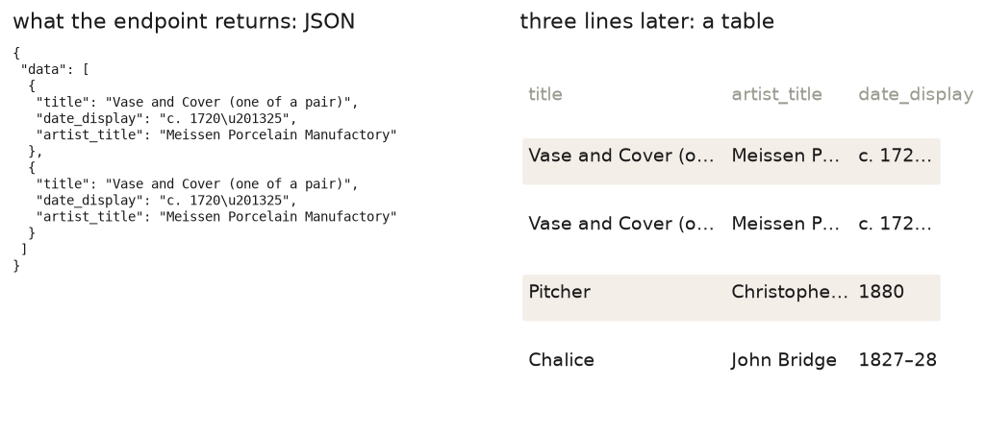
ROUTE TWO, LIVE
A URL, some JSON, and then a table
An endpoint is a URL that answers with data. A key is a name badge. Pagination hands you a page at a time.
Left panel: a real response, live from api.artic.edu. The AI writes the three lines that make the table.

Slide 29
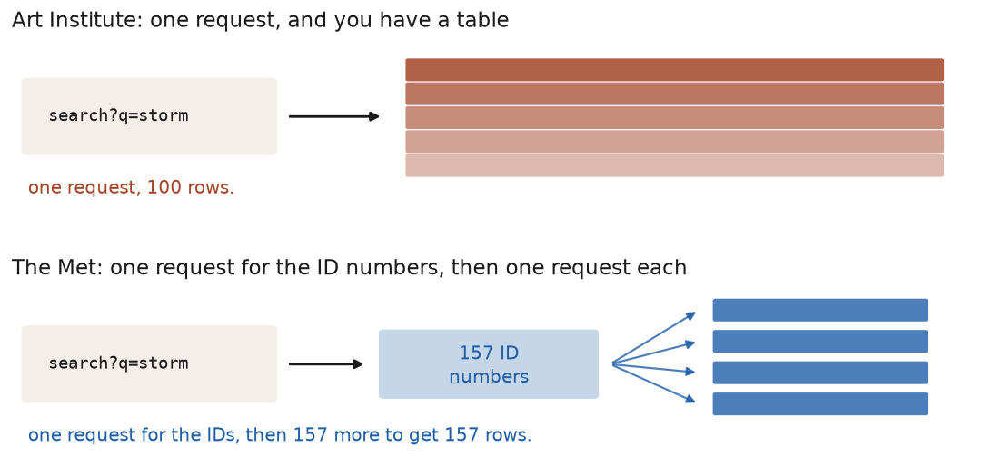
EVERY API IS SOMEBODY'S DESIGN
Two museums, two shapes
One returns rows. The other returns ID numbers, and every row after that is another request.
Both queried live for this slide. Work out which kind you have before you estimate how long it takes.

Slide 30
ROUTE THREE
Scraping, and the four things that come with it
Read robots.txt and the terms
before the first request, not after the complaint.
Request slowly
one page every couple of seconds. You are a guest on someone's server.
Take only what you need
the fields your question uses, not the whole site.
Never republish the text
analyse it, quote it, count it. Do not hand it on.
CC0 and public domain: go anywhere. Academic sets and community text: analyse, don't redistribute. Shadow libraries: never.

Slide 31
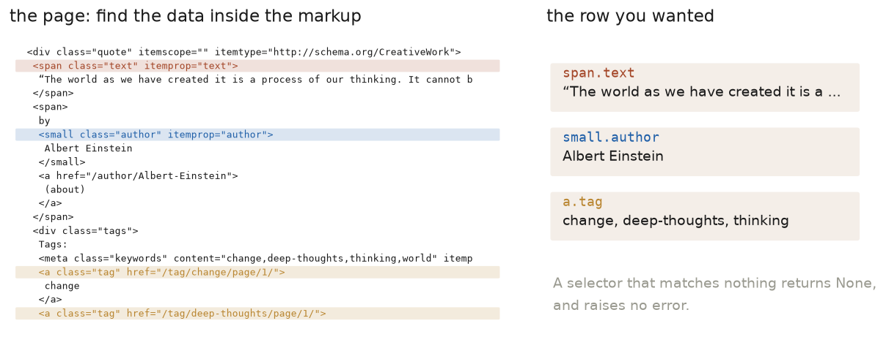
ROUTE THREE, IN PRACTICE
Find the data inside the markup
Fetch one page, look at one block, and read the selectors off it. In a browser: right-click, Inspect, and the tag names are there.
Real HTML from quotes.toscrape.com. A selector that matches nothing returns None and raises no error. That is the bug you will hit.

Slide 32
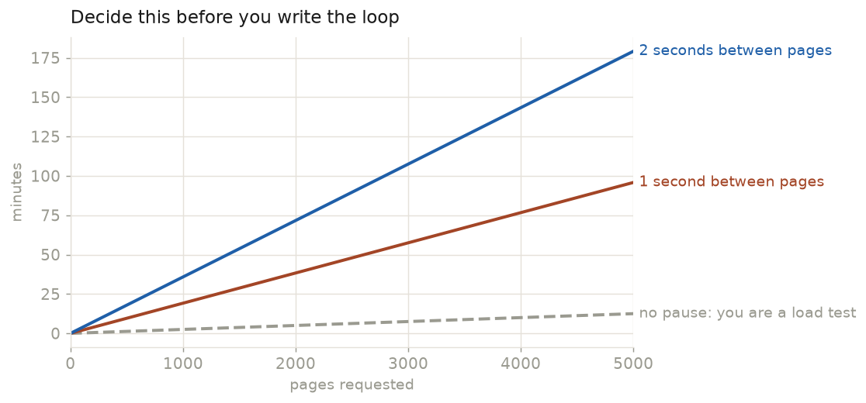
BEFORE YOU START IT RUNNING
How long will this take?
A one-second pause on 5,000 pages is an hour and a half. That number decides your sample size, so work it out first.
One page a second is a reader. Fifty a second is an outage.

Slide 33
YOUR TURN · 20 MINUTES
Collect it, save it, start the repo
a file in your Drive folder
Week 5 starts from it. Colab forgets everything else.
a repo with Pages switched on
so a live URL exists today, not in Week 9 under deadline.
two minutes of pitch, to a partner
corpus, two methods, what would count as a finding.
A null result, honestly shown, is a complete project. The pivot kit is insurance, not a demotion.

Slide 34
BEFORE WEEK 5
Homework
Data Biography
~400 words: where it came from, who is in it, who is missing, what it cannot tell you.
Collect it for real
The cookbook notebook, and leave the file in Drive. Week 5 begins there.
Play with the map
Embedding Projector: a word from your corpus, one neighbour that makes sense and one that does not.
Next week: embeddings on YOUR corpus, all session. Bring the file.

