Slide 1
Movement
6/25 - 7/21
Jumping
7/5 - 8/8
Enemies
7/30 - 9/12
Platforms
8/20 - 10/5
Graphical Assets
8/29 - 10/15
Task 8 Here
10/15 - 11/5
Task 9 Here
10/29 - 12/7
Task 10 Here
11/10 - 12/11
Task 11 Here
12/5 - 1/20
Task 12 Here
1/2 - 2/15
Today
8/15/2016
11/10/2016
Nov. 1st, 2016
Oct. 17th, 2016

Slide 2
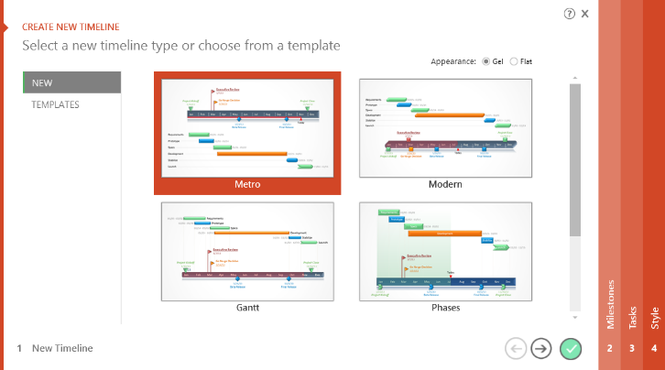

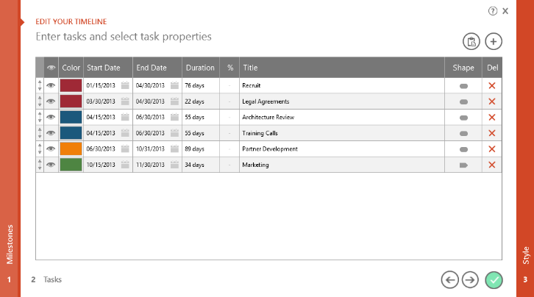
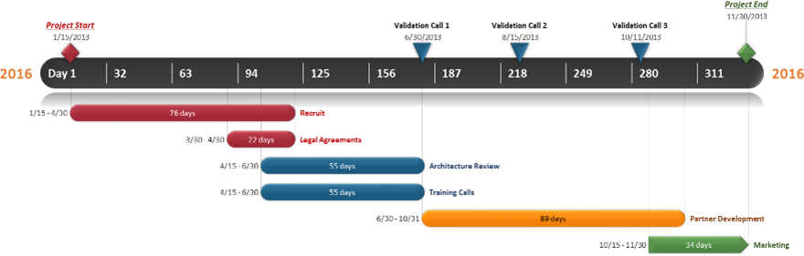
To change and update this template automatically,
download the free Office Timeline PowerPoint add-in!
Office Timeline is a free, award winning, timeline maker that's really easy to use.
Simple, easy-to-use wizards.
Professional, quick results.
Built directly into PowerPoint

