Slide 1
Basic Mechanics and Graphics
Design/Concept Planning
Platform Familiarization
Platforms/Background
Sprite Movement
Graphical Assets
Prototype Preperation
Graphical Change/Power Ups Examples
Fixing Bugs
Diagrams/Presentation Complete
Today
8/15/2016
11/10/2016
Nov. 1st, 2016
Oct. 17th, 2016
Oct. 24th, 2016

Slide 2
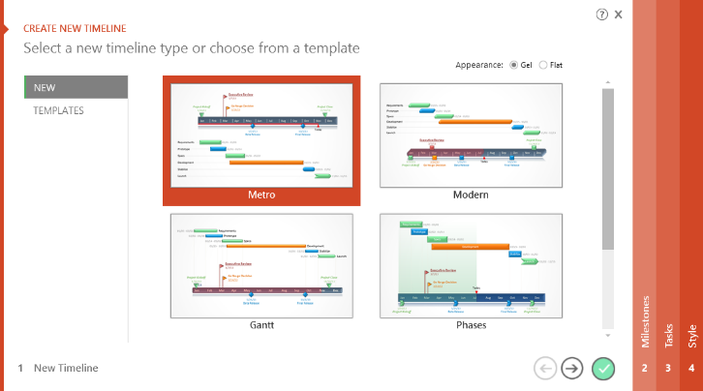

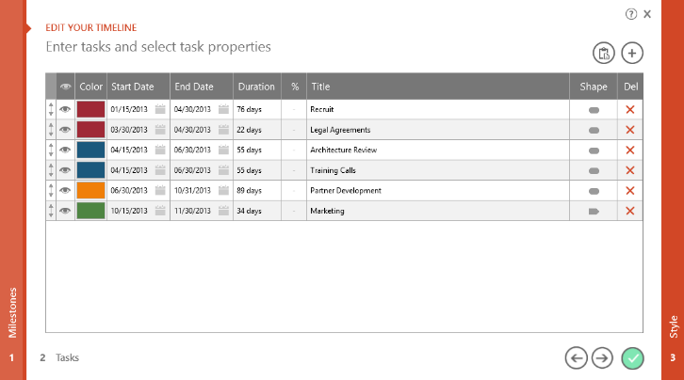
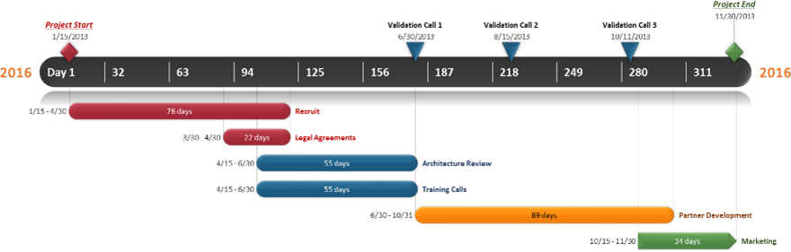
To change and update this template automatically,
download the free Office Timeline PowerPoint add-in!
Office Timeline is a free, award winning, timeline maker that's really easy to use.
Simple, easy-to-use wizards.
Professional, quick results.
Built directly into PowerPoint

