Slide 1
AZURE SYNAPSE ANALYTICS
Azure SQL Data Warehouse evolved
SIDNEY CIRQUEIRA
Notes:
[[MODERATOR]’s Part]
Hi and welcome everyone to this PASS Marathon Portuguese edition!
We’re excited you could join us today for [SPEAKER FIRST] [SPEAKER LAST]’s session, [SESSION TITLE].
This PASS Marathon features back-to-back live webinars, delivered by expert speakers from the PASS community.
The sessions will be recorded and posted online after the event. You will receive an email letting you know when the recordings become available.
My name is [MODERATOR] [you can say a bit about yourself here if you’d like]
I have a few introductory slides before I hand over the reins to [SPEAKER FIRST].
[move to next slide]

Slide 2
PASSsummit.com
more details.
Notes:
[Moderator Part]
This year PASSS will host their first ever PASS Virtual Summit on November 10-13! Head over to PASS Summit.Com to register and learn more about this year’s lineup.
Also, another exciting virtual event is coming to you this month! PASS Marathon: SQL Server Performance starts on July 23. Visit our upcoming PASS Marathons page to learn more! Don’t forget, registrations are now open!
[move to next slide]

Slide 3









Sidney Cirqueira
Biography
+9 years of experience with Information Technology
+2 years working with emphasis on Data & AI Engineering using Microsoft Azure Cloud Platform
Big Data & Machine Learning Student and Enthusiast
Speaker and participant in the Microsoft Technical Community
Microsoft Trainer
Data Analyst, Lanlink
/sidneyocirqueira
/sidneyoliveiracirqueira
@sidneycirqueira
M
@sidneyocirqueira
sidneyocirqueira@gmail.com
Notes:
[Moderator’s Part]

Slide 4
Agenda
What is Azure Synapse Analytics?
Key component of Modern Data Warehouse
Synapse Analytics (formerly SQL DW) – GA – “v1”
Synapse Analytics (preview) – “v2”
Synapse Analytics Key Features
Synapse Analytics Link for Azure Cosmos DB (preview)
Demo
Questions
References

Slide 5
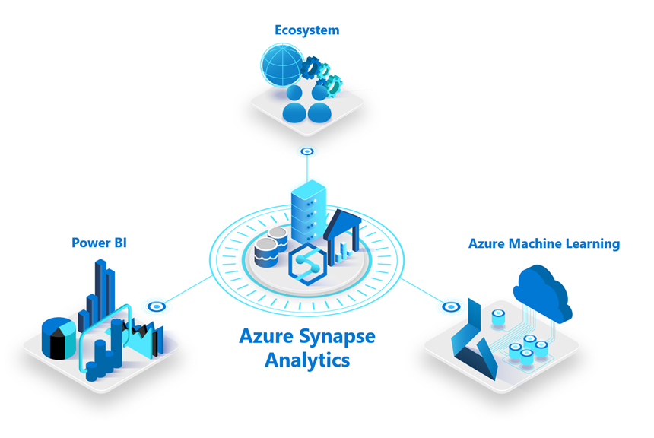
What is Azure Synapse Analytics?
Limitless Analytics Services
that brings together enterprise Data Warehousing and Big Data Analytics with a unified experience to ingest, prepare, manage, and serve data for immediate BI and machine learning needs.

Slide 6





Key component of Modern Data Warehouse
Ingest & Prep
Model & Serve
Visualize
Logs (unstructured)
Azure Data Factory
Azure SQL Data Warehouse
Code-free data ingestion from 85+ data integration connectors
Power BI
Media (unstructured)
Up to 14x faster and costs 94% less than other cloud providers
Leader in the Magic Quadrant for Business Intelligence and Analytics Platforms*
Azure Databricks
(Prep-only)
Files (unstructured)
Business/ custom apps (structured)
Store
Azure Data Lake Storage
High performance data lake available in all 54 Azure regions
https://azure.microsoft.com/en-us/services/synapse-analytics/compare/
Notes:
6

Slide 7
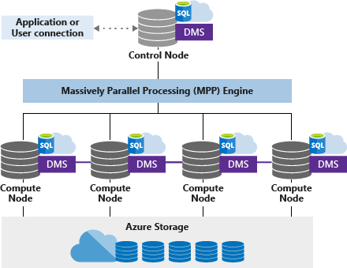
Azure Synapse Analytics (formerly SQL DW)
MPP – Massively Parallel
Processing

Slide 8

Azure Synapse Analytics – Data Lakehouse
Visualize
Logs (unstructured)
Azure
Synapse
Analytics
Power BI
Media (unstructured)
Leader in the Magic Quadrant for Business Intelligence and Analytics Platforms*
Brings together enterprise data warehousing and Big Data analytics
Files (unstructured)
Business/ custom apps (structured)
Store
Azure Data Lake Storage
High performance data lake available in all 54 Azure regions
Notes:
8

Slide 9
Azure Synapse Analytics
Logs (unstructured)
Azure
Synapse
Analytics
Media (unstructured)
Brings together enterprise data warehousing and Big Data analytics
Files (unstructured)
Business/ custom apps (structured)
Store
Azure Data Lake Storage
High performance data lake available in all 54 Azure regions
Notes:
unified experience to ingest, prepare, manage, and serve data for immediate BI and machine learning needs.
9

Slide 10
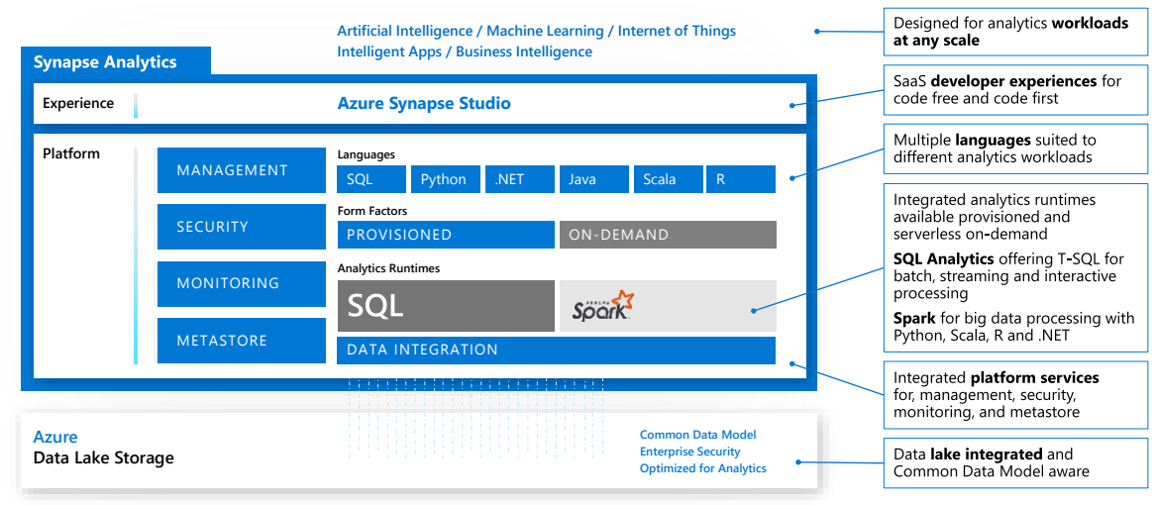
Azure Synapse Analytics
Notes:
unified experience to ingest, prepare, manage, and serve data for immediate BI and machine learning needs.
10

Slide 11
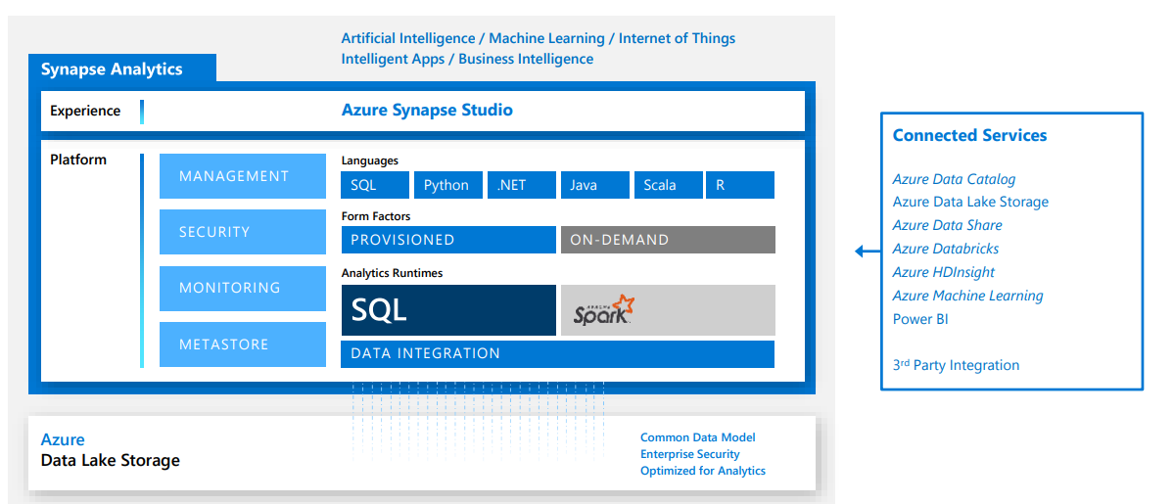
Azure Synapse Analytics
Notes:
unified experience to ingest, prepare, manage, and serve data for immediate BI and machine learning needs.
11

Slide 12
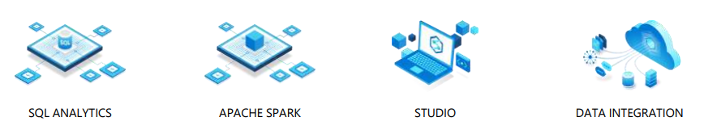
Azure Synapse Analytics - Features
Limitless Scale
GA
Provisioned Compute
Materialized views
Result-set cache
Workload importance
Workload isolation
Powerful insights
Preview
Power BI integration
Azure Machine Learning integration
Stream analytics (data warehouse)
Apache Spark integration
Instant Clarity
Preview
Azure Synapse Link
Unmatched security
GA
Column and row-level security
Dynamic data masking
Private endpoints
Unified experience
Preview
Hybrid data ingestion
Azure Synapse Studio
Preview
Serverless data lake Exploration
Notes:
12

Slide 13
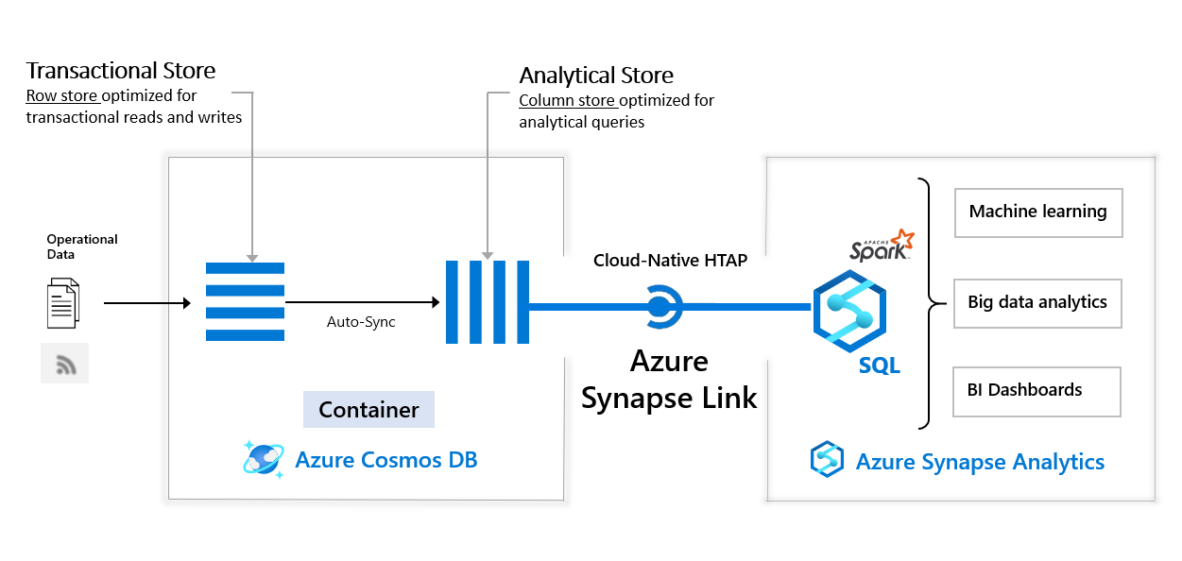
Azure Synapse Link for Cosmos DB (preview)

Slide 14
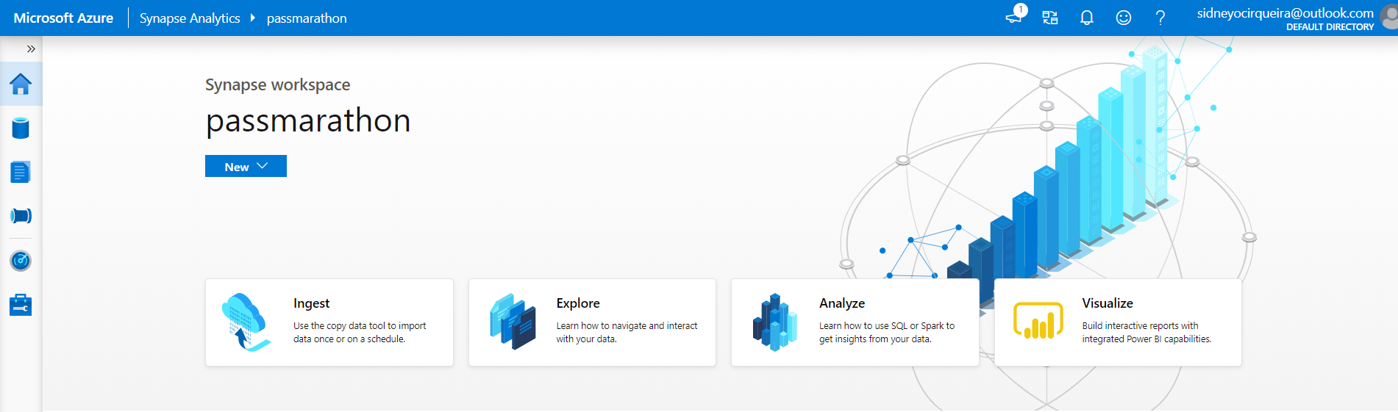
Demo

Slide 15
References
Synapse Analytics(workspaces): https://docs.microsoft.com/en-us/azure/synapse-analytics/overview-what-is
Synapse Analytics(SQL DW): https://docs.microsoft.com/en-us/azure/synapse-analytics/sql-data-warehouse/
Modern Data Warehouse: https://azure.microsoft.com/en-in/solutions/architecture/modern-data-warehouse/
MPP Architecture: https://docs.microsoft.com/en-us/azure/synapse-analytics/sql-data-warehouse/massively-parallel-processing-mpp-architecture
Product: https://azure.microsoft.com/en-us/services/synapse-analytics/
Synapse Link: https://docs.microsoft.com/en-us/azure/cosmos-db/synapse-link
Benchmark Cloud DW: https://azure.microsoft.com/en-us/services/synapse-analytics/compare/
Synapse Analytics Toolkit: https://azure.microsoft.com/en-us/resources/azure-synapse-analytics-toolkit/

Slide 16
Questions?
Notes:
[Moderator Part]

Slide 17
Learn more from Sidney Cirqueira
@sidneycirqueira
sidneyocirqueira@gmail.com
https: github.com/sidneyocirqueira/azure-synapse-analytics
Notes:
[Moderator Part]

